Slide 1
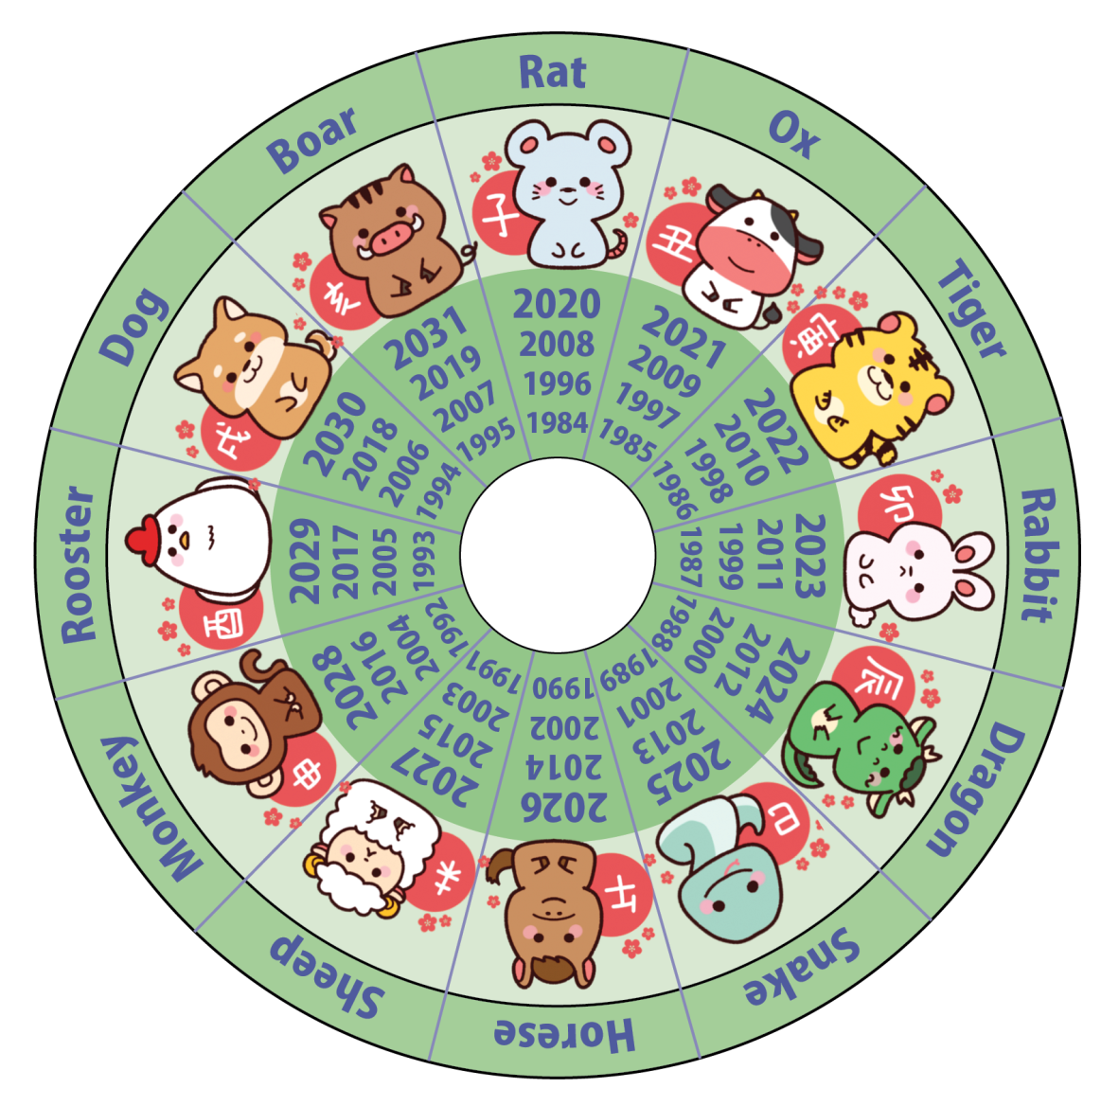
Warm Up: Zodiac Years
Pig/boar : Brave, kind, honest.
Rat : Honest, charming, ambitious.
Dog: Loyal, trustworthy, honest.
Snake : deep thinker, quiet, wise, determined.
Rooster : Deep thinker, direct.
Ox : patient, alert, successful.
Monkey : Clever, original, problem solver.
Rabbit : talented, ambitious, fortunate.
Sheep : Elegant, passionate.
Tiger : stubborn, sensitive, courageous.
Horse : Chatty, complimentary.
Dragon : energetic, brave, stubborn.
Notes:
Teacher’s Note
Display this on the screen/board as students enter the classroom so that they can begin straight away, leaving space for the date and title if they are writing their answer in their books. Instruct students to:
Find out which animal represents the year they were born in the Japanese zodiac calendar.
Decide if the your animal suits their personality? Why or why not?
Do the same for their brothers, sisters and friends?

Slide 2
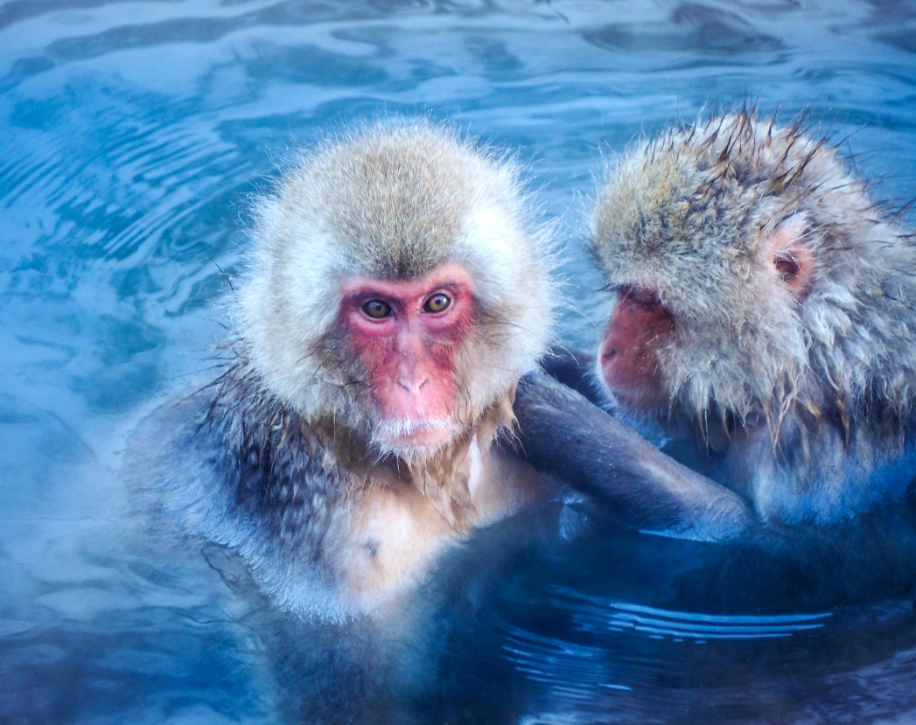
Animals of Japan
Your Learning Objectives:
Identify animals found in Japan.
Locate where each animal can be found.
Explain why there are so many animal species found in Japan.
Charge The Globe

Slide 3
Starter: Japan in numbers
Higher or lower?
1. Number of islands in total: 1032
Higher: 6852
2. Number of inhabited islands: 42
Higher: 416*
3. Human population: 236 million
Lower: 124,687,293
4. Percentage of land covered in forest: 41%
Higher: 69%
5. Number of animal species: 20,000
Higher: 90,000
Notes:
Teacher’s Notes
This activity can be a class discussion/vote or answers can be written in books and marked with an opportunity for self/peer assessment.

Slide 4
Starter: Higher or lower?
Why do you think there are so many different species of animals living in Japan?
Climatic variations
What else did you think of?
A wide range of habitats
Many uninhabited islands
Notes:
Teacher’s Note
Students could write their ideas down or share via class discussion.

Slide 5
Animals of Japan
Task: Use the animal information cards to find out about Japanese wildlife.
On your map worksheet, add labels to show where each animal is found to create a useful leaflet for tourists visiting Japan.
Challenge task: Turn your labels into annotations by adding explanations of why each animal lives where they do. Think about the climate and their preferred habitat.
Notes:
Teacher’s Notes
Explain the chain of islands seen in the top left of the map are Okinawa and are actually further south than Kyushu.

Slide 6
Animals of Japan
Task: Using the information on your worksheet, answer the following questions:
Name one endangered animal that is found in Japan.
Which animals live in the north of Japan?
Why are some animals only found in the north?
Which animals are found in the south of Japan?
What makes the south a better habitat for some animals?
Why does Japan have such diverse wildlife? Try to include some of the data from the start of this lesson.
Challenge task:
What might threaten Japan’s wildlife in the future?
Notes:
Teacher’s Note
You may like to give the following hints or tips to students completing the challenge:
Global warming disrupting habitats, logging, urbanisation or tourist developments destroying habitats, hunting animals for food.

Slide 7
Plenary
In Japan, many traditional fabric patterns are inspired by animals.
Task: Can you guess what animals inspired these fabric patterns?
1.
Hawk/Eagle feathers
2.
Shark skin
3.
Tortoise shell

Slide 8
Plenary
Task: Design your own fabric pattern to represent British or Japanese wildlife.
1.
Hawk/Eagle feathers
2.
Shark skin
3.
Tortoise shell
Notes:
Teacher’s Note
This task can be used as an alternative to the preceding slide or as an additional extension task.

Slide 9
This resource was authored by Katie Holmberg in collaboration with the Japan Society
The Japan Society 13/14 Cornwall Terrace, London NW1 4QP
Tel: 020 7935 0475
Email: education@japansociety.org.uk
www.japansociety.org.uk
Follow us on:
@japansocietylon
@JapanSocietyLondon

