Slide 1
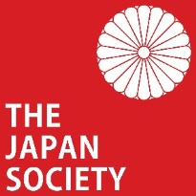
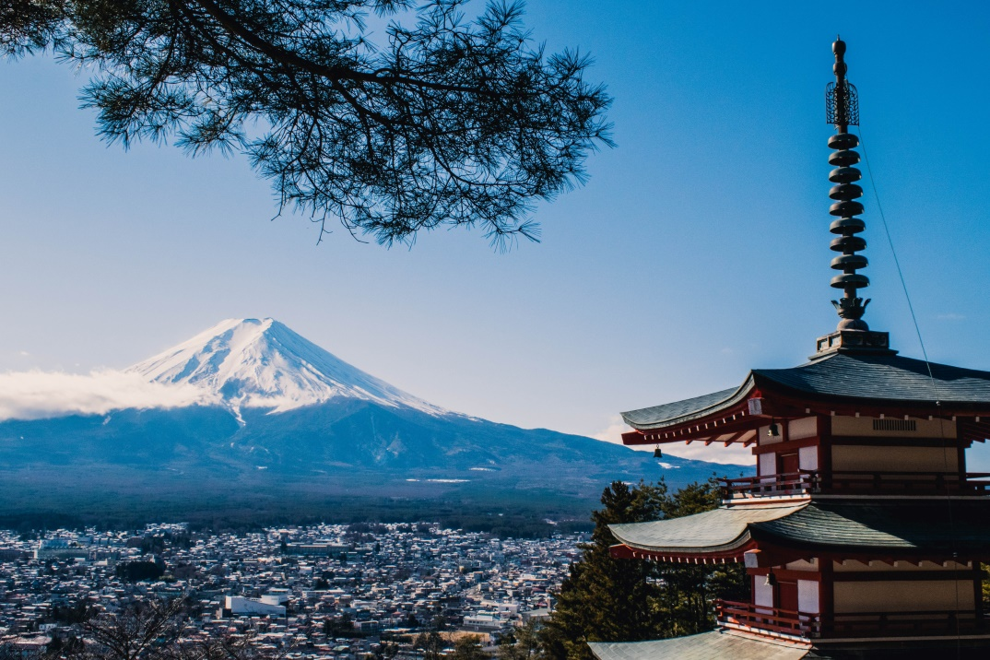
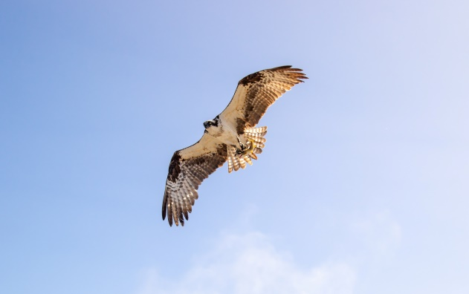
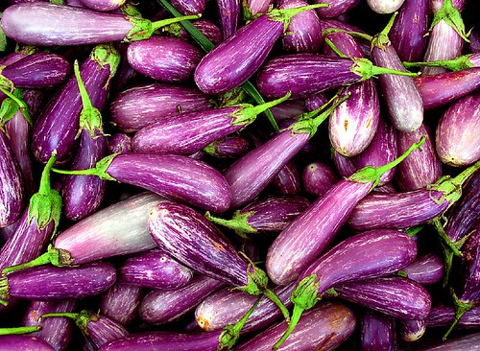
Warm Up
Hatsu-yume is the first dream of the new year. Some are considered lucky; what would you consider a lucky thing to dream about?
Here are the top 3 luckiest things to dream about in Japanese culture:
Mount Fuji
A Hawk
An aubergine
Notes:
Pronunciation: hat-sue you-may
Teacher’s Note
Display this on the screen/board as students enter the classroom so that they can begin straight away, leaving space for the date and title if they are writing their answer in their books.

Slide 2
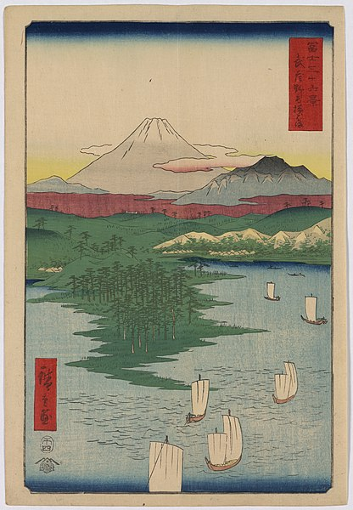
Volcanoes
of Japan
Your Learning Objectives:
Describe a volcano and its location.
Categorise the effects and responses of an eruption.
Evaluate the advantages and disadvantages of living near a volcano.
Notes:
Teacher’s Note
Woodblock print by Hiroshige (1797-1858) entitled Noge and Yokohama from the series 36 Views of Mount Fuji

Slide 3
Starter
Task: Match up the key terms with the definitions.
Environmental
The reasons why something happened.
The damage, positive and negative things that happen as a result of something.
The things that people do to try to reduce or prevent damage and other negative outcomes.
Things to do with people, such as their lives, health and wellbeing.
Things to do with jobs, money and trade.
Things to do with nature and habitats.
Responses
Social
Causes
Effects
Economic
Challenge task: What other key terms do you think will be useful when studying a volcano?
Notes:
Teacher’s Note
Opportunity for self or peer assessment if students write their answers in their books. Alternatively, complete this task through class discussion or using mini whiteboards.

Slide 4
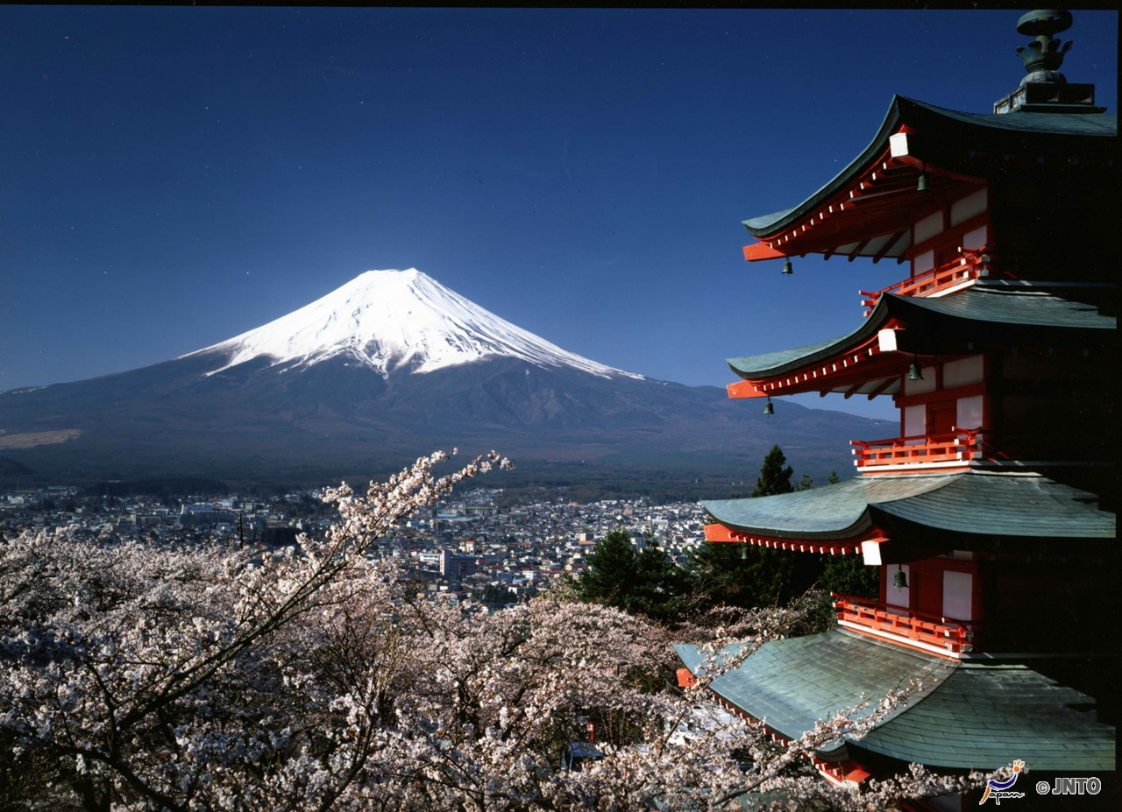
Describing Volcanoes
Mount Fuji is the most famous and recognisable volcano in Japan.
It has steep sides with a narrow crater (opening) at the top. The base is much wider. The slopes curve inwards, making them concave.
©Fujiyoshida City/© JNTO
Narrow crater
Concave slopes
Steep sides
Wide base
However, Mount Fuji hasn’t erupted since 1707, so we’re going to focus on a more active volcano today; Sakurajima.
Mount Fuji

Slide 5
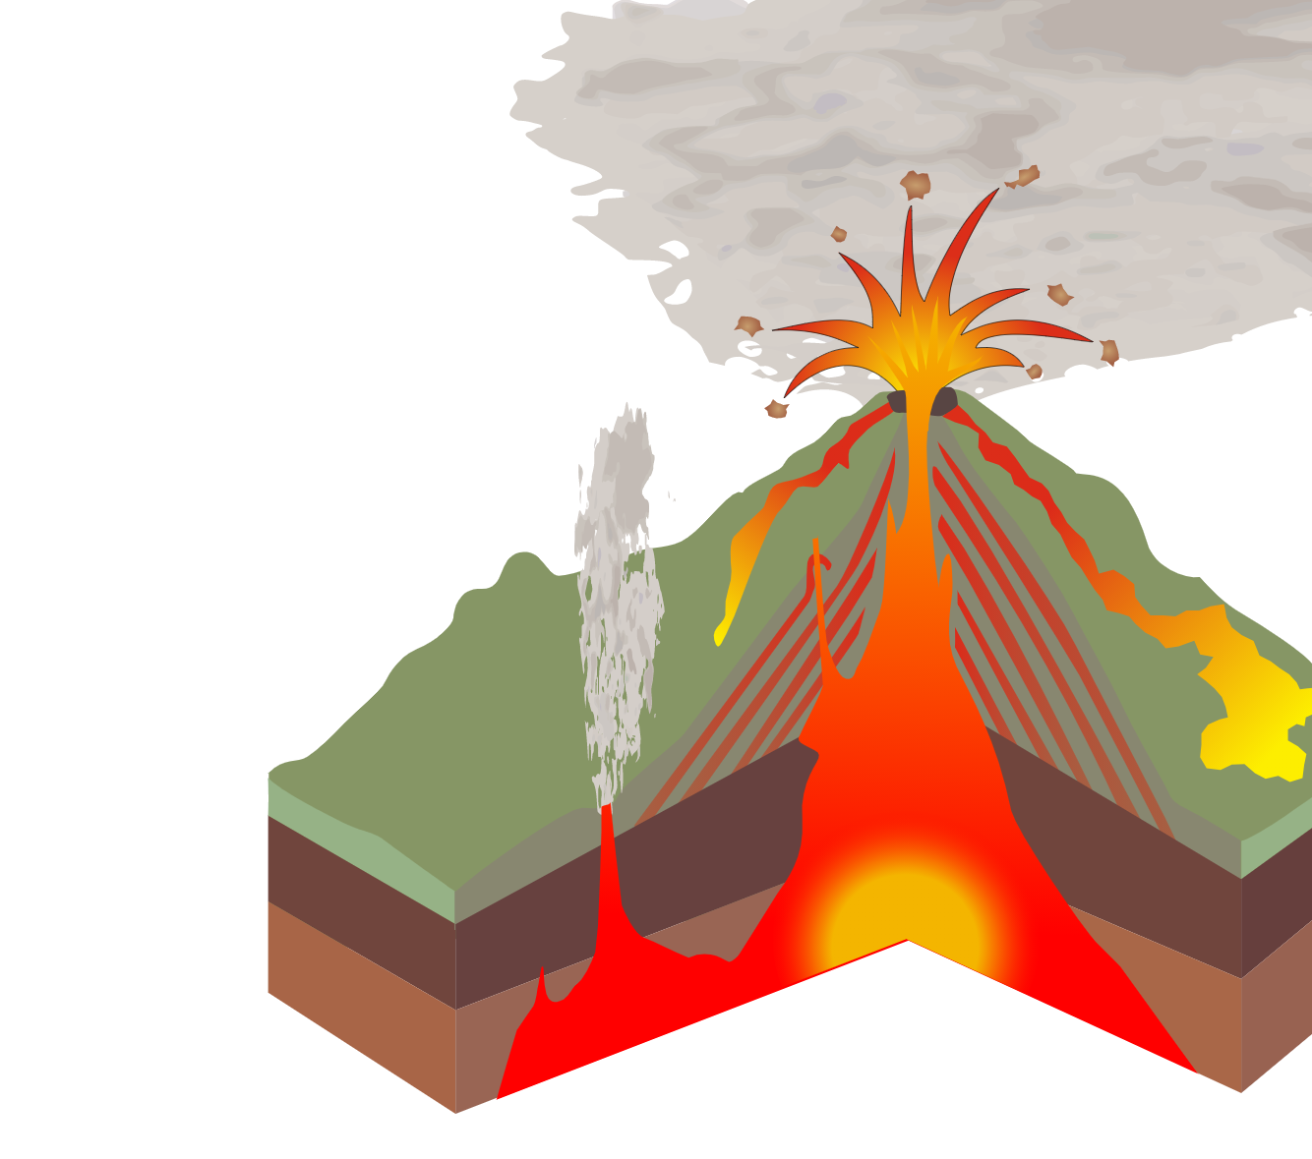
Describing Volcanoes
Sakurajima and Mount Fuji are both examples of composite volcanoes, which means they:
Were formed at destructive plate boundaries, where one plate is being subducted (going underneath) another,
Erupt violently, creating huge ash clouds,
Are made up of layers of cooled lava and ash that has settled on the ground.
Image: William Crochot
Notes:
Teacher’s Notes
This is an optional slide for use with classes who aren’t familiar with composite volcanoes.

Slide 6
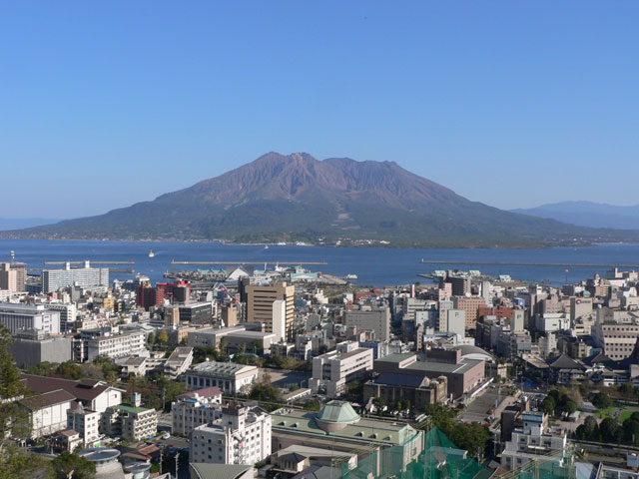
Task 1:
Describing Volcanoes
Sakurajima
How is Sakurajima different similar to Mount Fuji?
How is it different?
Task: Describe the Sakurajima volcano on your worksheet. Refer to it’s shape, the type of volcano that it is and it’s structure.
Include these key terms in your answer:
Steep Base Lava | Crater Composite Ash
Notes:
Teacher’s Notes
Discuss how the volcanoes are similar or different. Students should then write a description of Sakurajima.

Slide 7
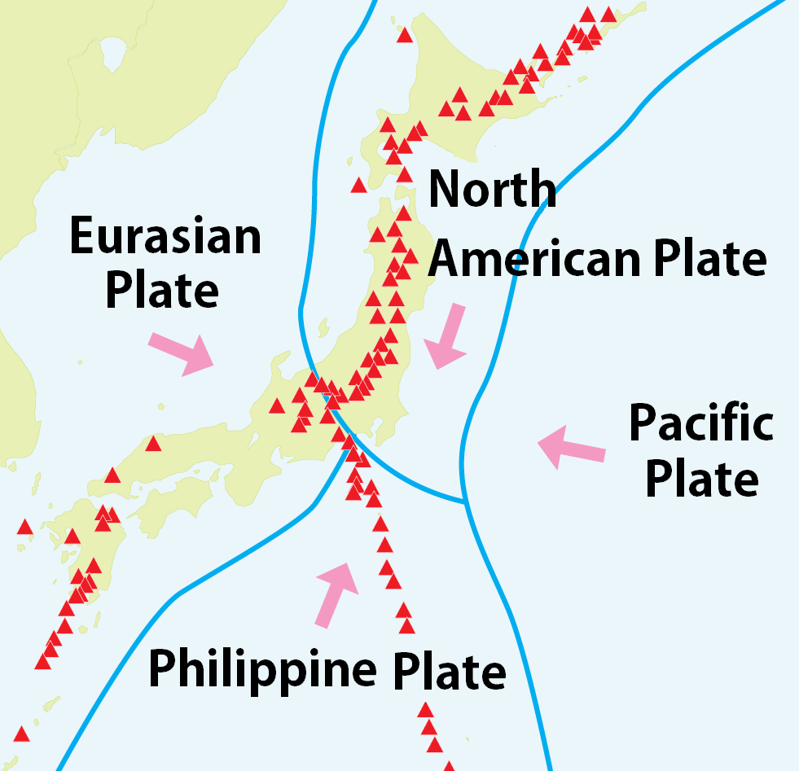
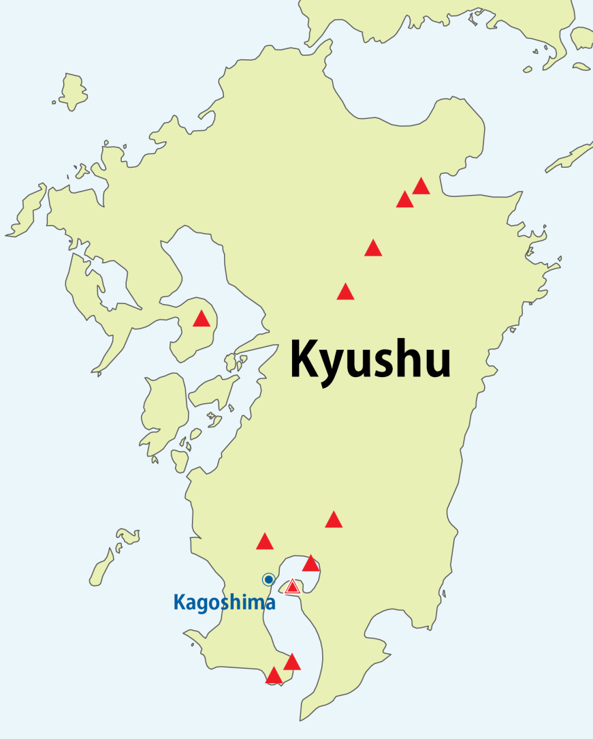
Location of Sakurajima
The volcano is just 8km from the city of Kagoshima.
Island of Kyushu
Sakurajima volcano
Task: Write a description of the location of Sakurajima on your worksheet.

Slide 8
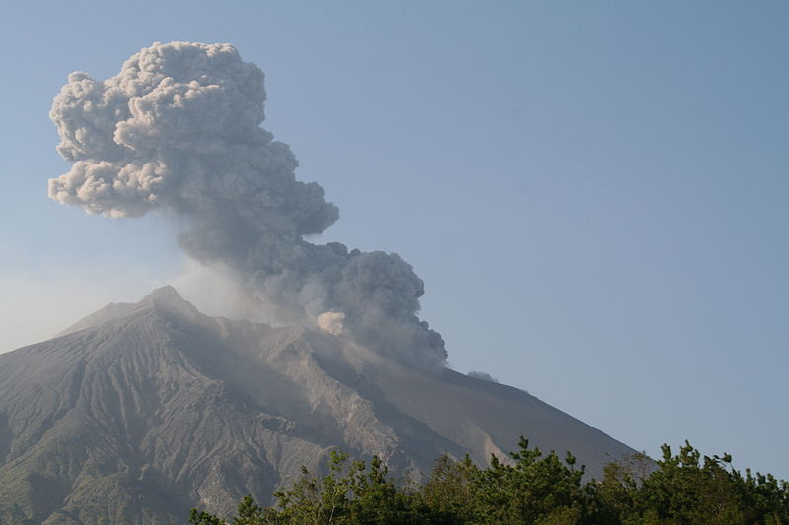
Eruption of Sakurajima
Sakurajima is one of the most active volcanoes in the world.
It has been erupting since 1955, with explosions happening every few hours.
Notes:
Teacher’s Notes
See the short BBC video below for footage of Sakurajima and local school children.
https://www.bbcasia.com/video/?v=542897#_ (BBC, ‘2:59)

Slide 9
Task 2
Task: Categorise the statements into effects (social/economic/ environmental) and responses. Look back at your work from the starter if you’re not sure what those terms mean.
Complete the key to show the colours or symbols that you use to complete the task.
Challenge task: Identify which of the effects are positive and which are negative. In your opinion, does the volcano do more harm than good?

Slide 10
Task 2: Fact File
Task: Categorise the statements into effects (social, economic and environmental) and responses using the fact file worksheet.
People living in Kagoshima have to practice evacuations regularly.
Friction inside the ash cloud can cause lightning.
Boulders and lava bombs sometimes hit the city, causing people to be injured.
The area is known for its radishes (Sakurajima Daikon) which can be as big as footballs thanks to the excellent soil.
The ash sometimes falls on the city, causing health concerns as people breathe it in.
Trains and flights often have to be cancelled.
The area has many hot springs known as onsen which attract many tourists.
The volcanic ash has made the soil very fertile and great for farming.
Small rock fragments can fall from the air during eruptions and have been known to damage windows, solar panels and car windscreens which cost a lot to repair.
Evacuation shelters have been built to protect people.
Cars parked near to the base of the volcano have been burnt by lava.
Notes:
Teacher’s Notes
This slide may be printed to support LA students.

Slide 11
Task 2: Fact File
Key |  | Social effects |  | Environmental effects
 |  | Economic effects |  | Responses
Check your answers
People living in Kagoshima have to practice evacuations regularly.
Friction inside the ash cloud can cause lightning.
Boulders and lava bombs sometimes hit the city, causing people to be injured.
The area is known for its radishes (Sakurajima Daikon) which can be as big as footballs thanks to the excellent soil.
The ash sometimes falls on the city, causing health concerns as people breathe it in.
Trains and flights often have to be cancelled.
The area has many hot springs known as onsen which attract many tourists.
The volcanic ash has made the soil very fertile and great for farming.
Small rock fragments can fall from the air during eruptions and have been known to damage windows, solar panels and car windscreens which cost a lot to repair.
Evacuation shelters have been built to protect people.
Cars parked near to the base of the volcano have been burnt by lava.
Notes:
Teacher’s Notes
Click on each box to reveal the colour coded answers. Opportunity for self/peer assessment.

Slide 12
Task 3: True or False?
People have had to abandon their homes because of the recent eruption of Sakurajima.
Sakurajima is the same type of volcano as Mount Fuji.
Many people have died as a result of the recent eruption of Sakurajima.
The fertile soils of the area have helped people to grow huge turnips.
Notes:
Teacher’s Notes
Students can write their answers in their book, use mini whiteboards or answer during class discussion.

Slide 13
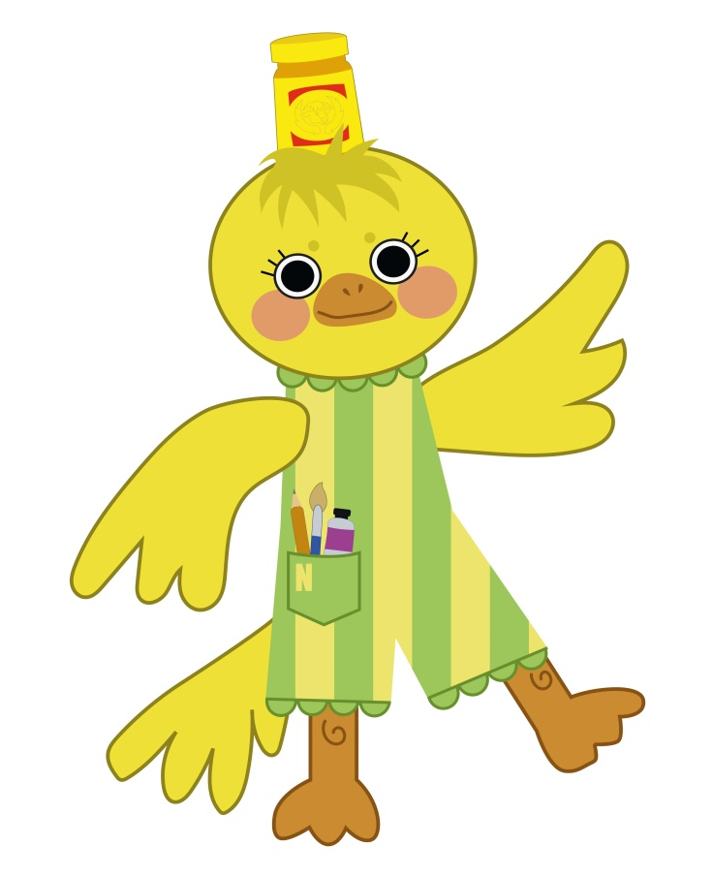
Plenary: Yuru-chara
Yuru-chara are cartoonish mascots which are really popular in Japan. Anything can have a yuru-chara, including schools, cities and volcanoes!
Click to see Sakurajiman and Guribu, the mascots for Sakurajima and the nearby city of Kagoshima.
This is Noj, an example mascot to represent Norwich in the UK.
Task: Design your own yuru-chara for either your school or the town where you live.
Mustard hat
Norwich is famous for mustard
Art supplies
University of the Arts is in Norwich
Stripy suit
Represents market stalls in Norwich
Canary
The mascot for Norwich City Football Club is a canary bird
Notes:
Teacher’s Notes
Alternatively, students could create their own yuru-chara for either the volcano or the town so that they reflect what they have learnt today.

Slide 14
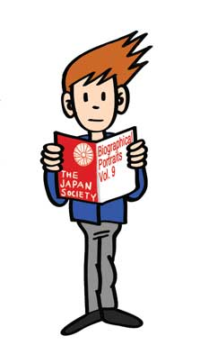
This resource was authored by Katie Holmberg in collaboration with the Japan Society
The Japan Society 13/14 Cornwall Terrace, London NW1 4QP
Tel: 020 7935 0475
Email: education@japansociety.org.uk
www.japansociety.org.uk
Follow us on:
@japansocietylon
@JapanSocietyLondon

