Slide 1
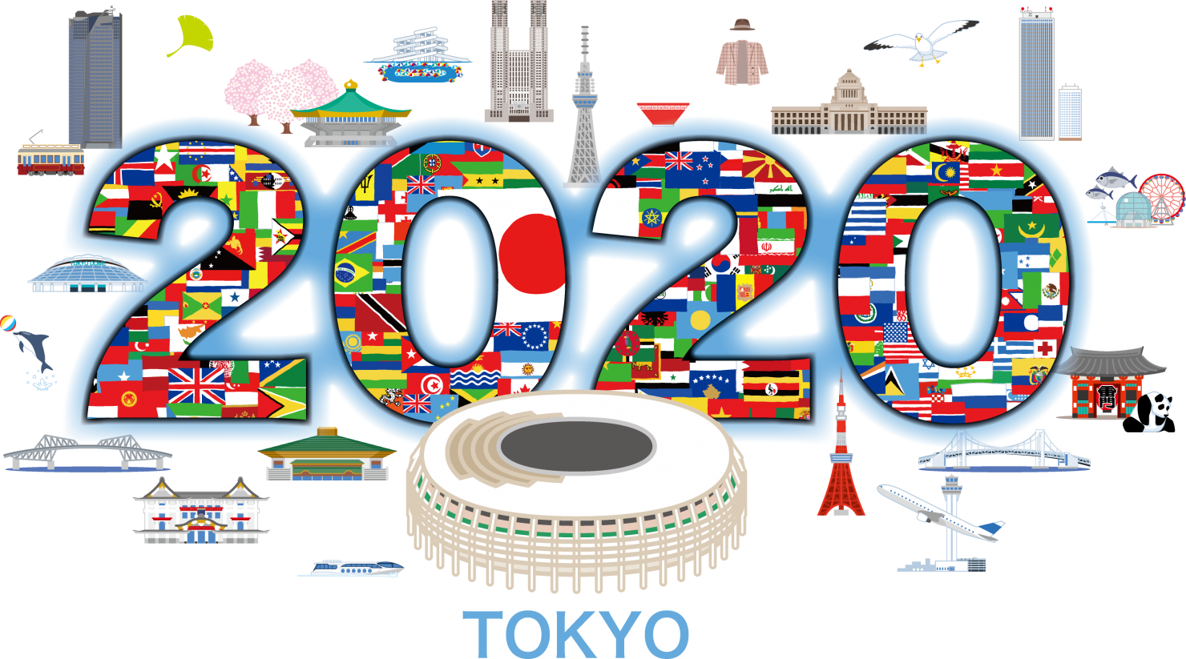
The Tokyo Games

Slide 2
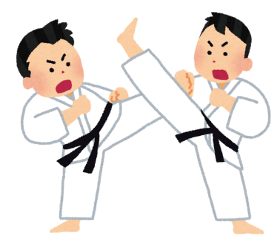
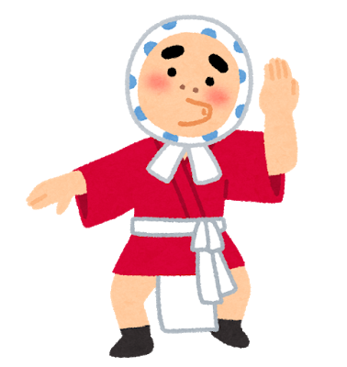
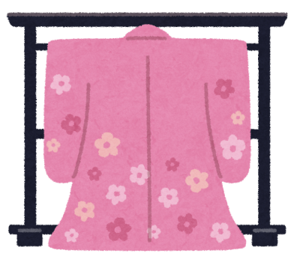
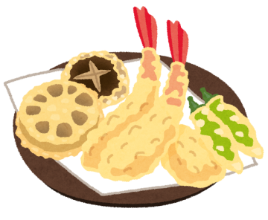
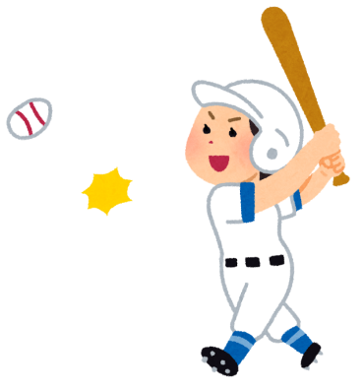
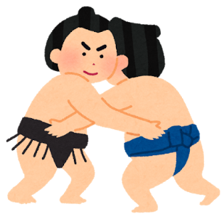
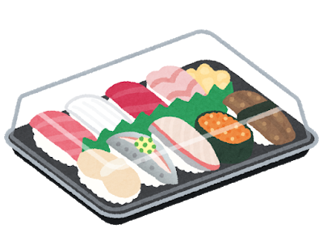
What do you know about Japan?
A
H
F
D
Traditional?
Foods?
G
B
I
E
Sports?
C
Notes:
Ask students
What do you know about Japan?
Point to the images and prompt students: ‘What do you think this is?’. See teacher’s notes word document for information about each picture.
Images from Irasutoya.

Slide 3
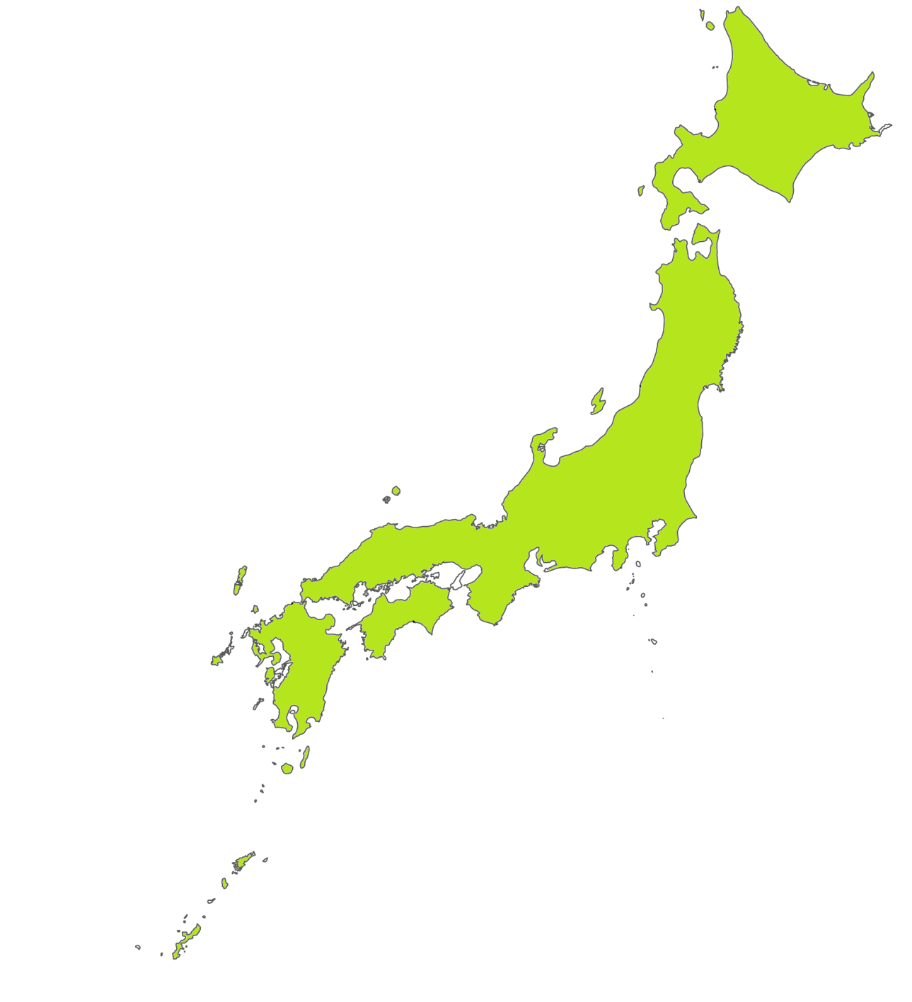
Geography
of Japan
There are 4 main islands.
Hokkaido
Honshu
Kyushu
Shikoku
Notes:
Ask students
Which island is the biggest? Honshu
Which island is the smallest? Shikoku
Teacher’s Notes
There are thousands of other smaller islands (not all of them are inhabited).
The group of southern islands below Kyushu are called Okinawa.

Slide 4
Japan's closest neighbours are Korea, Russia and China.
Can you spot Japan on the map?
Notes:
Ask students
If they can still see Japan and it’s neighbours.
If they can see the equator.

Slide 5
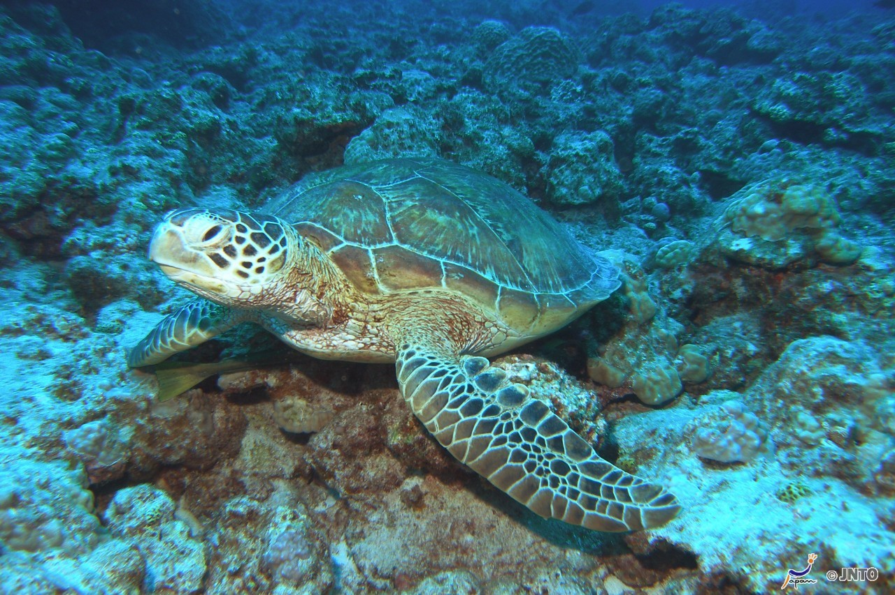
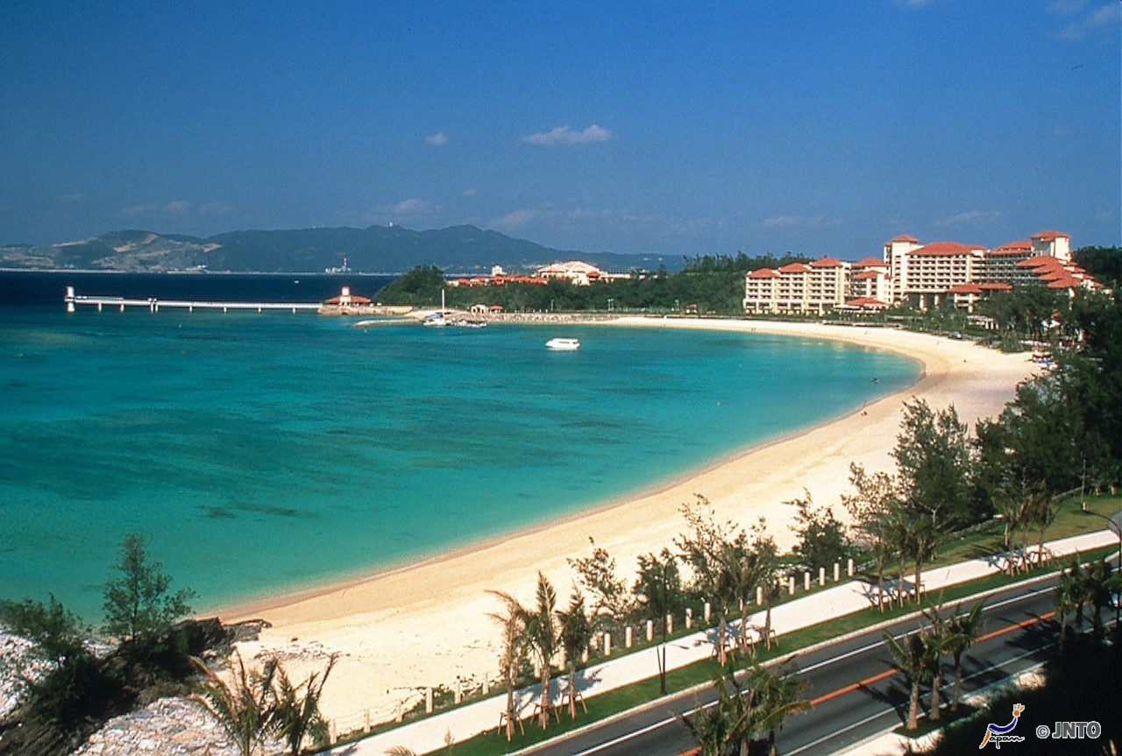
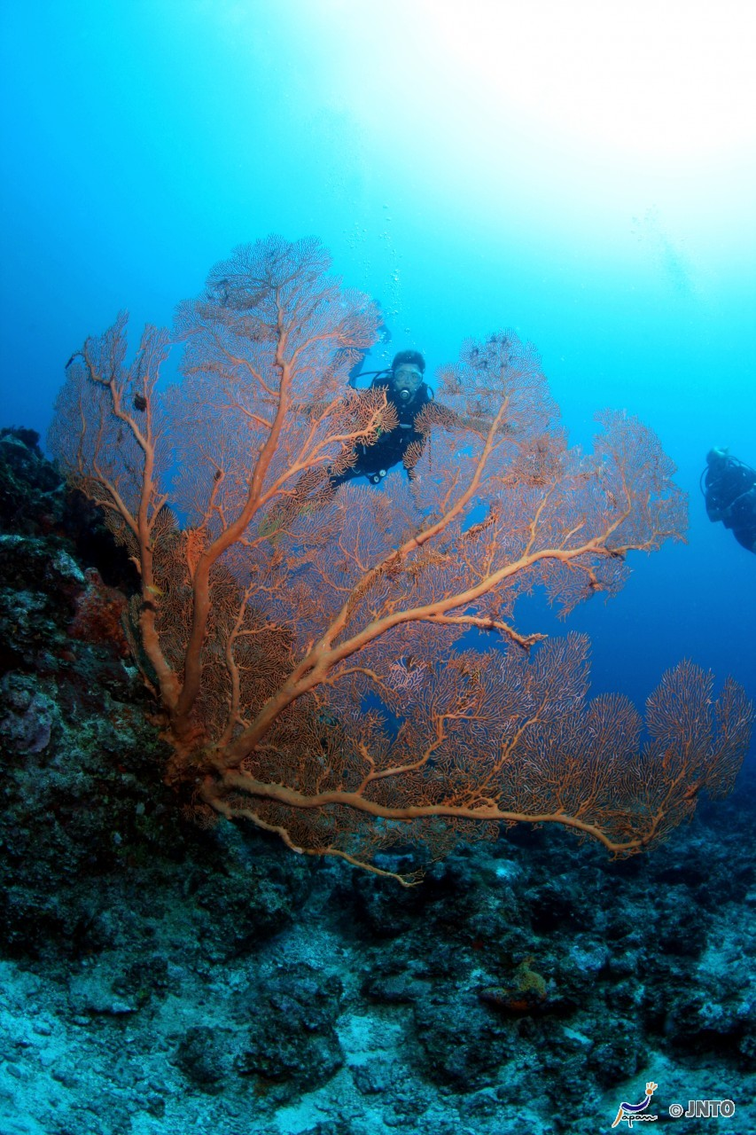
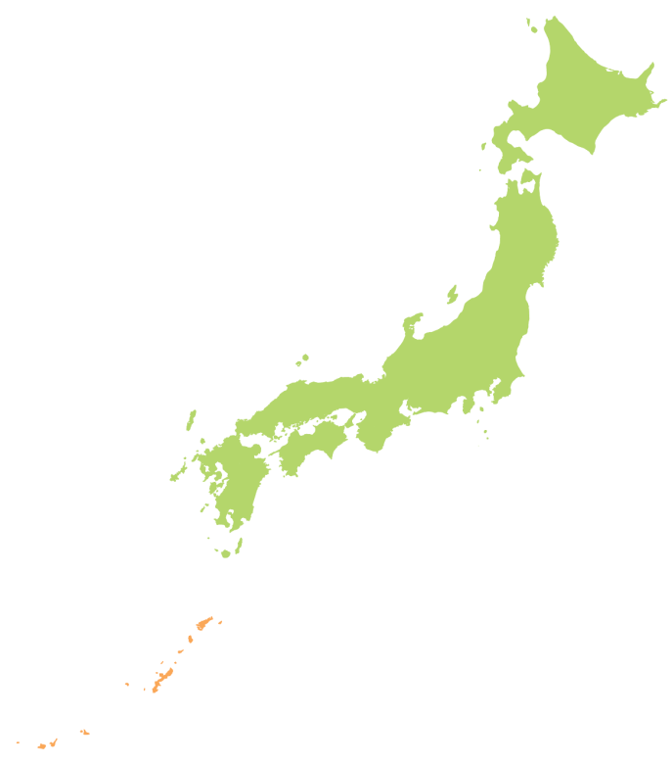
Japan has hot places like Okinawa,
where it is never very cold, even in winter!
Notes:
Tell students
Winter in Okinawa is usually between 15 – 20 degrees, similar to May or June in the UK.
There are lots of beaches and many people visit to go diving.

Slide 6
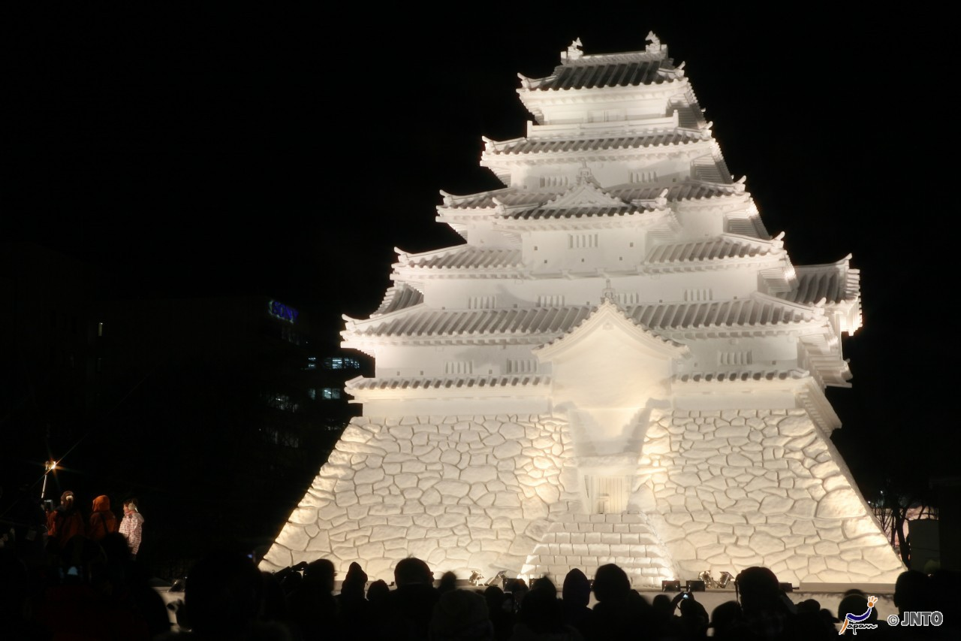
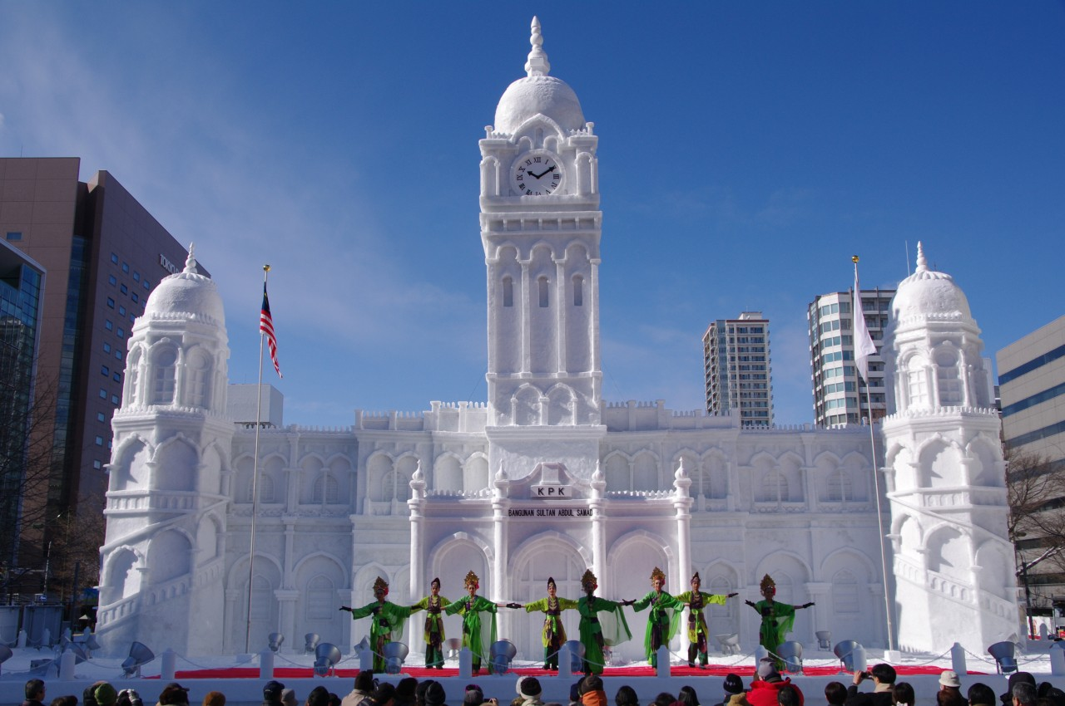
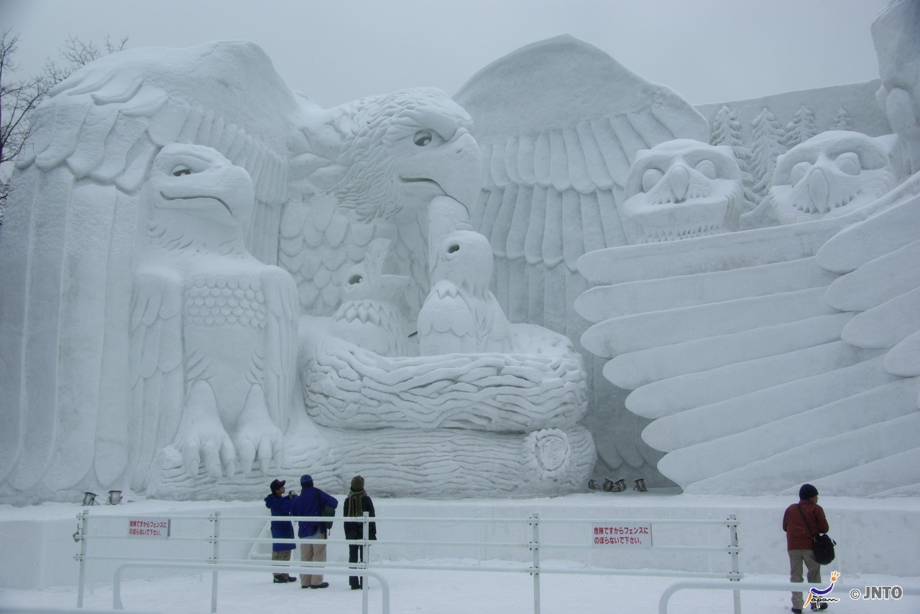
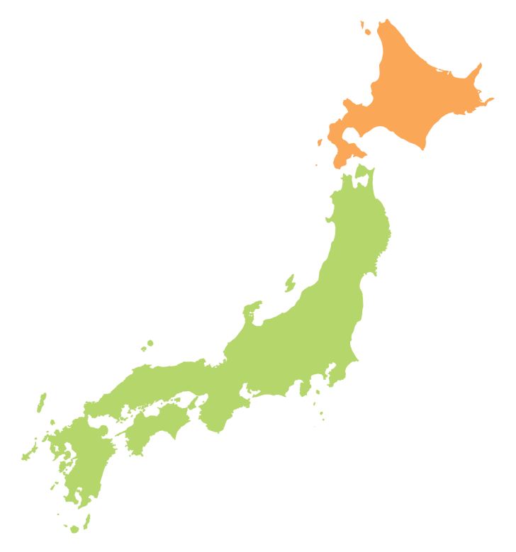
©Yasufumi Nishi/©JNTO
There are also places like Hokkaido where it is very cold and snows in winter.
There is a famous Snow Festival.
Notes:
Tell students
People make enormous snow and ice sculptures for the snow festival (yuki matsuri).
People from all over Japan and many foreign visitors attend the festival every year.

Slide 7
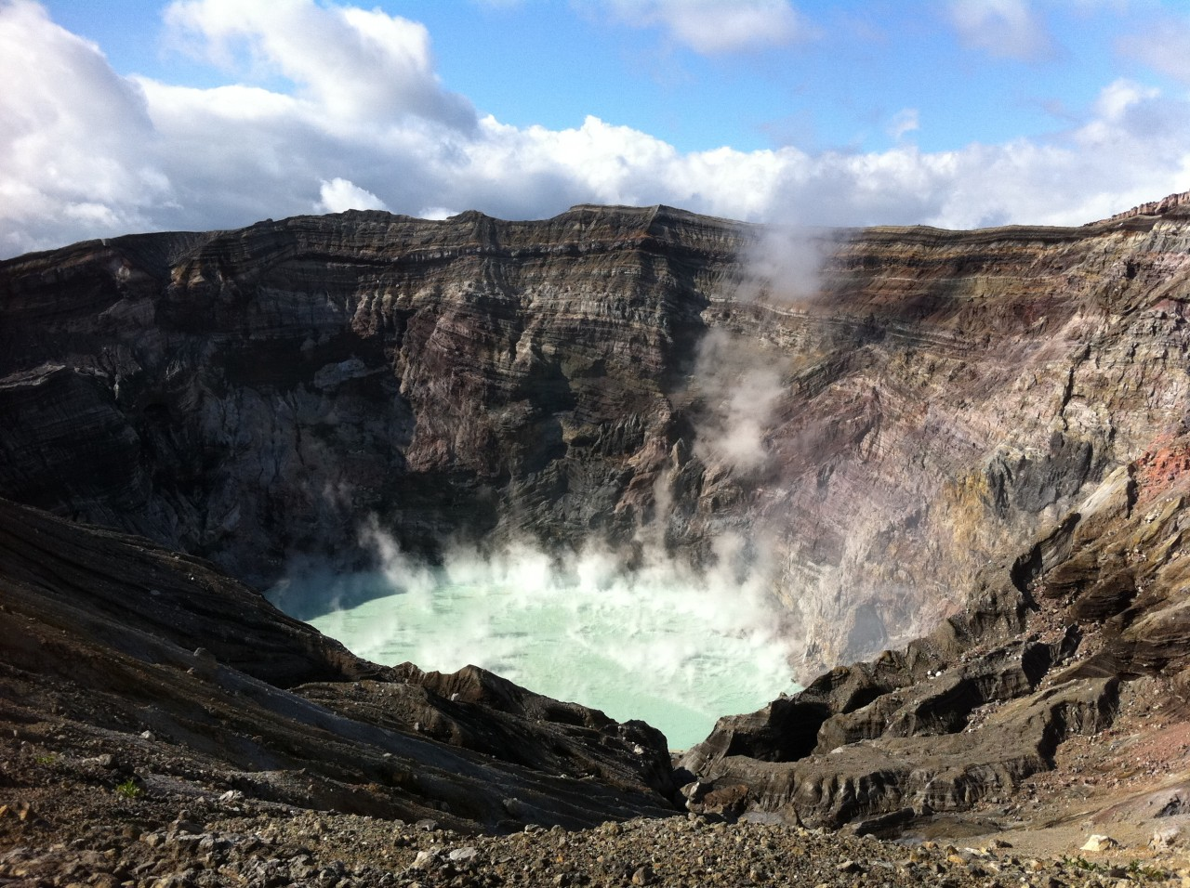
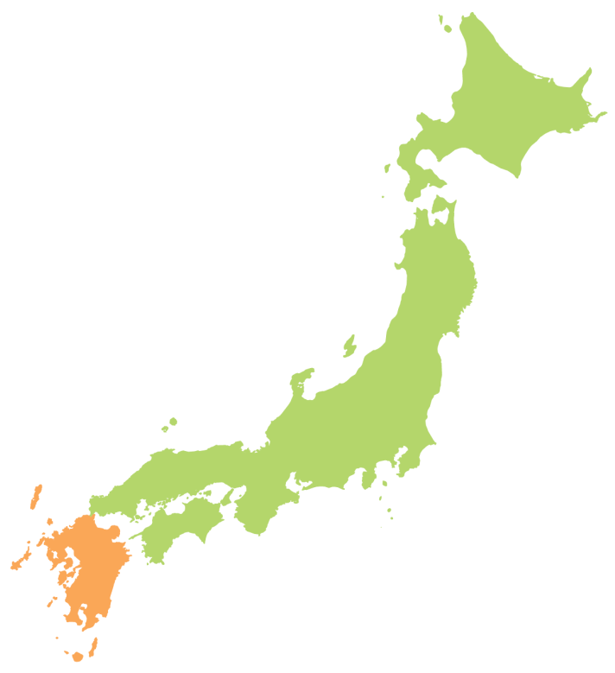
© JNTO
Kyushu is very mountainous and Japan’s most active volcano, Mount Aso, is located there.
Notes:
Tell students
This is an image of the volcano, taken in summer.

Slide 8
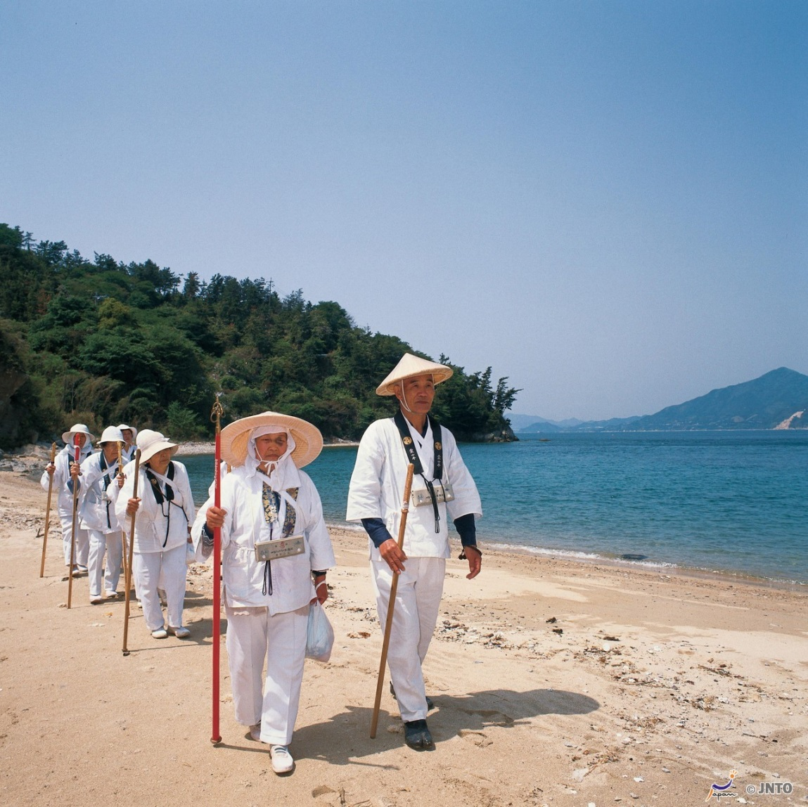
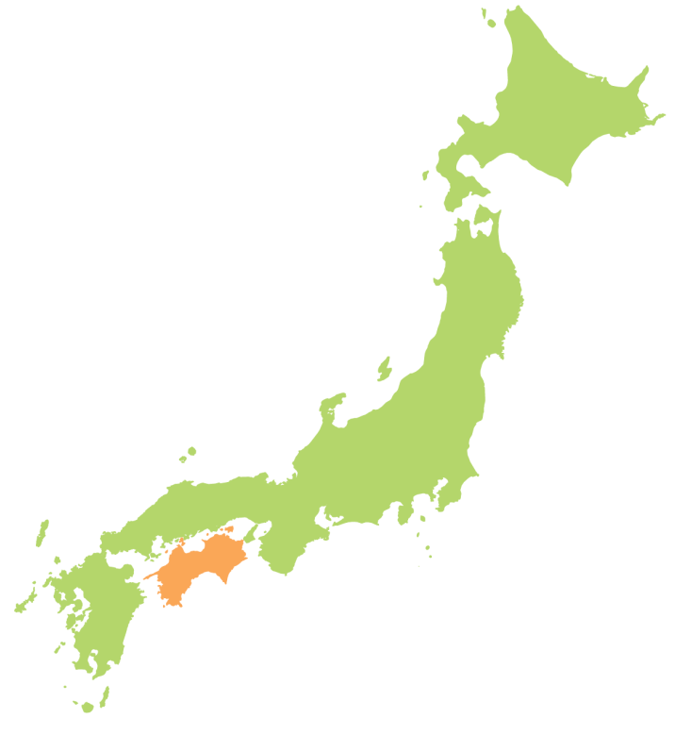
©Ehime Prefecture/©JNTO
Shikoku is famous for its pilgrimage route of 88 temples.
Notes:
Tell students
These people are on pilgrimage and are wearing traditional white pilgrim clothes.
Walking the whole route would take 6 weeks – many people won’t visit all the temples.

Slide 9
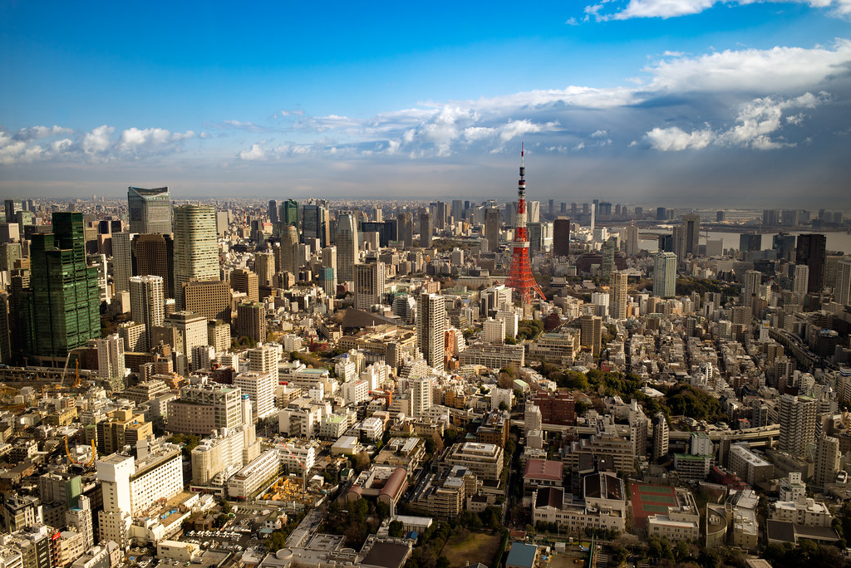
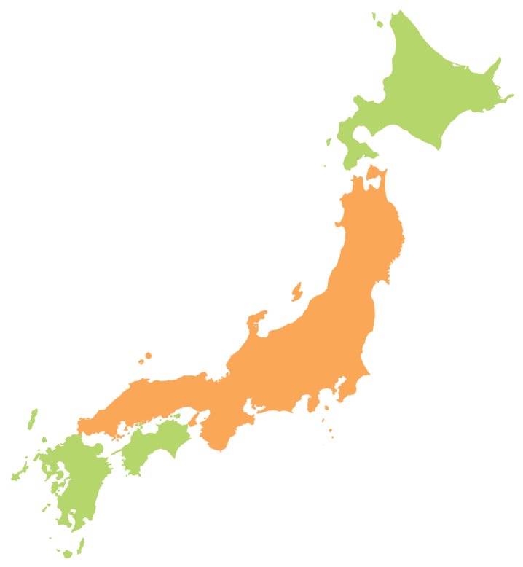
Most people live on Honshu, the biggest island. Big cities like Tokyo, Osaka, and Kyoto are all on Honshu.
Notes:
Tell students
This is an image of Tokyo. The red tower is called ‘Tokyo Tower’. Does it look familiar? (Students may notice it looks like the Eiffel Tower)
"The City" by romainguy is marked with CC0 1.0 and is in the public domain.

Slide 10
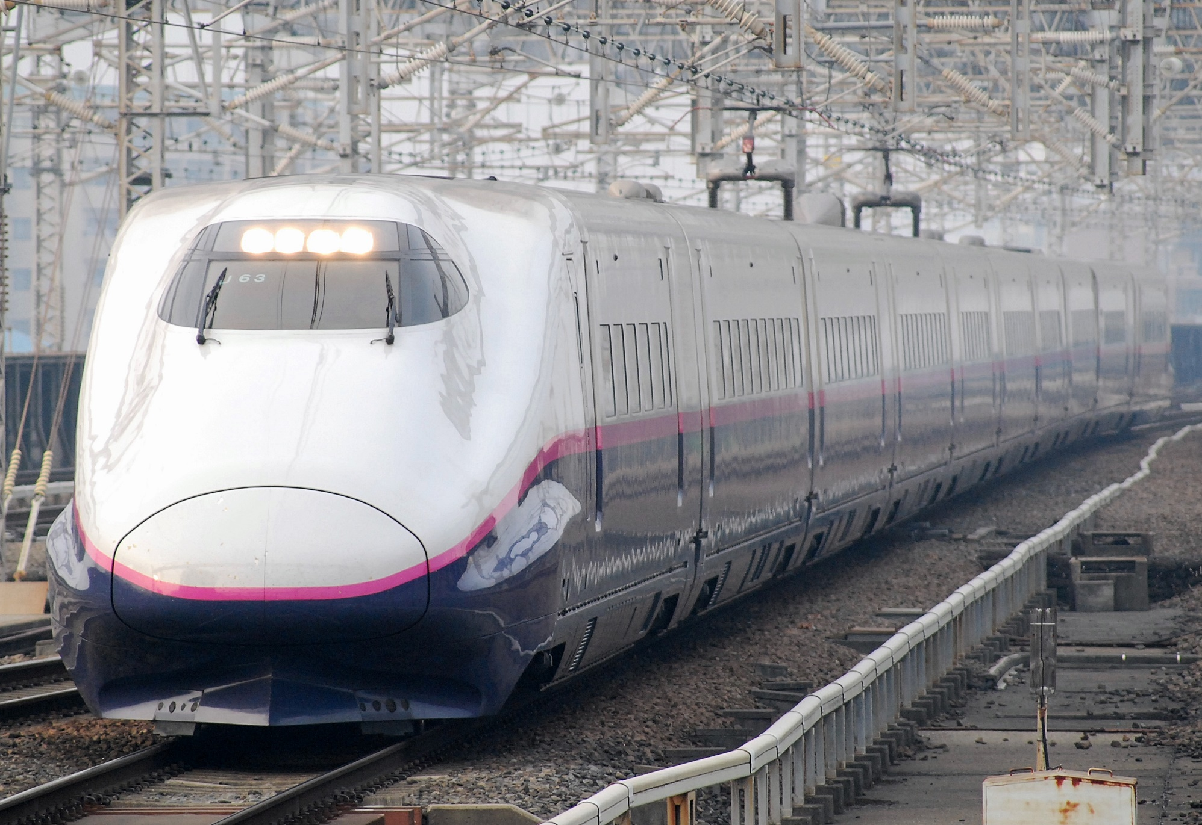
Different parts of Japan are well-connected by trains. The fastest train is called the bullet train, or shinkansen in Japanese.
Notes:
Tell students
The name ‘bullet train’ comes from the shaped of the front of the train and because it travels so quickly.
In Japanese, the name means ‘new main line’.
The first bullet train opened just before the Olympics in Tokyo in 1964!
"File:E2 J63 omiya.JPG" by toshinori baba is marked with CC0 1.0 and is in the public domain.

Slide 11
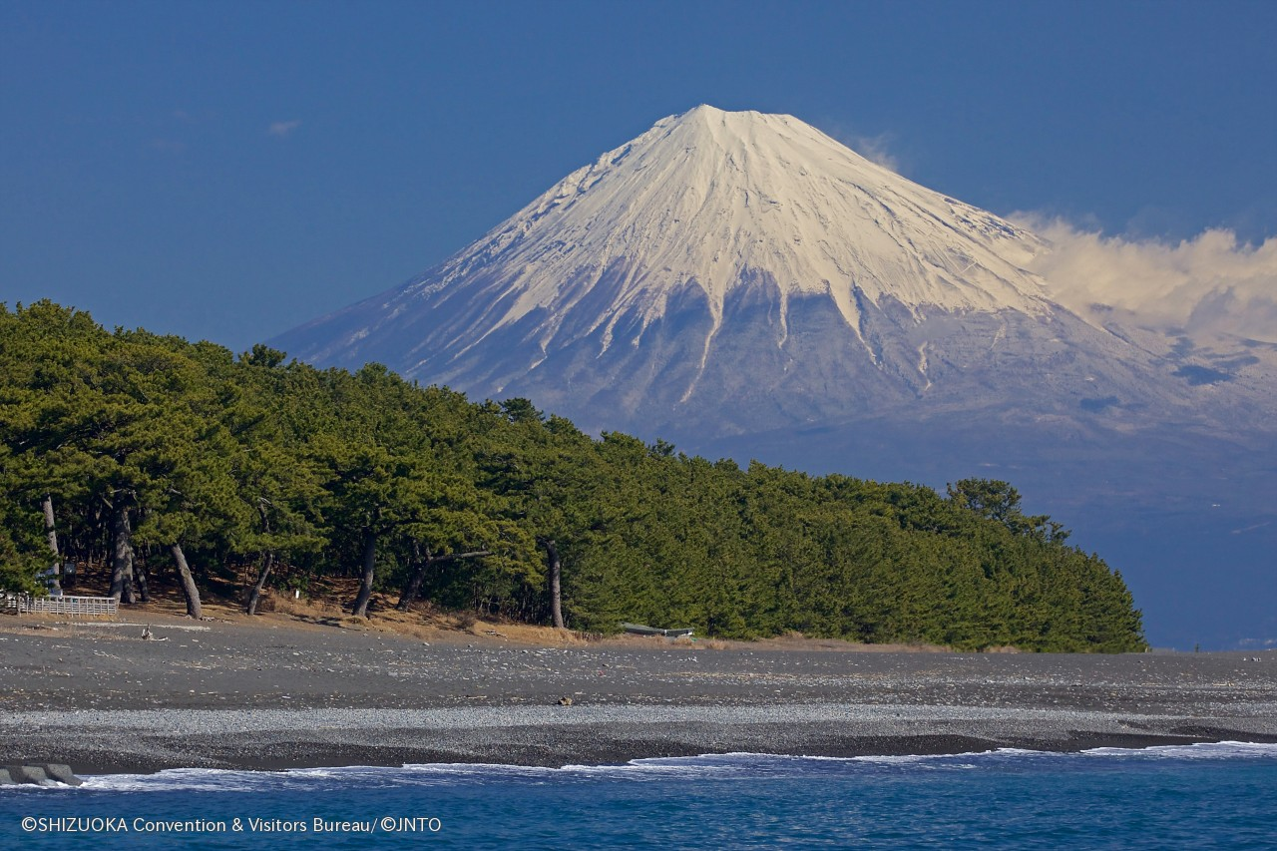
Mt. Fuji is the tallest mountain in Japan
Notes:
Tell students
Mt. Fuji is also an active volcano
There are more than 200 volcanoes in Japan.

Slide 12
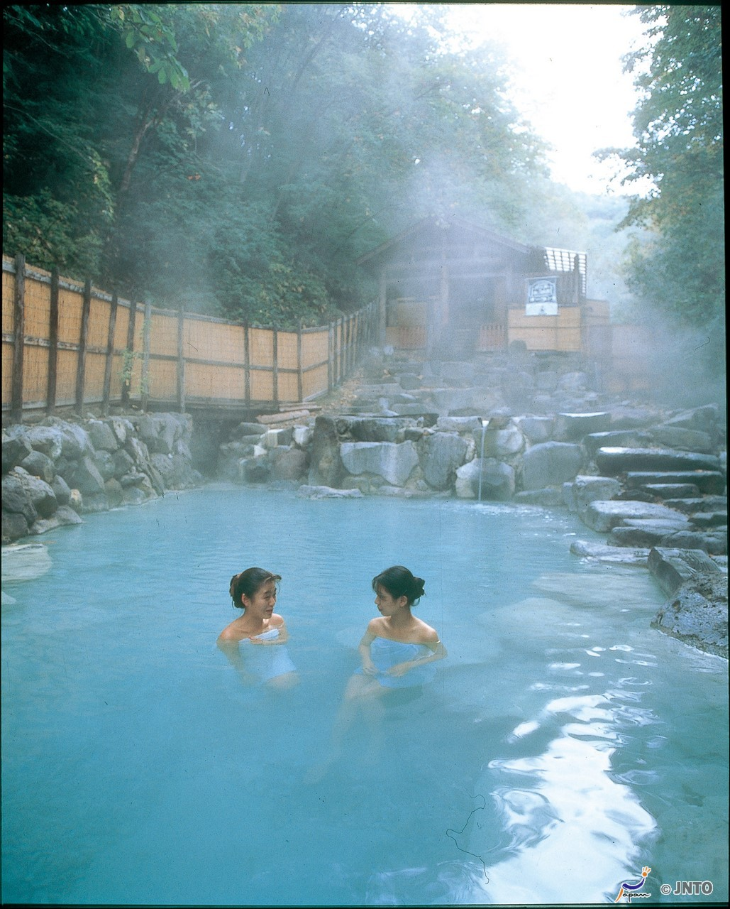
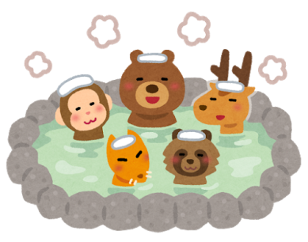
There are many hot springs
Notes:
Tell students
A hot spring is like a pool of naturally hot water from the ground.
People can relax in them, like in the picture
Images from Irasutoya
Onsen: https://3.bp.blogspot.com/-QTbUUAyhNxM/W_UGBCSi_bI/AAAAAAABQUk/VJ3z3da73pwAUZ3tdTkYdwxv_EuMHMlMwCLcBGAs/s800/ofuro_onsen_animals.png

Slide 13
Tokyo Games
The countdown is now on
to the start of the summer
Olympic and Paralympic games...
Tokyo
Watch this video
Notes:
Show the video: https://www.youtube.com/watch?v=ei_24LEAWYk
What impression of Japan do they have after watching it?
Alternative video:
Produced by the Japanese National Tourist Organisation: https://www.youtube.com/watch?v=WLIv7HnZ_fE

Slide 14
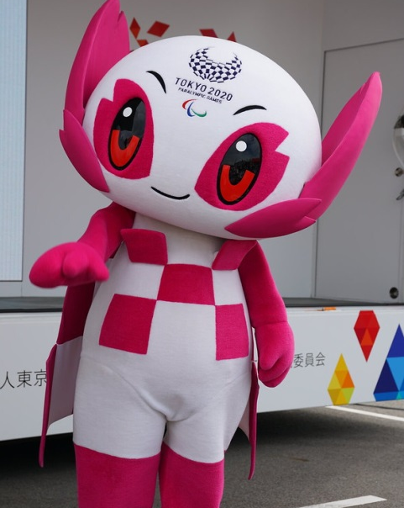
Paralympic Mascot
Someity
Olympic Mascot
Miraitowa
Olympic Facts
Notes:
Tell students
There are robot versions of the mascots that will greet athletes and guests at sporting venues. They can recognise people, wave, and shake hands!
Someity’s name comes from a type of cherry blossom and the words ‘so mighty’.
Someity loves being in nature, and can communicate with natural elements, such as stones and the wind.
Miraitowa’s name comes from the Japanese words for future (mirai) and eternity (towa).
Miraitowa’s special power is being able to instantly teleport anywhere it wants.
More info: https://tokyo2020.org/en/special/mascot
Optional video links:
Animation introducing Miraitowa and the Olympics:
https://www.youtube.com/watch?v=ixE1a6_l7e4
Animation introducing Someity and the Paralympics:
https://www.youtube.com/watch?v=bzdxwj4422Q

Slide 15
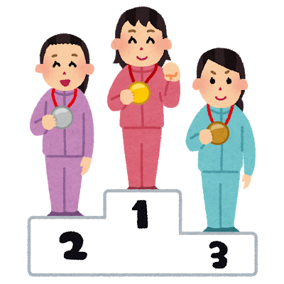
Olympic Facts
All the medals will be made from
recycled metal
See the medals
Notes:
Tell students
The metal came from old electronics that people didn’t use anymore.
Lots of old phones, digital cameras, handheld games and laptops were collected and the metal was removed and melted down.
Click the link to see the medals: https://www.olympic.org/tokyo-2020-medals

Slide 16
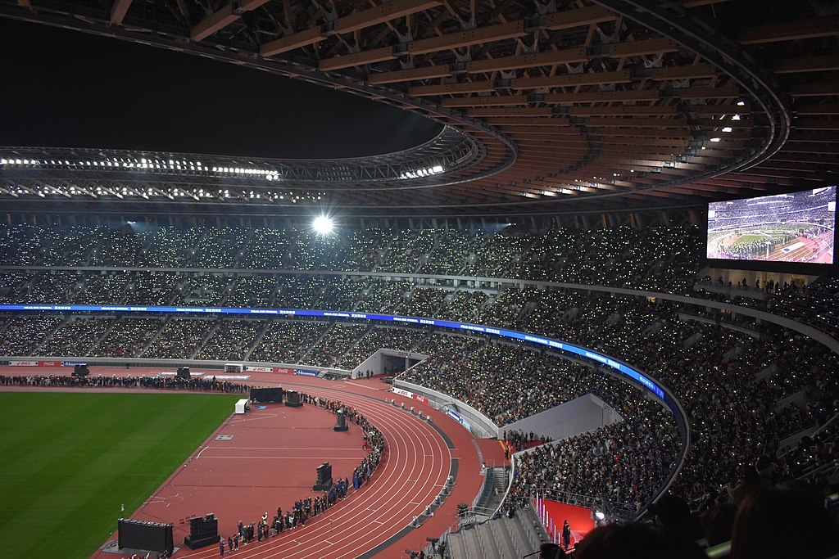
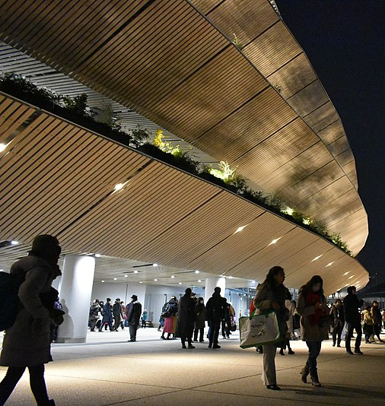
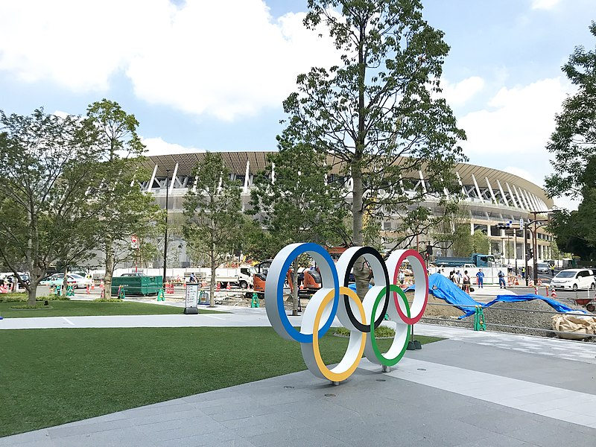
Olympic Facts
© 江戸村のとくぞう/CC BY-SA 4.0
© 江戸村のとくぞう/CC BY-SA 4.0
The stadium roof is made from wood collected from all 47 prefectures
© Tokyo-Good/CC BY-SA 4.0
Notes:
Tell students
It took almost 3 years to build the new Olympic Stadium
It will be used for the opening and closing ceremonies, athletics events, rugby and some football matches.
Images:
© Tokyo-Good – own work /CC BY-SA 4.0 https://commons.wikimedia.org/wiki/File:National-Olympic-Stadium-2019-08-08.jpg
© 江戸村のとくぞう - own work/ CC BY-SA 4.0 https://commons.wikimedia.org/w/index.php?curid=85129915 (cropped)
© 江戸村のとくぞう - own work/CC BY-SA 4.0 https://commons.wikimedia.org/w/index.php?curid=85129921

Slide 17
Quiz Time!

Slide 18
Japan Quiz
Japan is an archipelago with 4 main islands and many smaller islands. How many islands are there in Japan?
A. Less than 400 islands.
B. Around 1000 islands
C. Over 6000 islands

Slide 19
C. Over 6000!
Japan has approximately 6,852 islands in total!

Slide 20
Japan Quiz
Fish and rice are an important part of the Japanese diet. A traditional breakfast in Japan includes fish and rice.
True or false?

Slide 21
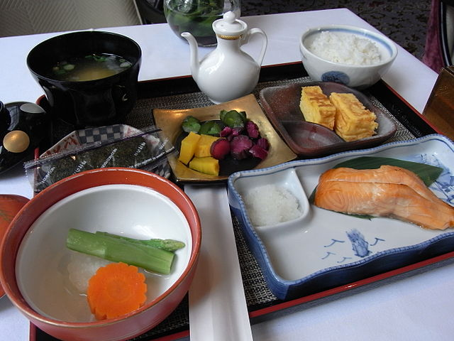
True!
A traditional Japanese breakfast usually consists of grilled fish served with miso soup, eggs, vegetables, and pickles.
Notes:
Image:

Slide 22
Japan Quiz
The Japanese invented many things we use today.
Which of the below was not invented by the Japanese?
A. Emojis
B. Selfie stick
C. Laptop computer
D. All of these were invented by the Japanese

Slide 23
D. They were all invented by the Japanese!

Slide 24
Japan Quiz
In Japan, people don’t use signature on documents. They use personal stamps instead.
True or false?

Slide 25
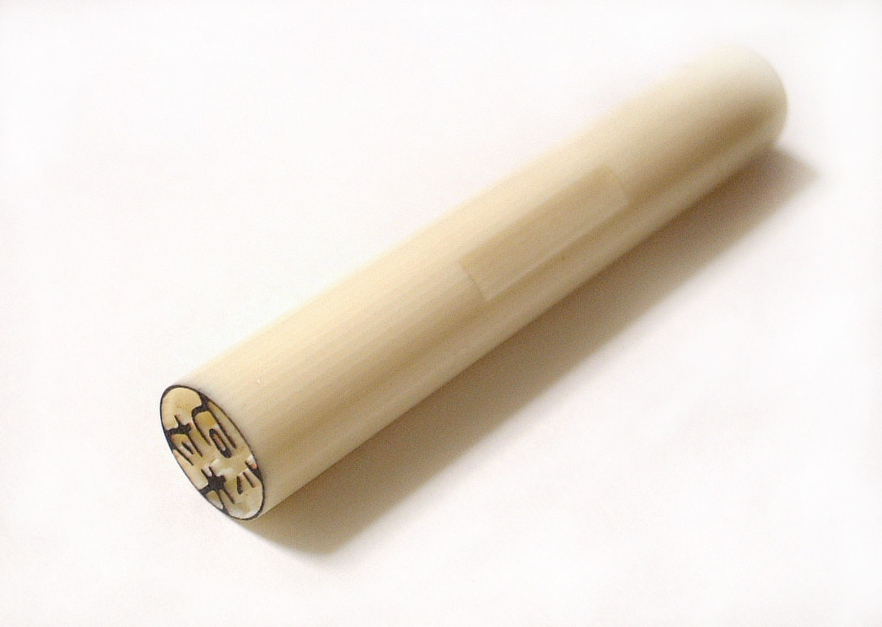
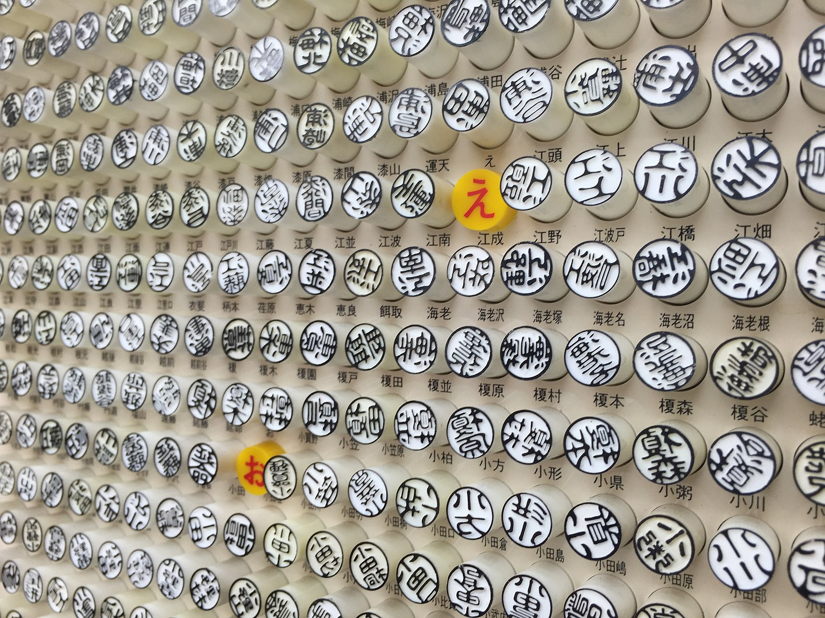
True!
In Japan, everyone has their own personal seals called ‘hanko’ which has their name in Japanese characters.
Notes:
CC-BY-SA-2.0

Slide 26
Japan Quiz
How many times has Japan hosted the Olympic Games in the past? (not including Tokyo 2020)
A. Four times
B. Three times
C. Twice

Slide 27
B. 3 times
Japan has hosted 2 Winter Olympics and 1 Summer Olympics in the past. Tokyo 2020 is the 4th time Japan will be hosting the games.

Slide 28
Japan Quiz
In what year did Japan win its first gold medals?
A. 1928
B. 1938
C. 1948

Slide 29
A. 1928
Japan won its first gold medals in Swimming and Athletics in 1928.

Slide 30
Japan Quiz
To date, how many medals has Japan won in the Olympic Games?
A. Less than 450
B. More than 450

Slide 31
B. More than 450
To date, Japan has won a total of 497 medals: 439 at the Summer Olympics and 58 at the Winter Olympics.

Slide 32
Japan Quiz
Japan has won most of its Olympic medals in Judo.
True or false?

Slide 33
True!
To date, Japan has won a total of 84 medals in Judo:
39 gold, 19 silver, and 26 bronze.

Slide 34
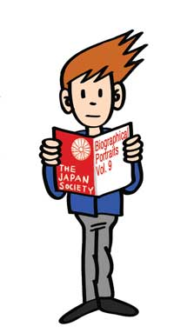
This resource was developed by the Japan Society.
The Japan Society 13/14 Cornwall Terrace, London NW1 4QP
Tel: 020 7935 0475
Email: education@japansociety.org.uk
www.japansociety.org.uk
Follow us on:
@japansocietylon
@JapanSocietyLondon

