Slide 1
Japanese Patterns
Your Learning Objectives:
To create tessellations using polygons.
To measure the interior angles of a shape
To understand why some shapes tessellate

Slide 2
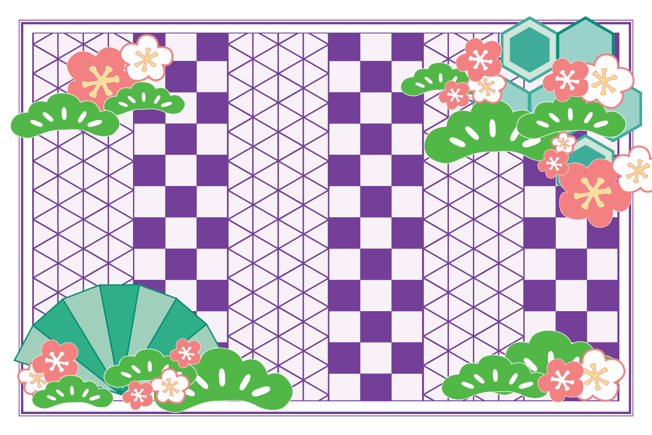
Starter
What shapes can you see in this pattern?
Notes:
Answers: triangles (equilateral and isosceles), hexagons, squares, rectangles.
Teacher’s Notes
The other shapes are cherry blossom (sakura) and pine (matsu) which are both important cultural symbols in Japan and often seen in traditional art.
The cherry blossom is considered Japan’s national flower and pine trees are a symbol of good fortune.

Slide 3
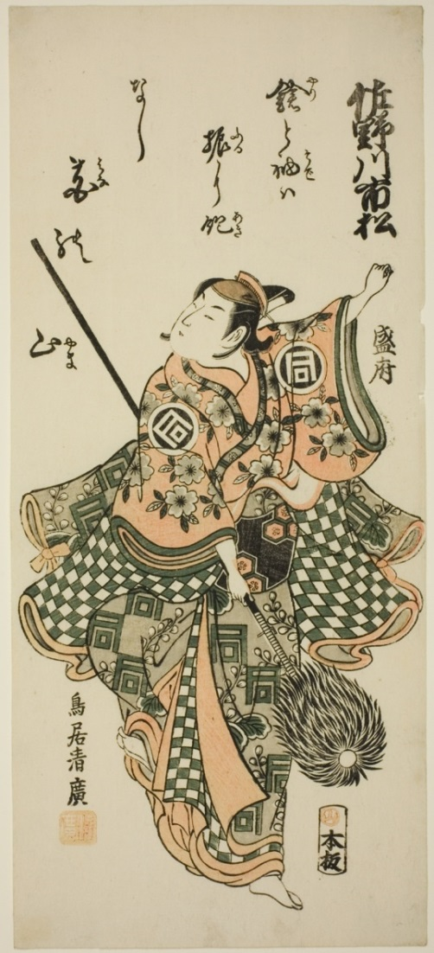
Topic 1: Ichimatsu pattern
市松模様
This is a traditional pattern in Japan. It was worn on stage by actors in the 18th century and is still a popular design today!
Notes:
Teacher’s Notes
This pattern was apparently named after the Japanese kabuki actor Ichimatsu Sanogawa (1722-1762).
Kabuki theatre was a very popular form of entertainment and it is said this pattern became fashionable after he (and other performers) wore it on stage.
This woodblock print shows him performing a dance, and the pattern is visible on his clothes.
More information about this print: https://www.artic.edu/artworks/19710/the-actor-sanogawa-ichimatsu-i-performing-the-spear-dance

Slide 4
Topic 1: Ichimatsu pattern
The Ichimatsu design symbolises prosperity because of the endless possibility of linking of squares together.
Where else you have seen this pattern?
Notes:
Teacher’s Notes
Give students a short time to think about where they might have seen the pattern.
They may point out that it looks like check or gingham and/or they have also seen the design used for clothes or fabrics (i.e. check shirts or tablecloths).
They might also notice that it looks like a chess board or come up with other ideas.

Slide 5
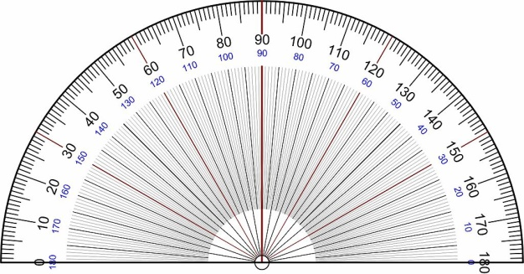
Task 1
Use the dotty paper provided to draw a square.
Measure one of the interior angles of a square.
1. Is there a special name for this type of angle?
2. How many angles meet at a point?
3. What is the total of these angles?
Hint: Remember to always start measuring from the zero!

Slide 6
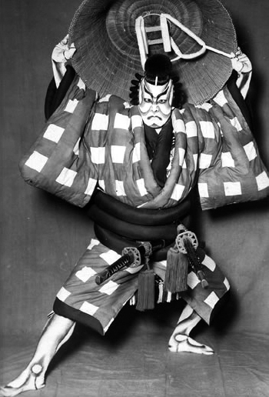
Why do some shapes tessellate?
Use the square dotty paper to create an Ichimatsu tessellation.
Imagine you are designing the fabric to make a new costume for a Japanese actor. Colour in the design to make it your own.
1. Why do squares tessellate?
2. Do all polygons tessellate?
Notes:
Teacher’s Notes
This image shows a kabuki actor, Onoe Kikugoro VI (1885-1949), in costume.
You may like to show students some more images of traditional Japanese clothing – kimono, obi (sash), or hakama (trousers) as inspiration.
Image: Kikugorō Onoe VI as Umeō-maru is in the public domain, via Wikipedia.

Slide 7
Task 1
Notes:
This slide can be skipped or drawn on if displayed on a whiteboard, or interactive whiteboard.

Slide 8
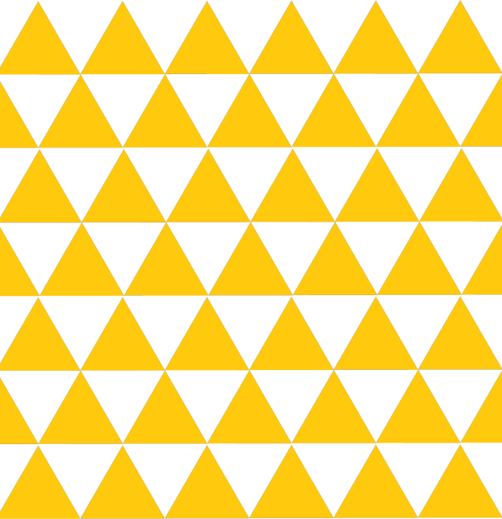
Topic 2: Uroko pattern
鱗模様
Uroko means ‘scales’ and this pattern is supposed to resemble scales.
Which animals can you think of which have scales?
Notes:
Teacher’s Notes
Give students a minute to come up with ideas or discuss in pairs.

Slide 9
Topic 2: Uroko pattern
Can you guess which animal inspired this pattern?
Answer: It’s a snake! Some people say fish too...
Notes:
Teacher’s Notes
This pattern was used by noh and kabuki actors to portray characters who had transformed into snakes or demons.
Nowadays, the pattern can symbolise protection against misfortune.

Slide 10
Task 2
Draw a triangle on the isometric paper provided. All 3 sides should be the same length.
1. What is the size of each interior angle in the triangle?
2. What is the special name of this triangle?
Hint: Remember to always start measuring from the zero!

Slide 11
Task 2 continued
Use the isometric paper to draw a tessellation of equilateral triangles.
1. How many corners (vertices) meet at a point?
2. What is the total sum of the angles at a point?
3. Colour in your tessellation to create an uroko design.

Slide 12
Task 2
Notes:
This slide can be skipped or drawn on if displayed on a whiteboard, or interactive whiteboard.

Slide 13
Task 2
Hint: Remember to always start measuring from the zero!

Slide 14
Task 2 continued…
Can you create tessellations using isosceles triangles?
Use the isometric paper to help you create your designs.
Notes:
Teacher’s Note
Skip this slide if working with younger students or if you have limited time.

Slide 15
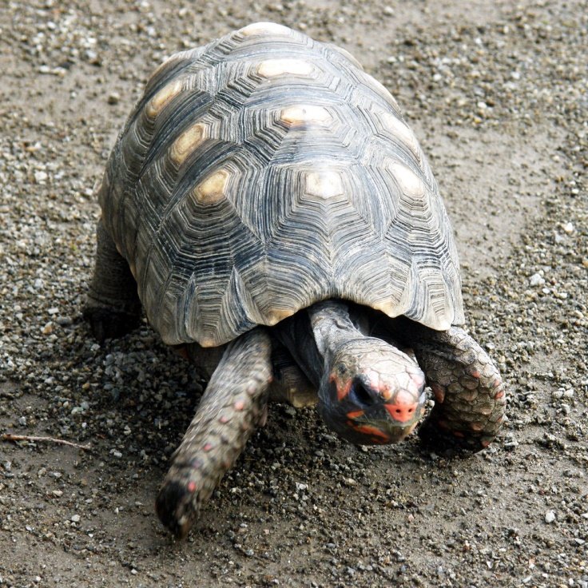
Topic 3: Kikko Pattern
亀甲模様
This pattern was also inspired by an animal.
Can you guess which one?
Answer: The pattern is modelled on a turtle shell!
Notes:
Teacher’s Note
Kikko means ‘turtle shell’ in Japanese.
Turtles are also a symbol of longevity in Japan and there is a proverb that says they live for 10,000 years.

Slide 16
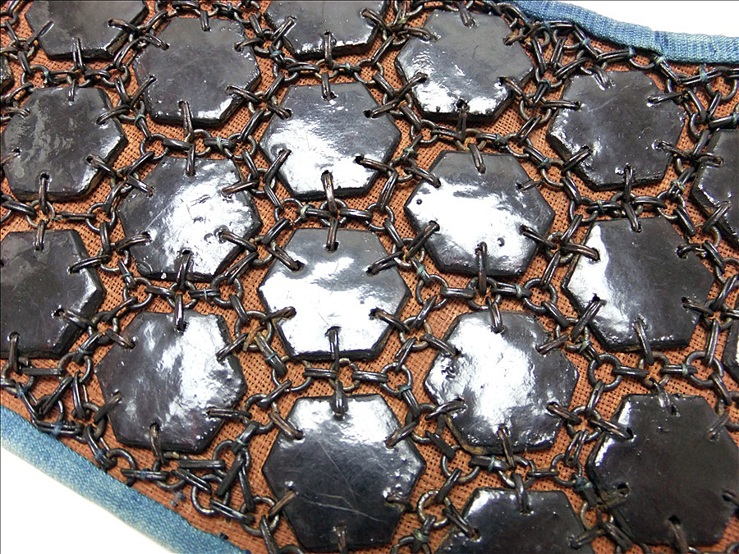
Topic 3: Kikko Pattern
The pattern also appears in Japanese armour worn by samurai and soldiers in the past.
The metal plates are joined together to form a protective covering.

Slide 17
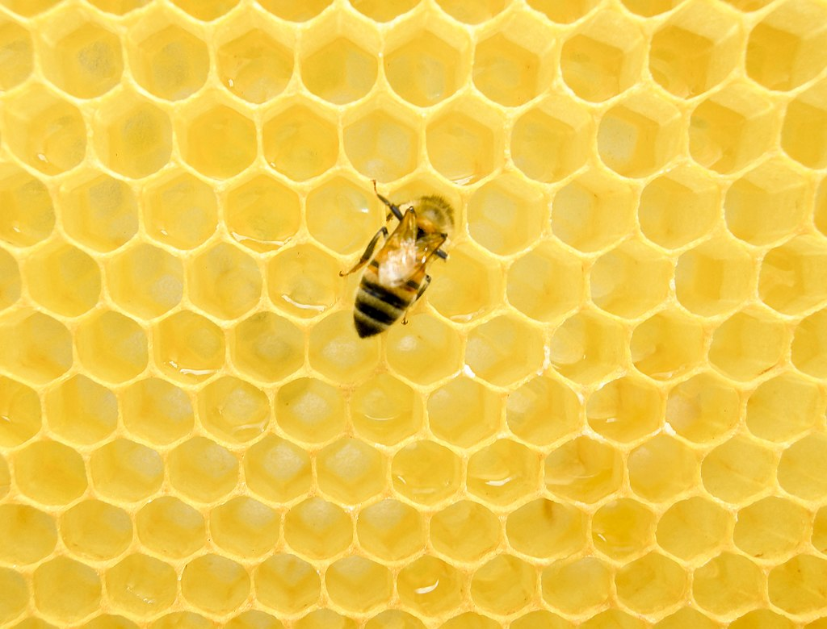
Topic 3: Kikko Pattern
What shape makes up the kikko pattern?
Did you know that this mathematical tessellation makes up one of the strongest patterns in nature?
Where else have you seen this pattern? Can you see where its strength can be a useful quality?

Slide 18
Task 3
Draw a hexagon on the isometric paper. Measure one of the internal angles.
1. What is the size of one interior Angle?
Draw a tessellation with regular hexagons on the isometric paper.
2. How many angles fit together at the point?
3. What do all the angles at a point total?
Now you can colour in your design.

Slide 19
Task 3
Hint: Remember to always start measuring from the zero!

Slide 20
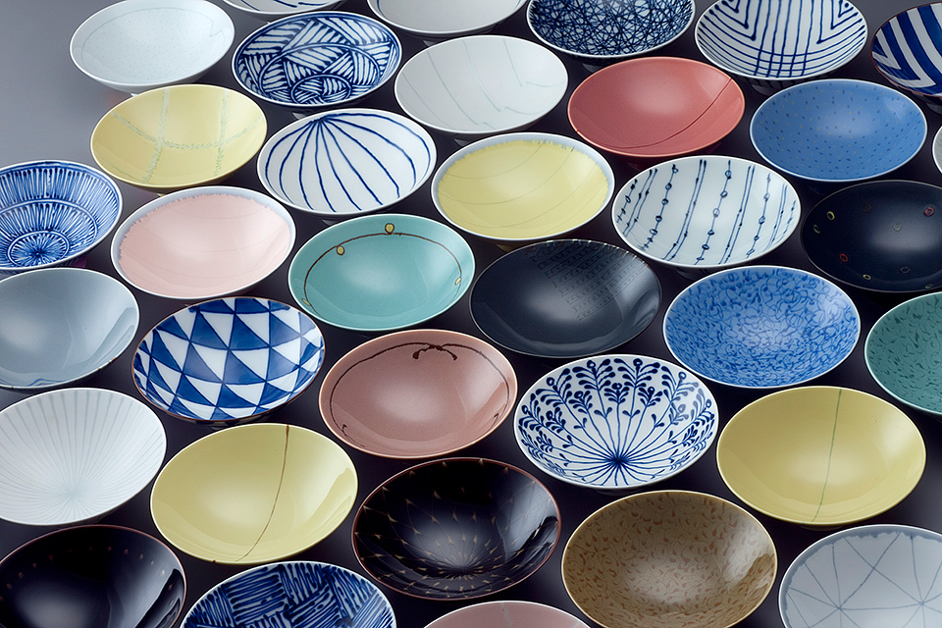
Patterns in Daily Life
What pattern can you see in the picture?
Uroko
Notes:
Tell Students
That these traditional patterns (and many others) can be seen in daily life. The designs have been used to decorate objects for hundreds of years and are still used today.

Slide 21
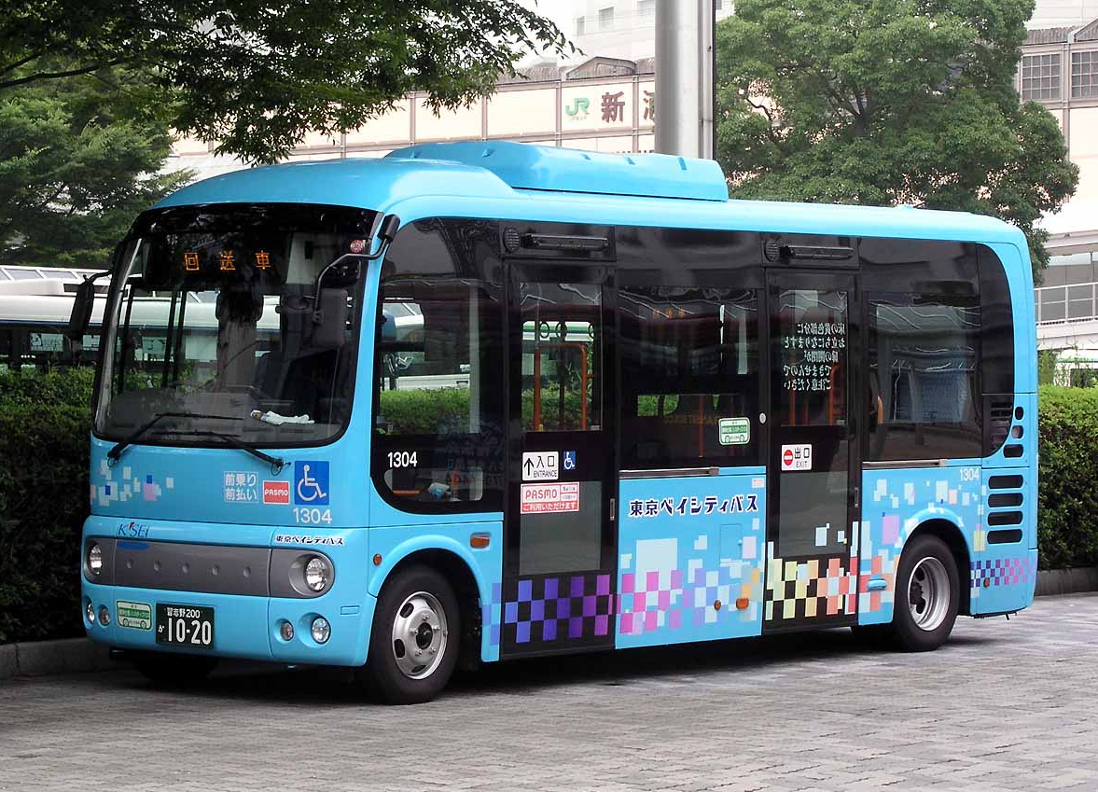
Patterns in Daily Life
What pattern can you see in the picture?
Ichimatsu

Slide 22
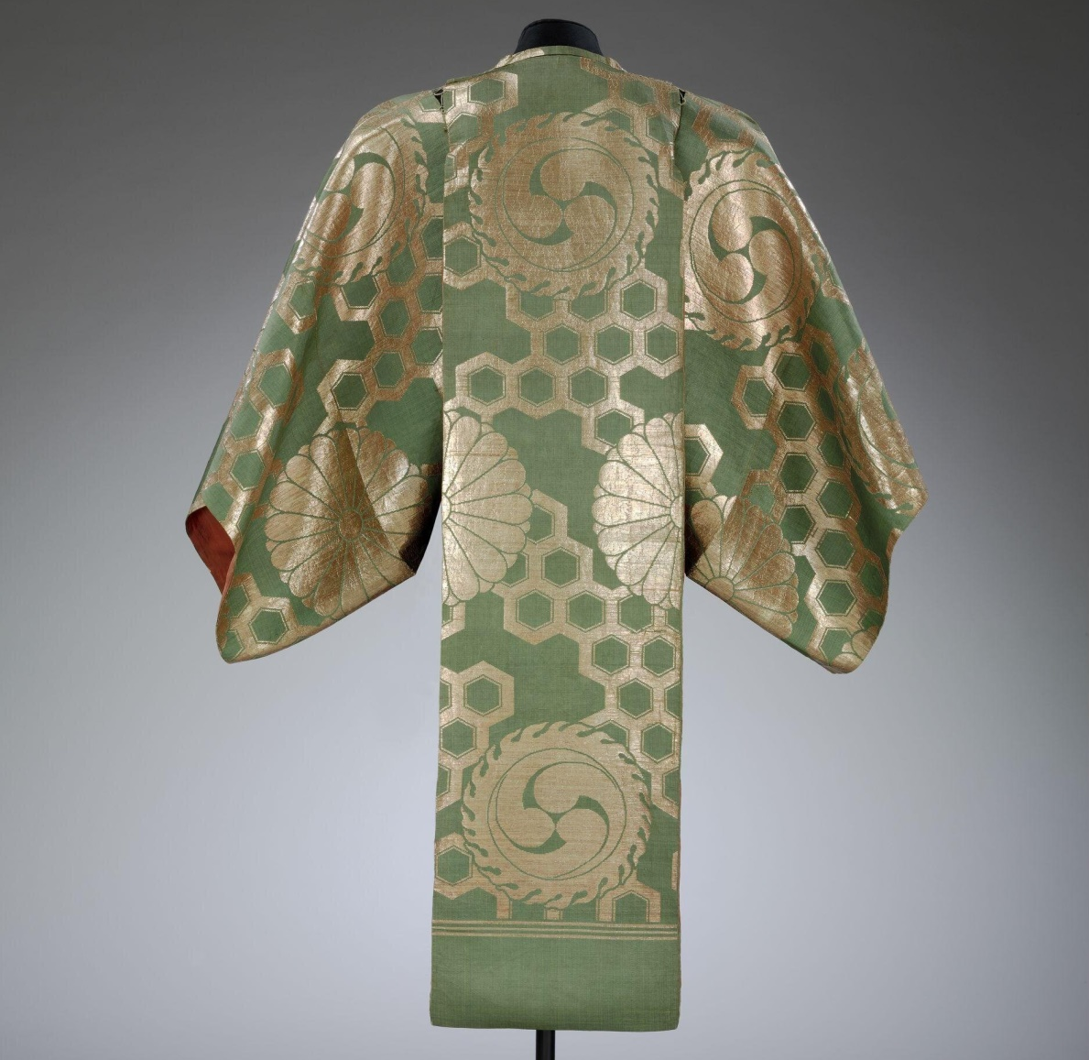
Patterns in Daily Life
What pattern can you see in the picture?
kikko

Slide 23
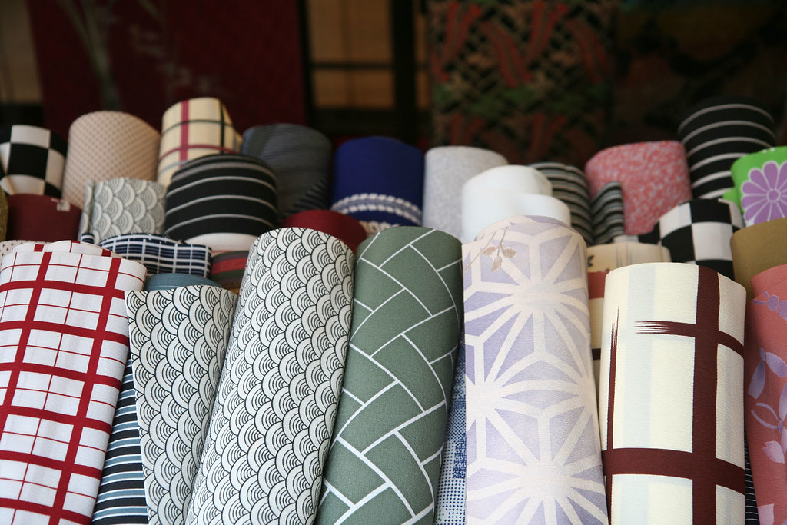
Patterns in Daily Life
What pattern can you see in the picture?
ichimatsu

Slide 24
Extension Activity
Can you combine the shapes that we have looked at and create a tessellation of your own?
You can colour in the pattern that you make in a creative way.
Look at the shape below. You can see that a regular hexagon tessellates with equilateral triangles.

Slide 25
Extension Activity 2
Look at how 4 shapes meet around a point.
2 regular hexagons and 2 equilateral triangles.
What do the 4 angles total?

Slide 26
Isometric Paper

Slide 27
This resource was authored by Ali Chaudhry in collaboration with the Japan Society
The Japan Society 13/14 Cornwall Terrace, London NW1 4QP
Tel: 020 7935 0475
Email: education@japansociety.org.uk
www.japansociety.org.uk
Follow us on:
@japansocietylon
@JapanSocietyLondon

