Slide 1
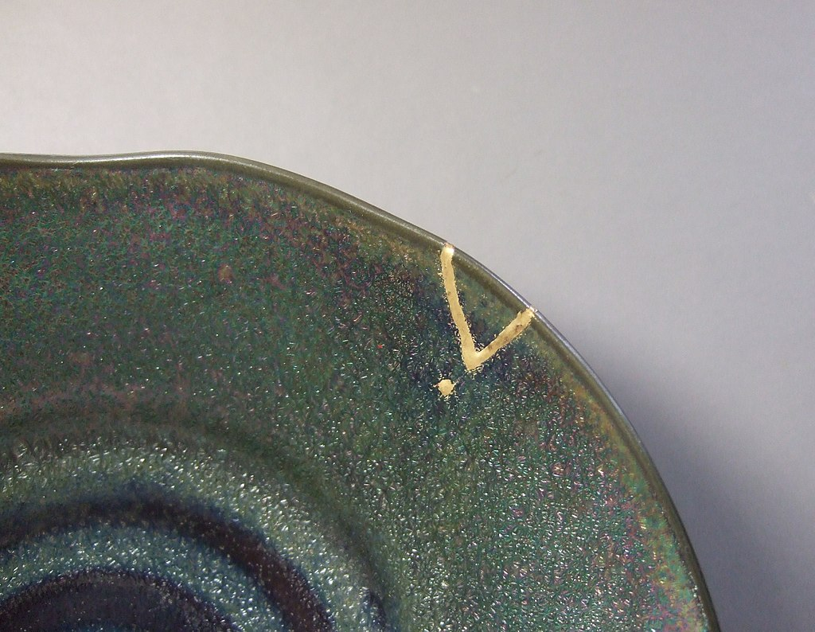
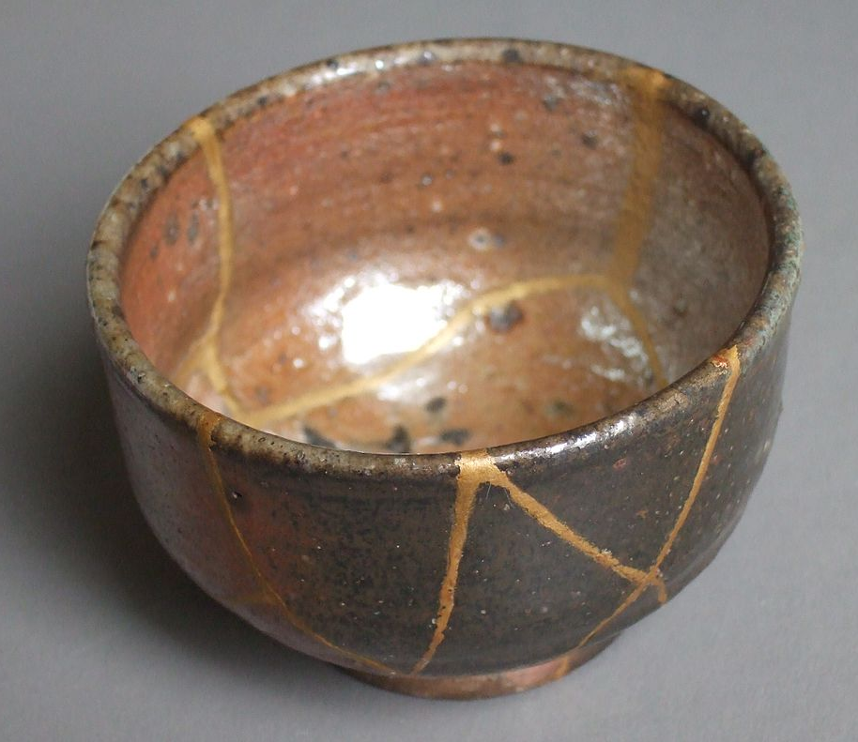
Warm Up
What questions could you ask about these objects?
Notes:
Teacher’s Notes
Display this on the screen/board as students enter the classroom so that they can begin straight away, leaving space for the date and title if they are writing their answer in their books.

Slide 2
Warm Up: Kintsugi
Does this answer your questions?
Kintsugi is when broken objects such as bowls, teapots and cups are repaired using gold and lacquer.
It is a way of making broken things beautiful and useful again. In many cases, the repairs even enhance the appearance of the object.

Slide 3
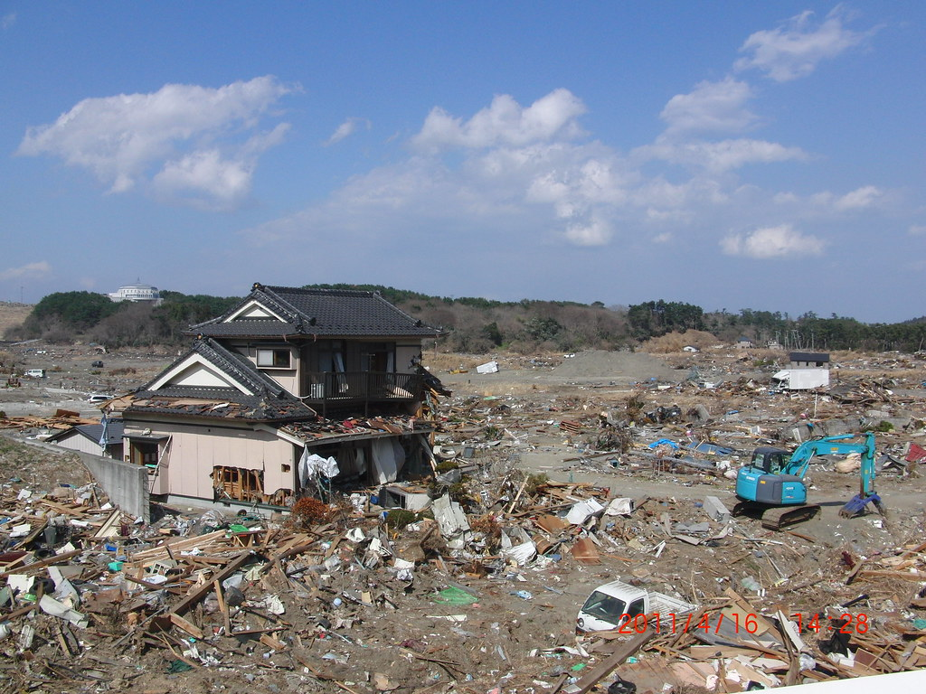
The Tohoku
Earthquake and Tsunami
(continued)
Your Learning Objectives:
Outline how an earthquake can cause a tsunami.
Illustrate the sequence of events of the Eastern Japan Great Earthquake Disaster.
Describe the effects of the tsunami on the Tohoku region.

Slide 4
Starter
What were the long term impacts of the disaster on the survivors?
How can social projects like this orchestra help?
4
Notes:
Teacher’s Notes
Click the image to go to clip on vimeo https://vimeo.com/521457476/ed672947cf
Explain that the orchestra was set up by Panos Karan, a Greek pianist and president of the charity Keys of Change, which aims to bring hope to children through music (or show clip ‘9:20 – ‘11:30)
Show the first ‘2:30 as members share some of the benefits of the orchestra. (Time depending, also listen to students talking about their experiences of the earthquake and tsunami between ‘2:30 and ‘7:08. The video goes on to explain further how the orchestra was set up and the impact it has had). Students can write down their answers to these questions, or they can be discussed.
Answers could include:
Music can offer comfort and support at difficult times
The orchestra brings people together – connected through music
This project gives people hope for the future
The young people are bringing joy to the audience

Slide 5
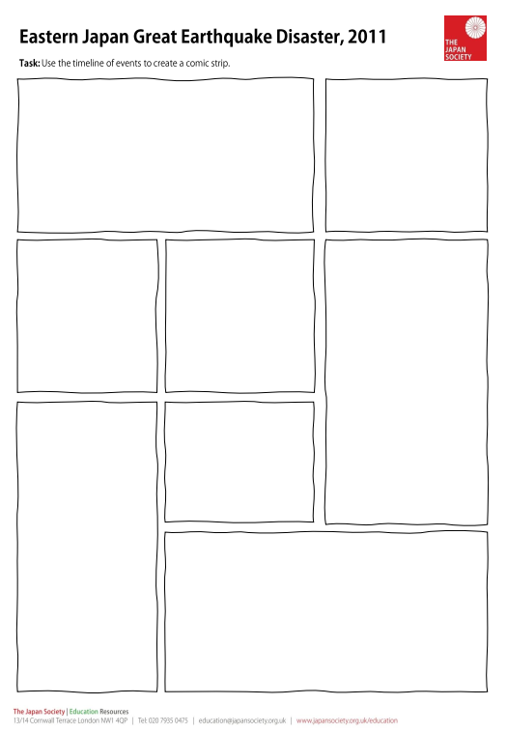
Task 1: Using Manga
Continue working on your own manga to tell the story of the 2011 Tohoku earthquake and tsunami.
Your aim is to educate people about the disaster and what caused it.
Use drawings to show the events and add in text boxes to give more detail.
Try to include specific details and data in the text boxes. Use the timeline to help you.

Slide 6
Extension
Your work has focussed on the causes of the tsunami and its immediate and short term effects.
Add a section to look at the long term effects and some of the responses. Think about the impacts on the survivors and issues such as the radiation from the destroyed nuclear power plant.
Use the blog entry to gather more details.
Notes:
Teacher’s Note
The blog began as a series of emails from Anne Kaneko to her family and friends in the UK and developed into a three year account of the disaster.
The final entry ‘Over and Out’ gives a useful overview which students could read and use to inform their work. See the worksheet for an edited version.
The full account and rest of the blog can be found here: http://annekaneko.blogspot.com/

Slide 7
Plenary: Gallery
Display your work around the classroom.
Have a look at everyone else’s work. Have a think about what was done well and what you could do better. If you notice something good about someone else’s work, make sure you let them know!
Go back to your work. Write one thing that you think you did well and one thing you could do to improve your work further.
Some ideas to consider:
Does your work clearly show the start of the disaster and the aftermath?
Have you used data (numbers) in your captions?
Are your drawings clear?
Would adding more colour help to make your drawings clearer?

Slide 8
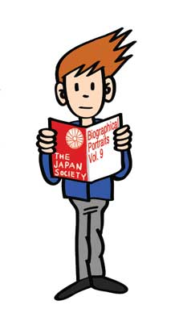
This resource was authored by Katie Holmberg in collaboration with the Japan Society
The Japan Society 13/14 Cornwall Terrace, London NW1 4QP
Tel: 020 7935 0475
Email: education@japansociety.org.uk
www.japansociety.org.uk
Follow us on:
@japansocietylon
@JapanSocietyLondon

