Slide 1
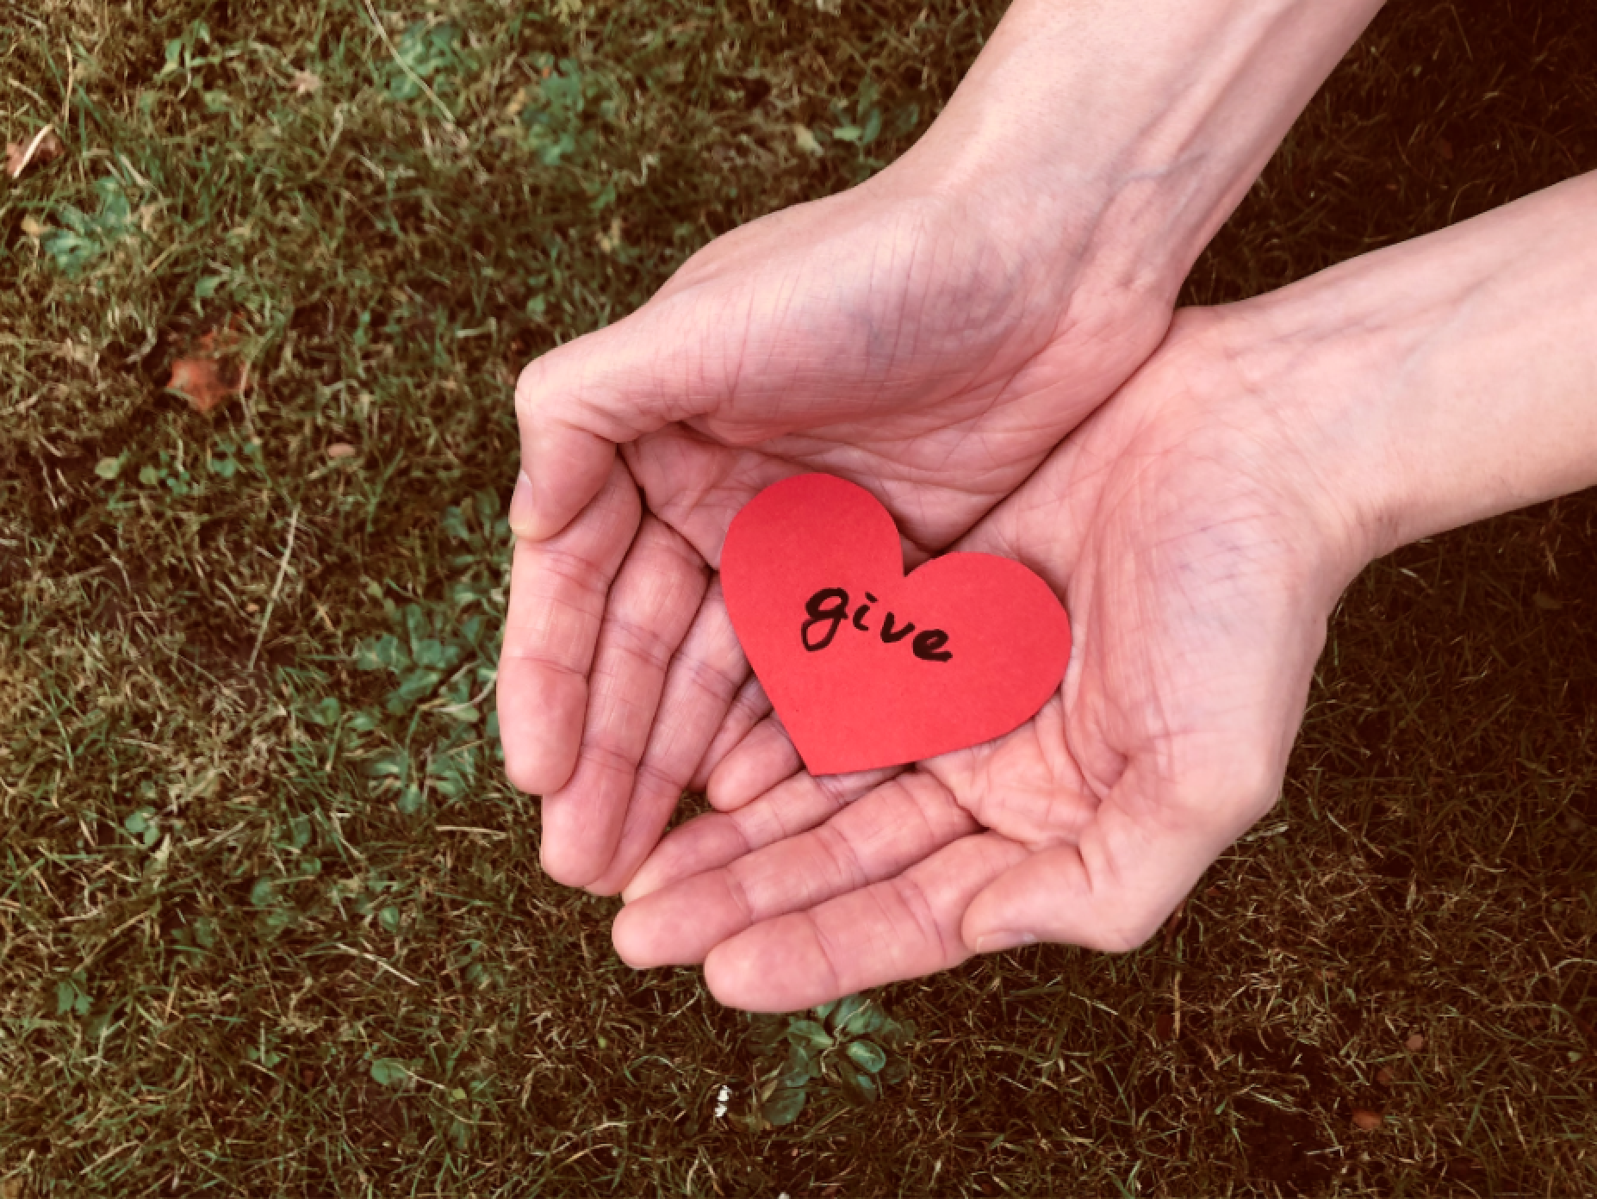
Giving to Others
Notes:
Theme: Exploring the links between giving to others and positive wellbeing through the customs and culture of Japan.

Slide 2
Learning Objectives
I can identify different ways of giving
I can create a ‘Thank you’ card for someone
I can consider why giving can improve wellbeing

Slide 3
Think, pair, share…
1. What kinds of things can we give?
2. Why do people give to others?
©Yasufumi Nishi/©JNTO
Notes:
Teacher’s Notes
Feedback from the class re. what they have discussed
Emphasise that giving does not have to be a physical gift, there are many ways to give.
Draw out answers that focus on giving thanks and showing appreciation.

Slide 4
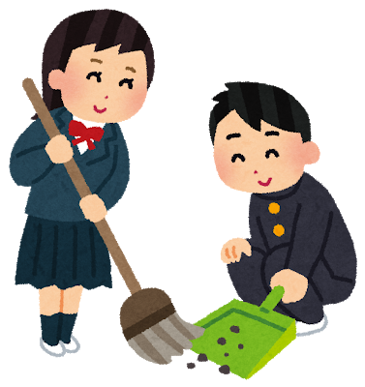
Giving in Japan
Watch the video and then answer the questions…
1. How do children in Japan give to others?
2. Why does the teacher think it is important?
3. How does it make the pupils feel?
4. Did anyone hear how to say ‘thank you’ in Japanese?
Notes:
Teacher’s notes – Students should watch the following video and then discuss the questions as a class.
Japanese Students Clean Classrooms To Learn Life Skills – YouTube
Alternative for a longer task is to complete the worksheet. Some students may also find the structure of the worksheet helpful… the video can be paused as they complete parts of the worksheet if they would find this more helpful than watching it all in one go.
Answers to questions on the slide are below. Answers to the questions on the worksheet are provided in the pack.
Cleaning their school and serving each other lunch
Builds self-confidence and prepare the students for adult life
Happy
Arigato – see next slide

Slide 5
Arigato
ありがとう
How do you feel when someone says
thank you?
Notes:
Practice saying it together ☺
Take feedback from class. Draw out answers around feeling valued, respected and appreciated.
Emphasise importance of saying thank you.

Slide 6
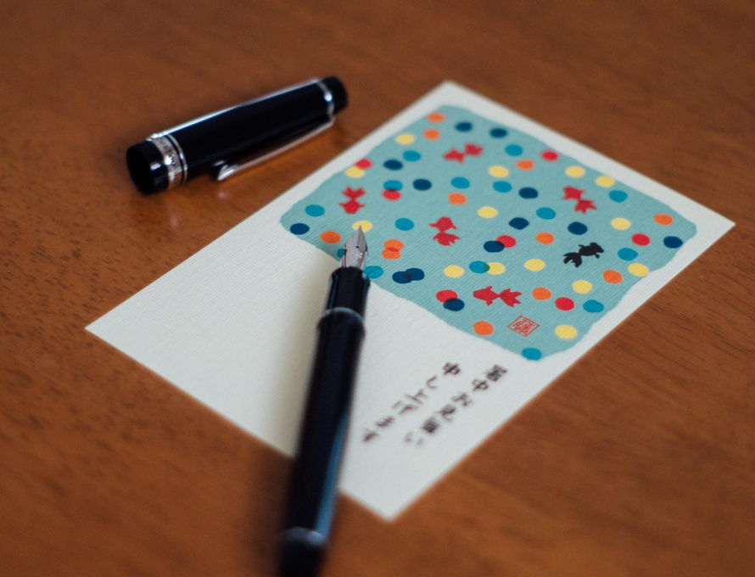
Thinking of others
This is a postcard called shochu-mimai.
Cards like this are sent to friends in the summer.
Notes:
Teacher’s Note
Shochu mimai (pronounced: show-chew me-my)
Japan is very hot and humid in the summer so this greetings card is sent in the height of summer to friends and family to wish them well.
This tradition isn’t as popular nowadays and not everyone will send shochu-mimai.
Ask students if they have ever sent or received a postcard. How did they feel if so?
1 minute explanation for teachers (in Japanese with English subtitles):
https://www.youtube.com/watch?v=IZTf9qdMHhU

Slide 7
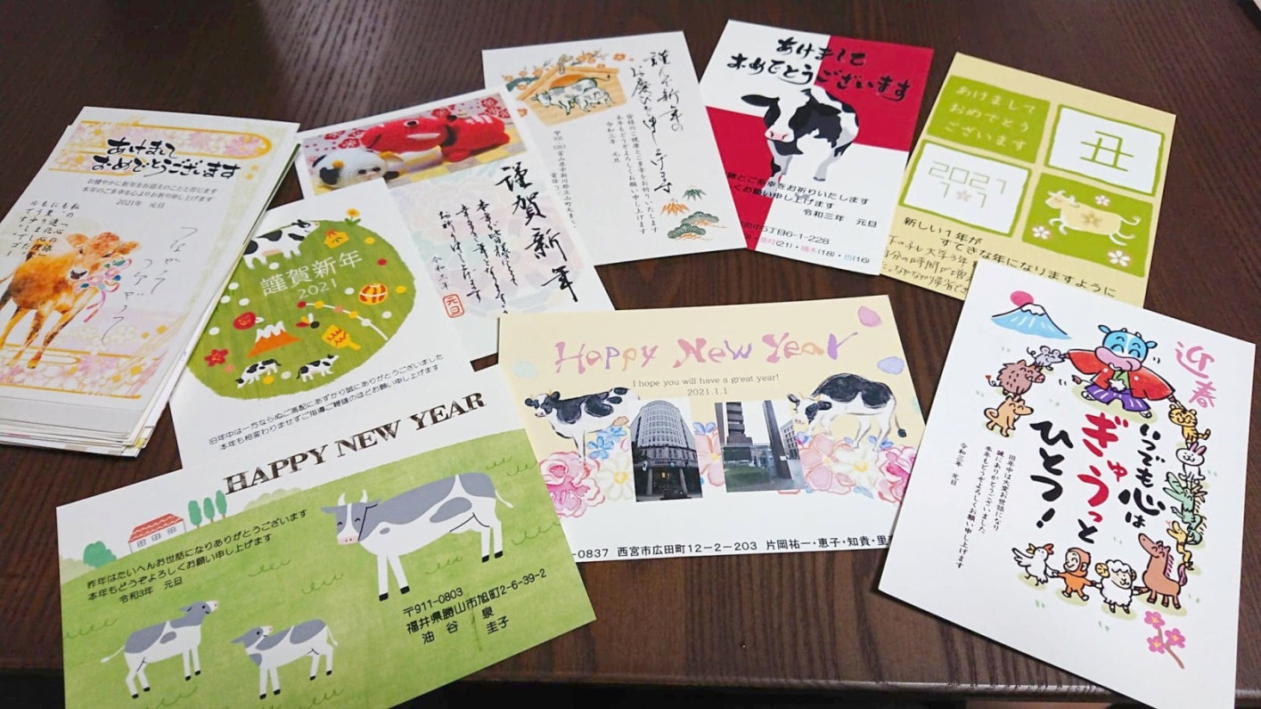
Thinking of others
At New Year’s people send cards called nengajo to friends and family who have helped them through the year.
Notes:
Teacher’s Note
Nengajo (pronounced: nen-gah-joe)
In Japan New Year is the most important festival and so sending and receiving these cards is really special and important.
They are like thank you cards. Ask students if they can think of a similar tradition in the UK or their own culture.
Ask students if they have received cards for a celebration (e.g. Christmas, Chinese New Year or Eid) How did they feel?
More information on nengajo for teachers: https://savvytokyo.com/need-know-japans-nengajo-new-years-cards/

Slide 8
Thank you cards
A thank you card is a type of giving.
Think of a friend or person in your family who has done something kind or helpful for you.
You are going to make them something special.
Notes:
Teacher’s Note
Students should include:
What you are thanking them for
How you felt when they helped you
Different options (structured templates and blank card templates) are available to be printed beforehand – see resources.
This task can be adapted depending on the time of year and what best suits the class i.e. you can theme it as a new year card or a summer greetings card if you prefer.

Slide 9
Template Letter
Dear ______,
I am writing to thank you for_________.
When you helped me/gave me ______ I felt ____________.
It meant a lot to me because________________________ .
Thank you again.
Best wishes from ______________________ .
Notes:
Teacher’s Note
You may wish to show this template slide on the screen.
See the resources for a alternative templates to print which students can fill in or use as a draft.
Alternatively, this slide can be hidden.

Slide 10
Reflection
Why do you think giving to others is good for wellbeing?
What could you do this week to help someone else?
Notes:
Ask students to identify which of the 5 Ways to Wellbeing they have been practising.
Not just about giving gifts and presents but about doing things to help other people.
Giving is important to our wellbeing because:
Acts of giving and kindness create positive feelings and a sense of reward.
Doing something for someone else gives us you a feeling of purpose and makes us feel good about ourselves.
When we help or give to others, we connect with them too and build a better relationship.
Giving makes us feel good too.

Slide 11
Wellbeing in school
Teachers should use this slide to signpost to any provision they have in school i.e. school counsellor, worry box, teachers etc.
Whilst it is normal for us to have ups and down, if pupils are feeling sad and the feeling does not go away then they should talk to someone they trust.

Slide 12
Extension Activities
Write a thank you letter for a friend or family member and fold it into a origami envelope.
Make an origami rabbit or heart for a friend or family member.
Notes:
Teacher’s Note
Video links available below. Printable instructions can be found in the lesson resources.
Fold a letter into a secret message envelope video: https://www.youtube.com/watch?v=Z1jhIf8Kop4
Make an Origami Rabbit video: https://www.youtube.com/watch?v=67ExD6FlYQs&t=2s

Slide 13
This resource was designed by Kimberley Evans in collaboration with the Japan Society.
The Japan Society 13/14 Cornwall Terrace, London NW1 4QP
Tel: 020 7935 0475
Email: education@japansociety.org.uk
www.japansociety.org.uk
Follow us on:
@japansocietylon
@JapanSocietyLondon

