Slide 1
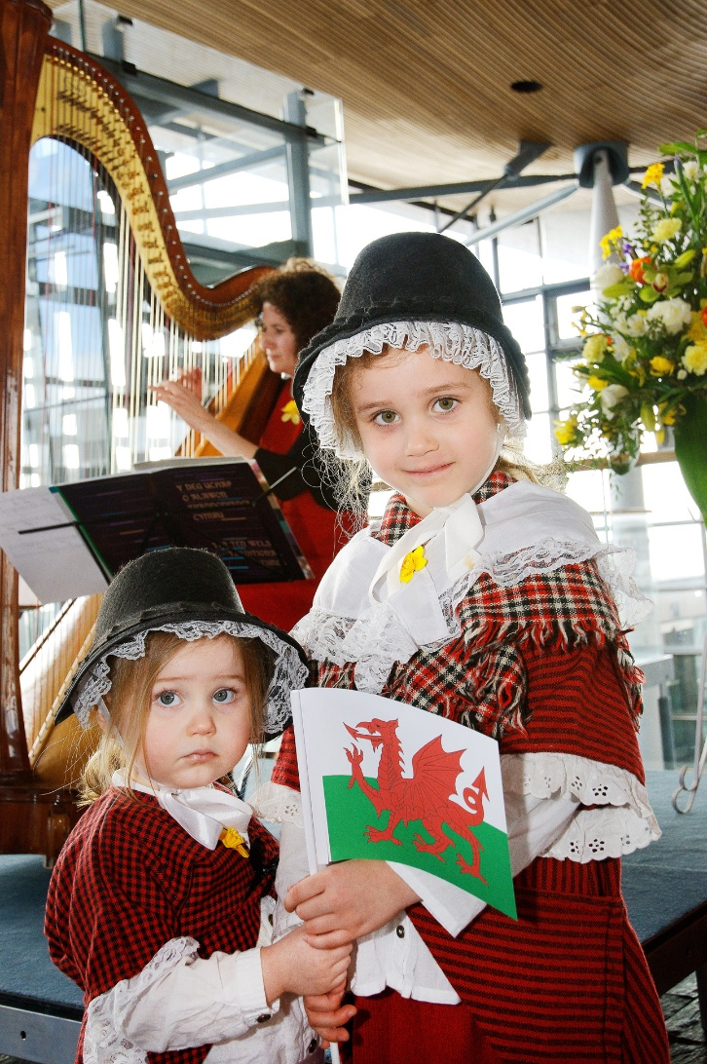
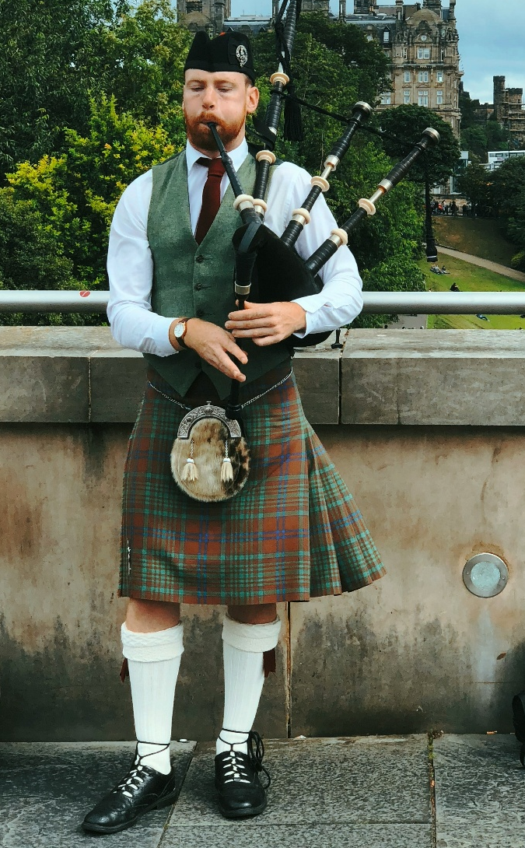

Starter
What do you notice about these pictures?
Images L-R: National Assembly for Wales from Wales, CC BY 2.0, via Wikimedia Commons;
Photo by Jon Tyson via Unsplash
Notes:
Teacher’s Notes
Show pupils the image on the slide and ask them the questions below to prompt discussion about the topic of today’s lesson: kimono! Before revealing the next slide, ask pupils if they
1. What do you notice about these pictures?
2. Do they have anything in common?
After taking some answers from the class, reveal these are examples of traditional dress. Do pupils know where these are from? Do pupils know any other types of traditional clothing?

Slide 2
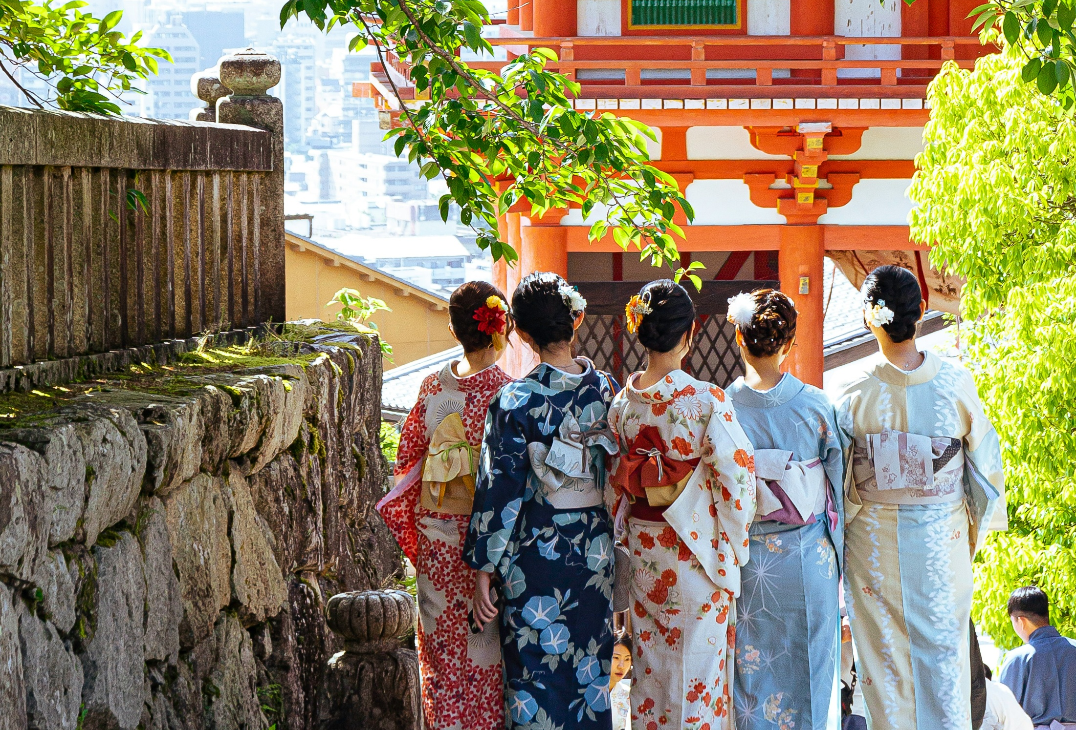
Kimono
Photo by Elena Di Lecce on Unsplash
Notes:
Teacher’s Notes
Introduce the topic of today’s lesson.

Slide 3
Learning Objectives
To understand what kimono are, and why they are important in Japanese culture.
To understand what kimono designs and patterns represent and symbolise.
To design my own seasonal kimono pattern using cultural symbols and motifs.
© The Japan Society 2026
Notes:
Teacher’s Notes
Introduce the Learning Objectives.

Slide 4
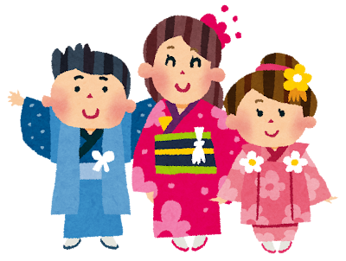
Key Words
Kimono
Obi
Traditional
Pattern
Motif
Geta and zori
Yukata
© The Japan Society 2026
Notes:
Teacher’s Notes
Introduce this lesson’s key words – pupils will learn about the unfamiliar ones later in the lesson.
Illustration from Irasutoya.

Slide 5
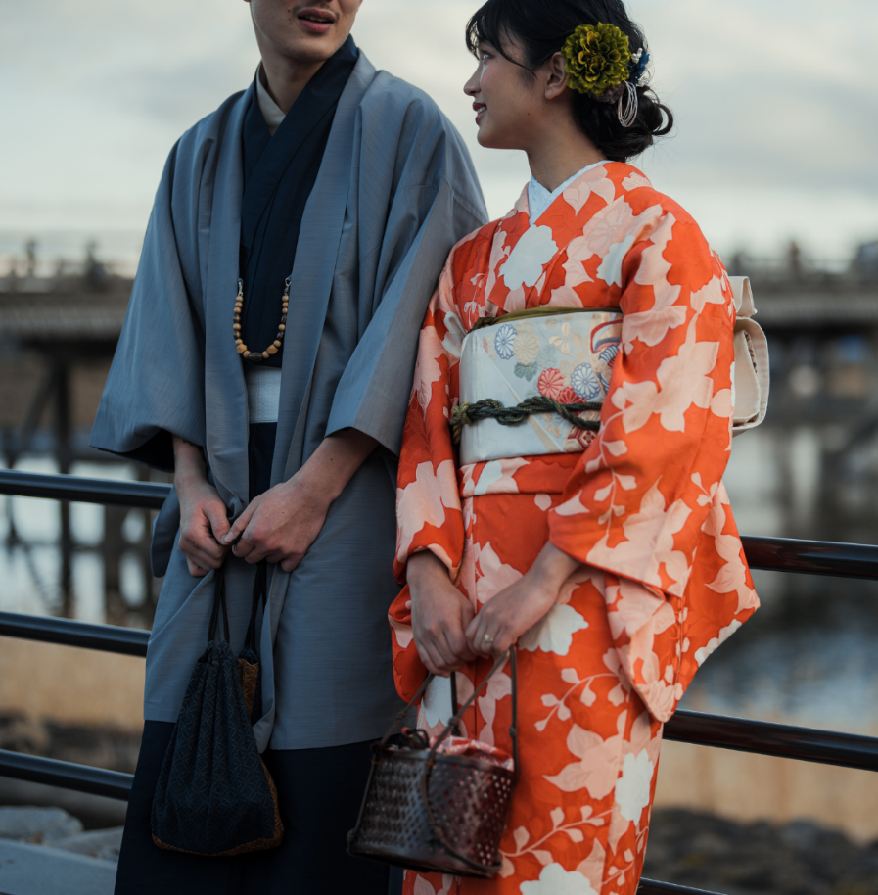
Kimono 着物
Kimono means “thing to wear” in Japanese.
It’s a traditional type of Japanese clothing, worn by both men and women.
Kimono is the national dress of Japan.
Look at the photo: what similarities and differences can you spot between the man and woman’s kimono?
© The Japan Society 2026
Notes:
Teacher’s Notes
Click on the slide to reveal the bullet points. Pupils may already know what kimono are or were able to guess what they were from the starter activity. Kimono is considered to be Japan’s national dress; do pupils know what the national dress/clothing is for other countries?
Ask pupils to look at the photo on the slide and briefly discuss with a partner/as a class the similarities and differences that they notice between the two kimono. This will be further explored in the video.

Slide 6
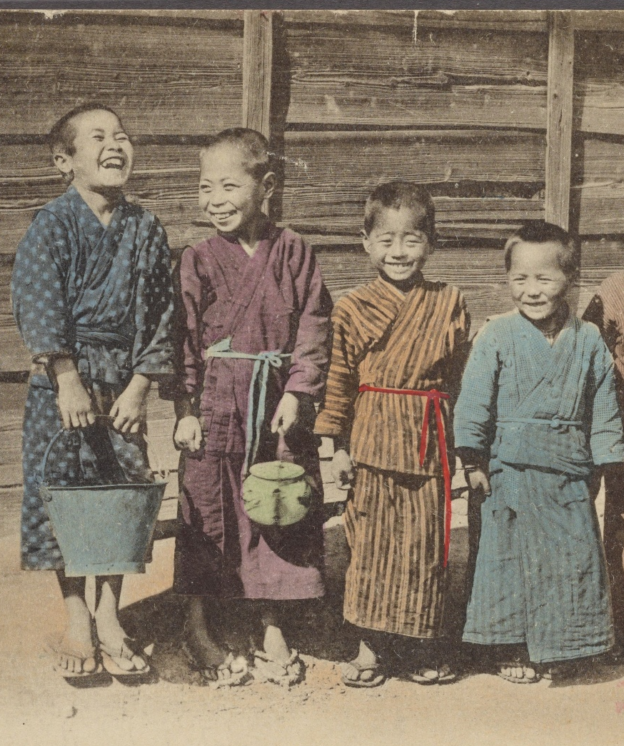
Kimono
Historically, kimono were worn in Japan as everyday clothing.
Nowadays, they are only worn for special and formal occasions.
Image: The Miriam and Ira D. Wallach Division of Art, Prints and Photographs: Picture Collection, The New York Public Library. "Japanese boys in (Kodomo) country." The New York Public Library Digital Collections. 1913.
Notes:
Teacher’s Notes
Look at the image of the historical kimono in comparison to the modern kimono. Is there much difference between the two? For what special occasions do you think people wear kimono for in Japan?
Image: https://digitalcollections.nypl.org/items/fc62a0c0-c5d1-012f-a111-58d385a7bc34

Slide 7
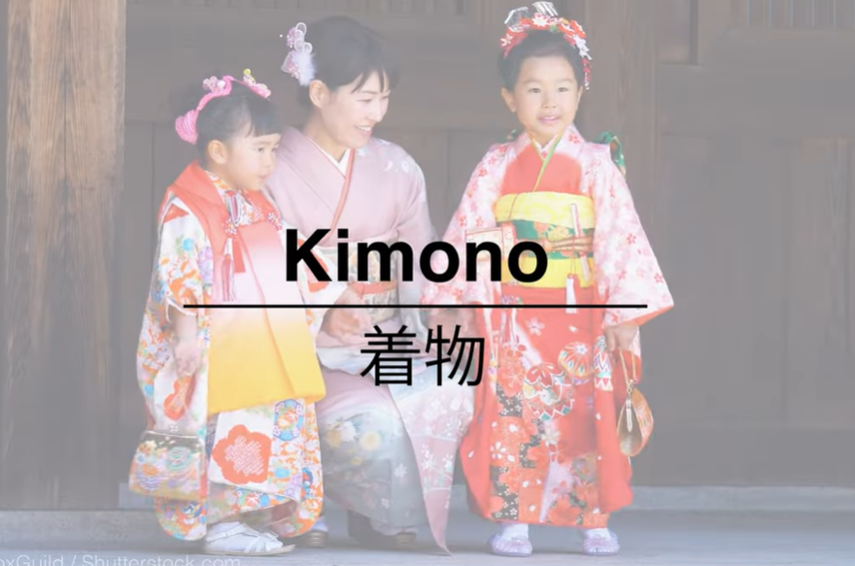
Video
Let’s discover more! Watch the video:
Activity: Fill in the worksheet as you watch the video.
© The Japan Society 2026
Notes:
Teacher’s Notes
Click on the hyperlinked text, image or paste the link below into your browser to watch the Kimono video (approx. 4 mins). Watch the video once and, if you choose to do so, ask pupils to answer the questions on the worksheet the second time they watch the video. The following slides in the PowerPoint will go over the content in the video in further detail. After watching the video, ask pupils for their thoughts: what would it be like to wear a kimono? Do they look comfortable to wear or heavy? Do you think they are practical or impractical? Would they like to try wearing one? etc.
https://www.youtube.com/watch?v=LWTew56lQTo

Slide 8
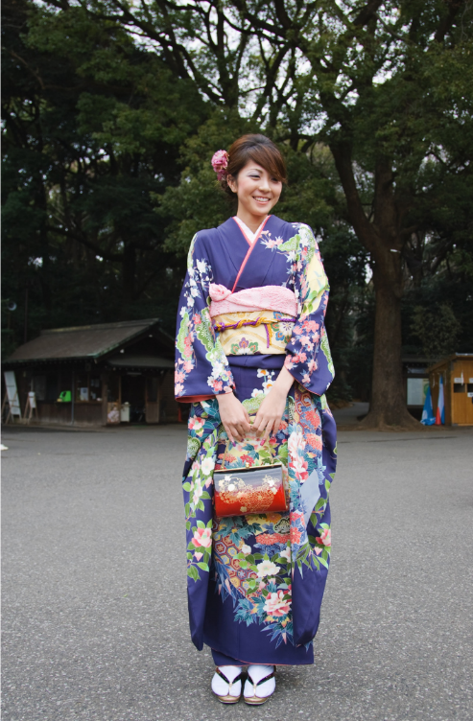
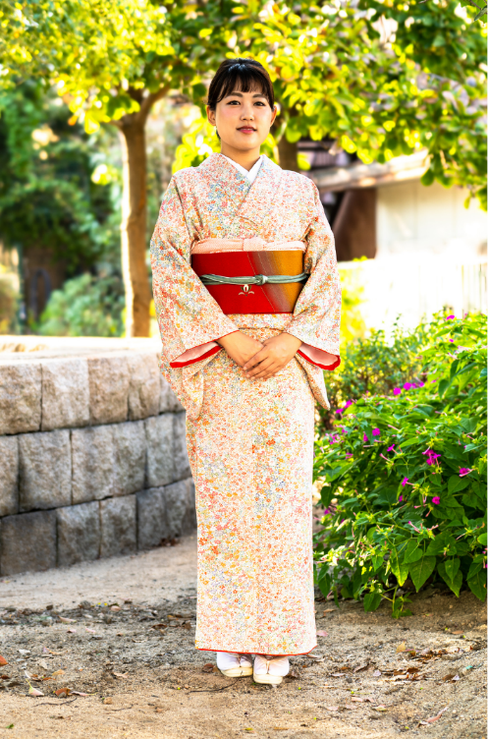
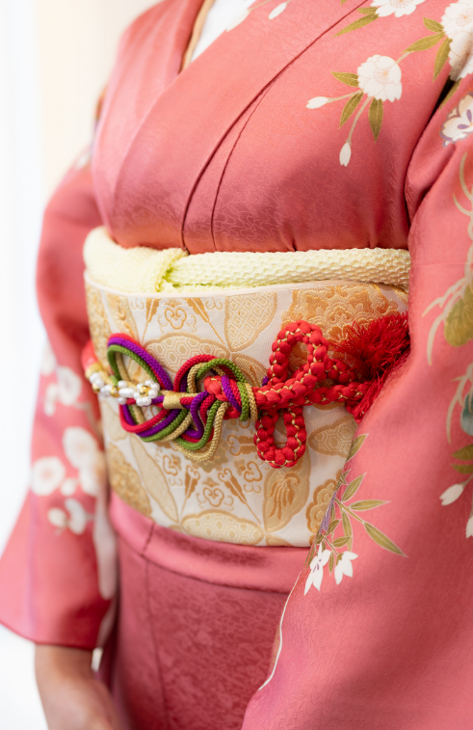
Women’s kimono
Women’s kimono are typically colourful and have detailed patterns.
© The Japan Society 2026
Notes:
Teacher’s Notes
As mentioned in the video, typically, women’s kimono tend to be much more colourful and have detailed and intricate patterns and designs, and are worn with various accessories. What do pupils notice about the kimono in the images here?

Slide 9
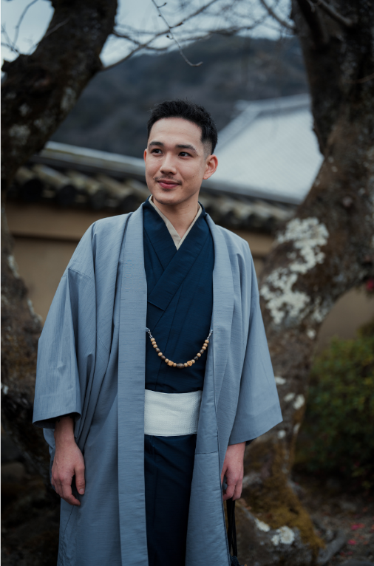
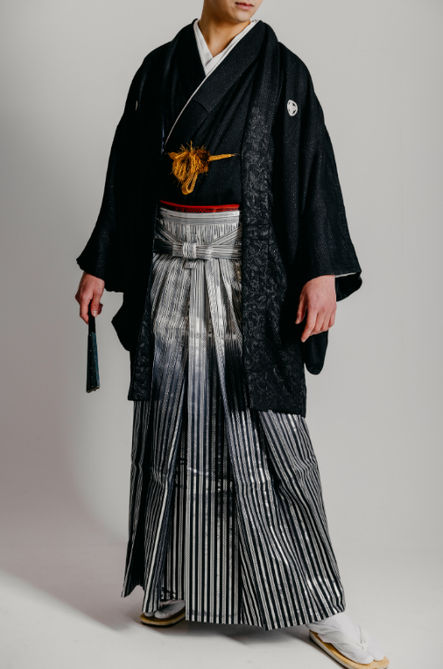
Men’s kimono
Typically, men’s kimono are not as colourful, and tend to have simpler patterns and designs.
© The Japan Society 2026
Notes:
Teacher’s Notes
In contrast, men’s kimono have simpler patterns and designs, and tend to be darker in colour. Interestingly, the kimono on the right is actually a men’s wedding kimono! What do pupil’s notice about the images of these kimono?

Slide 10
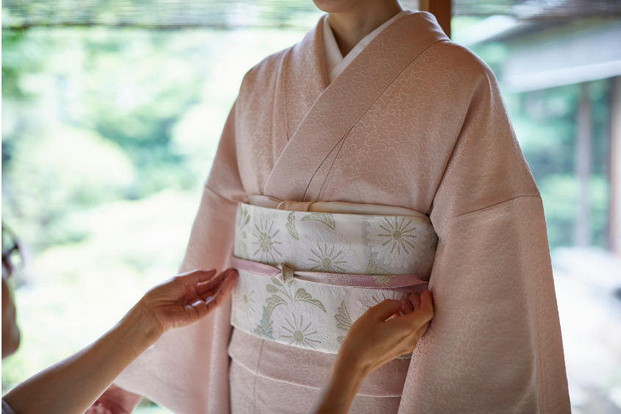
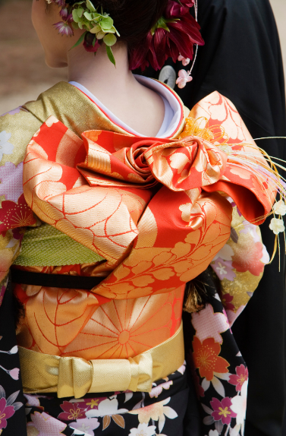
Obi
A kimono can be easily adjusted and tied using strings, so that they can fit different people.
The kimono is held together with the obi belt, which is put on last.
© The Japan Society 2026
Notes:
Teacher’s Notes
As noted in the video, kimono are interesting pieces of clothing, as they have no zips or buttons. Kimono can be adjusted to fit different sizes by using strings to tighten and fasten. The obi is the most important component, as it helps to hold the kimono in place. Obi can be tied into all sorts of interesting shapes and styles: the image on the right shows a particularly intricate and decorative obi, that has been tied to look like a bow.

Slide 11
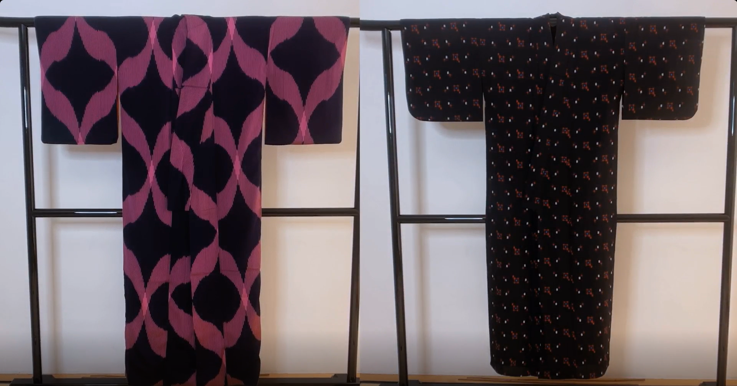
Kimono
In the video, the narrator explains how kimono all have the same basic shape.
How would you describe the shape of a kimono?
© The Japan Society 2026
Notes:
Teacher’s Notes
This is what a kimono looks like, before it has been put on and fastened with strings and the obi. Also note that a kimono is always wrapped with the left side over the right side – you can refer back to previous pictures to check this. Ask pupils to consider how they would describe the shape of these kimono seen in the video. They might say it looks like a T-shape, or come up with their own ideas instead.

Slide 12
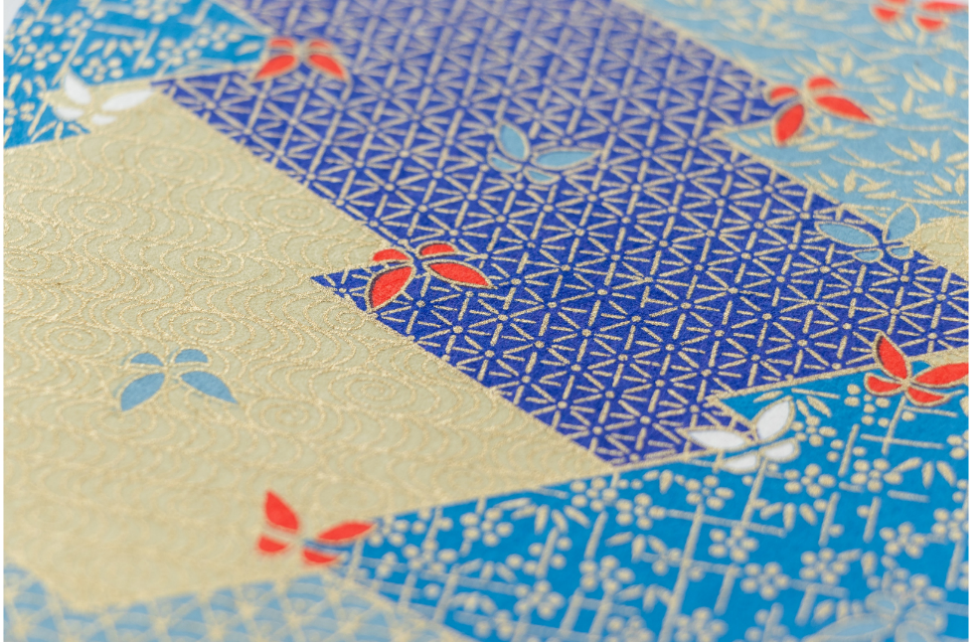
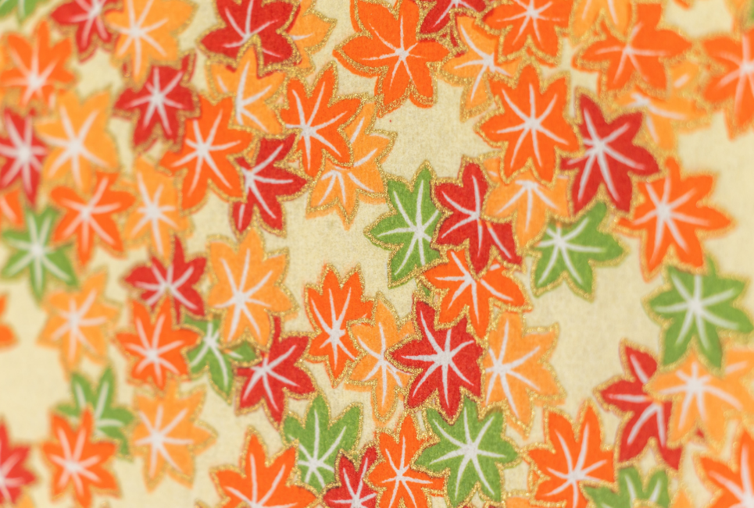
Seasonal Patterns
Different kimono are worn depending on the season.
Look at the kimono patterns above.
What seasons do you think they represent?
© The Japan Society 2026
Notes:
Teacher’s Notes
As mentioned in the video, different kimono are worn depending on the season. Spring and summer tend to be lighter in colour, and winter kimono tend to be darker. Ask pupils to look at the patterns on the slide: what seasons do they think they represent? Look at the shapes, colours, and seasonal motifs featured in each pattern.

Slide 13
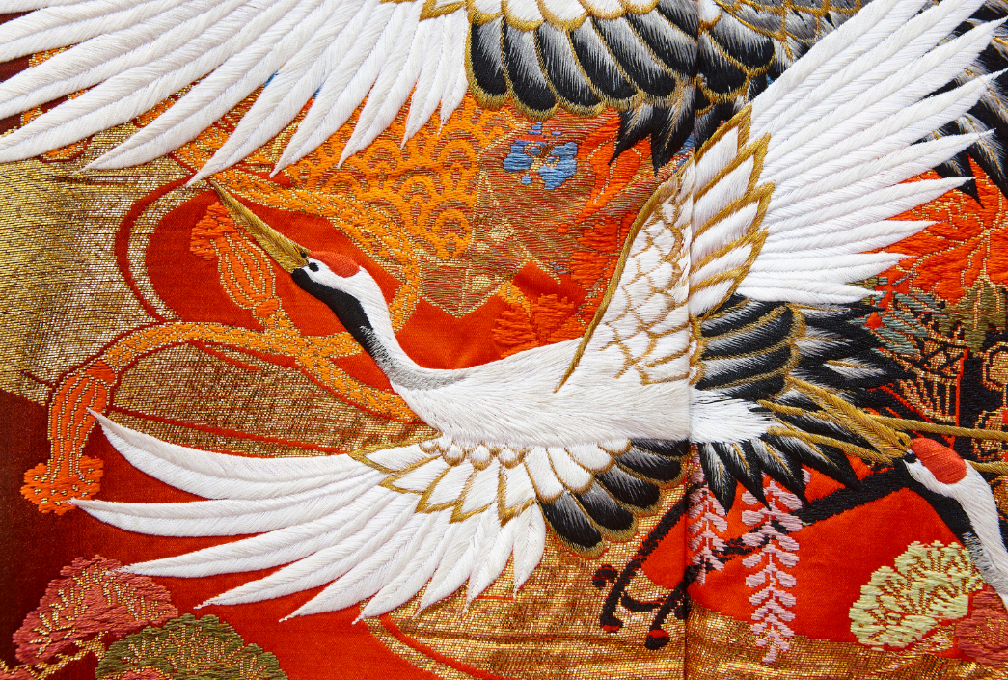
Patterns and Motifs
Kimono patterns will also often include symbolic motifs. For example, do you know what this bird is and what it symbolises?
In Japan, cranes symbolise luck and longevity (living a long life).
© The Japan Society 2026
Notes:
Teacher’s Notes
Some kimono feature symbolic and intricate motifs, including flowers and animals. You may have also noticed some in the video or on some of the images in this PowerPoint. Ask pupils if they know what the bird on this kimono is, and what they think it might symbolise in Japanese culture.

Slide 14
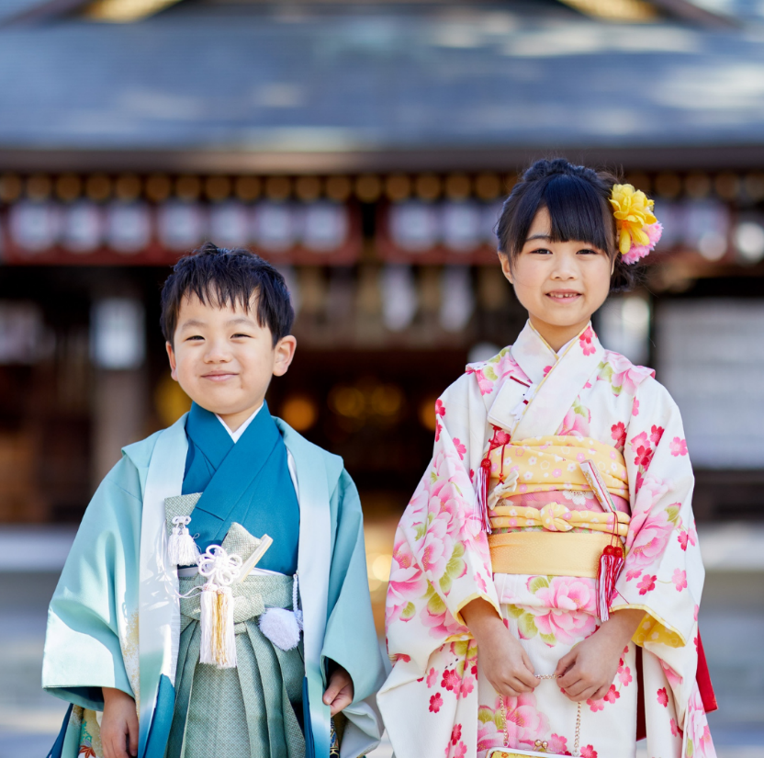
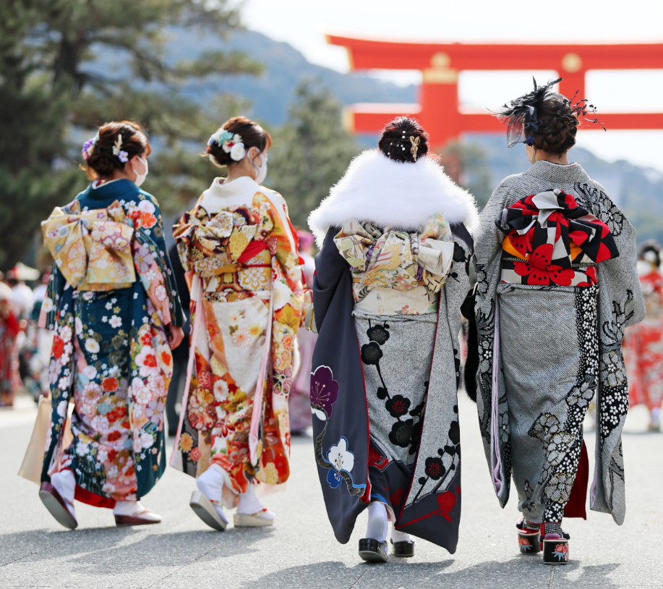
Special occasions
Shichi-Go-San
(ages 7-5-3)
Coming of Age ceremony
(age 20)
© The Japan Society 2026
Notes:
Teacher’s Notes
Here are some typical kimono that are worn for special occasions in Japan.
The children on the left are wearing special kimono for Shichi-Go-San; a festival that celebrates children who are 7, 5, and 3 years old.
The women on the right are wearing furisode for their Coming of Age ceremony; in Japan, it is believed that a person becomes an adult when they turn 20 years old! Furisode have long sleeves, and are worn by unmarried women. When a woman gets married, her furisode sleeves are cut, to symbolise her marriage status.
Shichi-Go-San takes places in November, and the Coming of Age ceremony in Japan takes place in January, so pupils may notice that both kimono styles look more suited to be worn in winter/colder seasons.

Slide 15
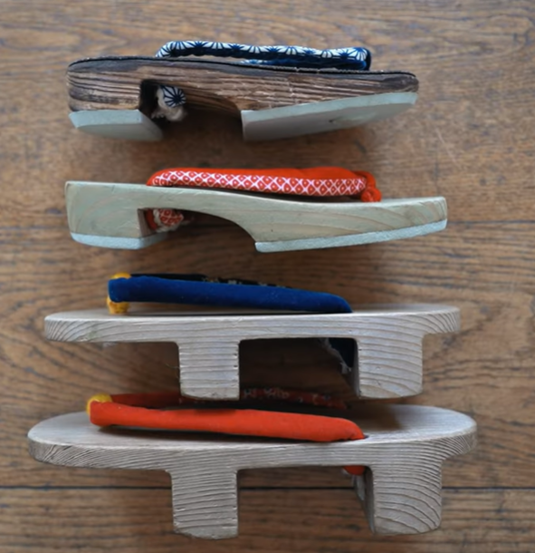
Geta and Zori
Kimono are worn with traditional shoes, known as geta and zori.
© The Japan Society 2026
Notes:
Teacher’s Notes
Geta (bottom) and zori (top) are typically worn with kimono. Do pupils remember which are which from the video?

Slide 16
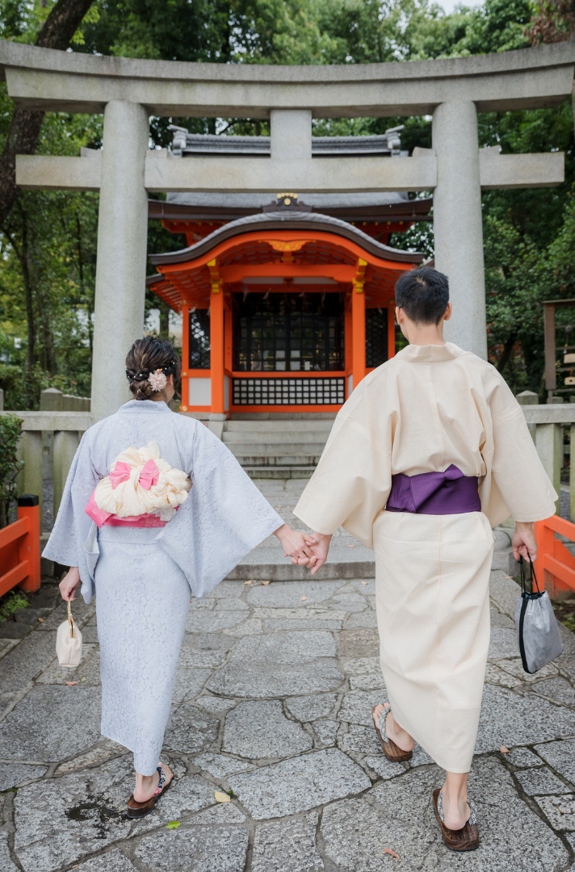
Yukata
Historically, yukata were traditionally worn as bathrobes!
Nowadays, people wear them as a casual kimono during the summer time.
© The Japan Society 2026
Notes:
Teacher’s Notes
Interestingly, yukata were traditionally worn as bathrobes; when people would visit public bath houses, they would wear yukata. Nowadays, people generally tend to wear yukata in the summer months; they are usually made with linen or cotton, making them cool to wear during the summer months. Many people like to wear yukata to summer festivals (matsuri) in Japan. Yukata are more casual and do not tend to have such intricate designs. Even though they are more casual in style, they are not typically worn as everyday clothing.

Slide 17
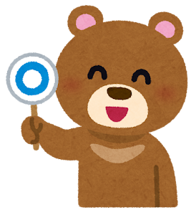
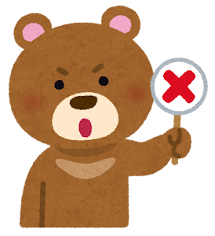
Maru-Batsu Quiz
Let’s see how much you can remember about kimono from today’s lesson with a quiz!
If you think the statement is true, make a maru (circle)!
If you think the statement is false, make a batsu (cross)!
© The Japan Society 2026
Notes:
Teacher’s Notes
Let’s re-cap today’s lesson with a Maru-Batsu (true or false) quiz! Pupils can make a maru (circle)/batsu (cross) shape with their arms, or they could draw a circle and cross on either side of a mini whiteboard and use these to answer the questions. There are 5 questions in total.
Illustrations from Irasutoya.

Slide 18
Question 1
The word kimono means "thing to wear".
Maru – that’s true!
© The Japan Society 2026
Notes:
Teacher’s Notes
True! Remember, in Japanese, it is written “to wear” + “things”.
Illustration from Irasutoya.

Slide 19
Question 2
People in Japan wear kimono everyday – when they are going to work, school, or even the supermarket!
Batsu – that’s false!
© The Japan Society 2026
Notes:
Teacher’s Notes
False! Kimono are worn for special occasions only. Ask pupils if they can think of some special occasions when a person might wear a kimono.
Illustration from Irasutoya.

Slide 20
Question 3
All kimono have the same basic T-shape, adjusted with strings and fastened with a belt.
Maru – that’s true!
© The Japan Society 2026
Notes:
Teacher’s Notes
True! Don’t reveal the name of the belt yet, as this will be asked in the last question!
Illustration from Irasutoya.

Slide 21
Question 4
The patterns on kimono can represent different seasons.
Maru – that’s true!
© The Japan Society 2026
Notes:
Teacher’s Notes
True! Typically, different types of kimono are worn for different seasons.
Illustration from Irasutoya.

Slide 22
Question 5
Kimono are fastened with belts called geta.
Batsu – that’s false!
© The Japan Society 2026
Notes:
Teacher’s Notes
False! Can pupils remember the name of the belt worn with a kimono? And what are geta?
Illustration from Irasutoya.

Slide 23
End of Quiz
How much did you remember about kimono?!
© The Japan Society 2026
Notes:
Teacher’s Notes
Illustration from Irasutoya.

Slide 24
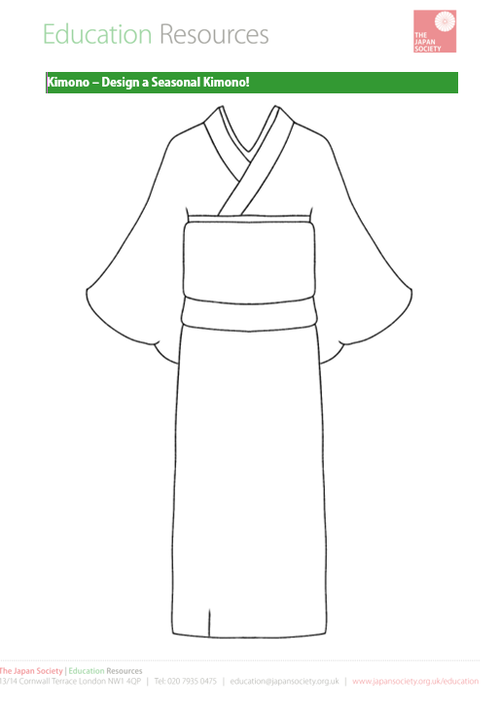
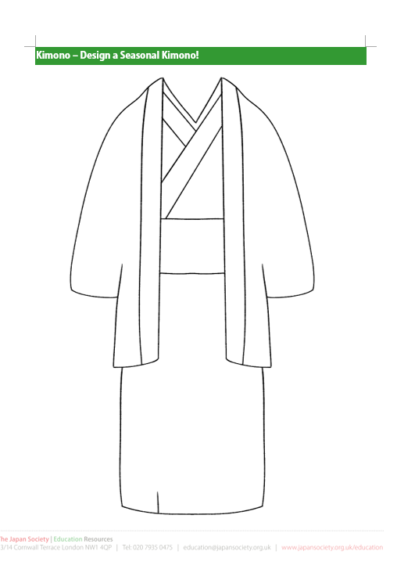
Activity 1
Using the worksheet, you are now going to design your own seasonal kimono!
Your design must include a pattern or motif that represents one of the four seasons.
© The Japan Society 2026
Notes:
Teacher’s Notes
Hand out the worksheet template. The purpose of this activity is for pupils to design their own kimono incorporating an symbol or motif that is associated with a particular season; it does not need to be inherently related to Japan and Japanese culture. For example, for spring, you could design a kimono with a tulip-inspired pattern, or for autumn, you could design a kimono with a pumpkin motif. You could brainstorm some ideas together as a class before beginning the activity to think of different associations for each season. The slides at the end of this PPT also include some examples of kimono patterns that may be useful for you to use as a reference. If you plan to display these, you can prepare printed photos of the students faces so that they can “wear” their kimono designs!

Slide 25

Activity 2 – part 1
You are now going to design your own seasonal kimono pattern, using a square piece of paper!
Your pattern must include a motif that represents one of the four seasons.
Tip: Make sure your pattern or design fills most of the space.
Emojis designed by OpenMoji , License: CC BY-SA 4.0
Notes:
Teacher’s Notes
Hand out the square pieces of paper to pupils; we recommend using origami paper to make sure it is the right size (pupils can draw on the white side, any pre-printed patterns will become part of their design). Pupils can sketch out their initial idea before creating a “neat” version if you like.
The purpose of this activity is for pupils to design their own kimono incorporating an element or motif that is associated with a particular season; it does not need to be inherently related to Japan and Japanese culture. For example, a tulip-inspired pattern for spring, or pumpkin motif for autumn. You could brainstorm some ideas together as a class before beginning the activity to think of different associations for each season. The following slide shows an example of a Christmas tree design.

Slide 26
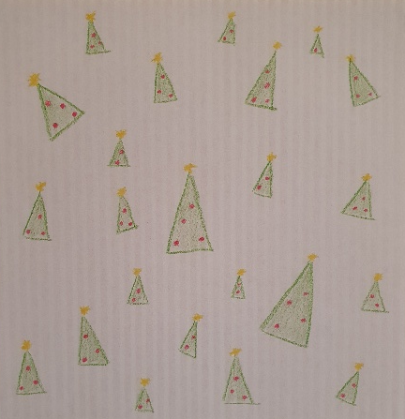
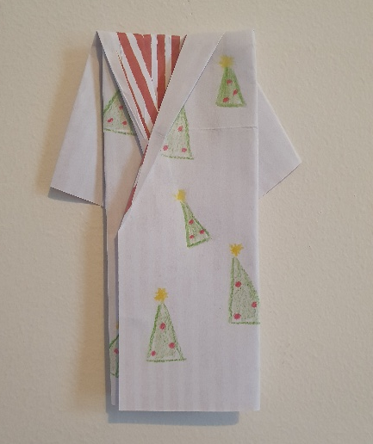
Activity 2 – part 2
Once you have finished designing your pattern, follow the folding instructions to create your own mini origami kimono!
Example
© The Japan Society 2026
Notes:
Teacher’s Notes
Using the instructions sheet, pupils will now fold their pattern to create a mini origami kimono. If you plan to display these, you can prepare printed photos of the students faces and stick the kimono underneath so that they can “wear” their designs!

Slide 27
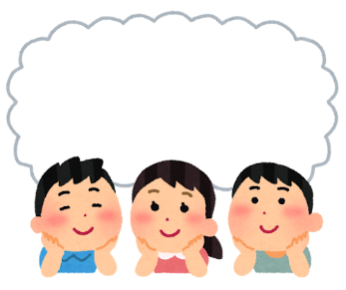
Reflection
Kimono are a ___________________ type of Japanese clothing.
People typically wear them for _________________ occasions.
The patterns and designs are different depending on the _____________________.
special
season
traditional
© The Japan Society 2026
Notes:
Teacher’s Notes
Ask pupils to discuss with a partner or as a class the answers to these fill-in-the-blank sentences.
Click on the slide to reveal the answers in order.
Illustration from Irasutoya.

Slide 28

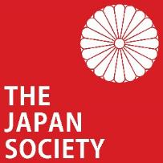
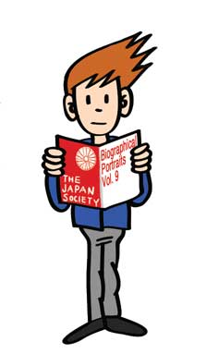




This resource was developed and created by
The Japan Society.
The Japan Society
13/14 Cornwall Terrace, London NW1 4QP
Tel: 020 7935 0475
Email: education@japansociety.org.uk
www.japansociety.org.uk
Follow us on social media:
@TheJapanSociety

