Slide 1
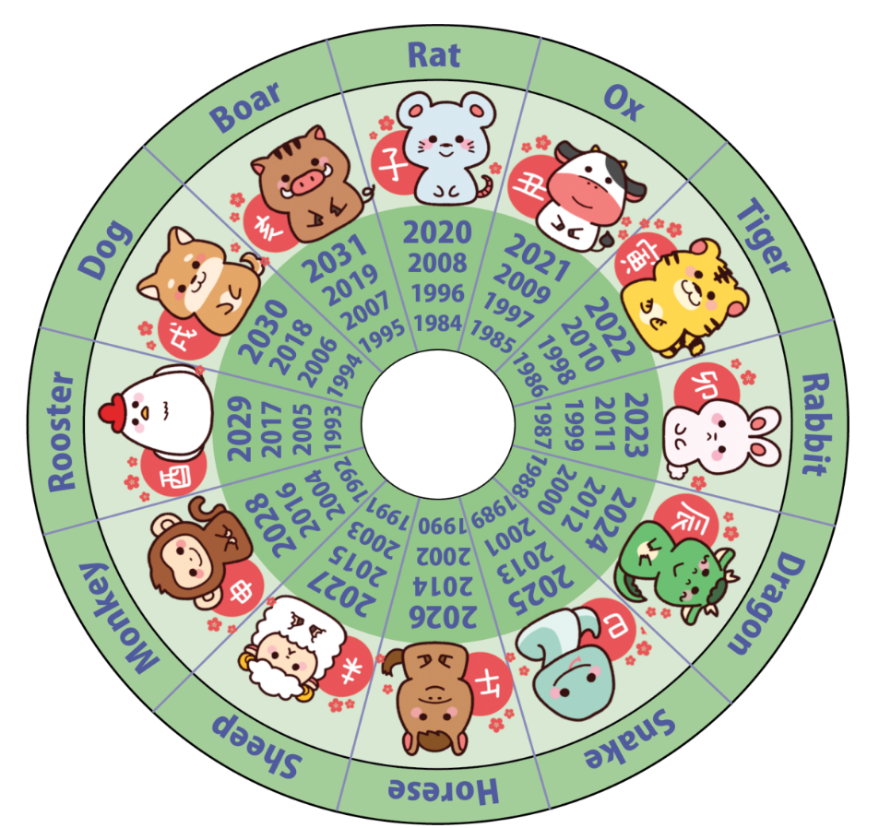

Warm Up: Zodiac Years
Rat : Honest, charming, ambitious.
Pig/boar : Brave, kind, honest.
Ox : patient, alert, successful.
Dog: Loyal, trustworthy, honest.
Tiger : stubborn, sensitive, courageous.
Rabbit : talented, ambitious, fortunate.
Rooster : Deep thinker, direct.
Monkey : Clever, original, problem solver.
Dragon : energetic, brave, stubborn.
Sheep : Elegant, passionate.
Snake : deep thinker, quiet, wise, determined.
Horse : Chatty, complimentary.
Notes:
Teacher’s Notes
As a warm up, ask students to use the zodiac calendar on the presentation to work out which animal is associated with the year of their birth. Do they think it matches their personality? What about for their siblings and friends?

Slide 2
Research information about animals found in Japan
Present our findings back to the class
Learning Objectives
Notes:
Teacher’s Notes
Introduce the Learning Objectives, explaining any key words as necessary. Ask pupils to share any facts they already know about the animals found in Japan.

Slide 3
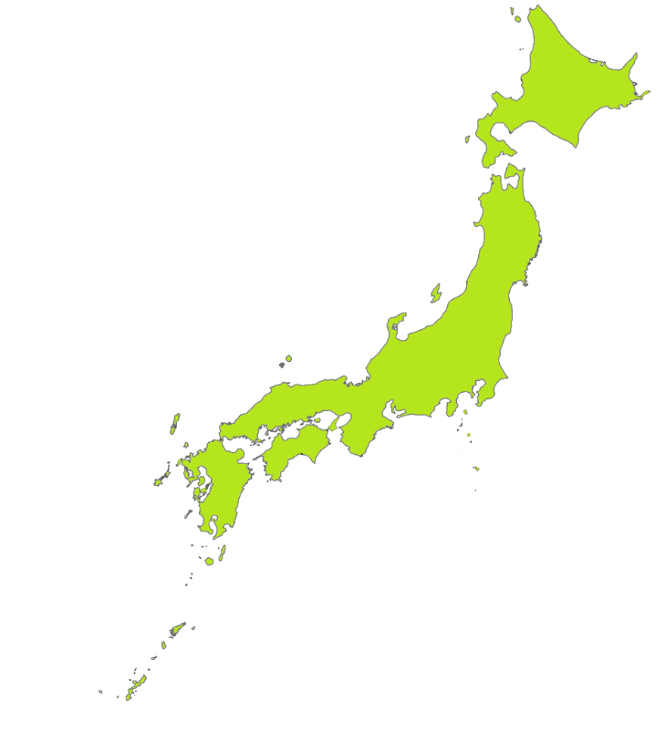




Notes:
Teacher’s Notes
Last week we explored the climate of Japan. We learned how this is affected by the geography of Japan, in particular the fact that Japan is a country made up of many islands that stretch for as much as 1,500 miles from north to south. We found out that the very north of Japan can be very cold and snowy, while the southern part of Japan can be very hot and tropical.
Today we are looking at the different types of animals found in Japan. KQ: Using our learning from last week, what predictions can you make about the animals that will be found across Japan?
Answer: the huge variety of climates found across Japan, as well as its isolation from mainland Asia means that the country has a high diversity of wildlife. Today we will learn about some of the incredible animals in Japan by exploring wildlife in five different areas: the north, mountains, rural areas, the sea and wetlands, and the subtropics.

Slide 4
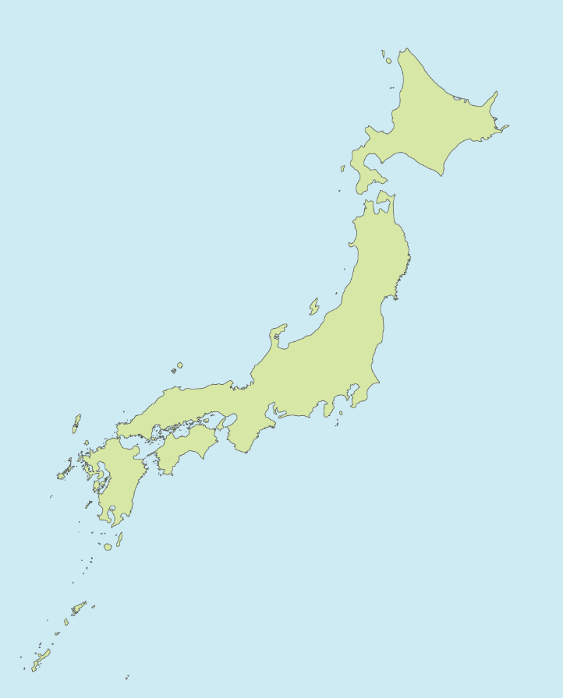

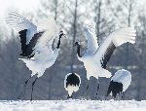
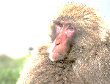
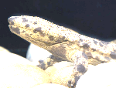
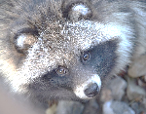
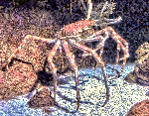
Task 1
Hokkaido Brown Bear
Look at these animals with a partner.
Can you guess where in Japan they live or what they might eat?
Japanese Macaque
Japanese Giant
Salamander
Red-crowned
Crane
Tanuki
Giant Spider Crab
Notes:
Teacher’s Notes
Ask pupils to look at the map on the lesson worksheet with a partner. Ask pairs to discuss the animals they can see around the map and to think about where in Japan these animals are likely to live (linking back to last week’s learning) and how the animals are classified: mammal, fish, bird, reptile or amphibian – or none of these? (Note: Crabs are crustaceans, which is a type of invertebrate).
If pupils have time, they can also think about what the animals are likely to eat. Explain that we will find out this information, and more, later in the lesson. Remind the pupils that this is just a discussion task – they should not annotate their maps at this stage.

Slide 5
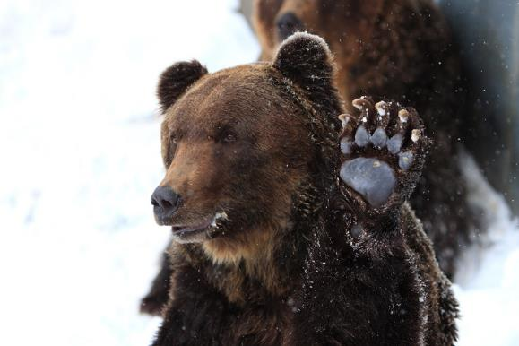
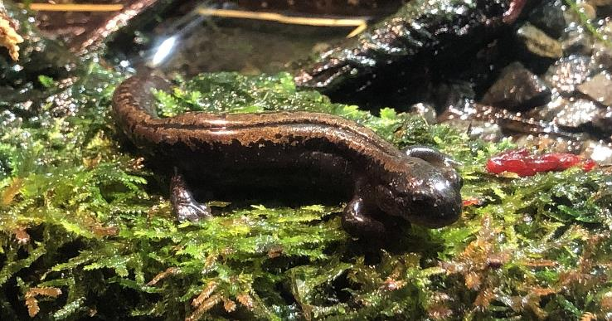
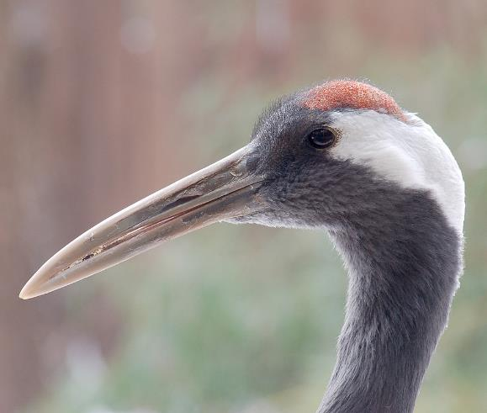
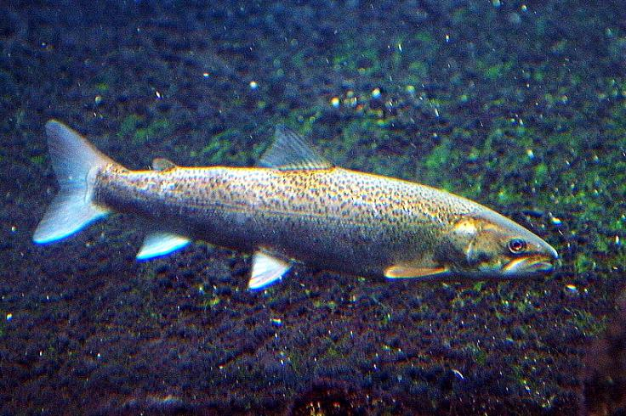
North
MiNe (sfmine79) さん
Totti
Derek Ramsey
OpenCage
See notes for image usage license
Notes:
Teacher’s Notes
Let’s take a closer look at the five different areas mentioned earlier to get a better understanding of the diversity of Japanese wildlife.
Hokkaido, Japan’s northernmost main island, is home to many animals not found in other parts of Japan. These include the Hokkaido brown bear, Siberian salamander, red-crowned crane, and Japanese huchen, a type of freshwater fish.
KQ: Why do you think Hokkaido has such unique wildlife?
A: Firstly, Hokkaido’s climate is very different to the rest of Japan and Hokkaido is at a much higher latitude than the rest of Japan. Also, it is because Hokkaido used to be connected to mainland Asia.
Images:
Ezo Brown Bear by MiNe (sfmine79) さん, CC BY 2.0 via Wikimedia Commons
Totti, CC BY-SA 4.0, via Wikimedia Commons
Photo by and (C)2007 Derek Ramsey (Ram-Man), CC BY-SA 2.5, via Wikimedia Commons
Hucho perryi by OpenCage,CC-BY-SA 2.5 via Wikimedia Commons

Slide 6
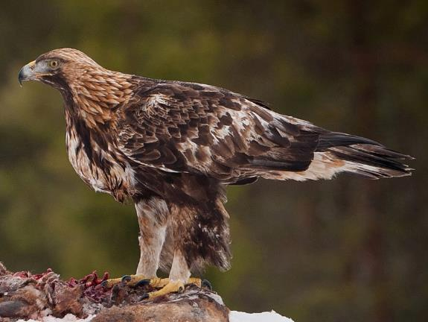
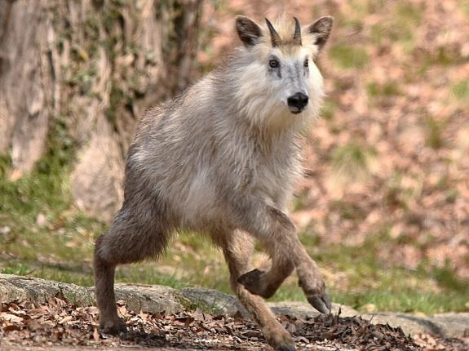
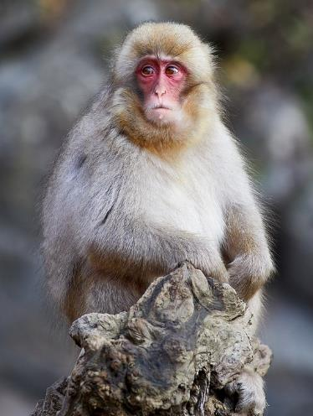
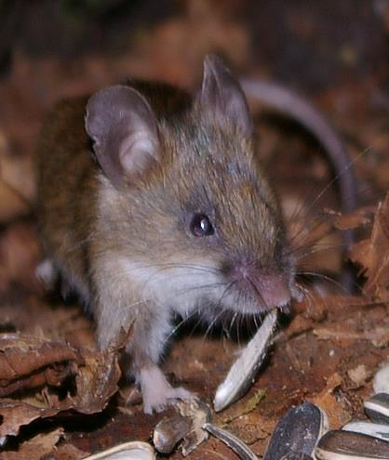
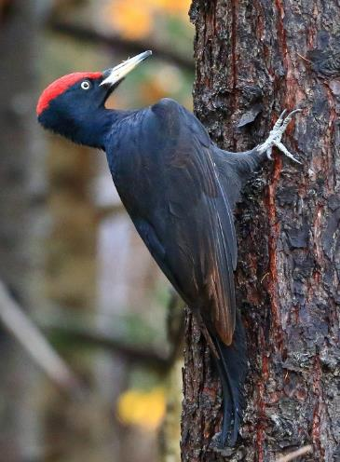
Mountains
Jarkko Järvinen
Ken Ishigaki
© Frank Schulenburg
NOZO
H yamaguchi
See notes for image usage license
Notes:
Teacher’s Notes
Around three quarters of Japan’s national land is mountains. Long mountain ranges form a backbone through the Japanese archipelago.
The type of wildlife found in mountain habitats varies depending on the latitude and altitude, and include the golden eagle, Japanese serow (or goat-antelope), Japanese macaques, Japanese fieldmice, and black woodpeckers.
Images:
Jarkko Järvinen, CC BY-SA 2.0, via Wikimedia Commons
Ken Ishigaki, CC BY 2.0, via Wikimedia Commons
Frank Schulenburg CC BY-SA 4.0 via Wikimedia Commons
NOZO, CC BY-SA 3.0, via Wikimedia Commons
H yamaguchi, CC BY 2.0, via Wikimedia Commons

Slide 7
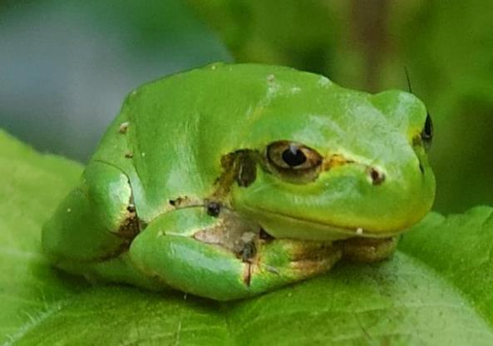
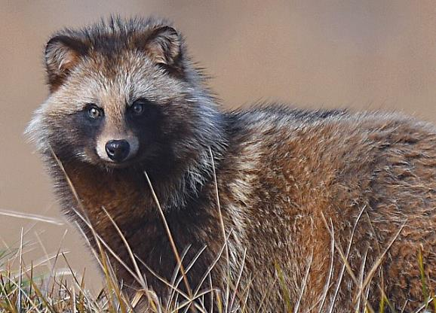
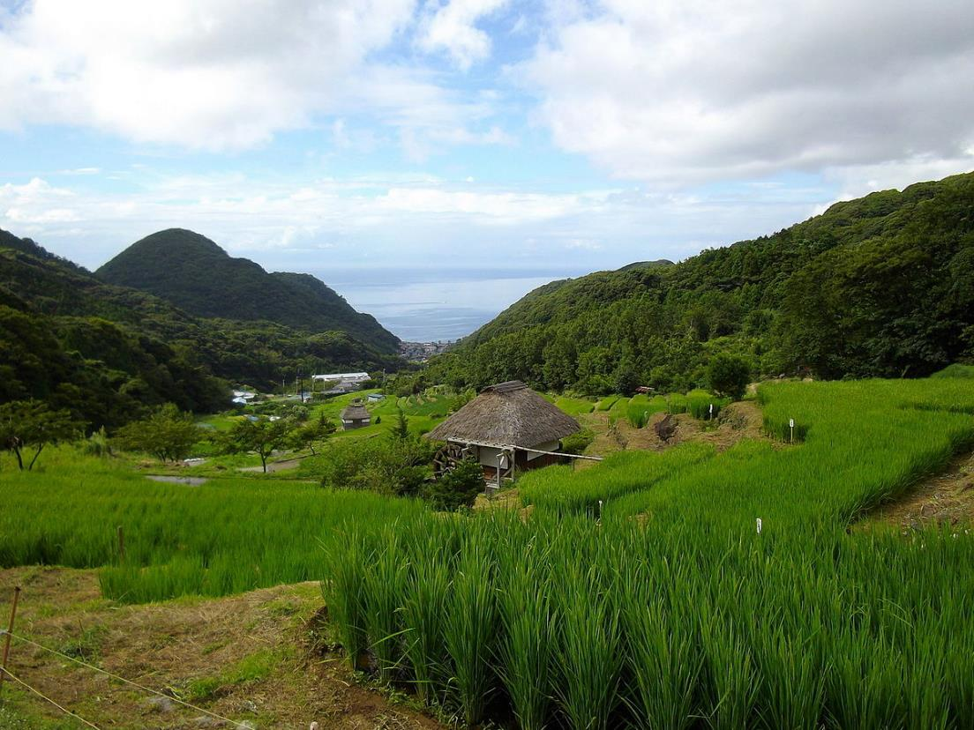
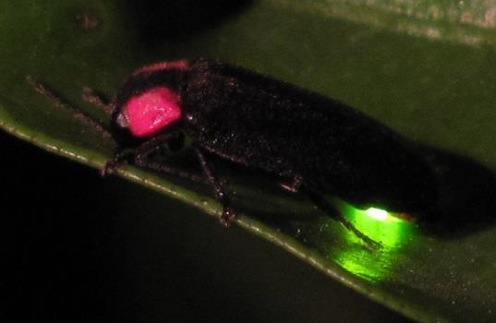
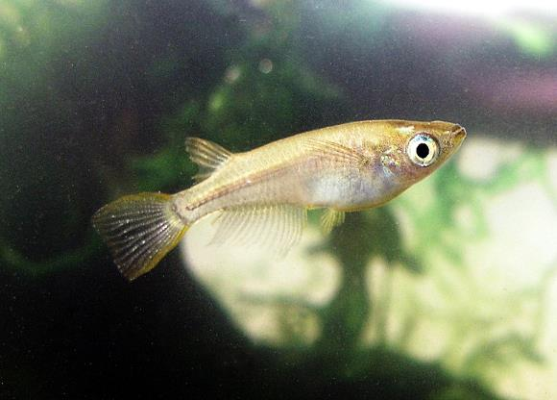
Rural Japan
Kropsoq
Ken Ishigaki
yellow_bird_woodstock さん
Izu navi
NOZO
See notes for image usage license
Notes:
Teacher’s Notes
In Japan there is a special word for the land found between mountains and flat farm land: satoyama, from the words sato, or village, and yama, or mountain. Satoyama is a form of rural landscape found in Japan that has been developed over centuries through small-scale farming and forestry. Features of this landscape includes rice paddy fields, canals and ponds used for irrigation, and managed grasslands and woodlands.
These form unique habitats for a variety of living things, such as the Japanese tree frog, tanuki (also know as raccoon dogs), heike firefly, and medaka, a tiny freshwater fish. However, in recent years satoyama has been disappearing. As more and more Japanese people move to cities and rural populations decline, the maintenance of such traditional rural habits has also declined. This, in turn, has resulted in threats to the wildlife found here.
Images:
Izu navi from Kyoto, Japan, CC BY 2.0 <https://creativecommons.org/licenses/by/2.0>, via Wikimedia Commons
Kropsoq, CC BY-SA 3.0, via Wikimedia Commons
Ken Ishigaki, CC BY 2.0 via Wikimedia Commons
yellow_bird_woodstock さん https://www.flickr.com/photos/yellow_bird_woodstock/, CC BY-SA 2.0, via Wikimedia Commons
NOZO, CC BY 3.0, via Wikimedia Commons

Slide 8
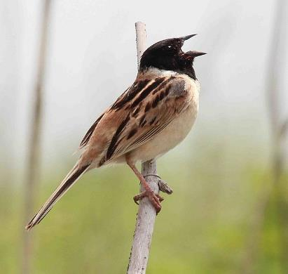
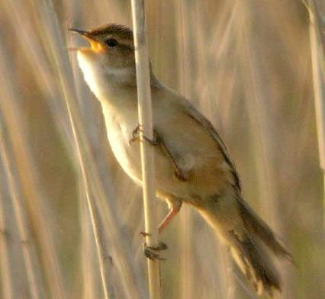
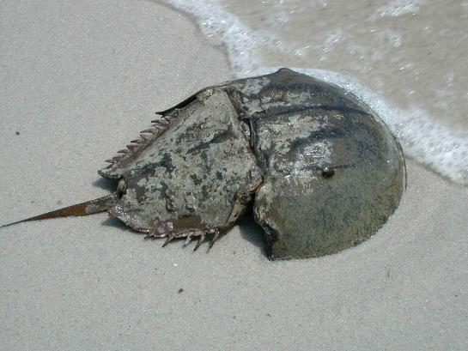
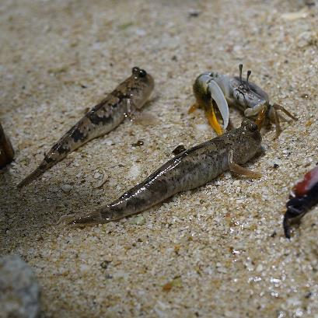
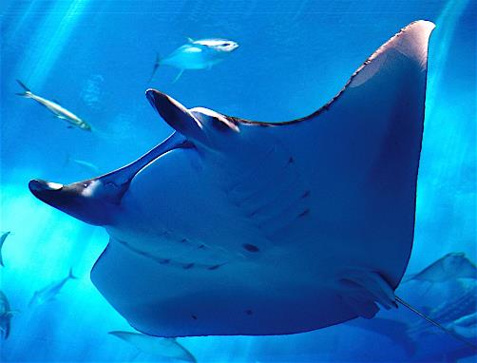
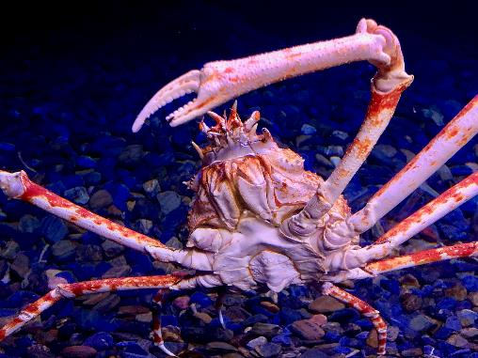
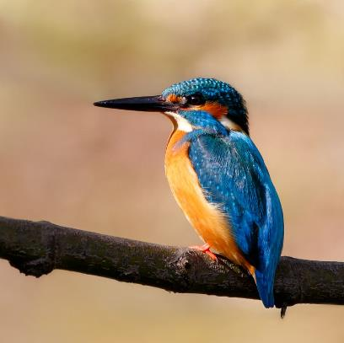
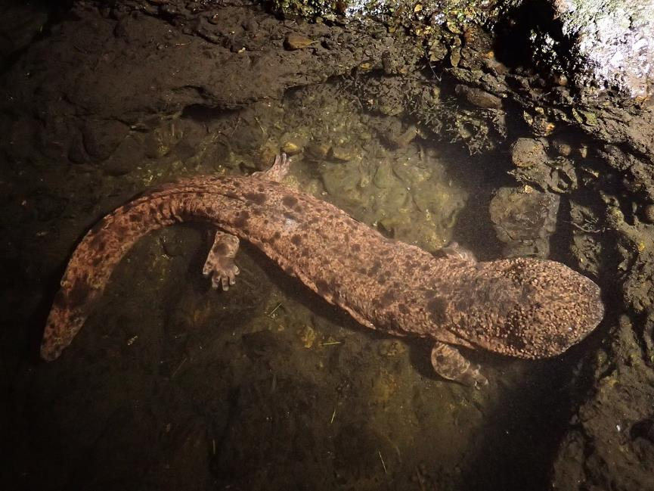
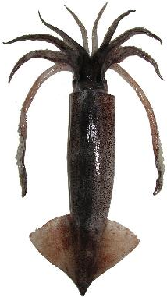
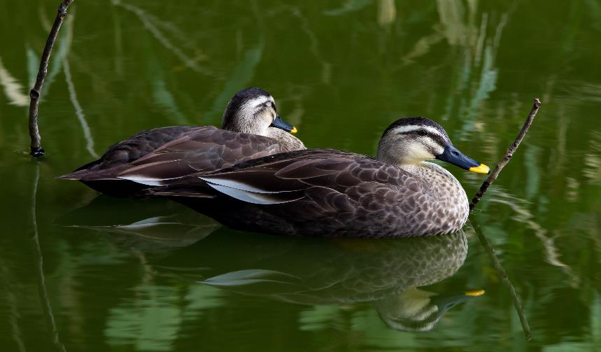
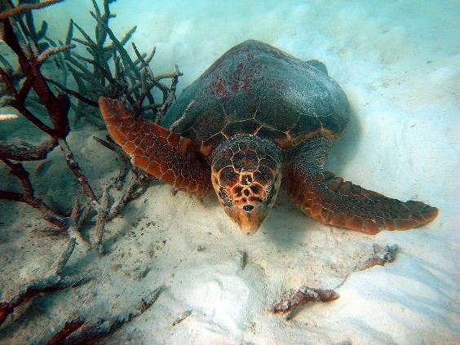
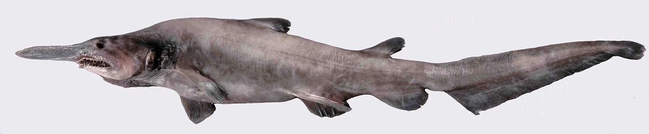
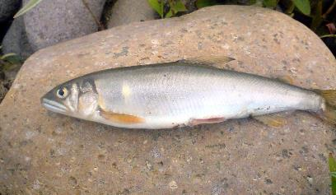
Sea and Wetlands
See notes for image usage license
Notes:
Japan is an island nation, meaning it is surrounded by seas and ocean. It also receives a huge amount of rainfall, which creates many rivers, ponds and marshlands. Wildlife has adapted to these watery habitats in a variety of ways.
Japanese rivers are home to an abundance of creatures, including the kingfisher, Japanese salamander, a type of huge amphibian unique to Japan, and ayu, a fish that uses both rivers and the sea in its lifecycle.
Japan’s marshlands are home to rich bird life, including the Japanese reed-bunting, the Japanese marsh warbler and the spot-billed duck.
Moving to the coast, tidal flats and beaches host horseshoe crabs, loggerhead sea turtles and mudskippers.
The waters around Japan are home to a variety of sea critters, including manta rays and Japanese flying squid, as well as Japanese spider crabs and goblin sharks in the deeper waters off Japan.
Images:
Photo by Laitche, CC BY-SA 4.0 via Wikimedia Commons
Salamandra2021,, via Wikimedia Commons
Apple2000, CC BY 3.0, via Wikimedia Commons
Kisswaynow, CC BY-SA 3.0, via Wikimedia Commons
WJMcBride, CC BY-SA 3.0, via Wikimedia Commons
Photo by Laitche, CC BY-SA 4.0, via Wikimedia Commons
Pos Robert, U.S. Fish and Wildlife Service, Public domain, via Wikimedia Commons
Sylke Rohrlach from Sydney, CC BY-SA 2.0 via Wikimedia Commons
Daiju Azuma, CC BY-SA 4.0, via Wikimedia Commons
Ken FUNAKOSHI, CC BY-SA 2.0, via Wikimedia Commons
self, CC BY-SA 3.0, via Wikimedia Commons
Sonse, CC BY 2.0, via Wikimedia Commons
Dianne Bray / Museum Victoria, CC BY 3.0 AU, via Wikimedia Commons

Slide 9
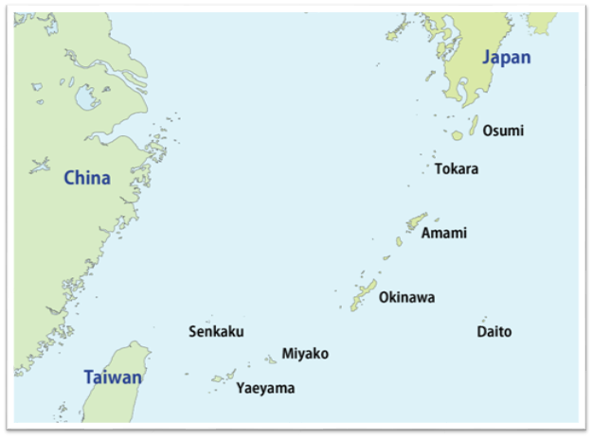
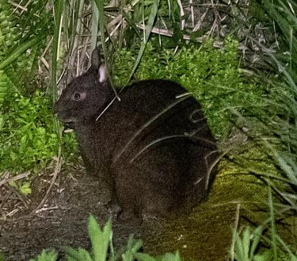
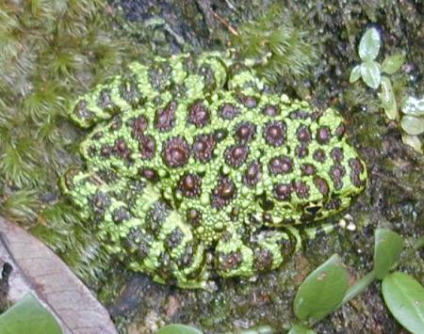
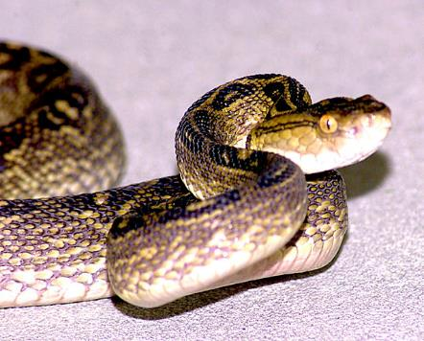
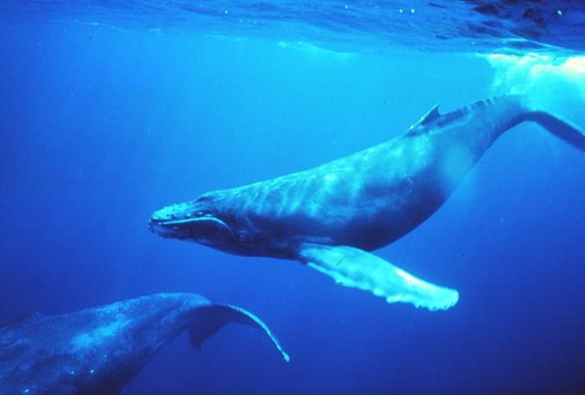
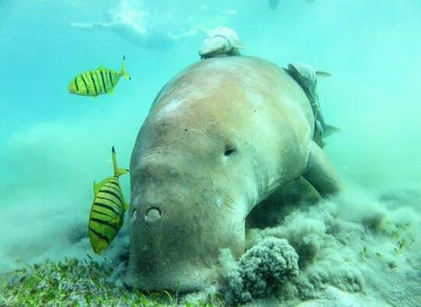
Subtropics
Aleš Buček
self
Dr. Louis M. Herman
Niklas Flindt
See notes for image usage license
Notes:
Teacher’s Notes
Stretching south from Kyushu are many islands (known collectively as Ryukyu or Nansei Islands), which includes the island of Okinawa. These have a subtropical climate and include natural features such as coral reefs, mangroves, and evergreen subtropical forests. Thanks to their climate, and the fact that the islands have been isolated from mainland Asia for even longer than the rest of Japan, the islands are home to some unique wildlife.
The amami rabbit is a primitive rabbit found only on the island of Amami Oshima. Ishikawa’s frog is found in mountain streams on Okinawa island. The habu snake is highly venomous and preys mainly on rodents. In the seas around the islands are an abundance of wildlife including the humpback whale, which can reach as long as 13m, and the dugong, a marine mammal that some say was the original inspiration for mermaids.
Images:
Aleš Buček, CC BY 4.0, via Wikimedia Commons
self, CC BY-SA 3.0, via Wikimedia Commons
No specific photographer credit, Public domain, via Wikimedia Commons
Dr. Louis M. Herman., Public domain, via Wikimedia Commons
Dugong closeup. by Niklas FliNdt is licensed under CC BY-SA 2.0.

Slide 10
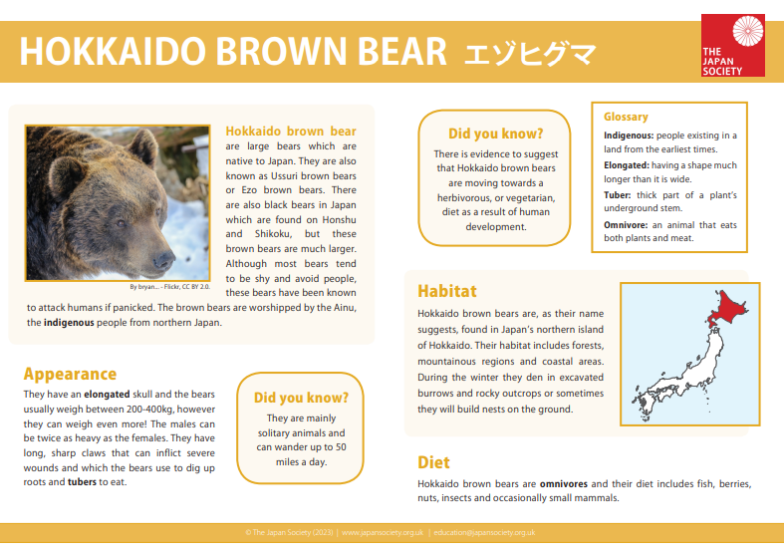
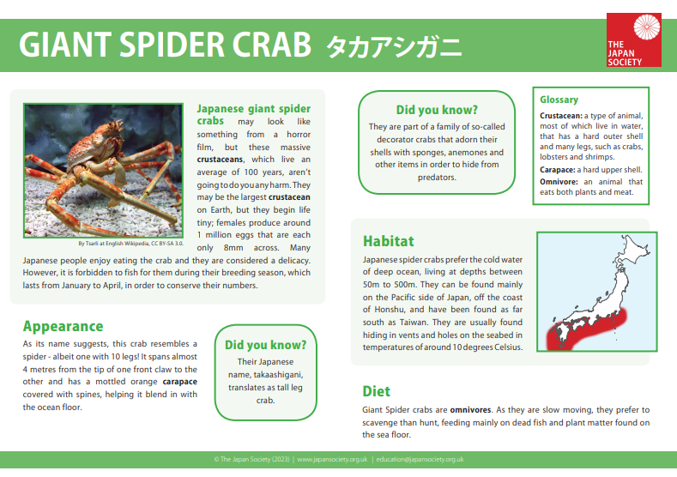
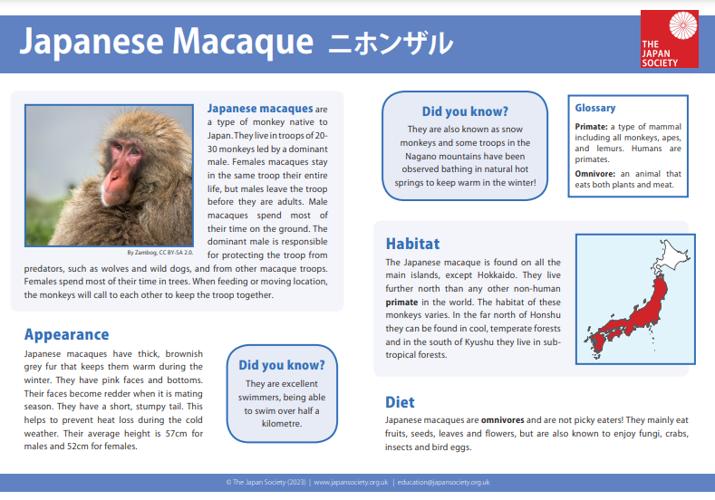
Task 2
Working in a group, research information about an animal found in Japan.
Notes:
Teacher’s Notes
Introduce today’s main task. Explain that pupils will have a range of resources available that they can use to research their assigned animal, including the fact files contained in the learning pack, iPads, and books from the school library. Add that the following slides will also provide some useful information for their presentations, so encourage them to make notes as they listen to you before moving off to complete their own research after slide 9.
As an additional challenge, pupils can choose their own animal to research and complete their own fact file using the blank template.

Slide 11

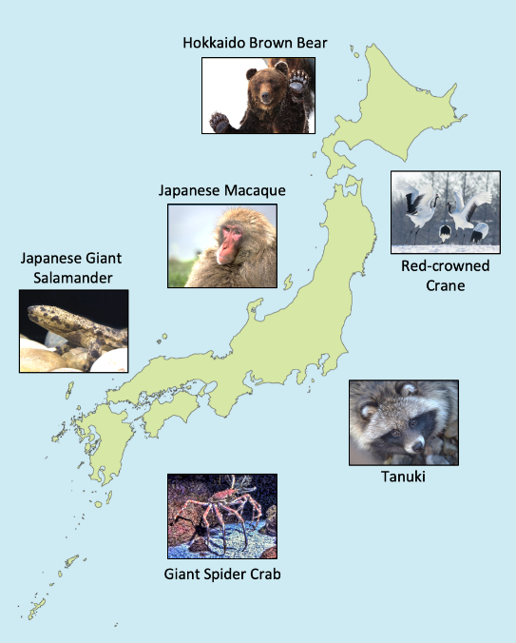
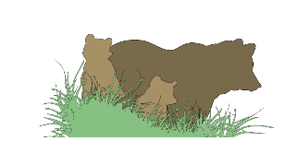
Hokkaido brown bear
As you listen to the presentations, annotate your map to show where in Japan each animal lives.
Present your research to the rest of the class.
Notes:
Images:
https://openclipart.org/detail/281440/kids-in-a-classroom
https://openclipart.org/detail/278674/Mommy-bear

Slide 12



Plenary
Task: Can you guess what animals inspired these fabric patterns?
1. Hawk or eagle feathers
2. Shark skin
3. Tortoise shell
Notes:
Teacher’s Notes
Wagara is the name given to traditional Japanese textile patterns, like these. Mostly they were inspired by nature and were connected with a particular season or occasion. The three designs shown here were each inspired by an animal.

Slide 13





These resources were developed by Oliver Reed in collaboration with the Japan Society.
The Japan Society
13/14 Cornwall Terrace, London NW1 4QP
Tel: 020 7935 0475
Email: education@japansociety.org.uk
www.japansociety.org.uk
Follow us on:
@japansocietylon
@JapanSocietyLondon
© The Japan Society

