Slide 1
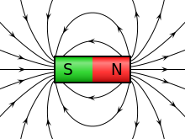
Electromagnets and their uses
Your Learning objectives:
To learn how to draw the magnetic field around a straight current-carrying wire.
To understand how to create an electromagnet.

Slide 2
Starter
The average train journey from London to Manchester is 2 hours 45 minutes.
Draw the free body diagram of the train travelling at a constant speed.
How could we reduce the travel time between Manchester and London? Refer to the forces acting on the train.

Slide 3
Answer
The train is being driven by the engine,
creating a thrust.
As the train travels faster, the force of
friction increases.
If we were able to reduce the effects of friction we could increase our speed and arrive sooner!
Normal Contact
Friction
Thrust
Train
Weight
Did you know?
The friction between wheels and rails in railways is called adhesive force.

Slide 4
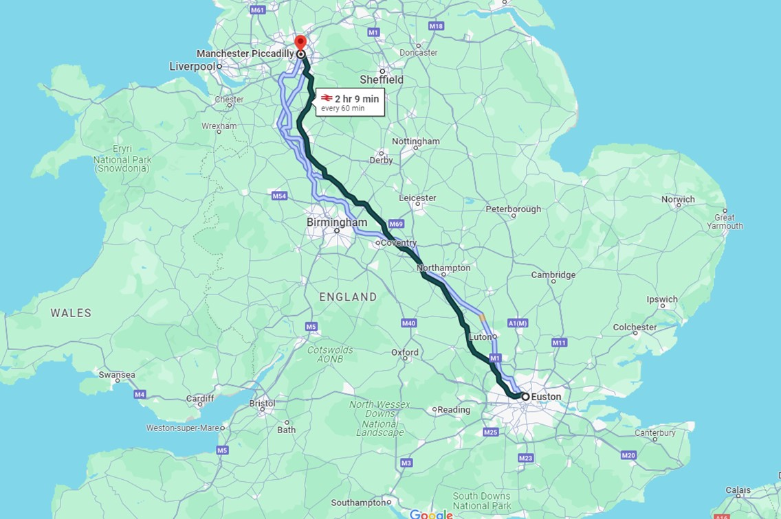
How do we reduce friction?
40 min
London - Manchester
Using Magnetic Levitation!

Slide 5
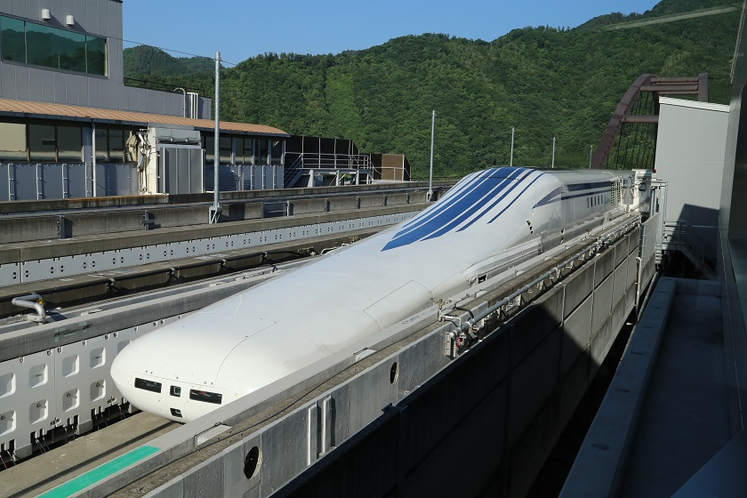
The SCMaglev Train
SCMaglev stands for...
S C Mag lev
uper
onducting
itation
netic

Slide 6
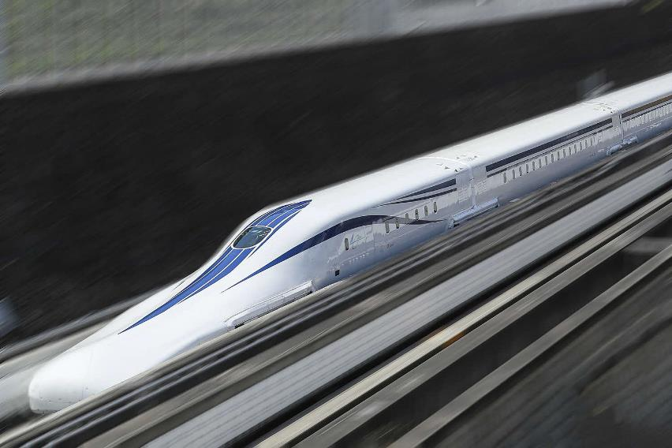
How fast can they go?
SMCMaglev stats:
World Record: 375mph (603km/h) Max Operation Speed: 311mph (500km/h)
Levitation: 10cm (4 inches)
Did you know?
Japan currently holds the world record in highest speed of crewed train!

Slide 7
How they use Magnets
The lead vehicle (head car) weighs about 35 tons and the middle cars weighs about 25 tons.
In order to lift these heavy train cars, strong magnets need to be used.
These magnets are known as:
SCM: Super Conducting Magnets

Slide 8
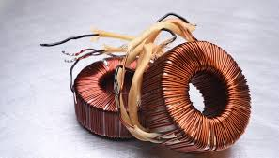
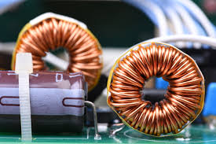
Electromagnets

Slide 9
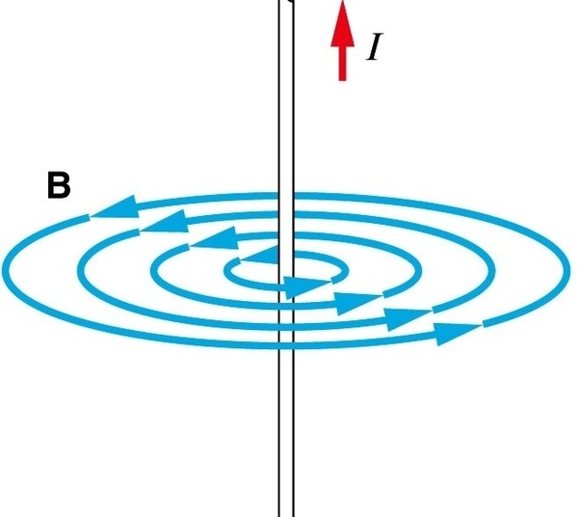
Current in a wire creates a magnetic field!
When current flows through a wire, the current generates a magnetic field around the wire!
The direction of the current determines
the direction of the poles.
Ampere’s right-hand rule!
Direction of current
Direction of Magnetic field

Slide 10
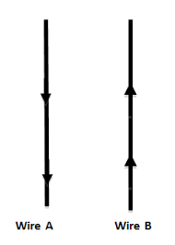
Task 1: Draw the magnetic fields around the wires

Slide 11
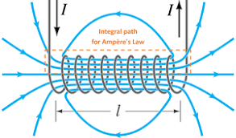
How do we make these magnets?
The magnetic field produced by a current flowing through a wire is very weak - too weak to be useful.
But...we can make it stronger!
Solenoids

Slide 12
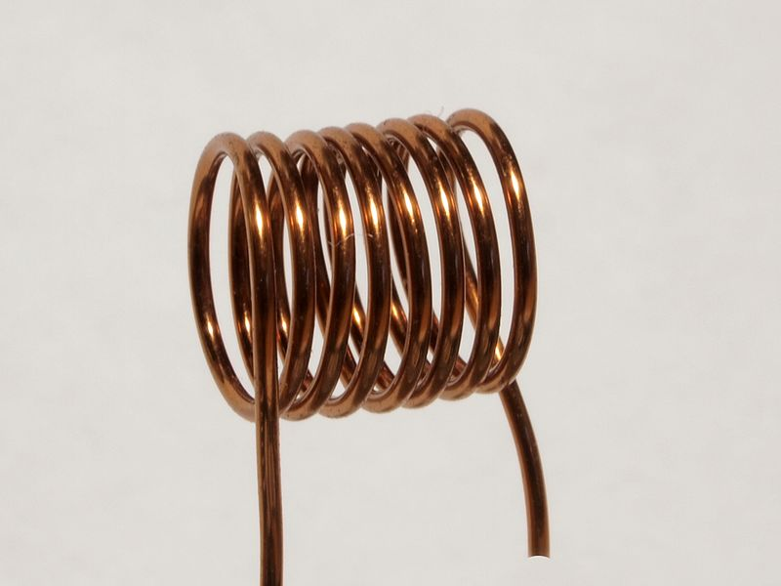
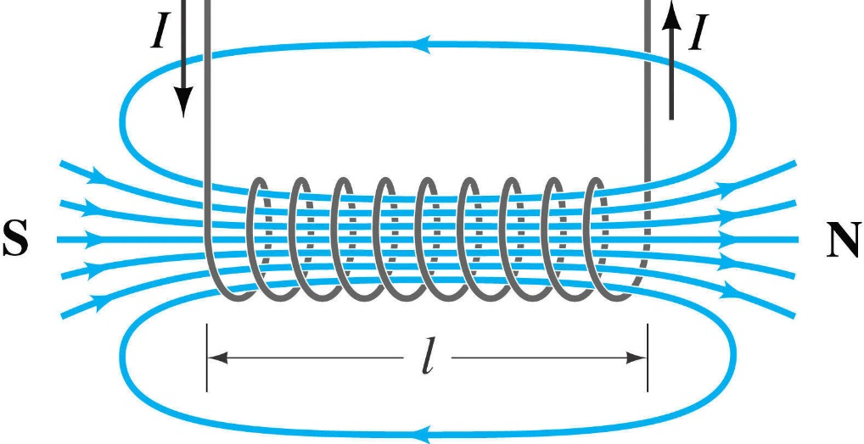
Solenoids
A solenoid is a long coil of insulated wire with current flowing through it.

Slide 13
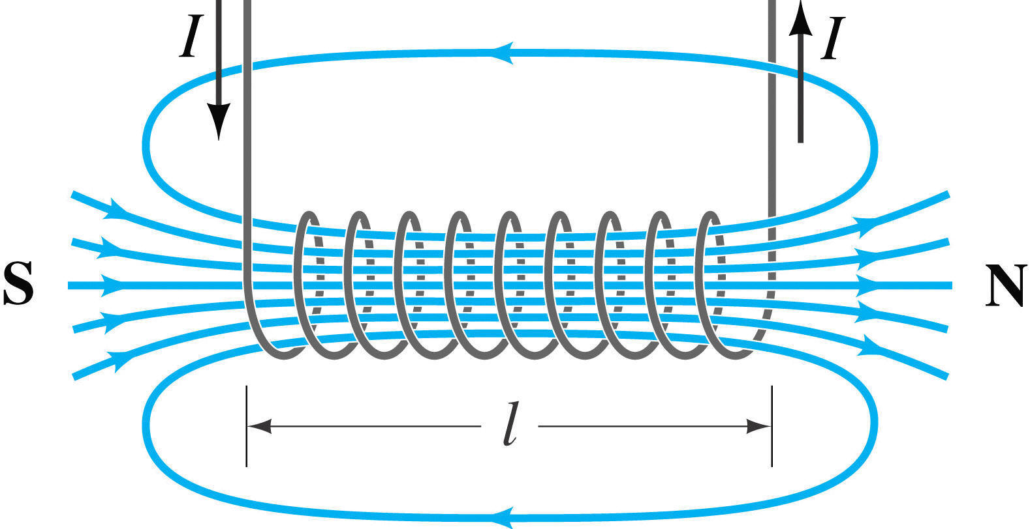
Task 2: Draw this
The magnetic field inside the solenoid is strong and uniform. Many field lines and all in the same direction.
The field lines outside the solenoid form a complete loop inside.
A solenoid produces a much stronger magnetic field than if the wire was straight.
The magnetic field is similar to that of a permanent magnet in some respects.

Slide 14
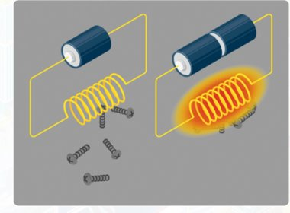
The magnet can be made stronger by increasing the current
The higher the current, the more heat is generated
The heat could damage the components
Heat is generated by​
Electrical Resistance!

Slide 15
So what should we do?
1 minute to discuss with the person next to you, before I choose people at random.

Slide 16
Remove the resistance!
Cool the coils to -269℃
No heat is generated
Strong current can be applied
The magnet can be strong!

Slide 17
Learning check: Quick questions
1 minute to discuss with the person next to you, before I choose people at random.
How would you increase the strength of an electromagnet
What is a Solenoid
Increase the current
Coiled wire carrying a current
Heat loss
What is the main source of energy loss in electromagnetics
How long would it take a MagLev train to travel from London to Manchester?
40 minutes
What temperature are the coils kept at?
Which hand & finger do we use to determine direction of current flowing
-269℃
Right Hand Thumb

Slide 18
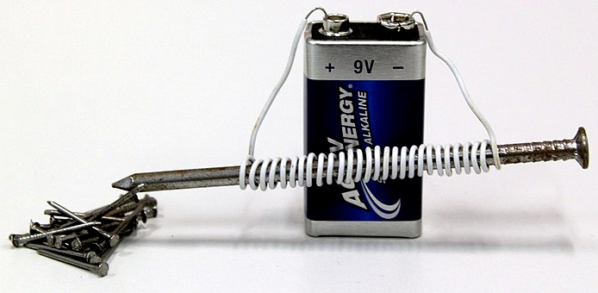
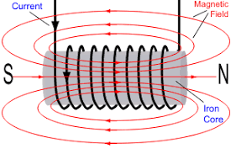
What is an Electromagnet?
An electromagnet is a solenoid (coil of wire with current flowing through it) with an iron core.
The iron core increases the strength of the magnetic field.

Slide 19
How does a MagLev Train move forward?
Propelling the Train Forward
Nature of Magnets
Magnets have two poles; North and South
Repulsion between the same poles N and N or S and S
Attraction between opposite poles (N and S)

Slide 20
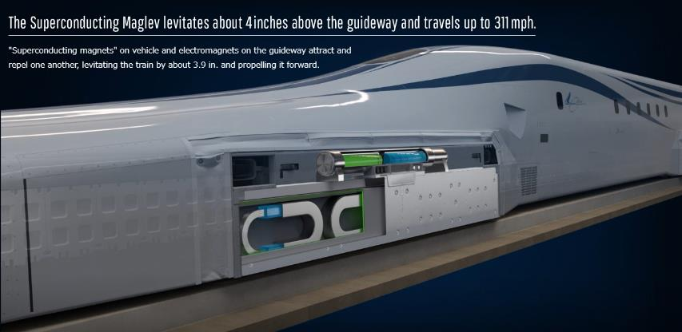
Four magnets
in one box
The vehicle has magnets on each side.
There are four magnets in one box.

Slide 21
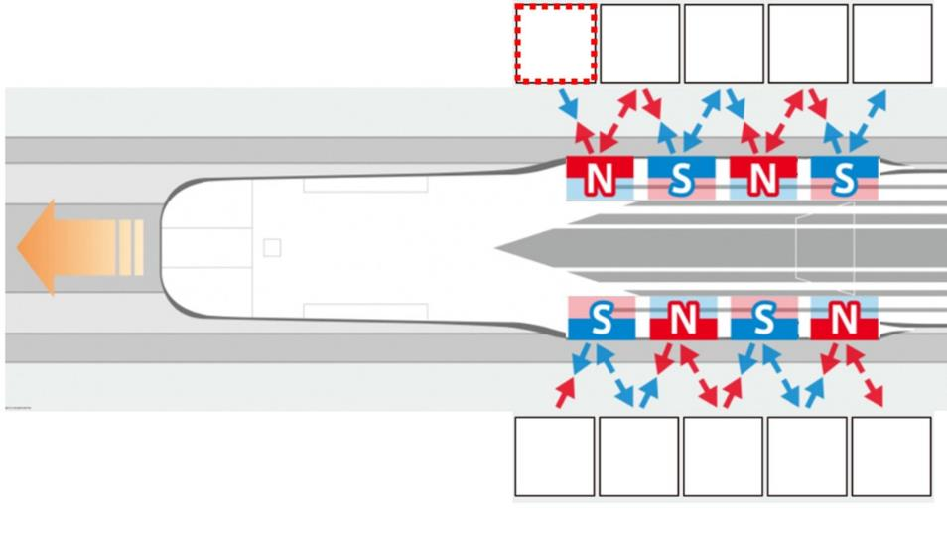
Propelling the train forward
Nature of magnets
N-N or S-S : Repel
N-S : Attract

Slide 22
Propelling the train forward
S
Which pole is
attracted by N?
Nature of magnets
N-N or S-S : Repel
N-S : Attract

Slide 23
Propelling the train forward
S
Which pole is
attracted by S?
Nature of magnets
N-N or S-S : Repel
N-S : Attract
N

Slide 24
Propelling the train forward
Ｓ
Ｎ
Ｓ
Ｎ
Ｓ
Ｎ
Ｓ
Ｎ
Ｓ
Ｎ

Slide 25
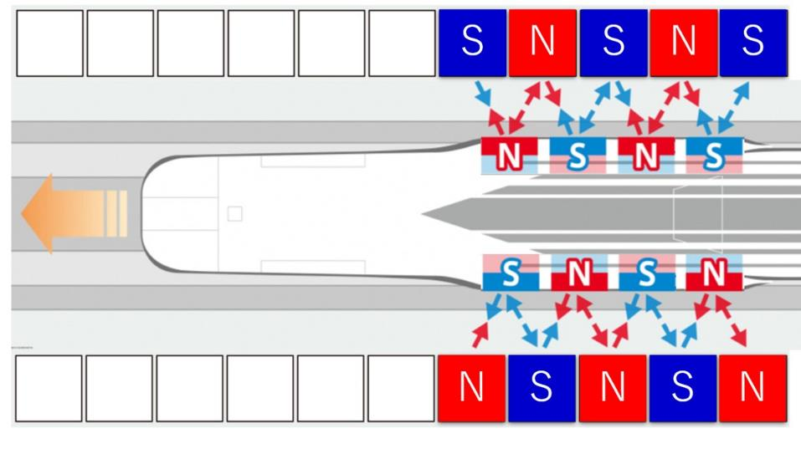
Propelling the train forward
Ｓ
Ｎ
Ｓ
Ｎ
Ｓ
Ｎ
Ｓ
Ｎ
Ｓ
Ｎ

Slide 26
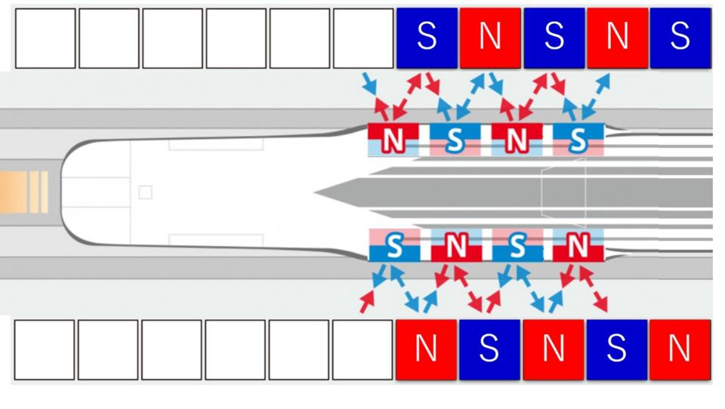
Propelling the train forward

Slide 27
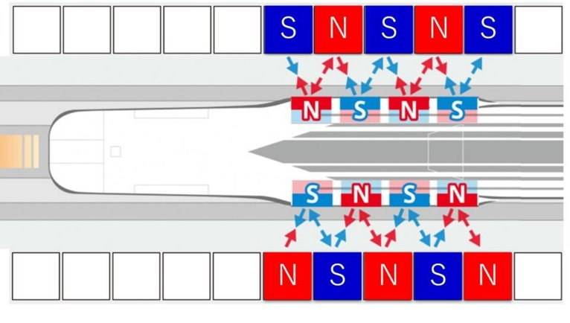
Propelling the train forward

Slide 28
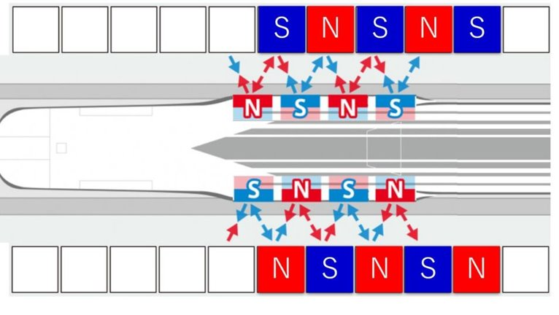
Propelling the train forward

Slide 29
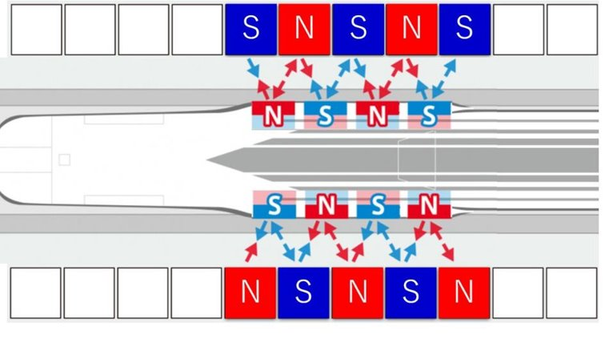
Propelling the train forward

Slide 30
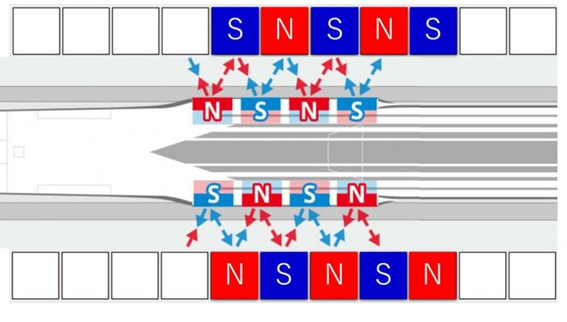
Propelling the train forward

Slide 31
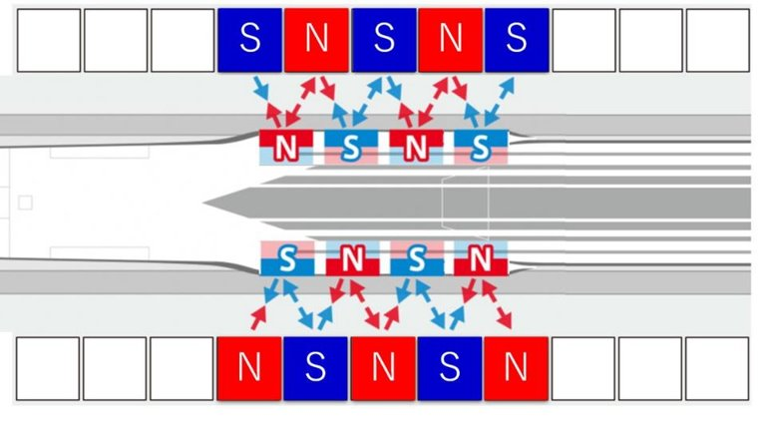
Propelling the train forward

Slide 32
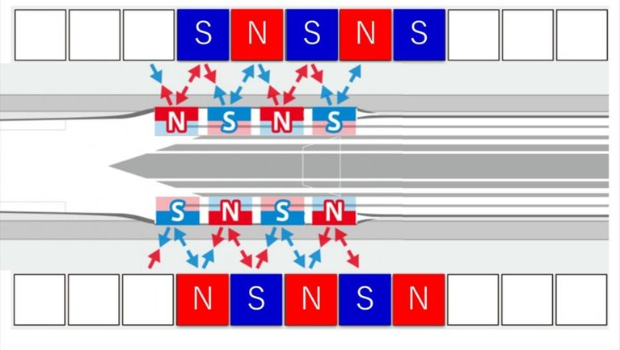
Propelling the train forward

Slide 33
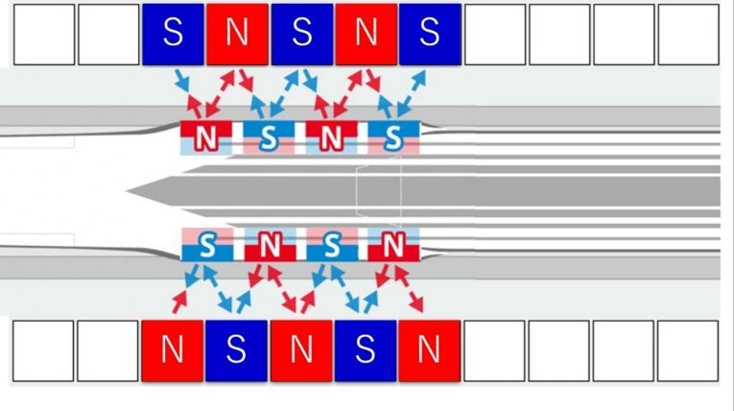
Propelling the train forward

Slide 34
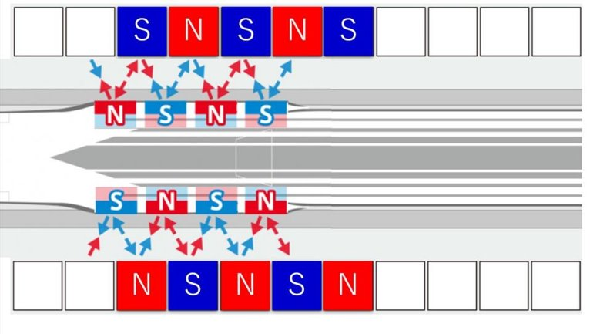
Propelling the train forward

Slide 35
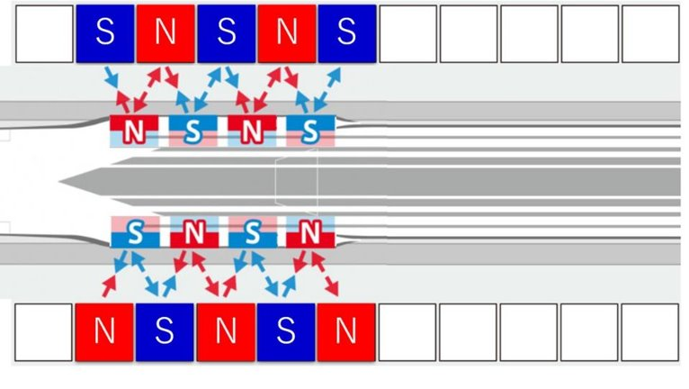
Propelling the train forward

Slide 36
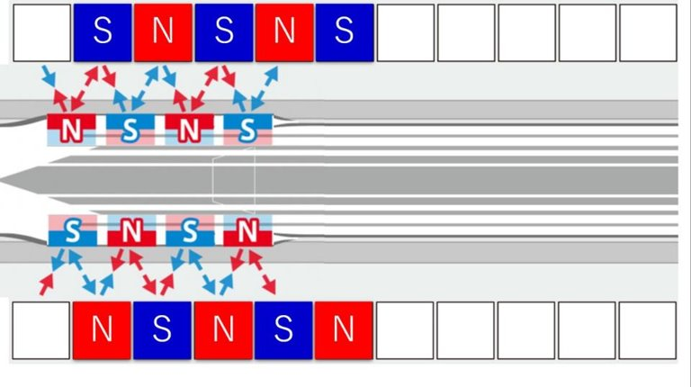
Propelling the train forward

Slide 37
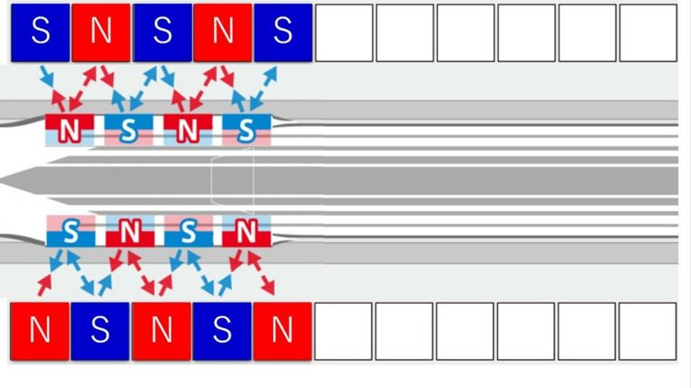
Propelling the train forward

Slide 38
Propelling the train forward
Let’s look at
one magnet on the ground!

Slide 39
Propelling the train forward

Slide 40
Propelling the train forward

Slide 41
Propelling the train forward
Pole changed from S to N!

Slide 42
Propelling the train forward

Slide 43
Propelling the train forward
Pole changed from N to S!

Slide 44
Propelling the train forward

Slide 45
Propelling the train forward
Controlling vehicle movements by switching poles!

Slide 46
Learning check 2:
Quick questions
1 minute to discuss with the person next to you,
before I choose people at random.
Repel
Ground/rails.*
Like poles ______.
Magnets are placed on the vehicle as well as the ______.
Attract
Opposite poles ______.
Switching between poles accelerates or decelerates the vehicle.
How do we change the speed of the train?
*Did you know? Maglev tracks are called guideways, not rails.

Slide 47
Task 3: In-Depth Learning Check
Magnetic Field Around a Solenoid
Tasks:
What is a solenoid? [2 marks]
How can you tell the south pole of a solenoid? [1 mark]
Draw the magnetic field pattern for a solenoid, showing the direction of the field, and labelling the south and north pole. [3 marks]
Describe the magnetic field inside the solenoid and outside it. [3 marks]
How do we turn a solenoid into an electromagnet? [1 mark]
Challenge: What are the similarities and differences between the magnetic field of a solenoid and that of a bar magnet?

Slide 48
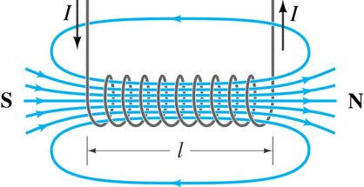
Task 3: Answers
A solenoid is a coil of wire (1) carrying an electrical current (1)​
The south pole would attract the north or repel another south pole (1)
One mark for lines running north to south; one mark for parallel lines in the centre; one mark for loop of magnetic field lines outside.

Slide 49
Task 3: Answers
The magnetic field inside the solenoid is strong and uniform (1)​
Field lines inside are all in the same direction (parallel to the axis of the solenoid) (1)
The field lines outside the solenoid are a complete loop (1)
Place an iron bar inside the coil / solenoid (1)

Slide 50
Task 3: Answers
What are the similarities and differences between the magnetic field of a solenoid and that of a bar magnet?
Similarities
Both run N to S
Similar shape
Differences
The magnetic field outside the solenoid is similar to that of a (permanent) bar magnet, but not as strong (we can tell as there are fewer magnetic field lines).
The fewer lines of a solenoid are also a complete loop (i.e., inside the solenoid), unlike those of a bar magnet.

Slide 51
Central Japan Railway Company’s original materials were adapted by Dylan Elliot Gentry in collaboration with The Japan Society to create this resource.
The Japan Society 13/14 Cornwall Terrace, London NW1 4QP
Tel: 020 7935 0475
Email: education@japansociety.org.uk
www.japansociety.org.uk
Follow us on:
@TheJapanSociety
@TheJapanSociety
© Original materials by Central Japan Railway Company, adapted by Dylan Elliot Gentry in collaboration with The Japan Society

