Slide 1
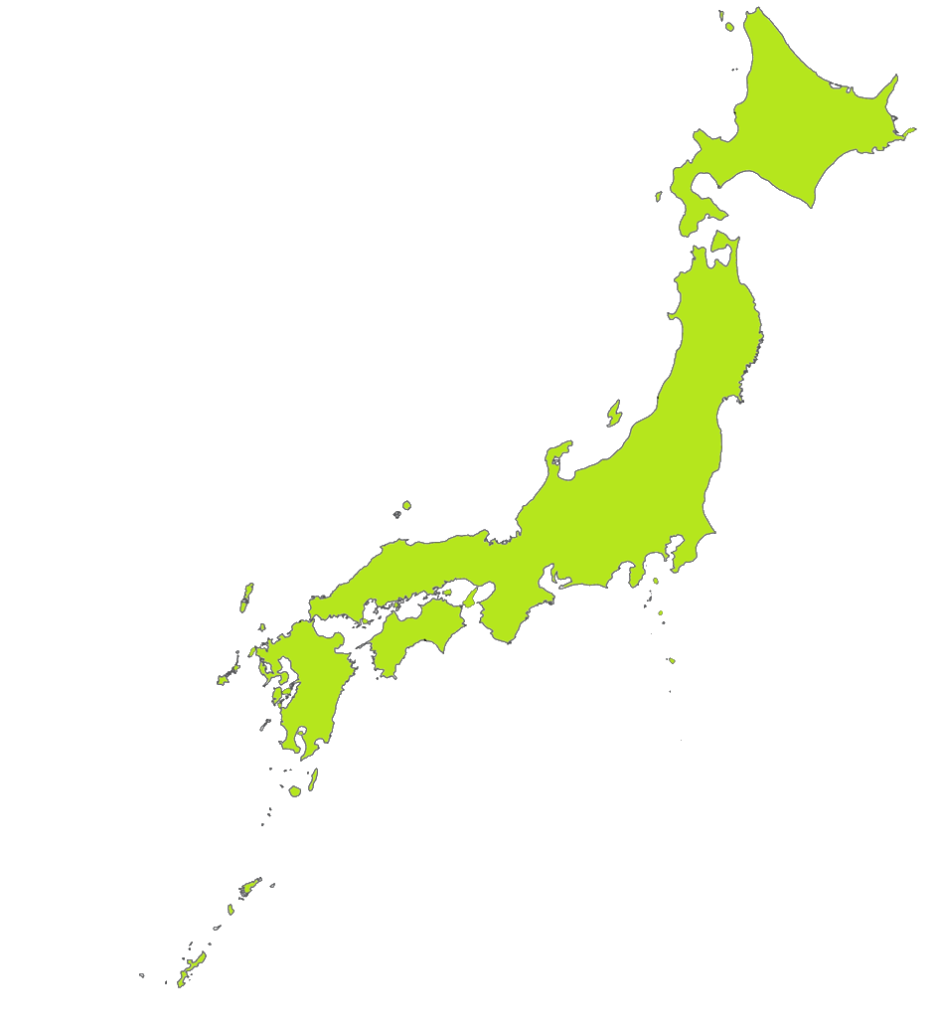
Hokkaido
Honshu
Tokyo
Mount Fuji
Tokyo
Shikoku
Kyushu
© The Japan Society
Notes:
Starter
In our previous lesson we learned the names of Japan’s four main islands and capital city. Talk to your partner (TTYP): Can you still remember?
Reveal answers on IWB.
In today’s lesson we will learn about a landmark on the island of Honshu. It is symbol of Japan, it’s tallest mountain, an iconic and sacred volcano – Mount Fuji.

Slide 2
Learning Objective
Explore the physical geography of Japan
Notes:
Teacher’s Notes
Introduce the LO. Explain that physical geography is the study of the Earth’s natural features, such as rivers, mountains and oceans, etc. Mount Fuji is an important feature in Japan’s physical geography for what it tells us about the geography of Japan as a whole. It is also important culturally and spiritually in Japan, as we will discover.

Slide 3
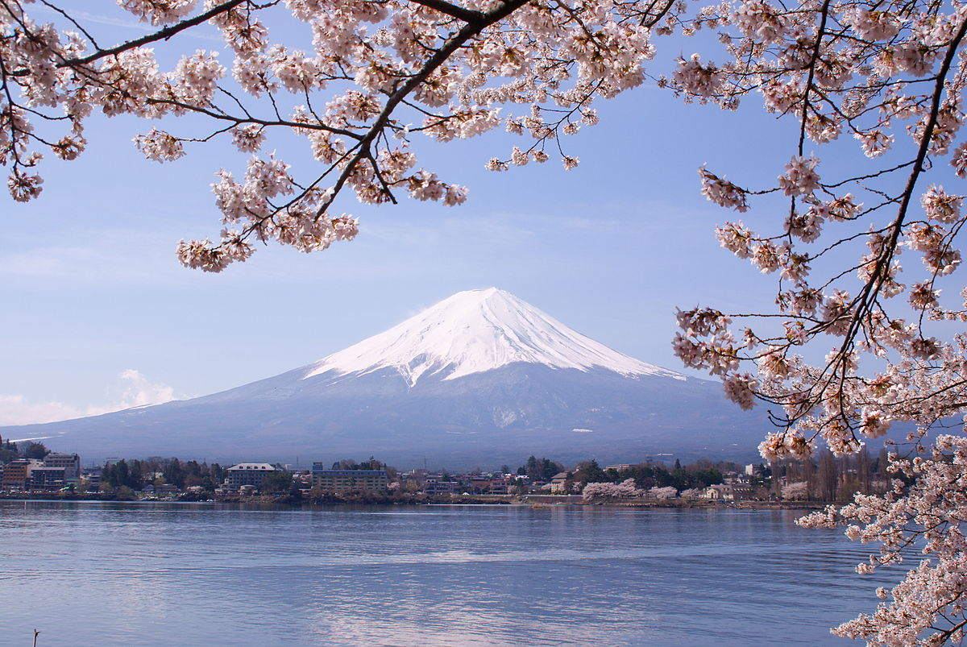
Midori, CC BY 3.0
Notes:
Teacher’s Notes
Known as Fujisan or Fujiyama in Japanese, Mount Fuji is a volcano around 60 miles south-west of Tokyo. Even though it has not erupted in more than 300 years, it is still considered an active volcano. This is because it is in a region with lots of seismic activity. TTYP: What do you know about volcanoes? Allow pupils to share their knowledge with a partner, then ask for volunteers to feedback what they know.
"File:Lake Kawaguchiko Sakura Mount Fuji 3.JPG" by Midori is licensed under CC BY 3.0.

Slide 4
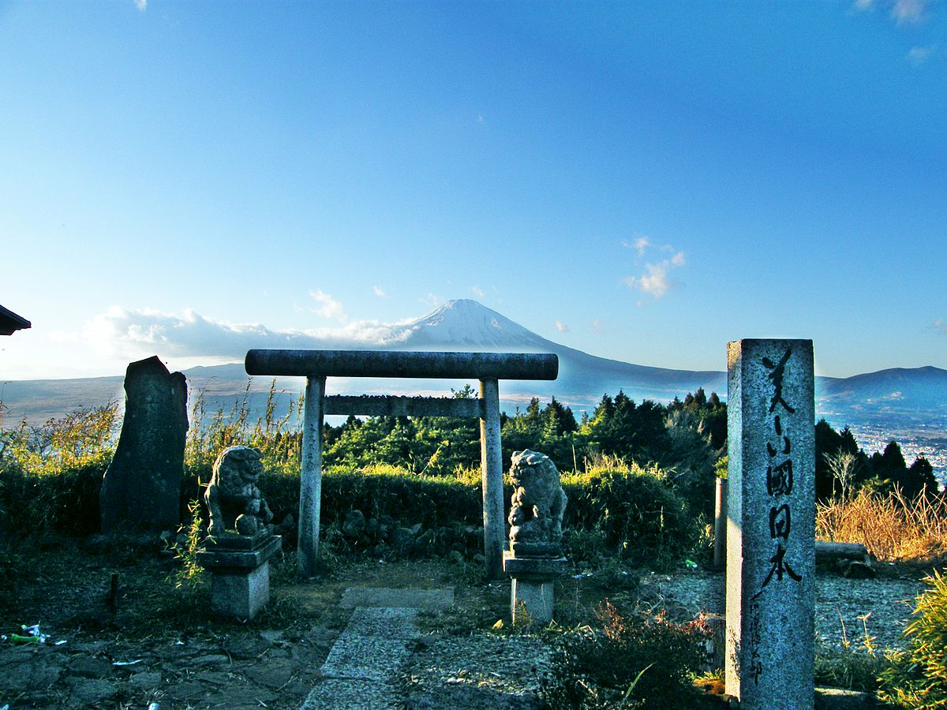
Emran Kassim CC BY 2.0
Notes:
Teacher’s Notes
Mount Fuji is a sacred site for Japanese people - a place for pilgrimage, and a home for kami (the divine beings, sprits or forces of nature in the Shinto religion).
("File:“しるこや茶屋” -torii and Mt. Fuji 01.jpg" by Emran Kassim from Nagoya, Aichi, Japan is licensed under CC BY 2.0. )

Slide 5
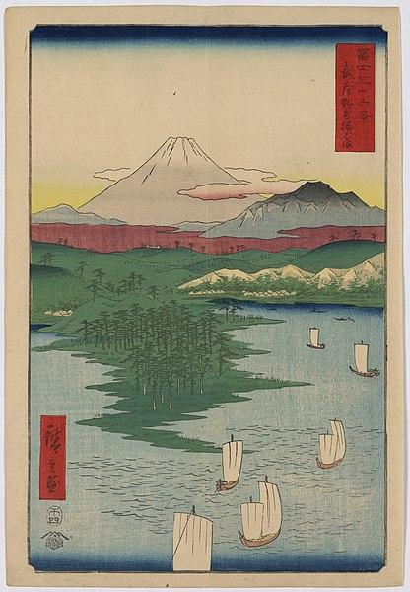
Notes:
Teacher’s Notes
For centuries, Mount Fuji has inspired Japanese artists and writers, being the subject of poems, epic sagas and paintings, such as the famous Views of Mount Fuji by Katsushika Hokusai.

Slide 6
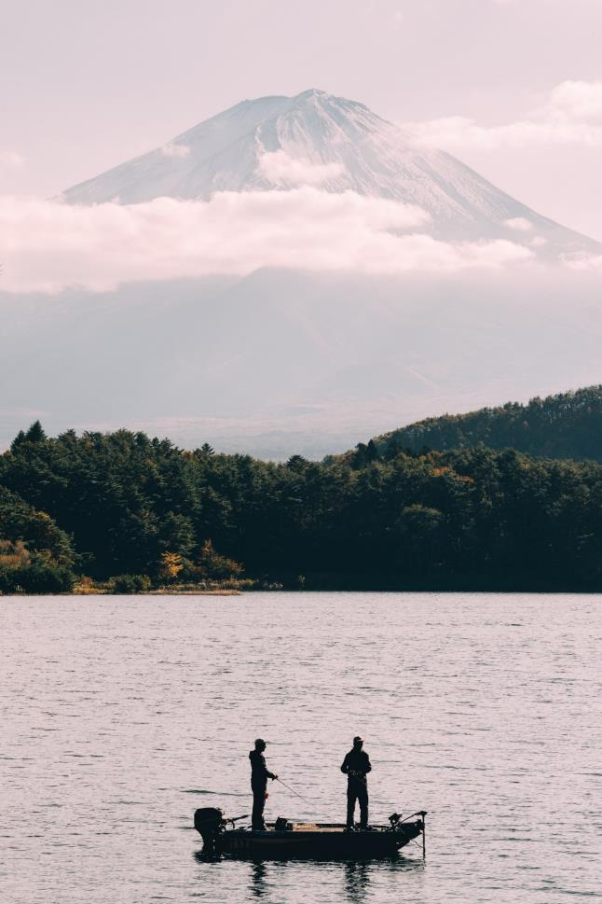
Notes:
Teacher’s Notes
Today, Mount Fuji and the surrounding area are popular destinations for hiking, camping and for people to enjoy being in the outdoors.
Photo by Felipe Alves from Pexels: https://www.pexels.com/photo/green-trees-near-body-of-water-4077937/

Slide 7
Task 1
True or False
Women were forbidden to climb Mount Fuji in the past.
Mount Fuji is actually three volcanoes in one.
The first person who climbed Mount Fuji
was a monk around 1,350 years ago.
Mount Fuji last erupted in 1707.
It takes an average of around 6 hours
to reach the summit of Mount Fuji.
Mount Fuji is the most hiked mountain in the world.
Notes:
Instructions for Task 1
Send pupils to their tables with a set of the above statements. Explain that they must discuss each statement in a small group to decide which statements you think are true and which are false.
Answers:
True - As the mountain had religious importance and climbing it was a sacred practice, it was forbidden territory for women until the government abolished those rules in 1872.
True - Mount Fuji is made up of three separate volcanoes: Komitake at the bottom, Kofuji in the middle and Fuji, the youngest of the three, at the top.
True – Although we don’t know his name, the first person to climb Mount Fuji is thought to have been a monk in 663 AD.
True – The most recent eruption was on December 16, 1707, just a few weeks after an earthquake caused huge destruction to the Japanese city of Osaka. The ash sent into the sky during the eruption was so thick that people in Tokyo had to use candles at midday.
True – Most climbers reach the summit in 6 hours from one of the four trails which you can take. Food, drink, and rest spots can be found at different stations along each route.
True – Up to 300,000 climbers attempt Mount Fuji every year, which is particularly incredible when you consider that it can only be accessed for just over two months of the year.

Slide 8
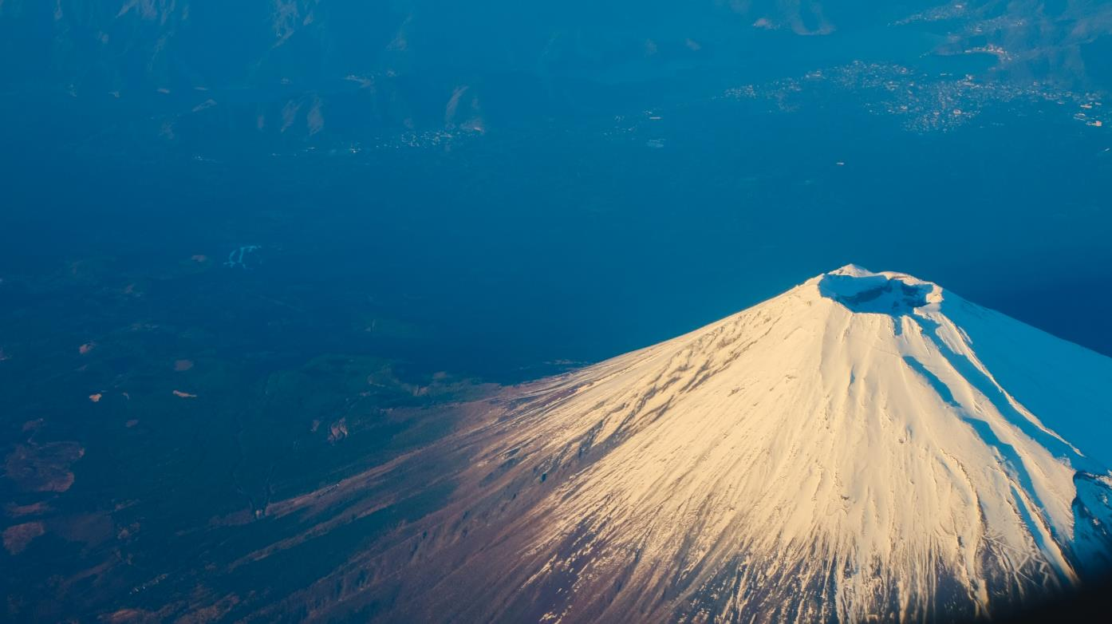
Notes:
Teacher’s Notes
We know that Mount Fuji is a volcano. Let’s investigate what a volcano is and what Japan’s volcanoes tell us about its geography.
Photo by Tirachard Kumtanom from Pexels: https://www.pexels.com/photo/mountain-covered-by-snow-347145/

Slide 9
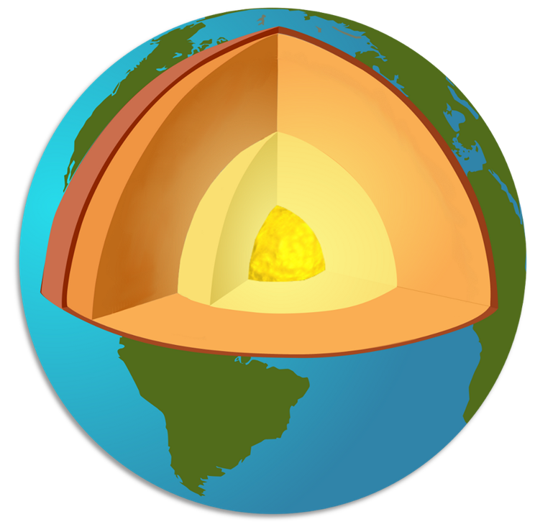
crust
mantle
outer core
inner core
Notes:
Teacher’s Notes
The earth is made up of three different layers: the crust, the mantle and the core. A volcano is a vent, or hole, in the crust that releases lava, rock fragments and gases from the mantle.

Slide 10
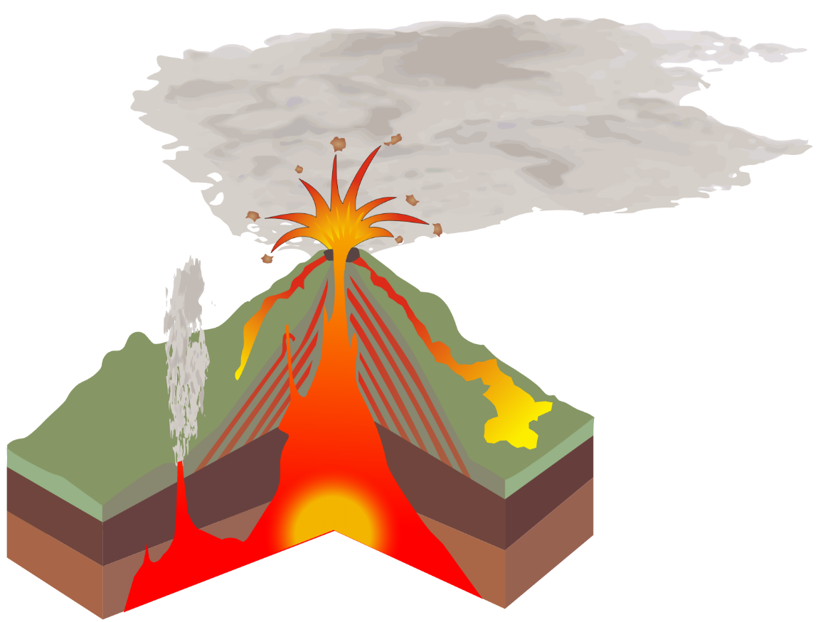
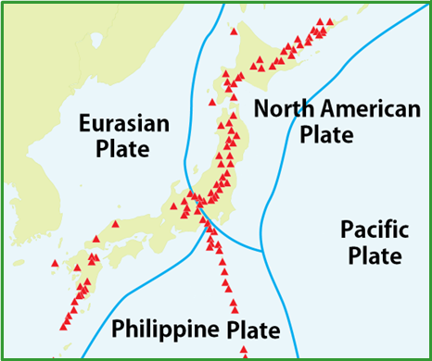
Play the Move the Plates Game!
Image: William Crochot
Notes:
Teacher’s Notes
Most volcanoes form when tectonic plates, which are huge sections of the Earth’s crust, collide, rub, or move apart from each other. When the plates collide, magma is squeezed out through the Earth’s crust as lava, creating mountainous, volcanic regions. Because four different tectonic plates all meet at Japan, the Pacific, Philippine, Eurasian, and North American plates, this explains why Japan has so many volcanoes and why it has earthquakes so frequently.
Visit the American Museum of Natural History’s ‘Plates on the Move’ game (https://www.amnh.org/explore/ology/earth/plates-on-the-move2/game) to see a map of the world’s tectonic plates and highlight Japan’s location at the convergence of multiple plates. Click on the marker above Japan on the map to explore how plates are moving there. Students may notice that the North American plate isn’t labelled on the map.

Slide 11
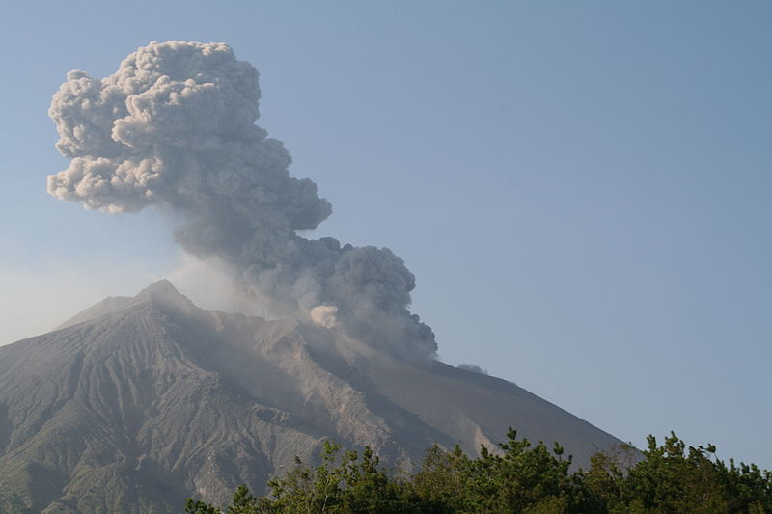
Notes:
Teacher’s Notes
Japan has over 100 active volcanoes, meaning 10% of the world’s active volcanoes are in Japan. If you include non active volcanoes, Japan has over 400 volcanoes.
While some, like Mount Fuji, have not erupted in hundreds of years, some erupt frequently. Japan’s most active volcano is Sakurajima in southern Kyushu and there are frequent eruptions of various sizes.
See the short BBC newsround video and article about a Sakurajima eruption in July 2022.
https://www.bbc.co.uk/newsround/62289233

Slide 12
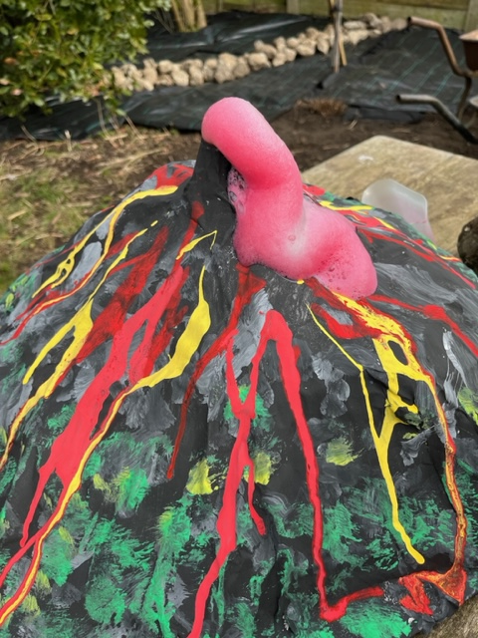
Task 2
Make an erupting papier-mâché volcano.
Notes:
Task 2

Slide 13
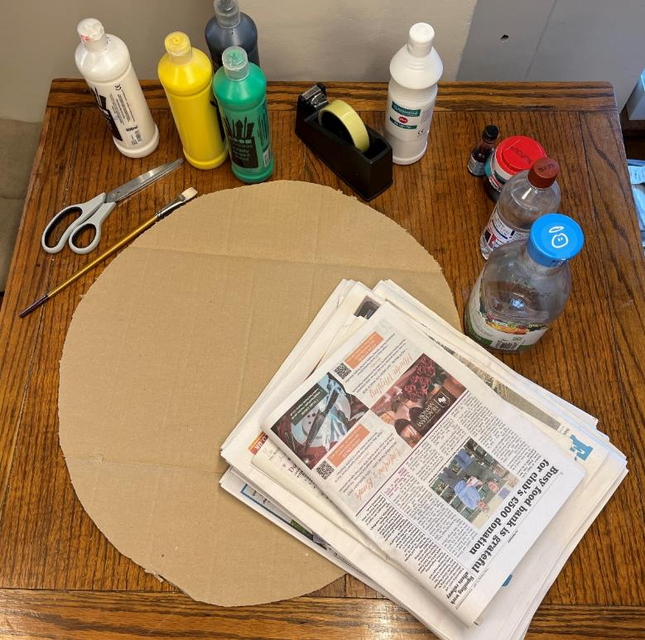
Resources
Cardboard base
Plastic bottle
Newspaper
PVA glue
Scissors
Masking tape
Paint and brushes
Bicarbonate of soda
Vinegar
Washing up liquid
Red food colouring
Notes:
Teacher’s Notes
The resources you need will depend on whether you want each child to build their own volcano or if you will ask them to work in small groups building larger volcanoes. For the former each child will need a 200ml bottle, while for the latter each group will need a 2l bottle.
Cut out a base from corrugated cardboard. This can be any shape, although a circle does lend itself well to recreating Mount Fuji. Sticky tape can be used instead of masking tape, but the papier-mâché might not attach itself so well.
The amount of bicarbonate of soda and vinegar you need for an effective eruption will depend on the size of the bottle used. Therefore, it is recommended to do a test run before doing the activity with your class in order to get the correct amount. As a guide, the correct measurements for a 200ml bottle are 1 tbsp bicarbonate of soda, 1 tbsp washing up liquid (with 2 tbsp water added), ½ cup vinegar and 1 tbsp red food colouring.

Slide 14
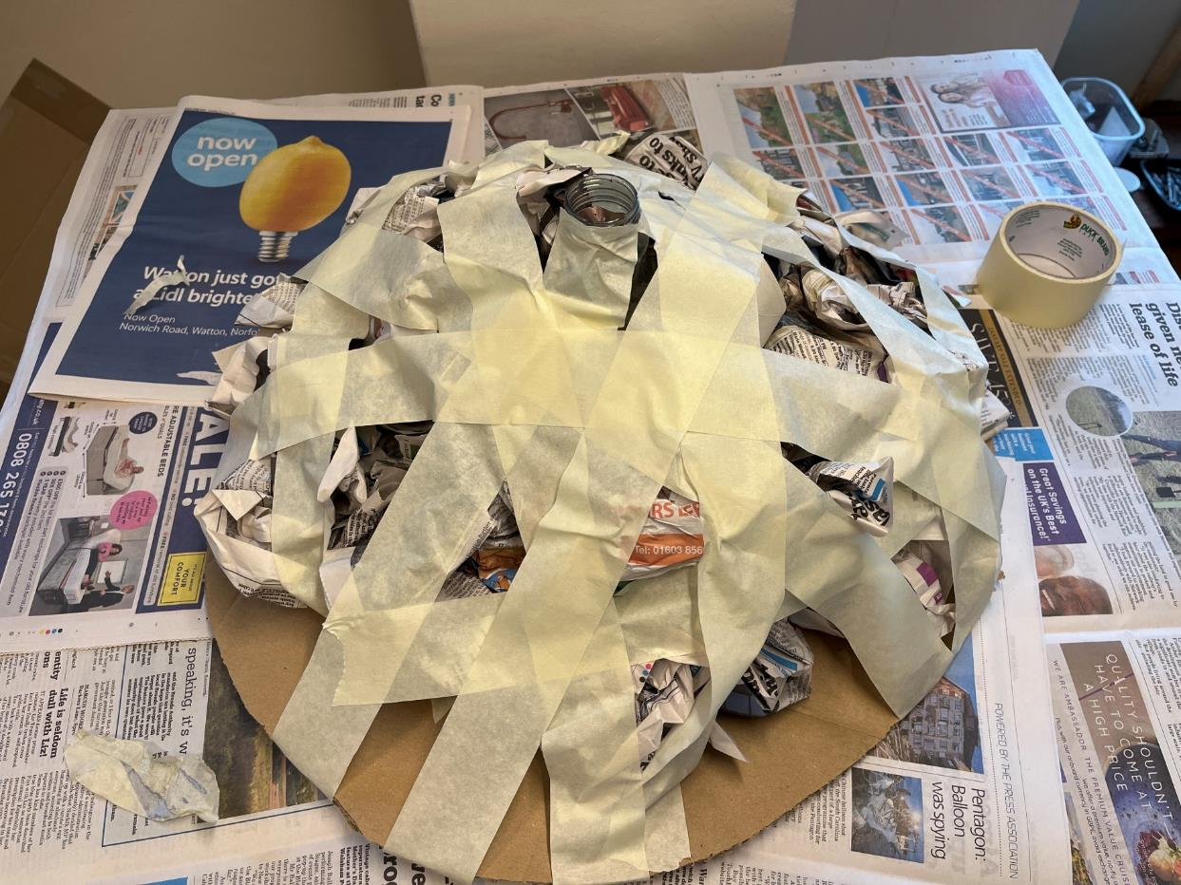
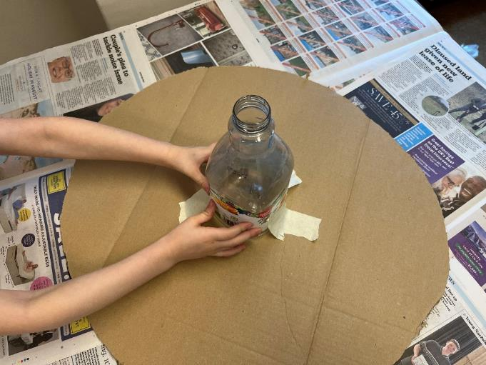
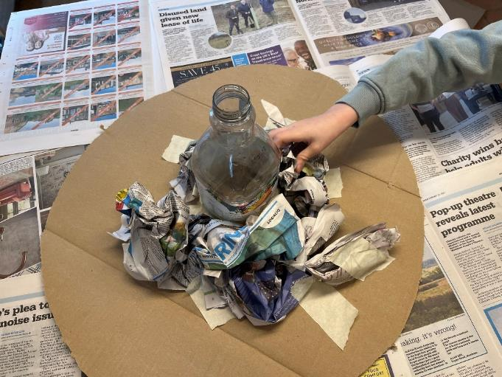
Notes:
Teacher’s Notes
Start by taping the bottle to the centre of the cardboard base. Crumple the newspaper into balls and position around the bottle, using small bits of tape to hold in place. Once you have created the desired shape, apply strips of tape all over to hold secure.

Slide 15
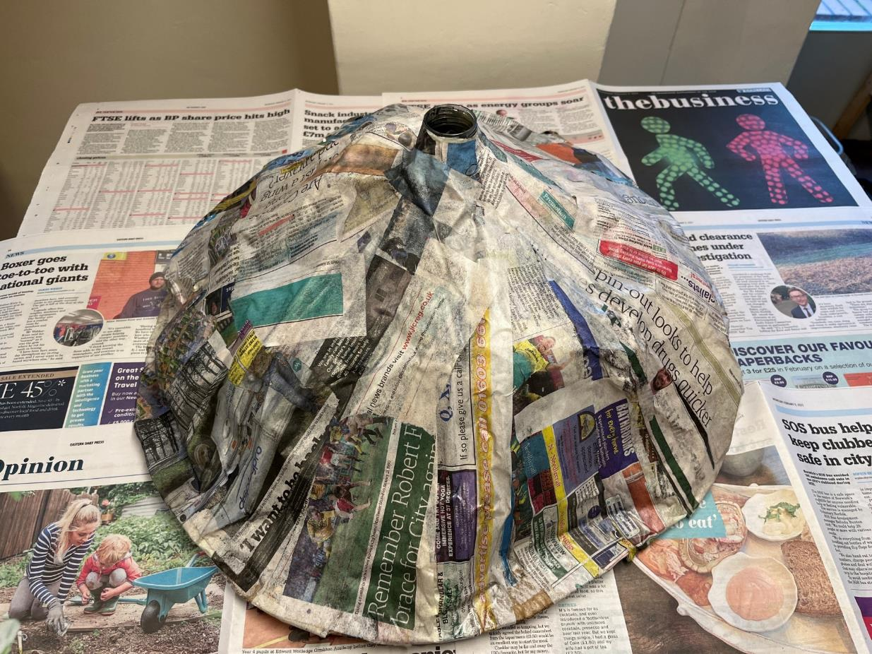
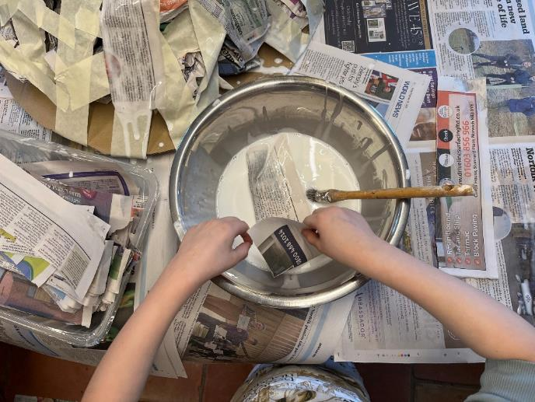
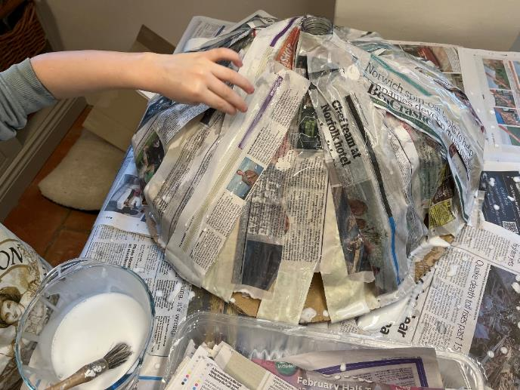
Notes:
Teacher’s Notes
Create your papier-mâché mixture by adding 1-part PVA to 2-parts water in a bowl. Prepare your newspaper by ripping into strips. Dip the paper strips into the glue mixture quickly (you don’t want them to get too wet!), and put on top of the volcano structure. Keep adding strips until the entire structure is covered with 2 or 3 layers of paper. Remember to not cover the mouth of the bottle! Once the entire structure is covered and there are no gaps, leave until fully dry.

Slide 16
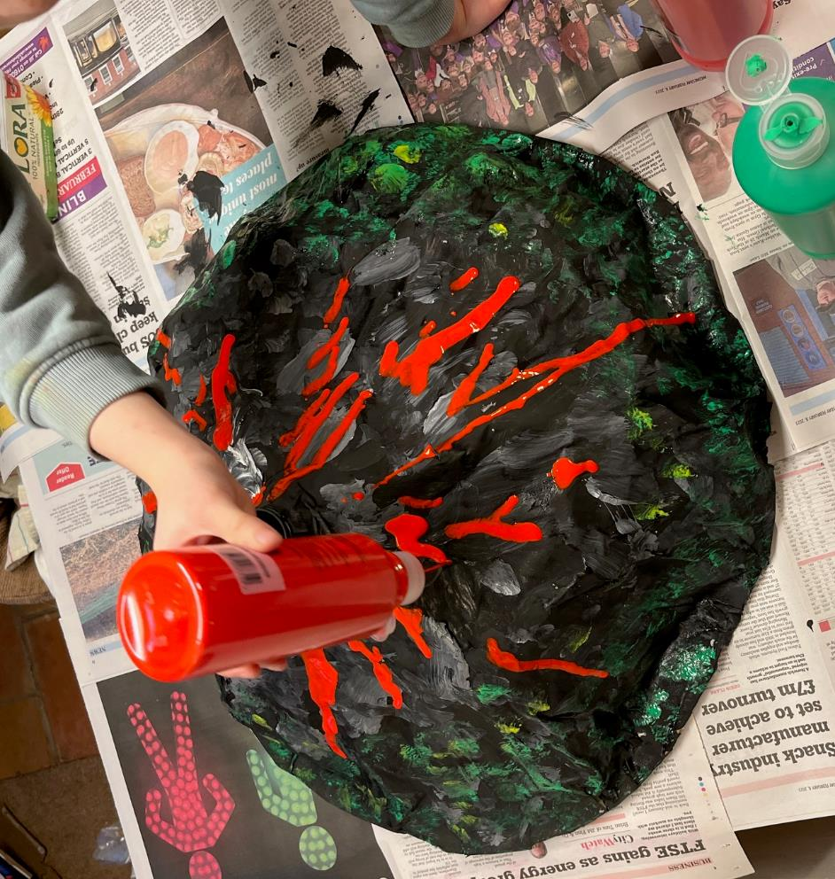
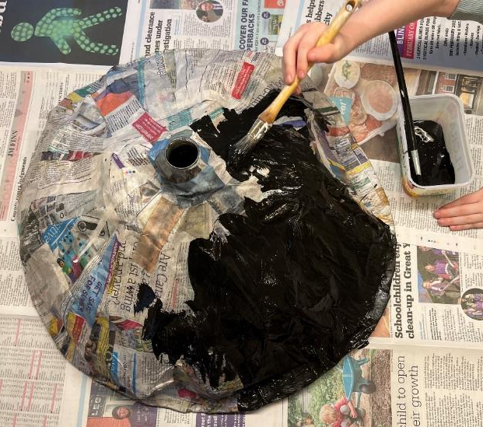
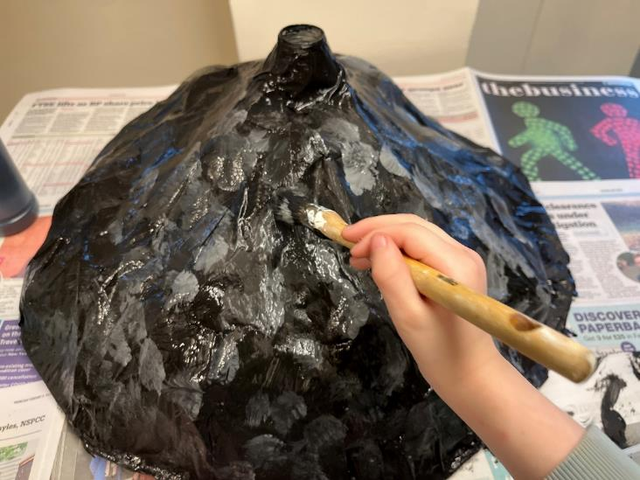
Notes:
Teacher’s Notes
Next, paint your volcano. Pupils can have free reign. You might want to show them some images of Mount Fuji and challenge them to recreate what they see. In these images the volcano was painted black with grey to add texture. Green and yellow paints were used around the base to suggest greenery, then dripped red and orange paint were used to resemble flowing lava. Once you have painted the volcano, leave it to dry.

Slide 17
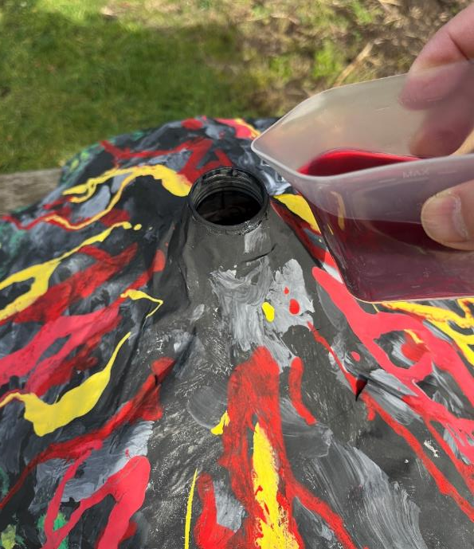
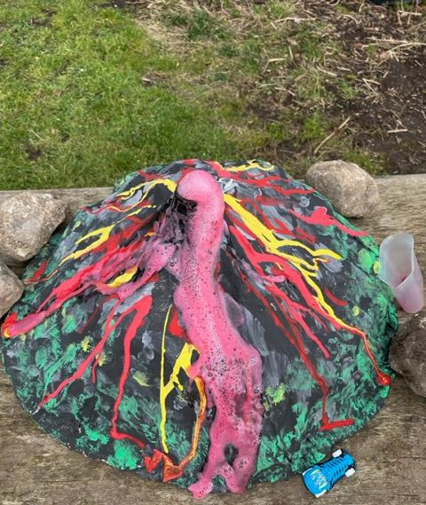
Notes:
Teacher’s Notes
Conduct the eruption somewhere easy to clean up, like outside on the playground. First, combine the bicarbonate of soda and washing up liquid in a small bowl, then add the water and mix thoroughly. Pour this mixture into the mouth of the bottle. In a small cup, mix together the vinegar and food colouring. Then, when ready, pour the vinegar mixture into the bottle. Wait for the eruption and watch how the lava flows. If the class has made several volcanoes, you may want to experiment with different amounts of bicarbonate and vinegar and see how this effects the volcano's eruption.
Ask pupils why they think the vinegar and bicarbonate of soda react in this way when they are mixed. Explain that we have created a chemical reaction by mixing an acid (vinegar) and an alkali (bicarbonate of soda). The vinegar causes the bicarbonate of soda to transform into water and carbon dioxide, a gas, which is released during the reaction to give the bubbling effect. The washing up liquid traps those bubbles so it flows over the volcano like real lava.

Slide 18
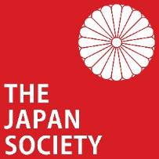
These resources were developed by Oliver Reed in collaboration with the Japan Society.
The Japan Society 13/14 Cornwall Terrace, London NW1 4QP
Tel: 020 7935 0475
Email: education@japansociety.org.uk
www.japansociety.org.uk
Follow us on:
@TheJapanSociety
The Japan Society
© The Japan Society

