Slide 1
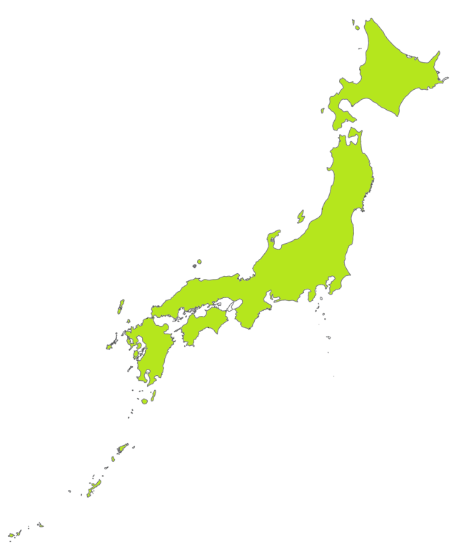
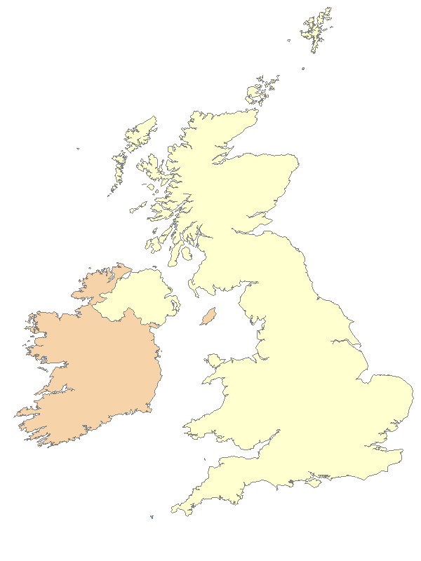
Warm up Activity
or
Notes:
Teacher’s Note
Designate one side of the classroom for ‘UK’ and one side for ‘Japan’.
Explain that for this activity, students will decide on whether the answer to a question is Japan or the UK and ‘vote with their feet’.
Students should move to the relevant side after you’ve read the question.
Alternatively, you can ask students to stand up or sit down depending on their answer.

Slide 2
Q1. Which has the highest mountain…
Japan or the UK?
The Japan Society

Slide 3
Answer 1. Which has the highest mountain…
Japan!
The Japan Society

Slide 4
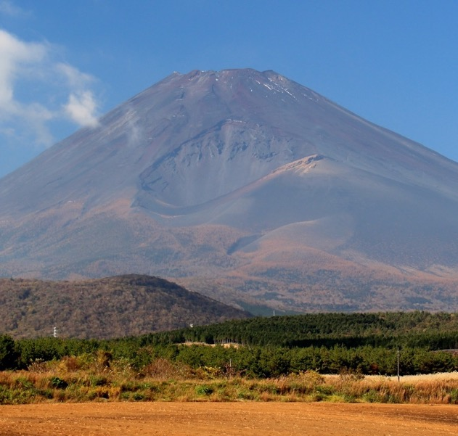
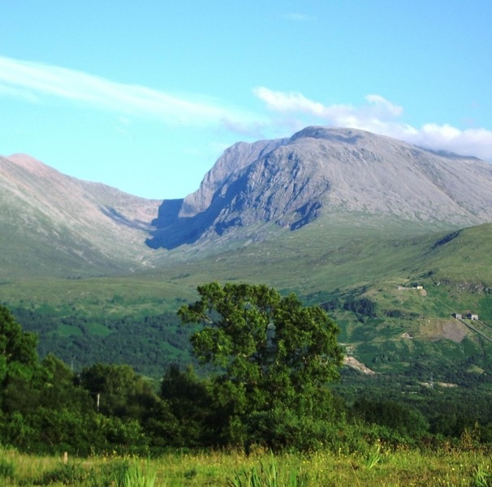
Japan has the highest mountain!
Mount Fuji
Ben Nevis
Mount Fuji by Alpsdake, CC BY-SA 4.0
Image of Ben Nevis, public domain
Notes:
Teacher’s Note
Ask children if they know the names of either mountain.
Mount Fuji (L) is 3,776 m and it is also an active volcano. The last time it erupted was 1707!
Ben Nevis (R) is 1,345 m. Ask children if they know where it is: England, Scotland, Wales or N. Ireland?
You could tell students that a long time ago it used to be an active volcano.

Slide 5
Q2. Which is smaller …
Japan or the UK?
The Japan Society
Notes:
Teacher’s Note
Tell students that these illustrations are not to scale.

Slide 6
Answer 2. Which is smaller …
the UK!
The Japan Society

Slide 7
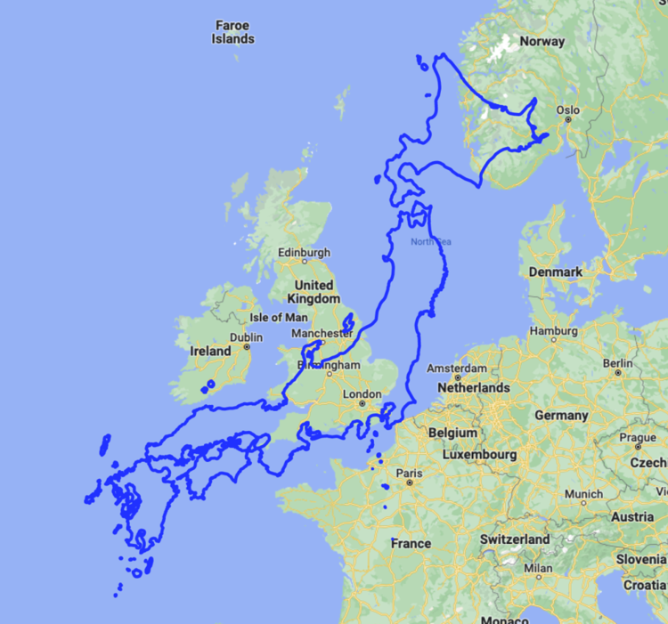
The UK is smaller than Japan!
Map Data © Google 2022, edited by the Japan Society
Notes:
Teacher’s Note
Tell students they might think the UK is bigger because of the size of the images on the previous slides and/or maps which are not to scale.
Explain that Japan is actually bigger.

Slide 8
Q3. Which has the most populous city…
Japan or the UK?
Populous means many people or a large population!

Slide 9
Answer 3. Which has the most populous city…
Japan!

Slide 10
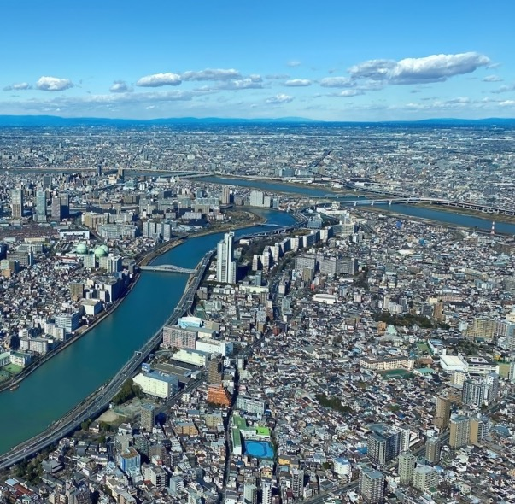
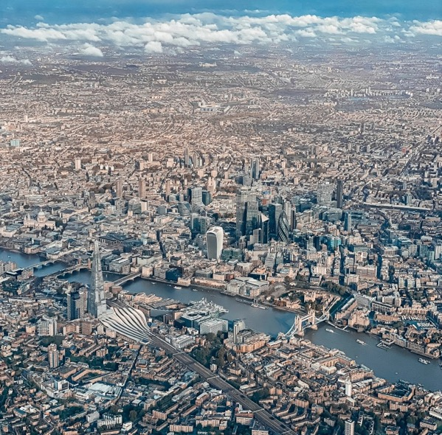
Japan has the most populous city.
Tokyo
London
Notes:
Teacher’s Note
Check students know the capital cities of Japan and the UK.
Here Tokyo (approx. 14 million people) is compared to London (approx. 9 million people).
You could compare Tokyo to Cardiff, Edinburgh, or Belfast (all under 1 million) as well.
Greater Tokyo is considered the world’s largest city.

Slide 11
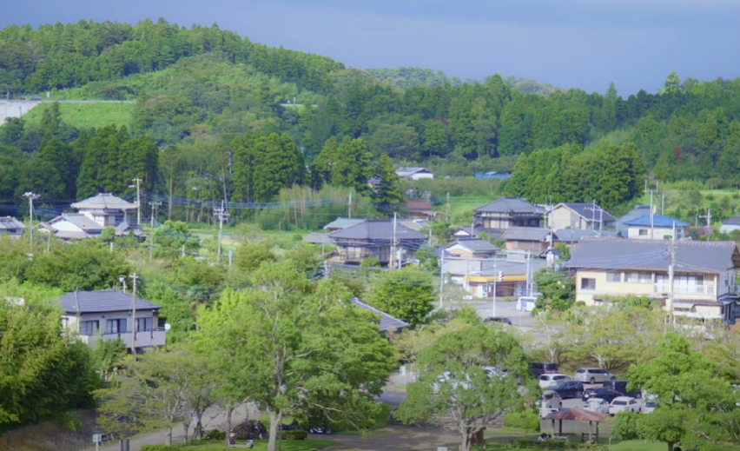
Watch the video to find out more!
Notes:
Teacher’s Note
Copy and paste address into your browser if the hyperlink doesn’t work: https://youtu.be/_01Eat0Zo_Q

Slide 12
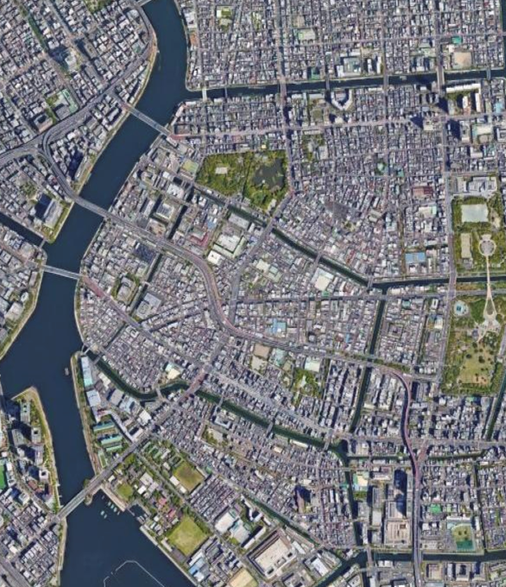
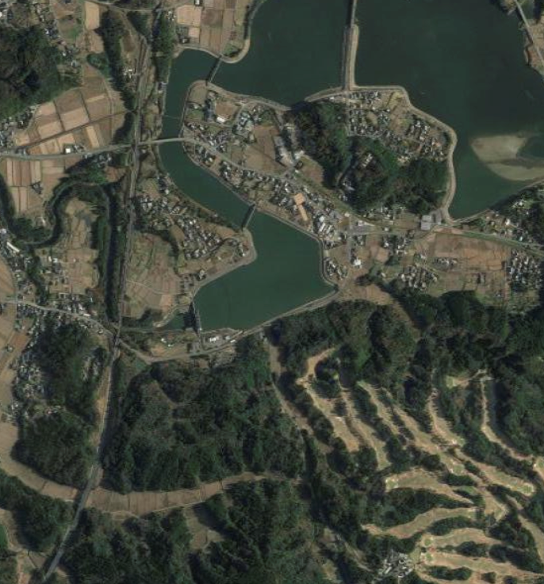
Task: Find one difference and one similarity between the pictures below.
Notes:
Teacher’s Note
After watching the video and discussing some of the questions in the lesson plan, ask students to come up with at least one similarity and one difference between these images. Set as a quick think, pair, share task.

Slide 13
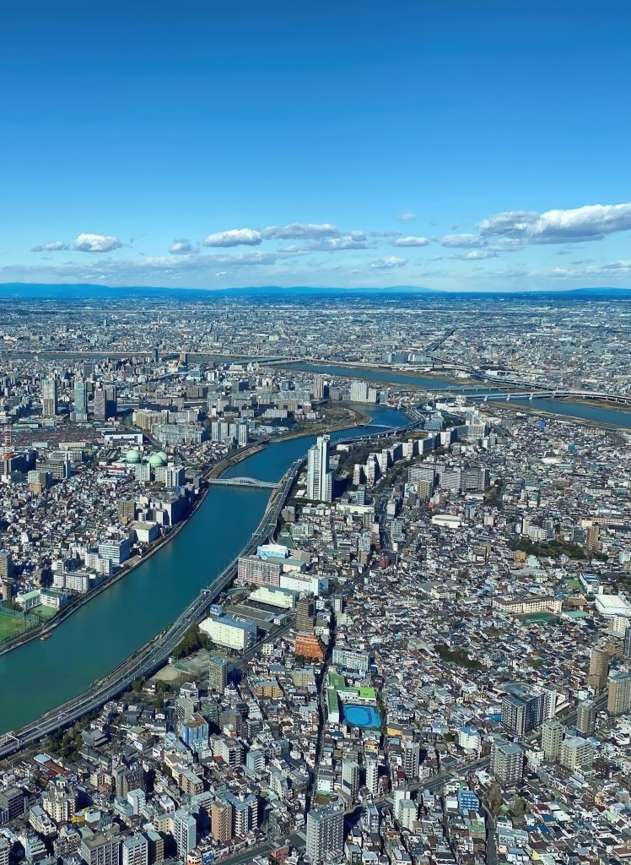
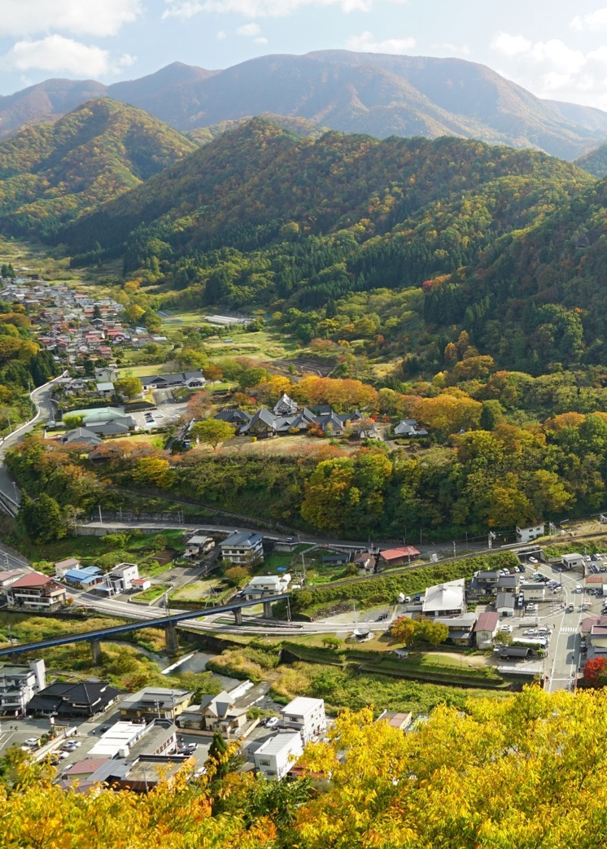
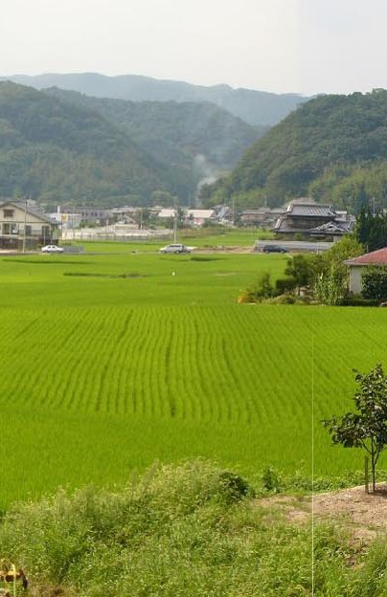
Rural and Urban Japan
Notes:
Teacher’s Note
Make sure students understand the key terms, urban and rural.
You may like to confirm other terms such as settlements, town, villages, city, etc.
Ask students to shout out some ideas of what they might see in a rural area and then an urban area.
If students are familiar with physical features and human features, ask them to identify them when looking at images as a class.
You may like students to compare some images to your local area.

Slide 14
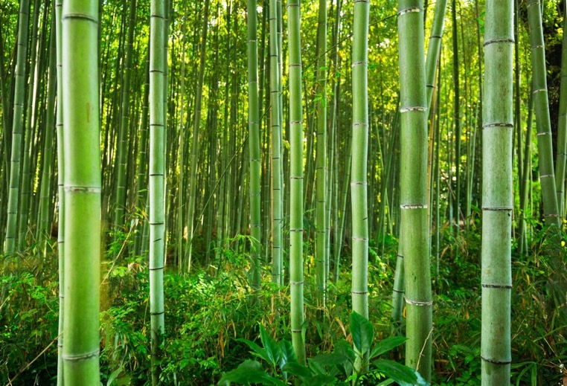
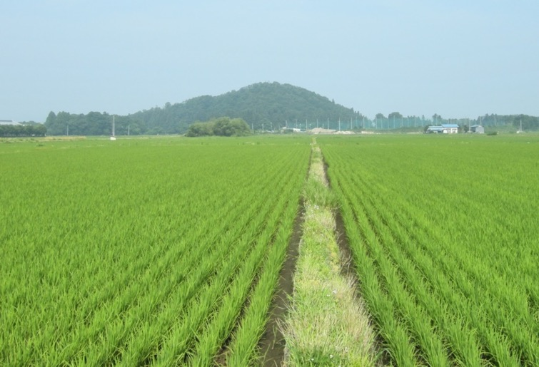
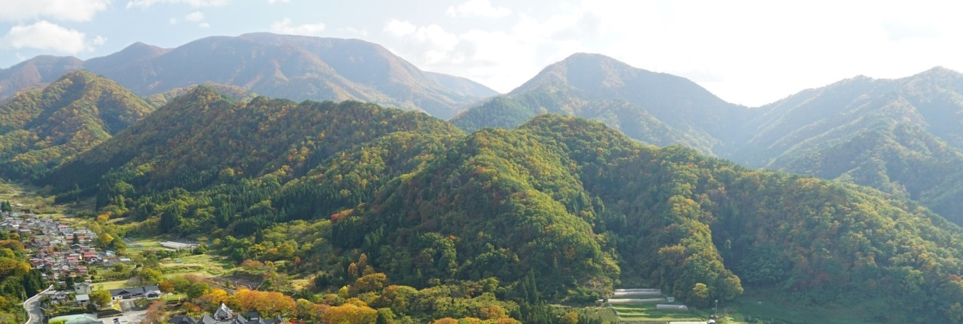
Bamboo 竹
Rice Paddies 田んぼ
Rural Japan
Mountains and Forests 山と森
Notes:
Teacher’s Note
This slide is intended as a quick look at some features seen in rural Japan – students may have more ideas.
More details are given in the following slides.

Slide 15
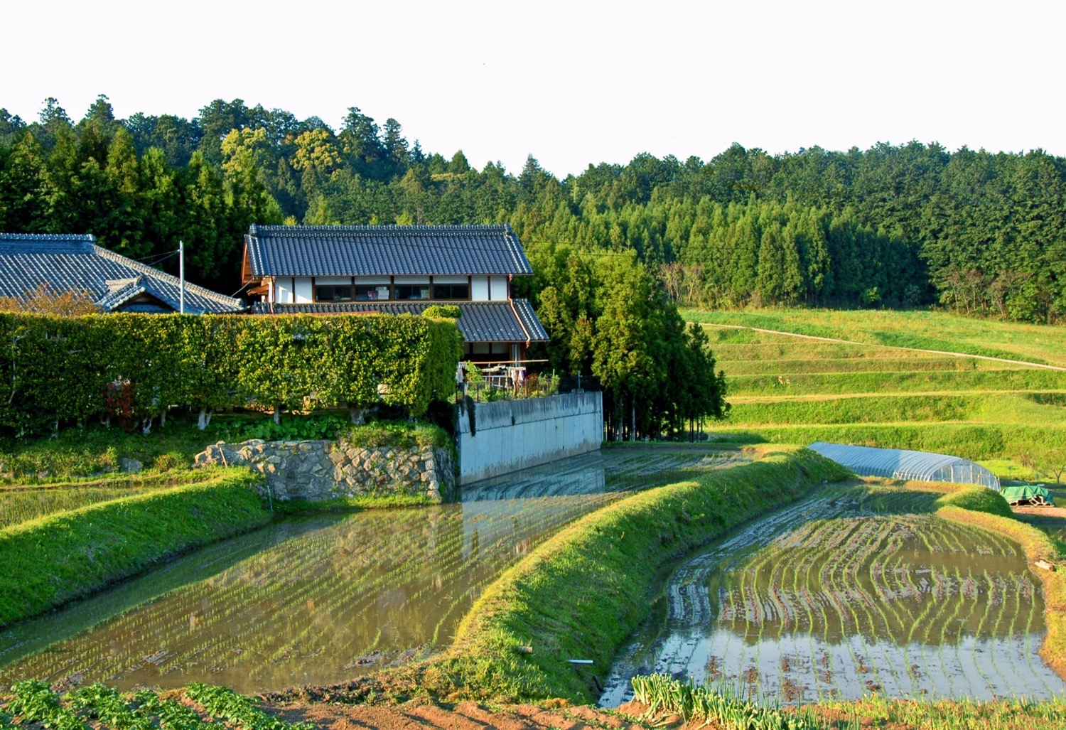
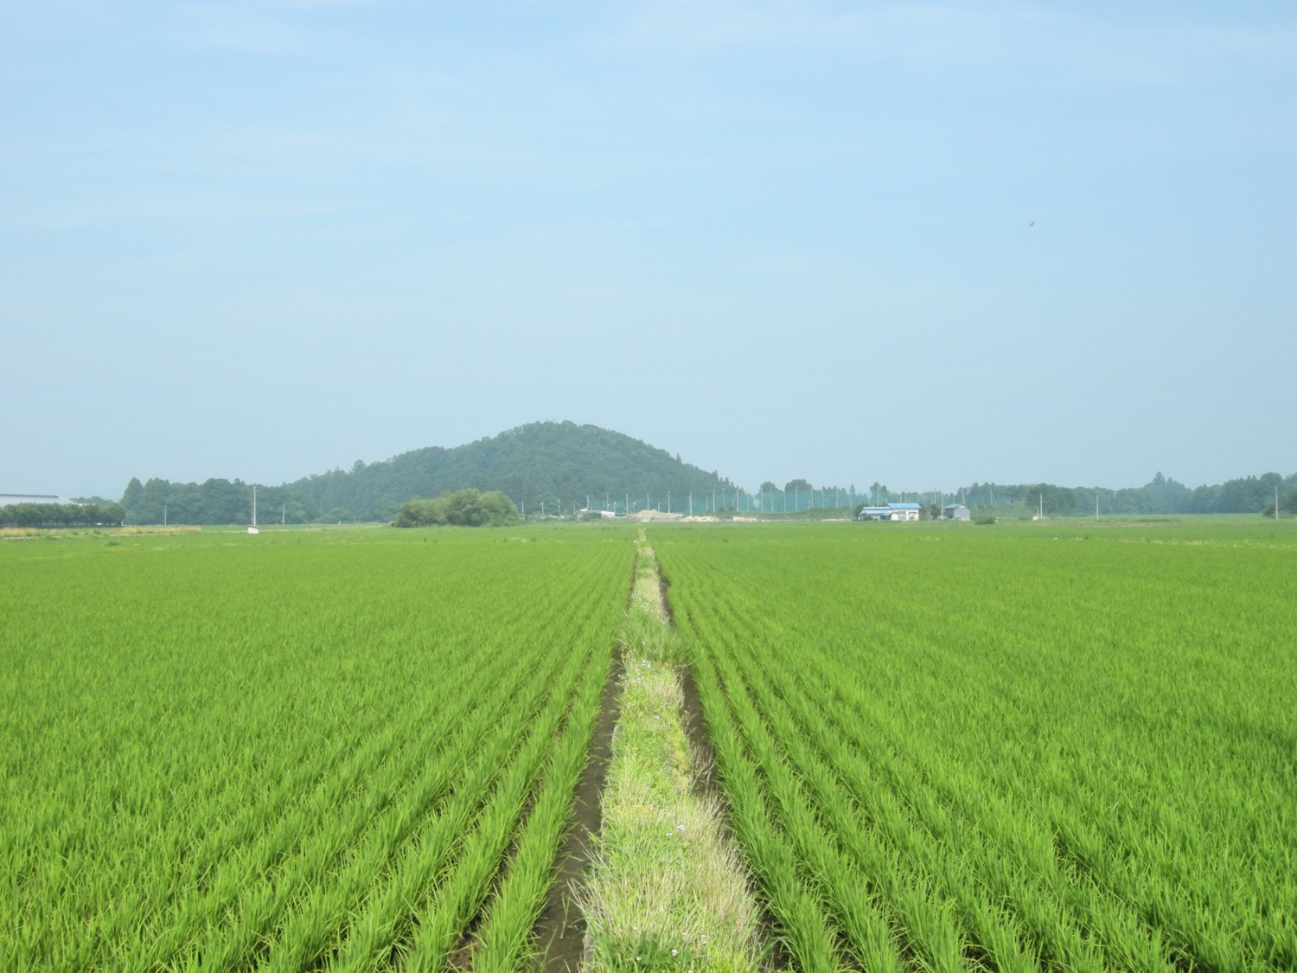
Notes:
Teacher’s Note
Recap the video explanation that rice is eaten everyday in Japan so land is needed to grow the rice.
Explain that the paddies need to fill with water (see second image) to grow rice so the land has to be flat.

Slide 16
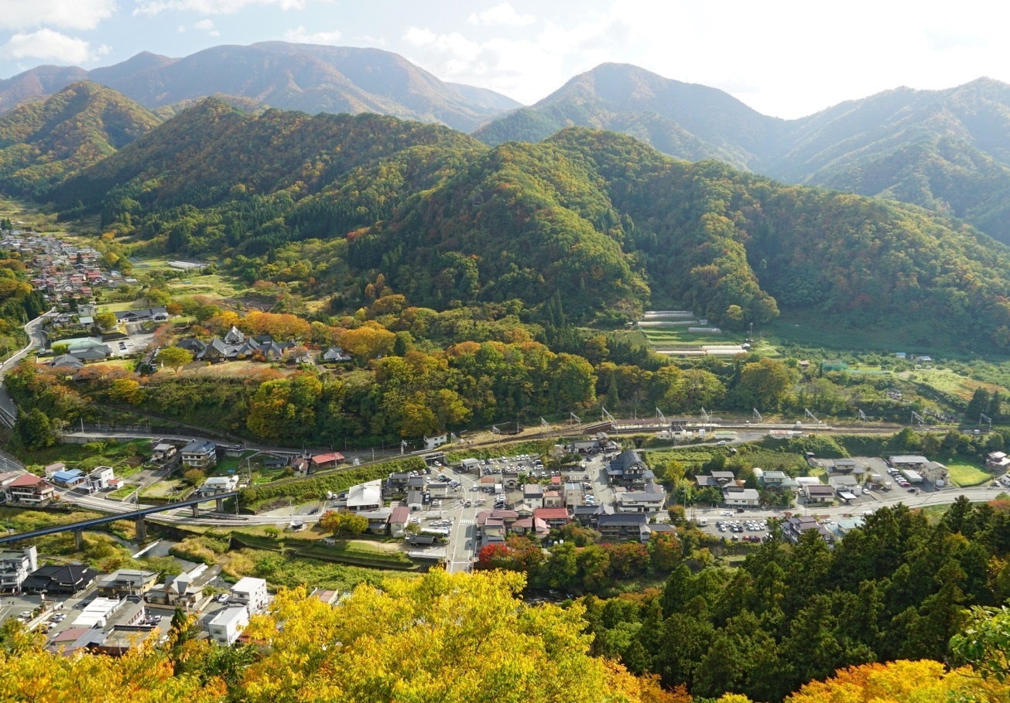
Notes:
Teacher’s Note
Tell students that a lot of Japan is covered in mountains and forests.
Approximately 70% of Japan’s land is mountainous.
And 68.5% of the land is forested areas (according to CIA world factbook, 2018).
Draw their attention to the roads and buildings – where are they? (Elicit the answer: flat land)

Slide 17
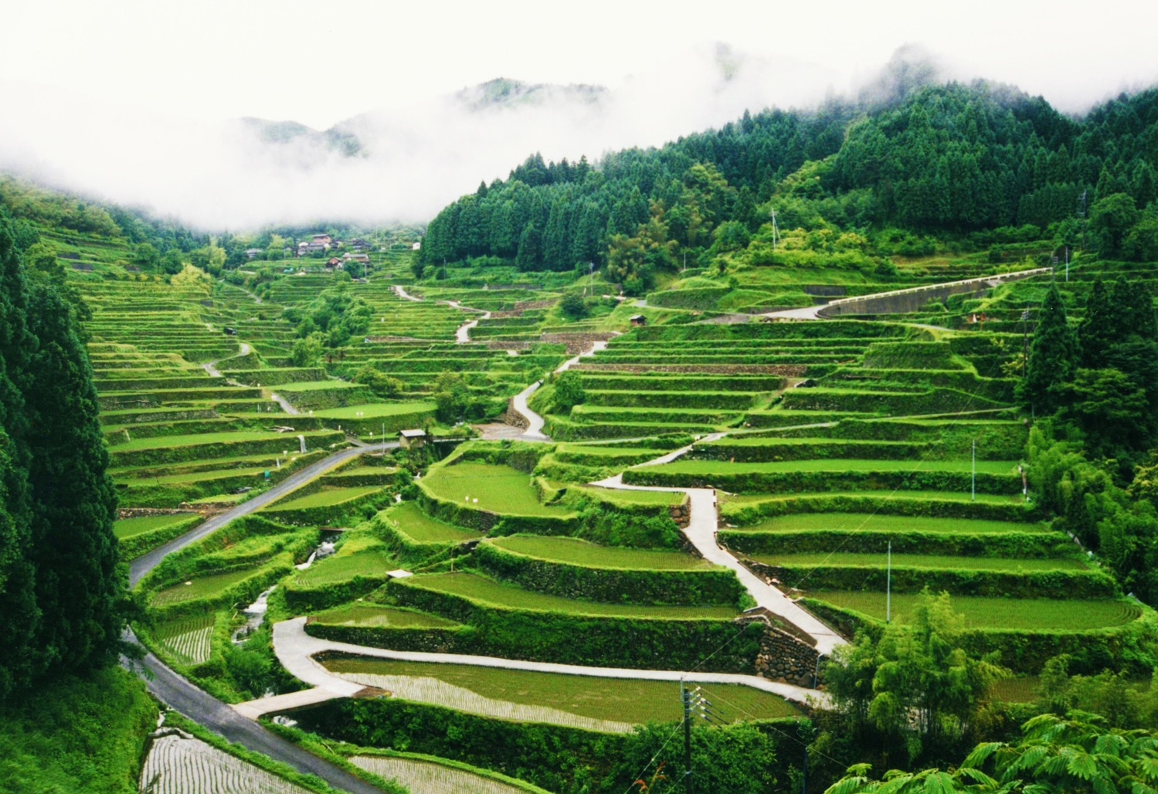
Notes:
Teacher’s Note
Here there are terrace rice paddies in the mountains and some buildings in the distance.
However, the mountains and forests mean that a lot of the land in Japan isn’t suitable for farming or for building places like homes, shops and schools.
There is a limited amount of suitable space for building on which is one reason why Japanese cities are so populous.

Slide 18
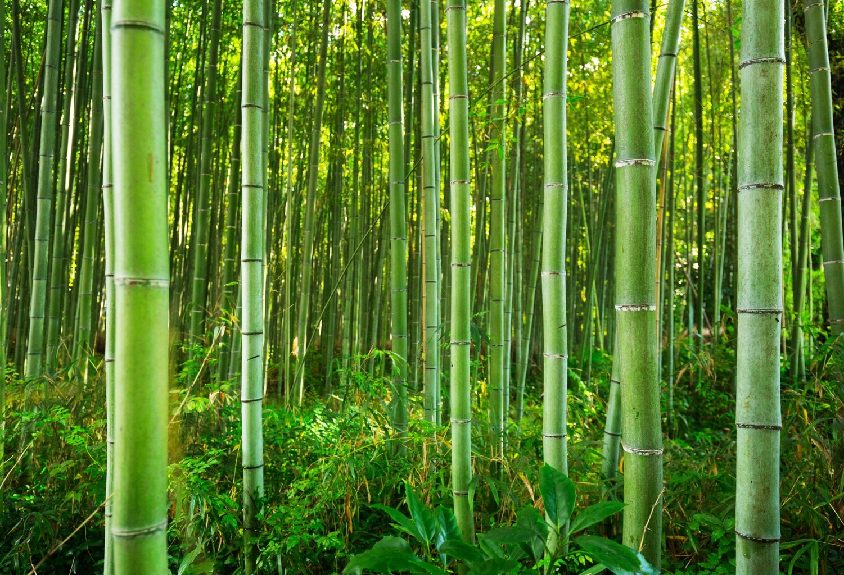
Notes:
Teacher’s Note
Bamboo is well suited to the Japanese climate (warm and humid) so bamboo groves are a common sight in rural Japan.
It grows quickly and is a strong and flexible material.
Objects such as toys, musical instruments, chopsticks and furniture can all be made from bamboo.

Slide 19
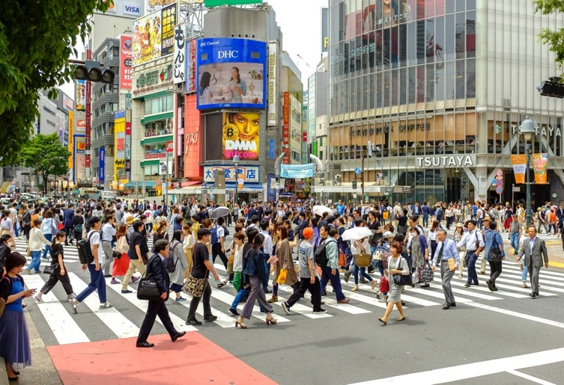
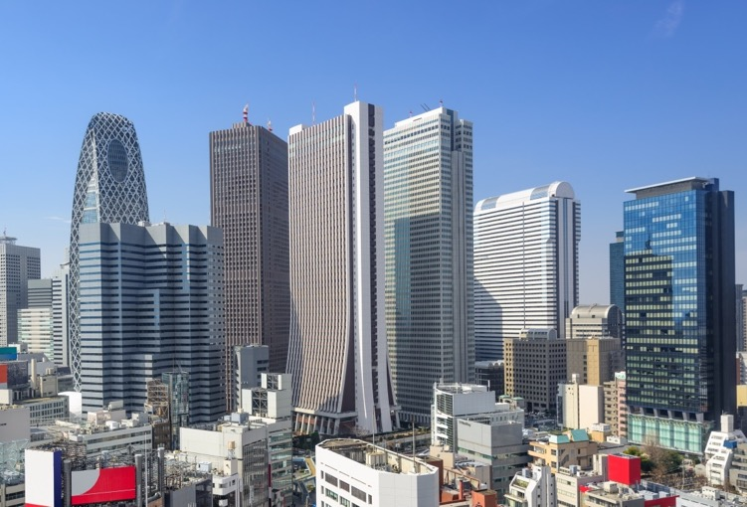
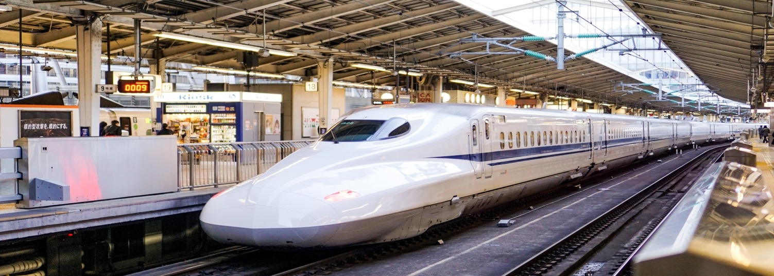
Busy streets にぎやかな道
Tall Buildings 高いビル
Urban Japan
Bullet Trains 新幹線
Notes:
Teacher’s Note
This slide is intended as a quick look at some features in urban areas – students may have more ideas.
More details are given in the following slides.

Slide 20
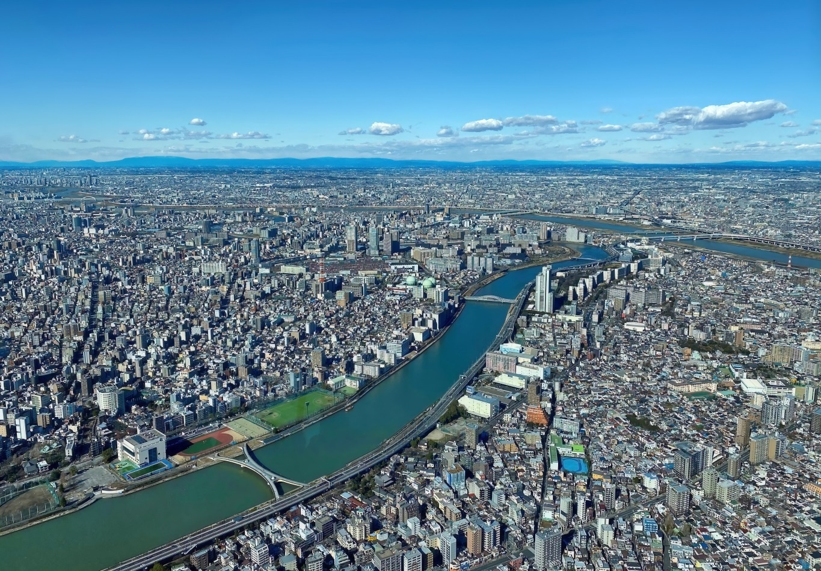
Landscape
Notes:
Teacher’s Note
This is Tokyo. Can they see any mountains? (They might be able to make out the mountains in the far distance).
Why might this area have developed into a city? (As appropriate for your class – flat land, proximity to a river, etc.)

Slide 21
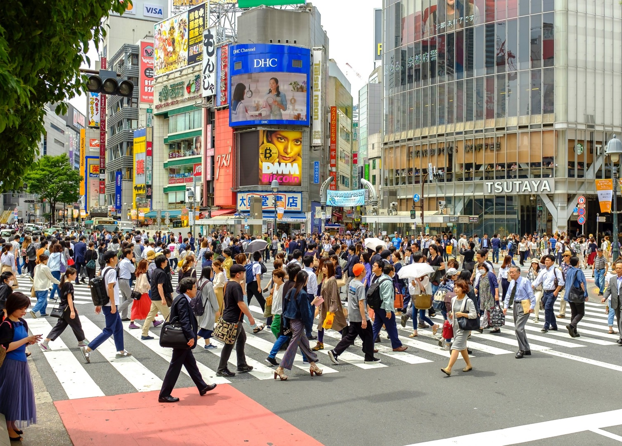
Notes:
Teacher’s Notes
The majority of the population in Japan lives in cities (92% according to the CIA World Factbook, 2022), making them very busy.
There are lots of people, places to work and leisure and entertainment options.

Slide 22
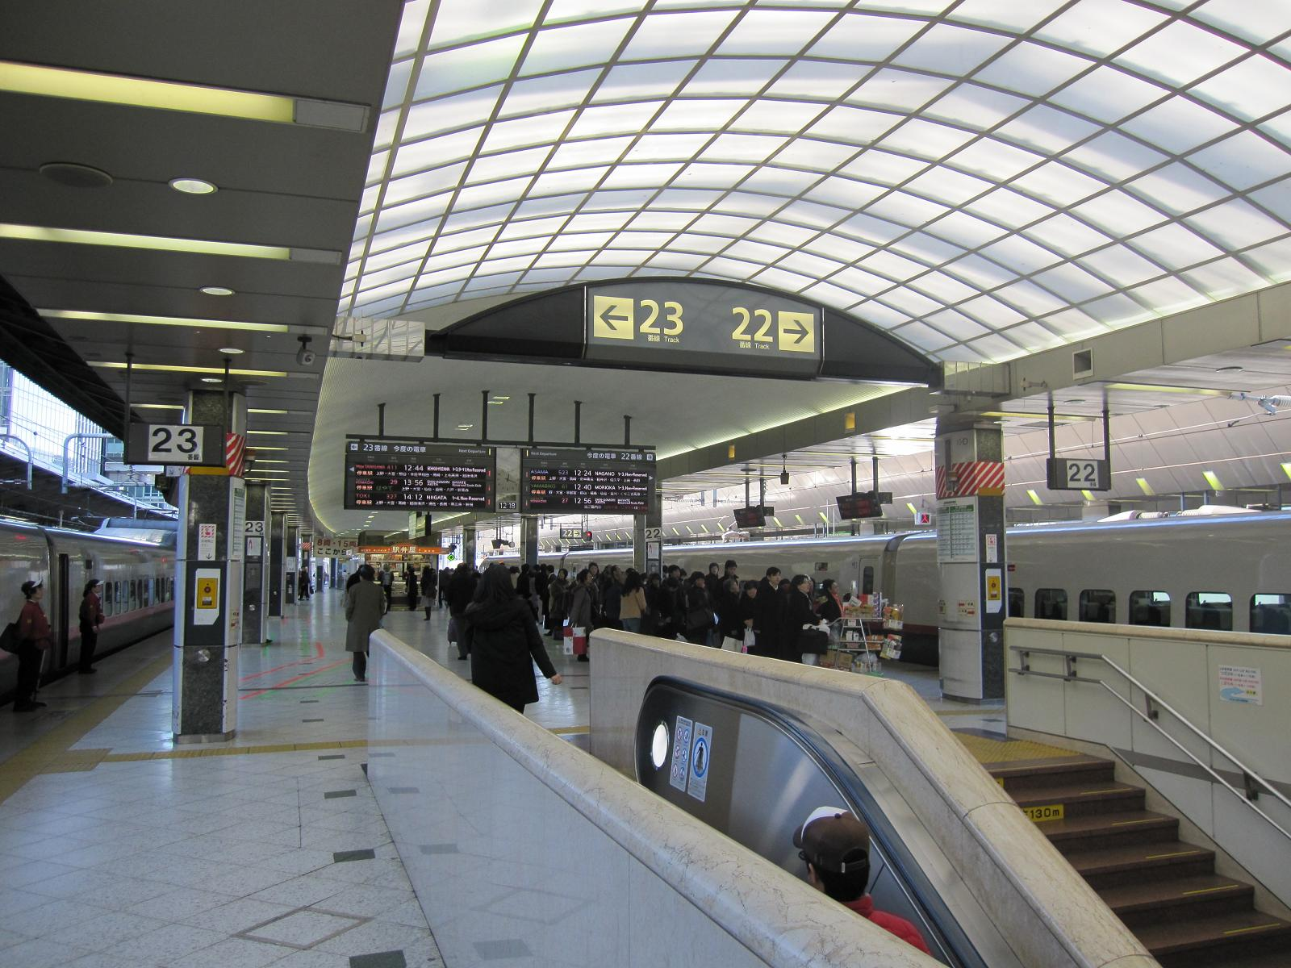
Notes:
Teacher’s Notes
Japanese cities are well-connected. People travelling in cities in Japan will have a lot of options to get to their destination using public transport, possibly including: planes, high-speed trains called shinkansen (bullet train), local trains, the metro system, buses, taxi, tram, and monorail.
Point out that the station in this image has over 20 platforms!

Slide 23
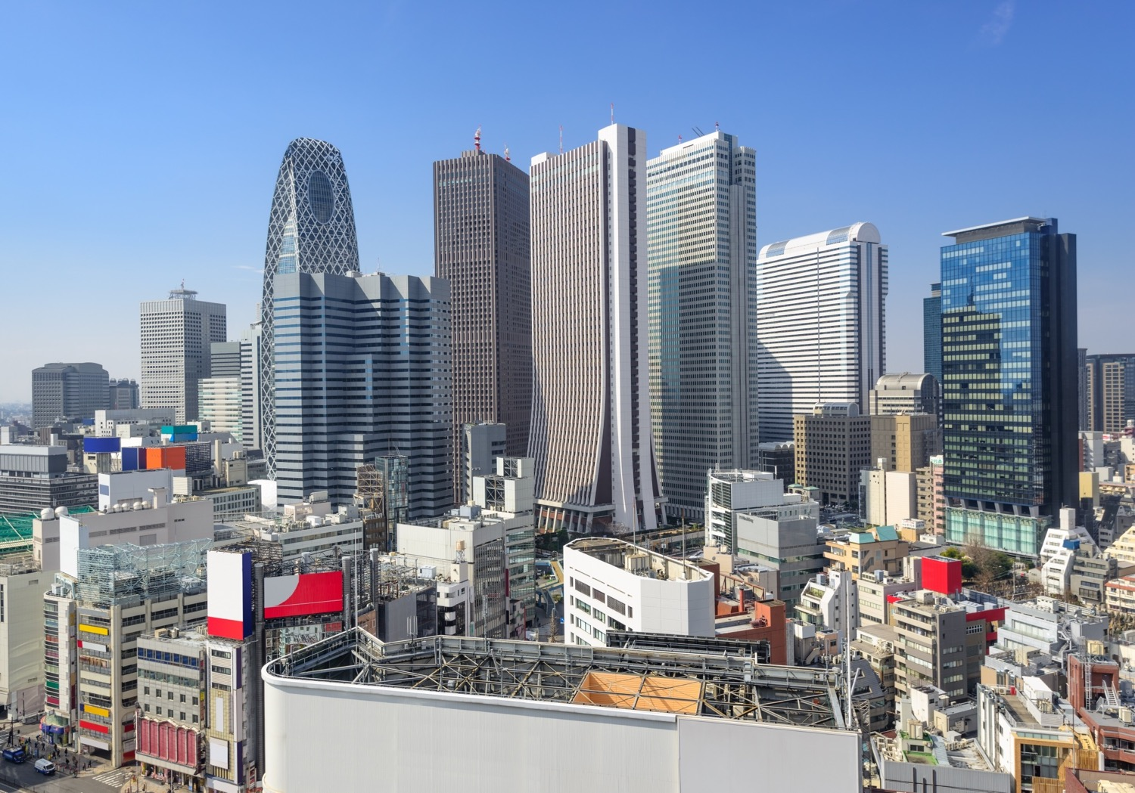
Notes:
Teacher’s Note
These tall buildings are offices in central Tokyo.

Slide 24
Urban and rural areas have differences, but they also have things in common.
Wherever people live, they need access to basic facilities, such as homes, shops and schools.
Facilities may be different, depending on the area.
Let’s look at some examples…

Slide 25
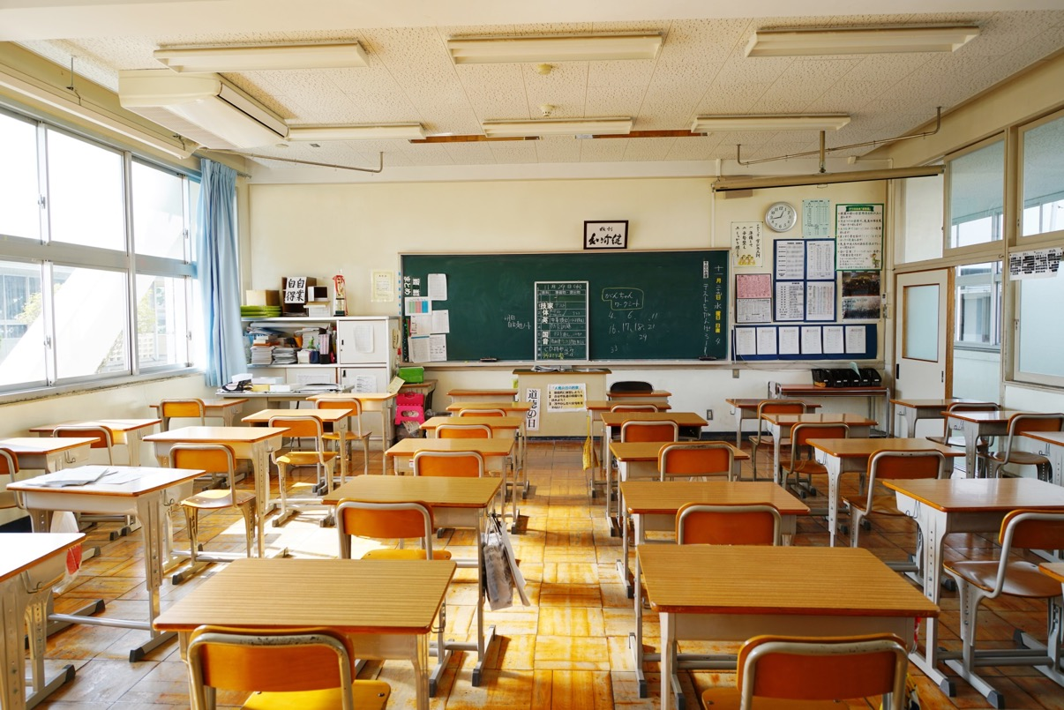
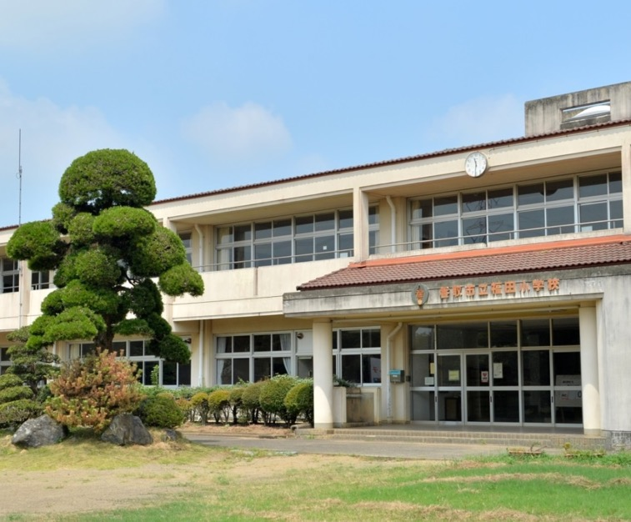
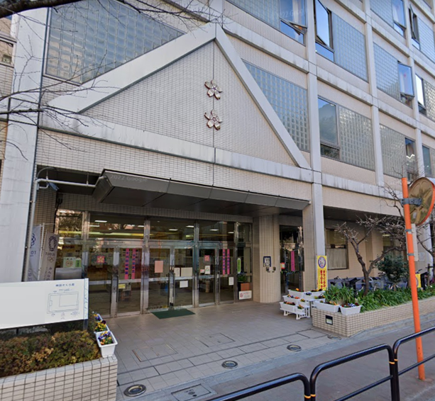
Schools
Notes:
Teacher’s Note
Left: a typical school in rural or suburban Japan (2 or 3 stories high with a large open playground for sports)
Right: a city school on a road and attached to neighbouring buildings.
Additional image: Classrooms in both rural and city areas look similar – each student has a desk which can be easily moved for group work or lunch times (lunch is eaten in the classroom).

Slide 26
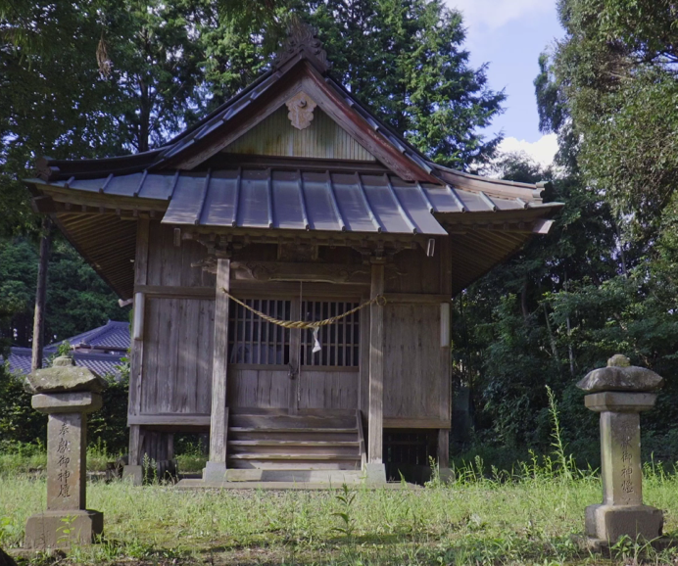
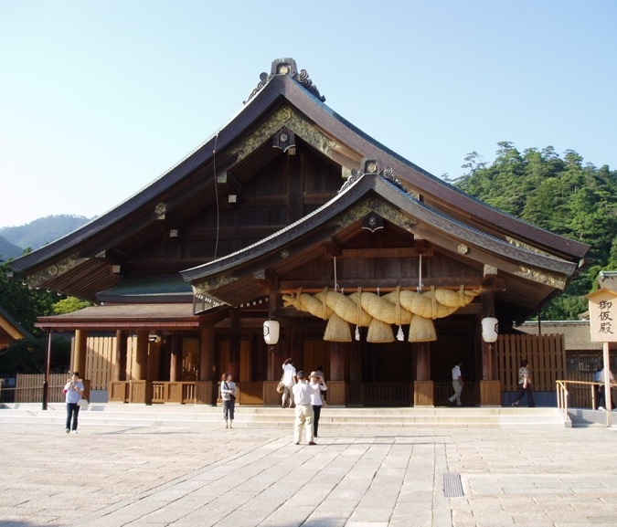
Places of Worship
Notes:
Teacher’s Notes
Left: Students see this building in the video – do they remember what it is? It’s a shrine, which is a Shinto place of worship. This is a small local one.
Right: This shrine (Izumo Taisha in the city of Izumo) is one of the oldest and most important shrines in Japan. It is a popular tourist sightseeing spot.
The two main religions in Japan are called Shinto and Buddhism. Shinto is Japan's own religion, Buddhism came to Japan from other countries.
There are both Shinto shrines (and Buddhist temples), large and small, all across Japan in rural areas and city centres.
There are some churches, mosques, and other religious buildings, but they are not common.

Slide 27
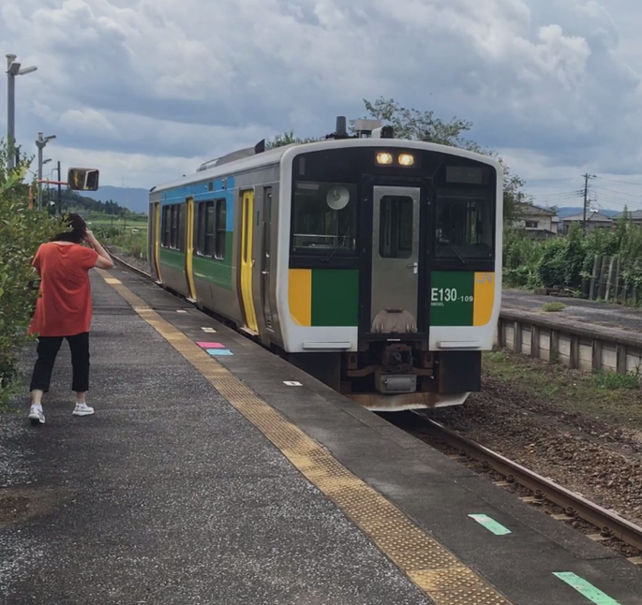
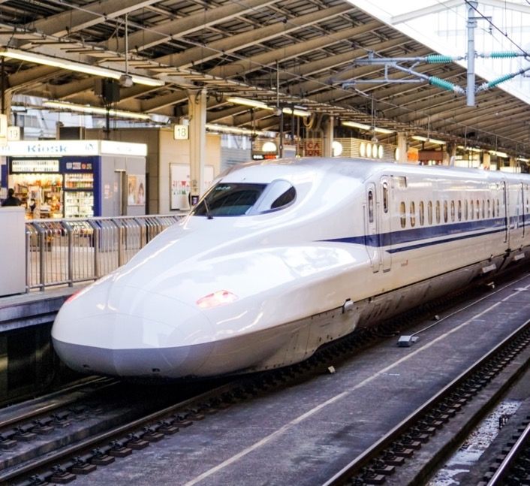
Transport
Notes:
Teacher’s Note
Left: A local train with only 1 carriage – it will make lots of stops in towns and rural areas.
Right: The shinkansen or ‘bullet train’ travels a long distance and is very fast. It only stops at major cities.
Ask students: Does this look similar or different to trains you have travelled on? How so?
What other modes of transport did you hear about or see in the video?

Slide 28
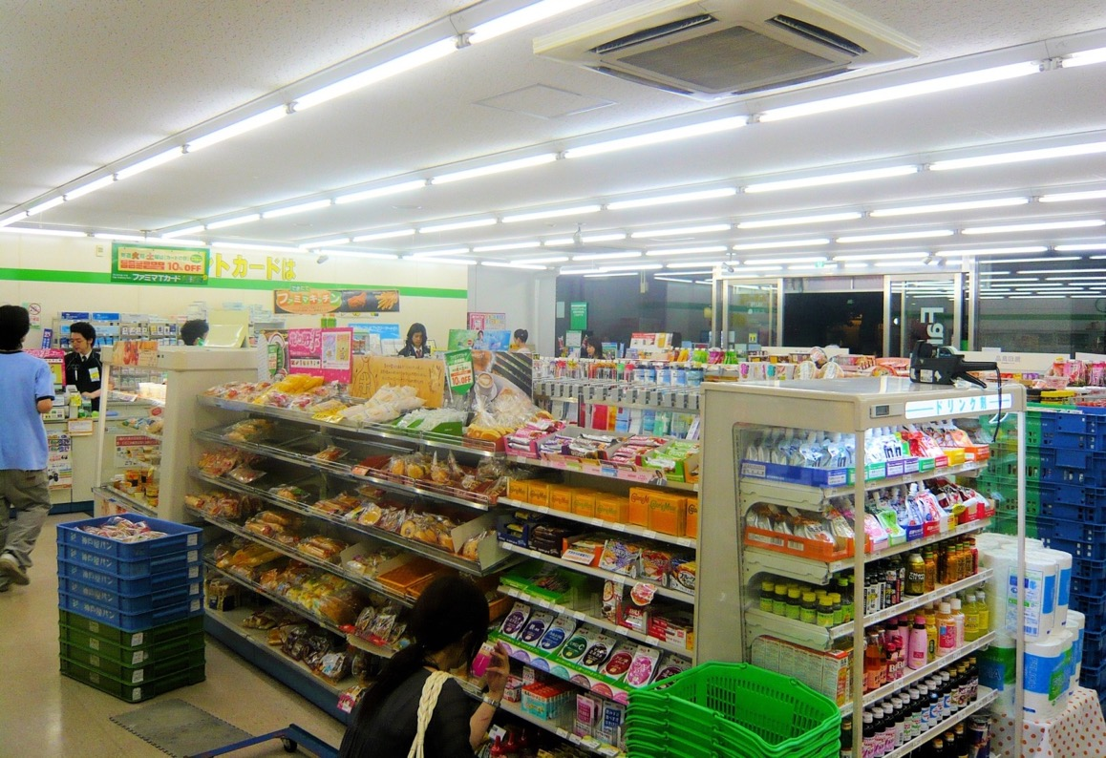
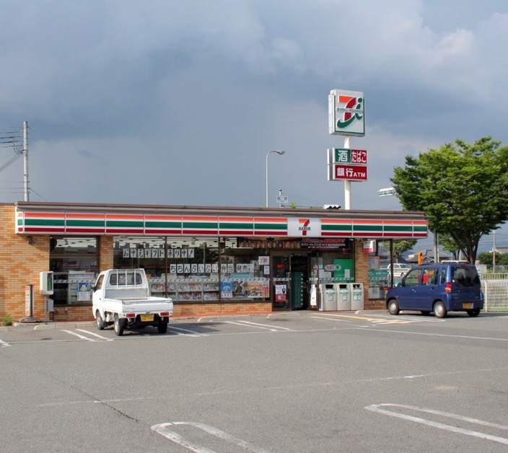
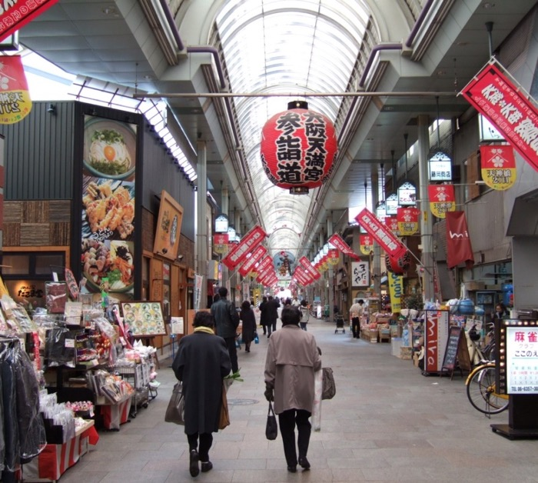
Shops
Notes:
Teacher’s Note
Left: Rural areas may only have a few shops and people may have to drive there. This is a convenience store, called conbini, open 7 days a week, 24 hours a day.
Right: Shows a covered shopping street/arcade – these are common in Japanese cities.
Nowadays many rural areas have a conbini, but in cities they are on practically every street corner. Like a small supermarket, they are well-stocked with things that people might need on the go (see additional image).

Slide 29
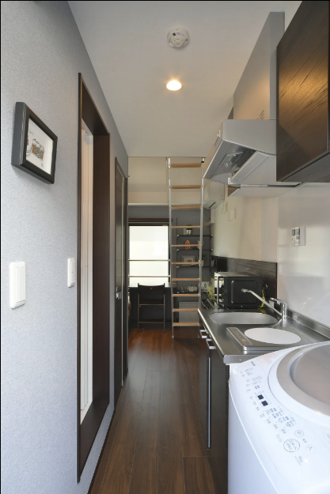
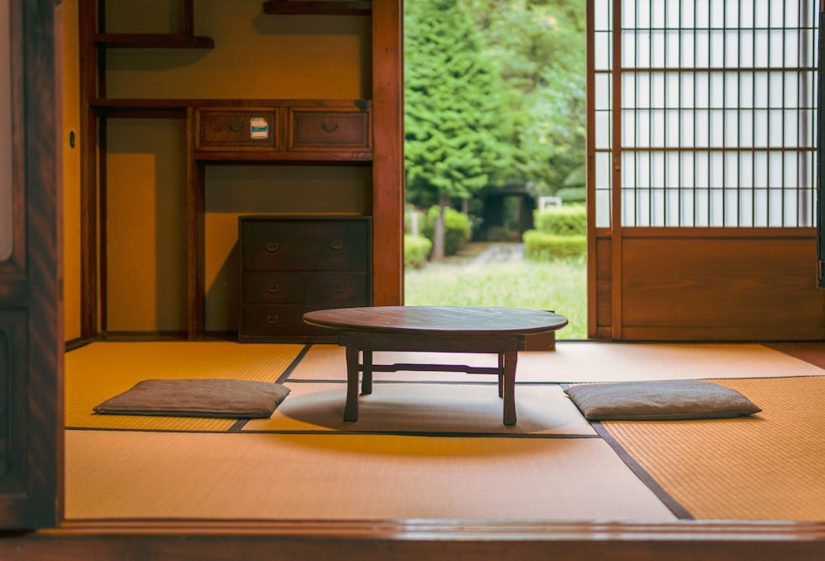
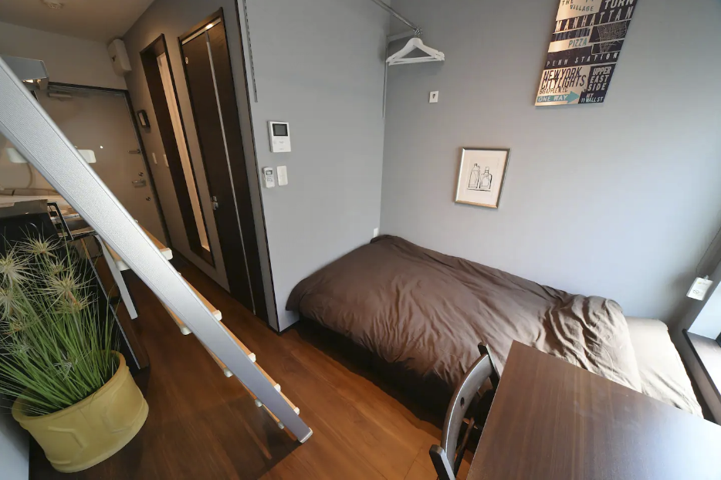
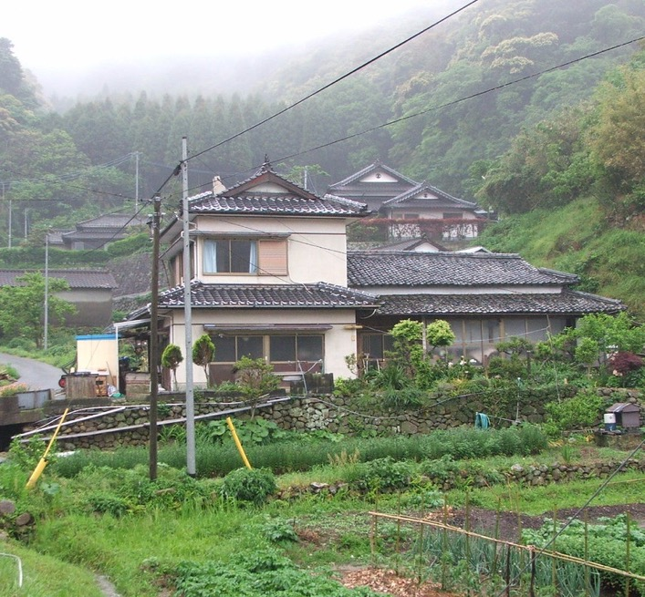
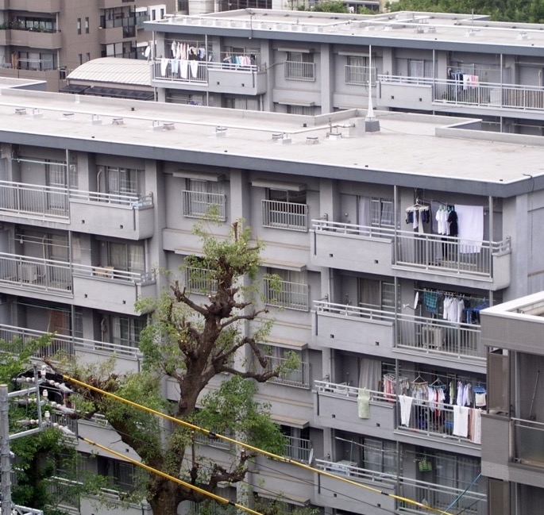
Homes
Notes:
Teacher’s Note
Left: A large detached home in a rural area. Traditional-style homes featuring paper sliding doors (shoji) and tatami mats are more common there.(See additional image)
Right: Apartment buildings in cities. Many people in cities live in apartments. Some are very small (see additional image)
Additional images: Traditional tatami flooring and paper sliding doors; a “micro” apartment which has a washing machine and kitchen in the corridor by the front door. There is a small bathroom to the left and a bed at the back.

Slide 30
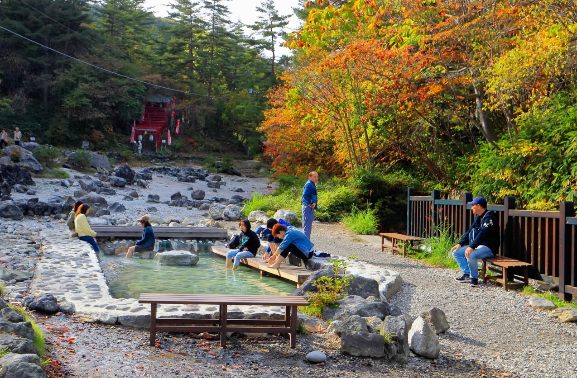
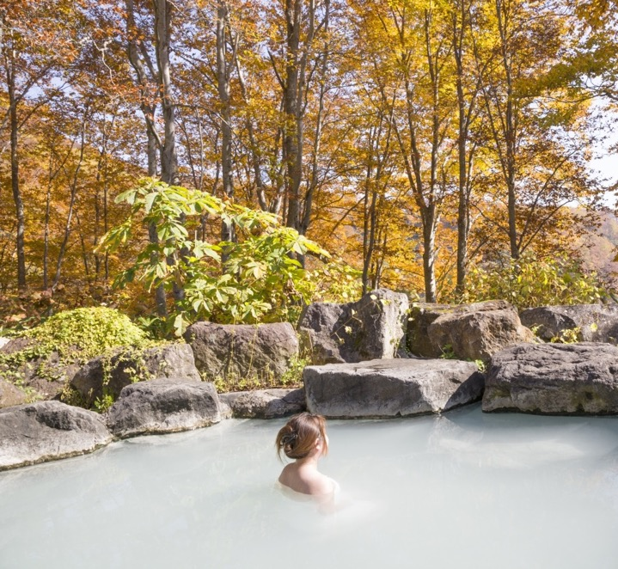
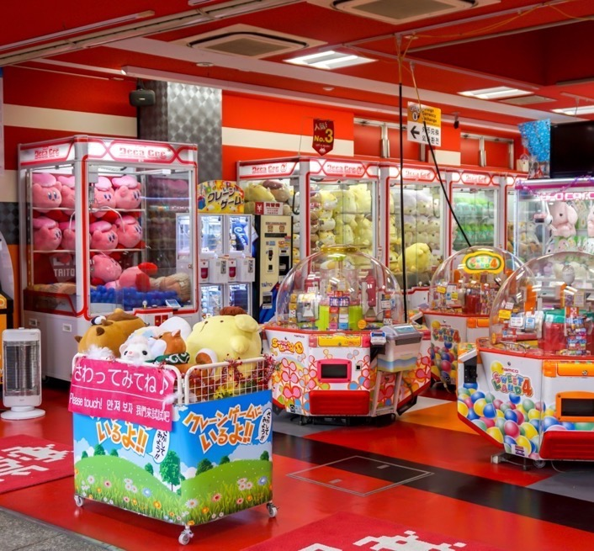
Leisure & entertainment
Notes:
Teacher’s Notes
Left: a hot spring, called onsen in Japanese. Explain that it’s naturally hot water from the ground which people can bathe in.
Right: a games arcade which are a common and popular source of entertainment in Japanese cities.
There are onsen in cities and even ‘onsen towns’ (where there are many hot springs) but many Japanese people also travel to rural areas for relaxing onsen or ‘foot onsen’ in natural settings (see additional image).
Ask students what other forms of leisure or entertainment they would expect to find in cities/rural areas.

Slide 31
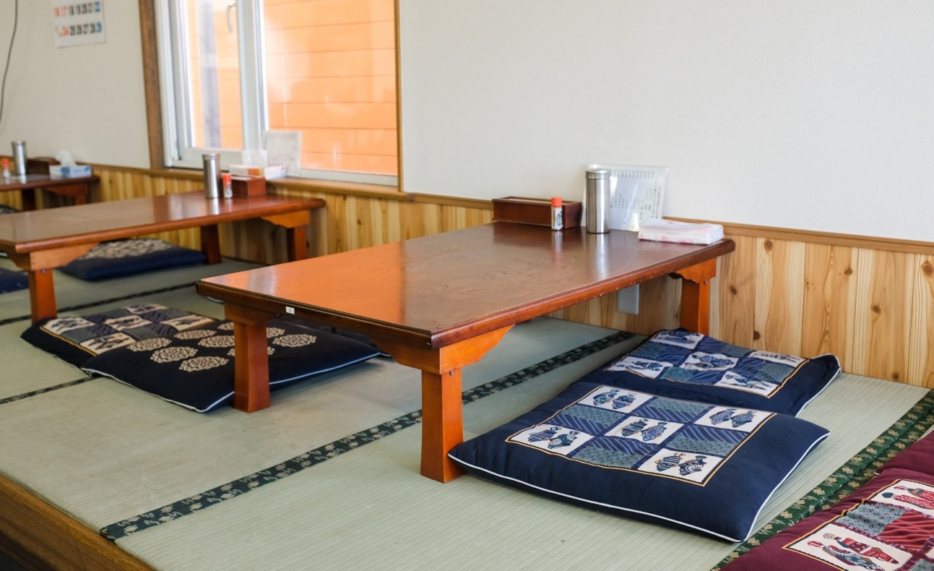
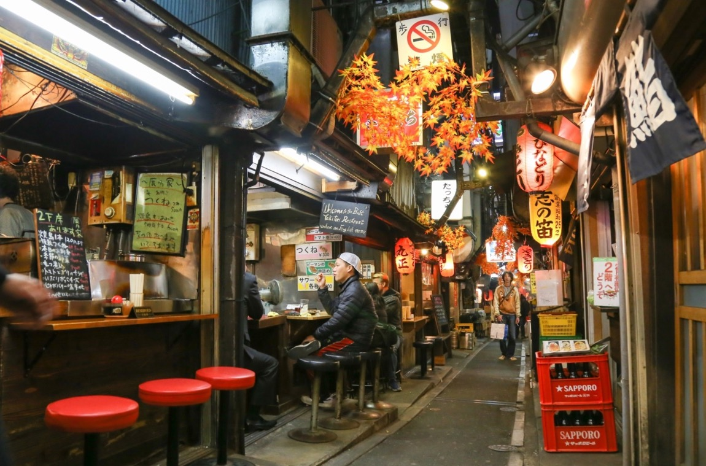
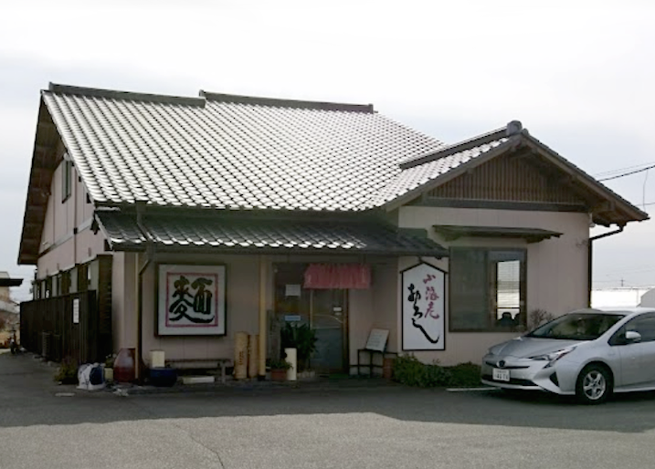
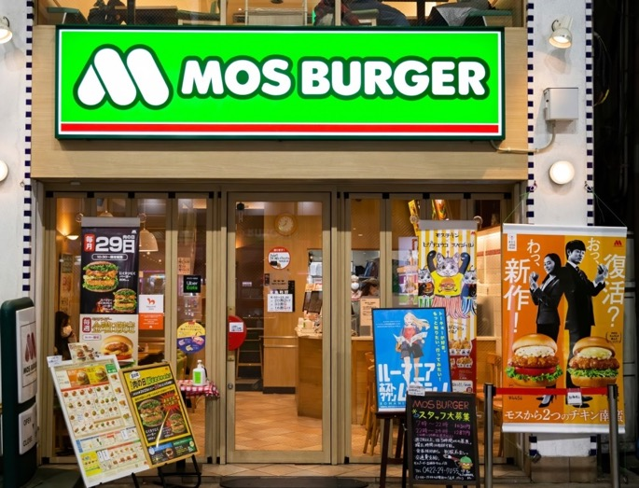
Restaurants
Notes:
Teacher’s Notes
Left: A restaurant in a rural area which serves noodles.
Right:A fast-food burger chain in Japan. As well as usual options it has Japanese-style items such as a “Teriyaki Burger”.
Restaurants in cities tend to be brightly lit and in main shopping areas. There are many choices and some streets have lots of very small restaurants clustered together. (See additional image). Rural areas may only have 1 or 2 restaurants.
Some restaurants (in both rural areas and cities) have traditional seating - tatami mats (made from woven straw), with low tables and cushions for the customers to sit on. (See additional image).

Slide 32
Workplaces
Notes:
Teacher’s Note
Left: A local town hall office in a rural area.
Right: Offices and high-rise buildings in central Tokyo.
Ask students for their ideas about other workplaces or jobs people might do in cities or rural areas.

Slide 33
Sort the images
into rural and urban
Notes:
Teacher’s Note
Give out the photo sets and ask the students to sort them in groups.

Slide 34
Activity 1
Compare the images of urban and rural Japan.
Write down things which are:
1. Different
2. Similar
3. The same
Notes:
Teacher’s Note
Choose between this activity (recommended KS1/lower KS2) or the ones on the following slides. Time depending, you could pick multiple activities.
Draw a venn diagram on the board and do a few examples together as a class.
See additional resources for a venn diagram worksheet or ask students to draw their own.

Slide 35
Activity 2
Compare one set of images (urban or rural) to another place.
Write down things you spot which are:
1. Different
2. Similar
3. The same
Notes:
Teacher’s Note
Choose between this activity (recommended KS1/lower KS2) or the ones on the previous/following slides. Time depending, you could pick multiple activities. Draw a venn diagram on the board and do a few examples together as a class.
See additional resources for a venn diagram worksheet or ask students to draw their own.

Slide 36
Activity 3
Imagine you meet a genie on your way to school. They offer to move you to Japan!
You can live in the countryside or the city. Discuss with your group:
Benefits of living in your chosen area?
Disadvantages of living in your chosen area ?
Notes:
Teacher’s Note
Choose between this activity (recommended upper KS2) or the previous slides (recommended KS1/lower KS2). Time depending, you could pick multiple activities.
You can designate groups as city or countryside or let them choose freely.
Draw a simple grid on the board and do a few examples together as a class.

Slide 37
Question Time!
Would you like to live in the Japanese countyside or a Japanese city?
Why?
Be ready to give your reason!
Notes:
Teacher’s Note
You can ask students to vote with their feet again or set as a think, pair, share or individual activity if short on time.

Slide 38
The Japan Society 13/14 Cornwall Terrace, London NW1 4QP
Tel: 020 7935 0475
Email: education@japansociety.org.uk
www.japansociety.org.uk
Follow us on:
@japansocietylon
@JapanSocietyLondon

