Slide 1
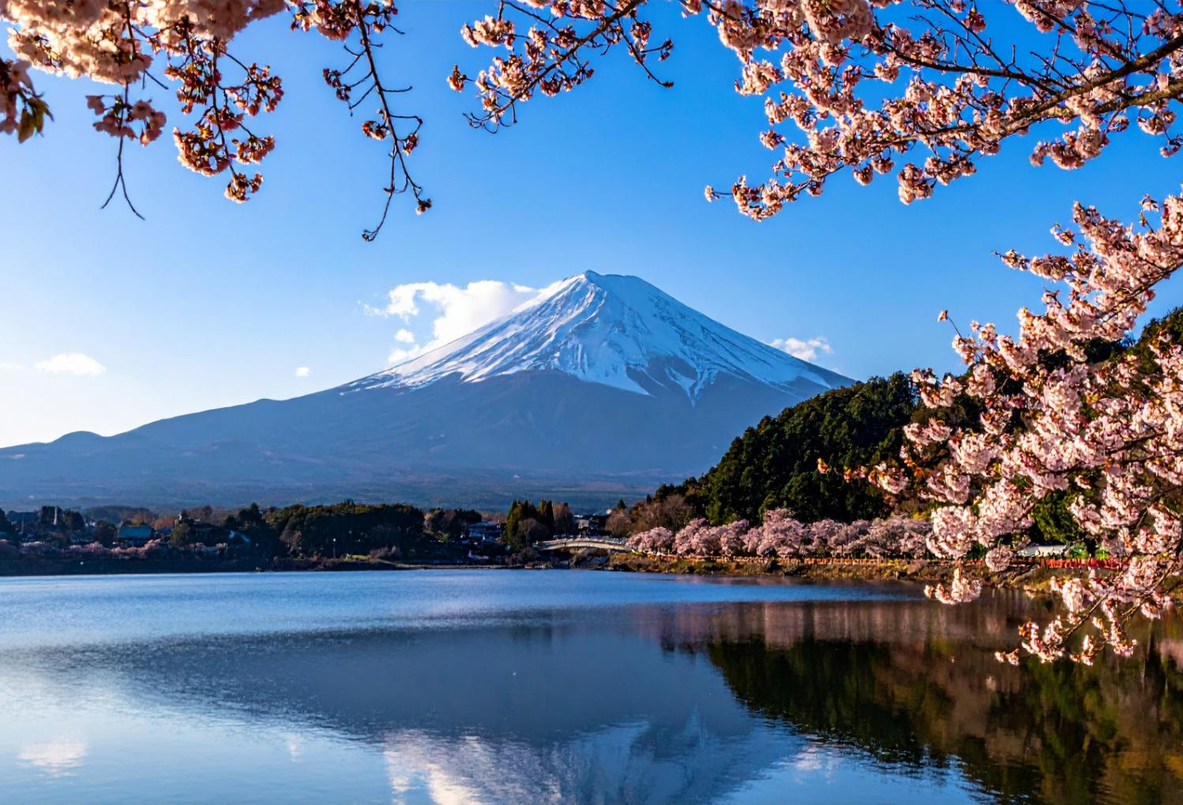

© The Japan Society 2026
Notes:
Teacher’s Notes
Show pupils the image on the slide and ask them questions to prompt discussion about Japan and what the topic of today’s lesson will be. Some questions you could ask could be:
What can you see in this picture?
Where do you think this is? Is it somewhere nearby or far away?
What words would you use to describe this picture?
How does it make you feel?
Would you like to visit this place?
What season do you think it is?

Slide 2
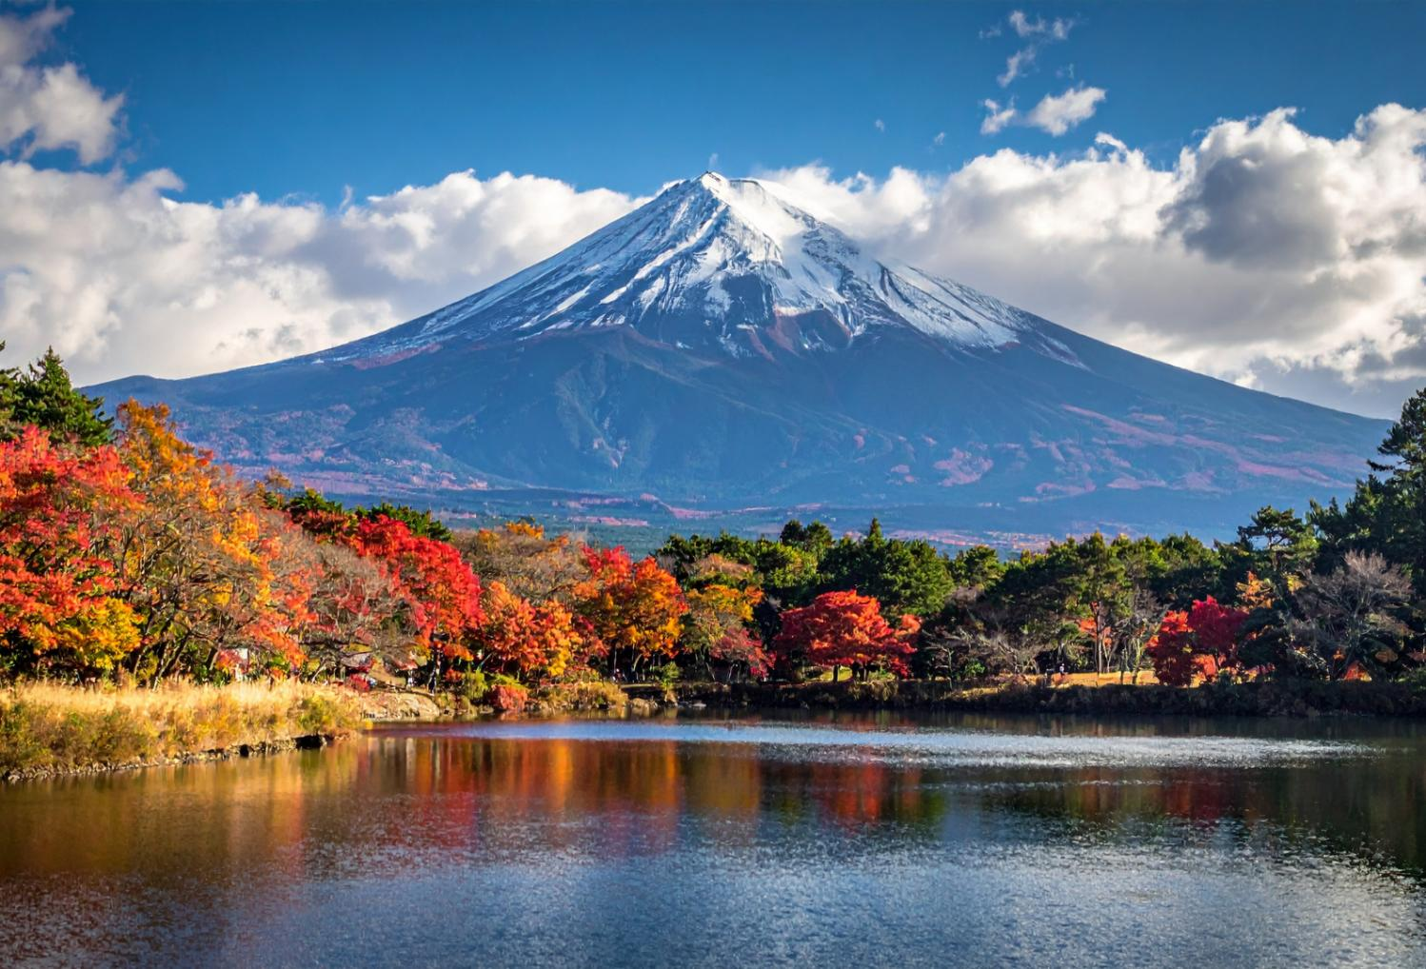
© The Japan Society 2026
Notes:
Teacher’s Notes
You could show this image as an alternative to the first slide. You could ask pupils to compare the images – what do you see in this picture? How does this picture make you feel? What season do you think it is? Based on these 2 pictures, what topic could we be looking at today?

Slide 3
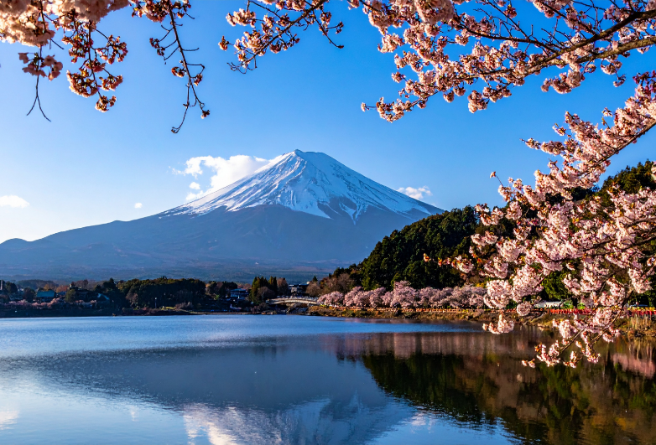
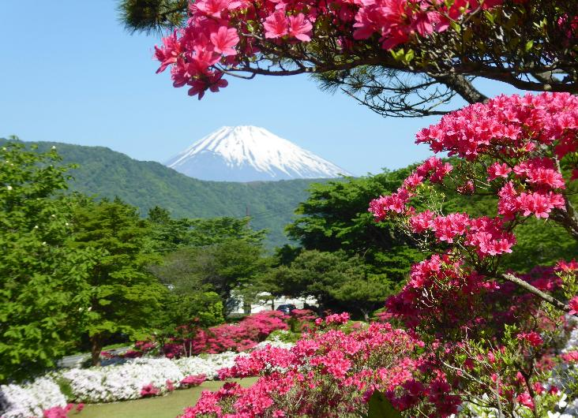
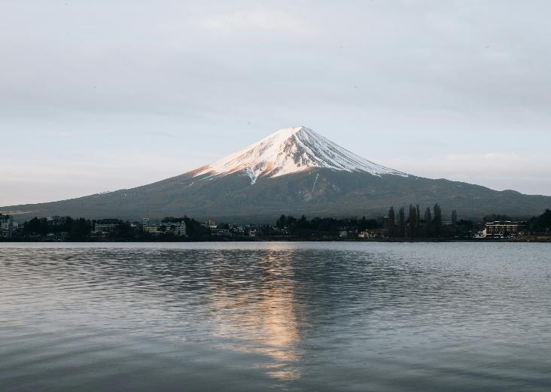

Japan’s Seasons
© The Japan Society 2026
Notes:
Teacher’s Notes
Introduce the topic of today’s lesson.

Slide 4
Learning Objectives
To learn what spring, summer, autumn, and winter in Japan are like
To identify key features of the four seasons in Japan
© The Japan Society 2026
Notes:
Teacher’s Notes
Introduce the Learning Objectives.

Slide 5
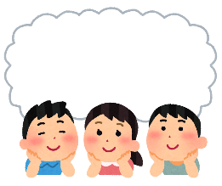
Key Words
Seasons
Weather
Nature
Food
Festival
Celebration
© The Japan Society 2026
Notes:
Teacher’s Notes
Introduce this lesson’s key words. Do pupils know what they mean? You can always come back to the slide at the end of this lesson and check pupil understanding, i.e., what food did we learn about today? What nature did we learn about today?

Slide 6
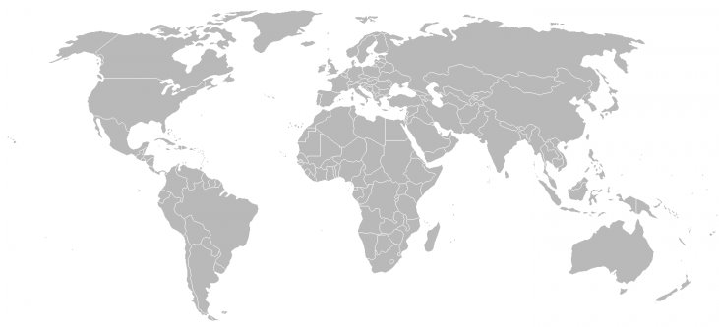
Where is Japan?
© The Japan Society 2026
Notes:
Teacher’s Notes
Do pupils know where the UK/Japan is on the map? Click to reveal Japan, click again to reveal UK. How long do you think it takes to fly to Japan from the UK? (Approximately 13 hours!)
Use the map to indicate to pupils where Japan is in Asia and in relation to the UK.

Slide 7
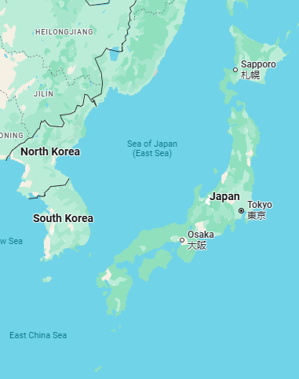
Japan
Japan is an island country in East Asia.
Map Data: Google, © 2026
Notes:
Teacher’s Notes
Japan’s nearest neighbours are China, South Korea, North Korea and Russia. To the east of Japan is the Pacific Ocean, the largest ocean in the world.

Slide 8
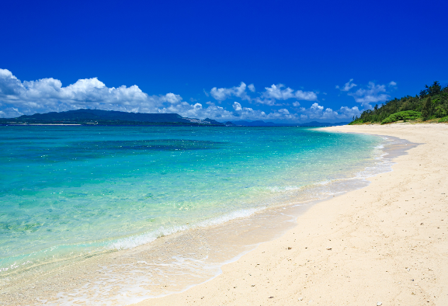
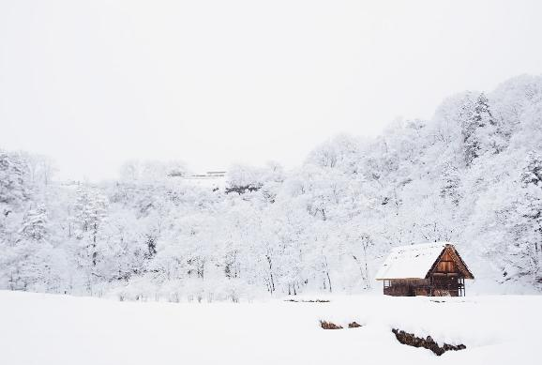
Japan
Most of Japan has four seasons.
The weather can be very hot and sunny in summer, and very cold and snowy in winter.
© The Japan Society 2026
Notes:
Teacher’s Notes
Before moving onto this slide, you could ask pupils what they think the weather in Japan will be like. Note where Japan is in relation to the equator and this could help guide their answers.
Mention that Japan’s four seasons can be quite different to what spring, summer, autumn, and winter in the UK is like.
Not all of Japan experiences seasons in the same way. As mentioned on the slide, some parts of northern Japan can be extremely cold and snowy during winter, but in other parts of the country, winters can be much milder. This PowerPoint will explore some of the common key features many people in Japan associate with each season.
Images from Canva (Left) and Unsplash (Right)

Slide 9
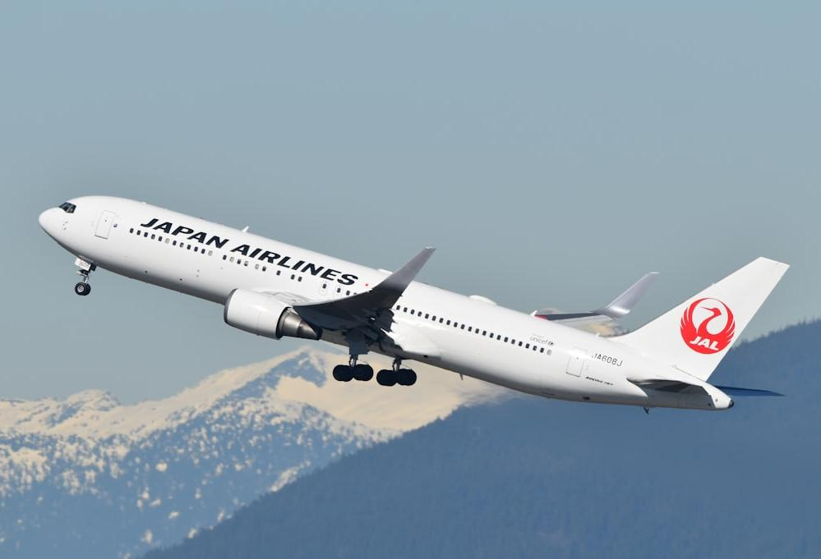
Let’s take a
trip to Japan!
Image credits: David Syphers via Unsplash
Notes:
Teacher’s Notes
Introduce the main learning of today’s lesson.
To get a better understanding of what Japan’s four seasons are like, let’s go on a trip to Japan! What can we see? What can we do?
Why not role-play your journey to Japan? Get ready for take-off!
Image: https://unsplash.com/photos/a-large-jetliner-flying-through-a-blue-sky-ZQPytreYnm0

Slide 10
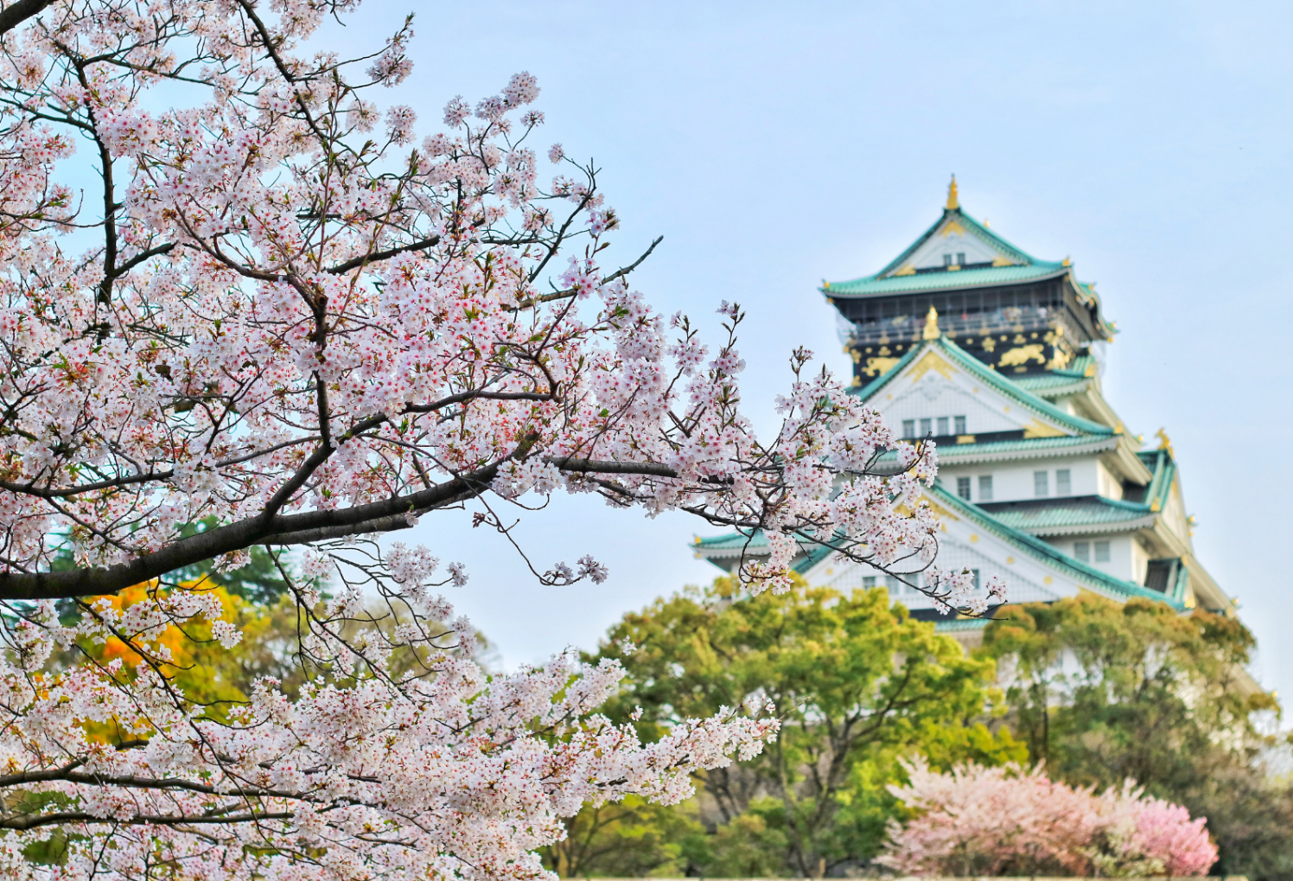
Spring
Haru 春
© The Japan Society 2026
Notes:
Teacher’s Notes
Let’s start with spring, haru (hah-roo) in Japanese.

Slide 11
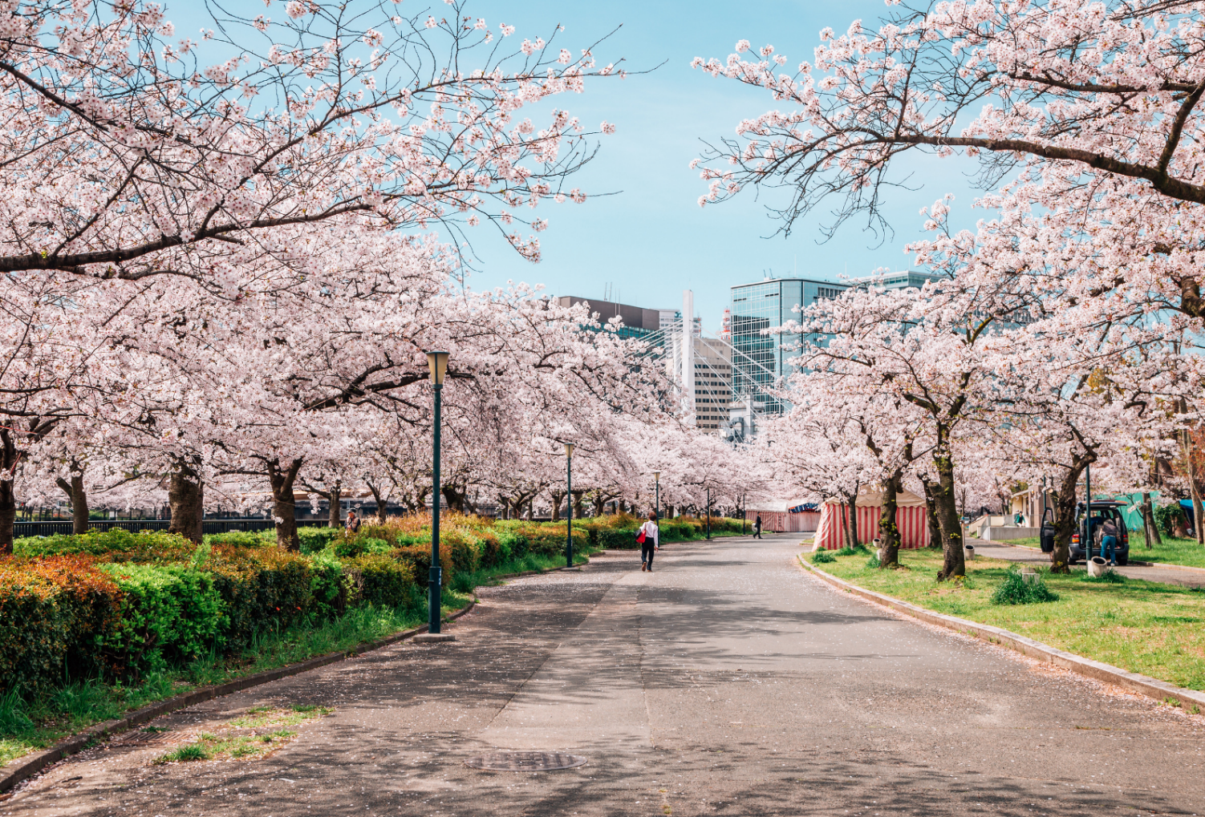
© The Japan Society 2026
Notes:
Teacher’s Notes
Spring is a time of year where nature blooms and comes to life. Look how pink the trees are. What are the flowers growing on this tree called? Have pupils seen them before? Click to the next slide to reveal the answer.

Slide 12
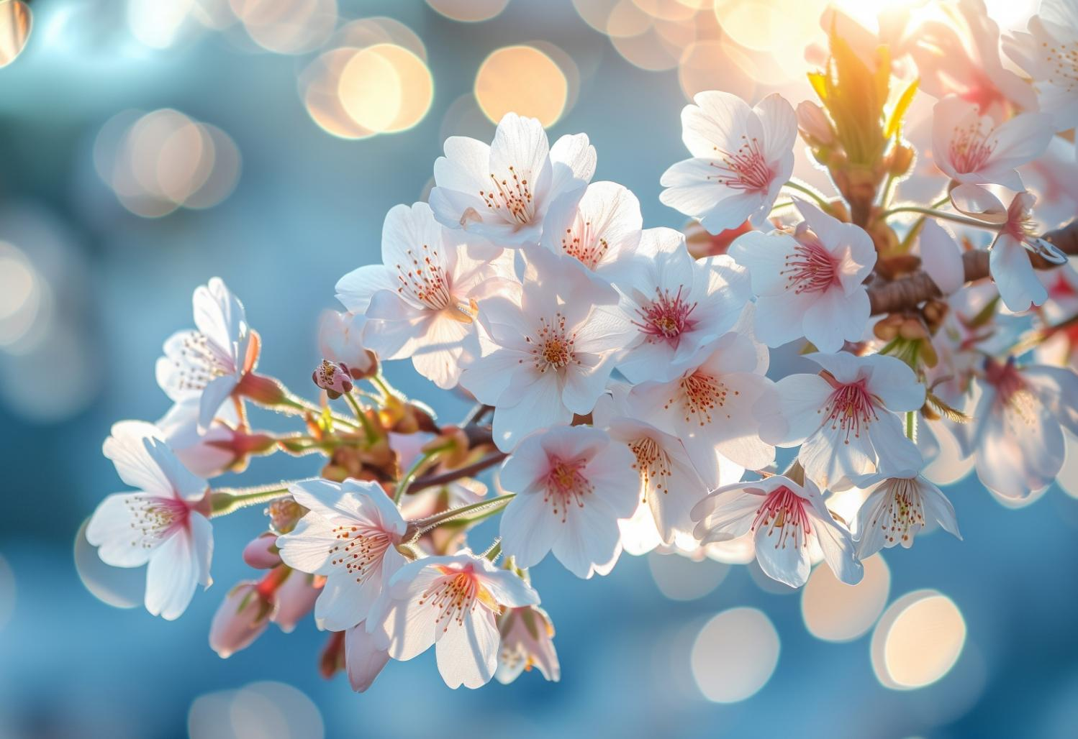
cherry blossom
sakura 桜
© The Japan Society 2026
Notes:
Teacher’s Notes
You can see lots of cherry blossom during spring. In Japanese, they are called sakura (桜).
Japan is famous for its cherry blossoms and the flowers themselves are symbolic of spring.
During spring time, you may even see “cherry blossom forecasts” on TV, which show predictions of when certain parts of the country can expect to see cherry blossoms starting to bloom.

Slide 13
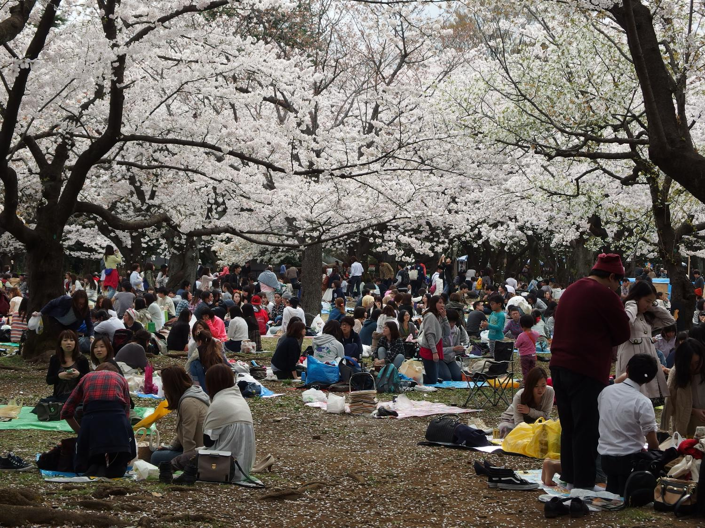
hanami 花見
© The Japan Society 2026
Notes:
Teacher’s Notes
People like to enjoy the cherry blossoms by sitting together with family and friends under the trees and enjoying a picnic. This is called hanami (花見), which means “flower-viewing”. This picture was taken at a park in Tokyo during the peak cherry blossom season. Look at how many people there are sat enjoying the cherry blossoms together!
The Japan Society website has a further resource on Hanami which further explores this topic. Visit the resource page to find out more: https://www.japansociety.org.uk/resource?resource=30
Image credits: https://upload.wikimedia.org/wikipedia/commons/f/f3/Picnic_%40_White_cherry_blossoms_%40_Yoyogi_Park_%2813607017585%29.jpg

Slide 14
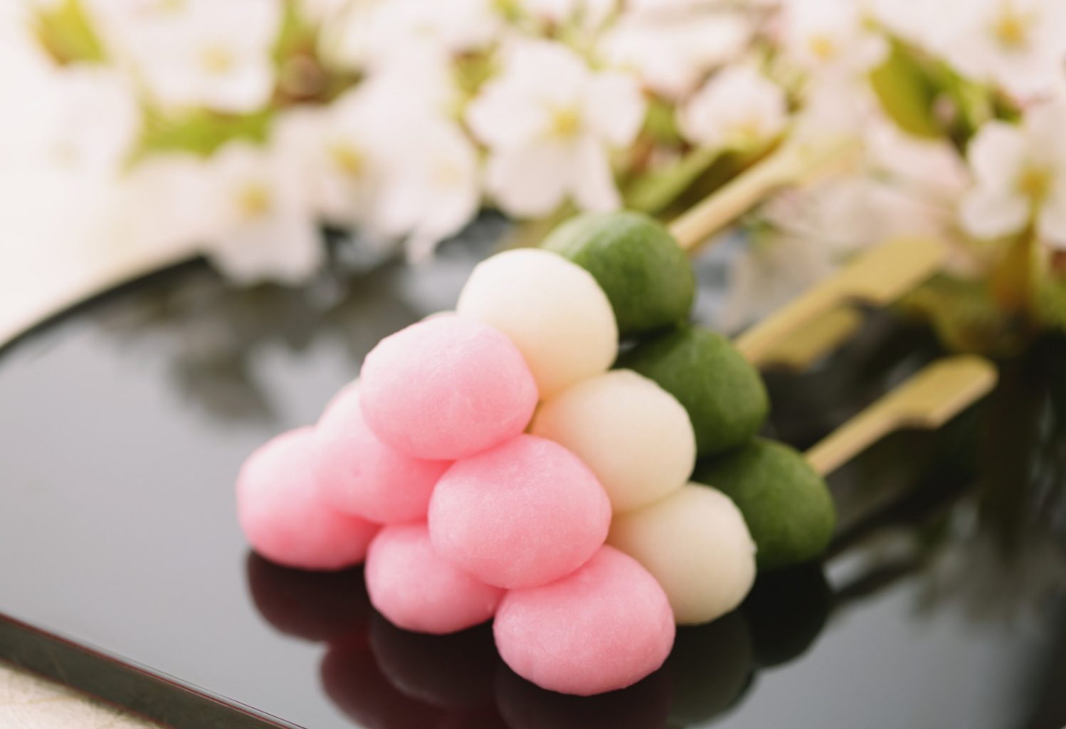
dango 団子
© The Japan Society 2026
Notes:
Teacher’s Notes
During spring, people like to eat lots of delicious seasonal sweets. This is dango, a delicious sweet that many people like to enjoy during the spring. It is made using glutinous rice flour.
What do you think the colours represent? (Answer: Pink – cherry blossoms; White –snow and goodbye to winter; Green –nature and new growth)
Image from Canva.

Slide 15
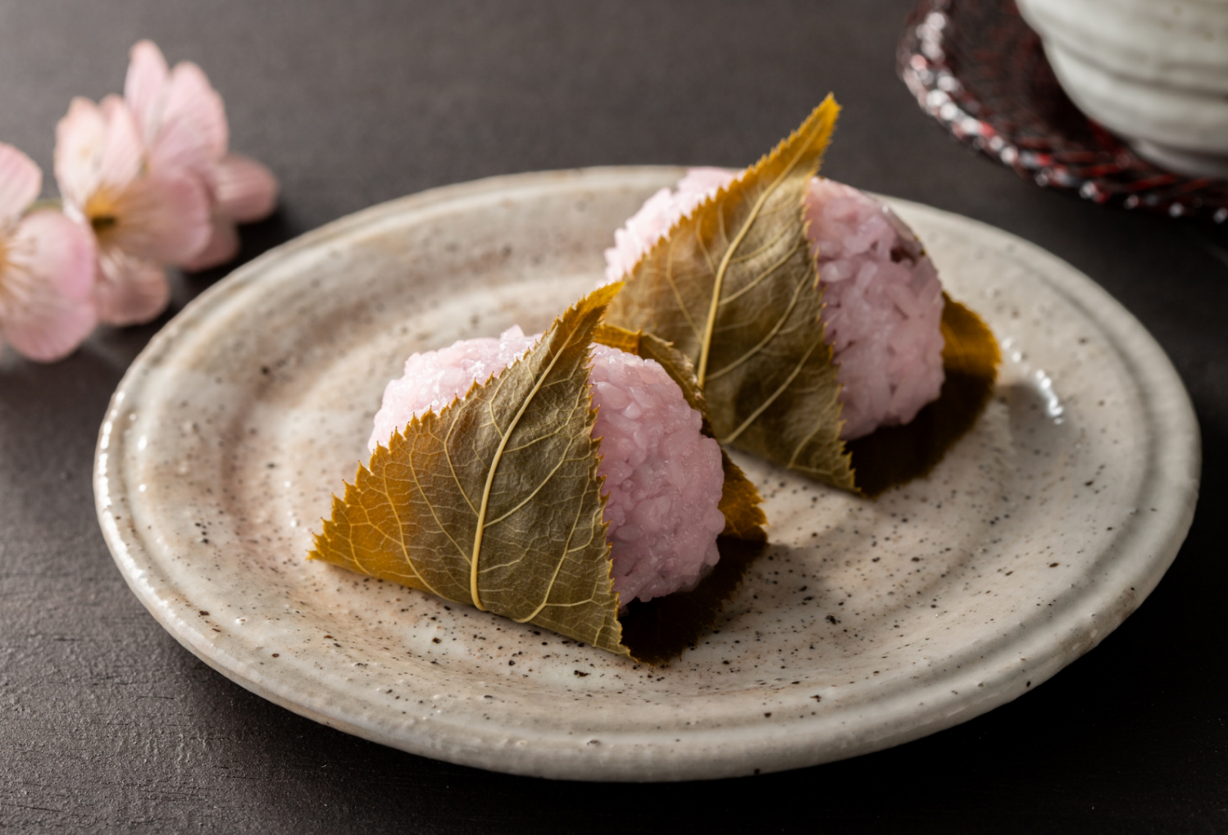
sakura mochi 桜餅
© The Japan Society 2026
Notes:
Teacher’s Notes
This is sakura mochi (cherry blossom mochi). It is a traditional Japanese sweet; a sticky rice cake filled with red bean paste and wrapped in a sakura leaf.
Mochi is a popular Japanese sweet enjoyed around the world, so you could ask your pupils if they have tried mochi before. Did they like it?
Image from Canva.

Slide 16
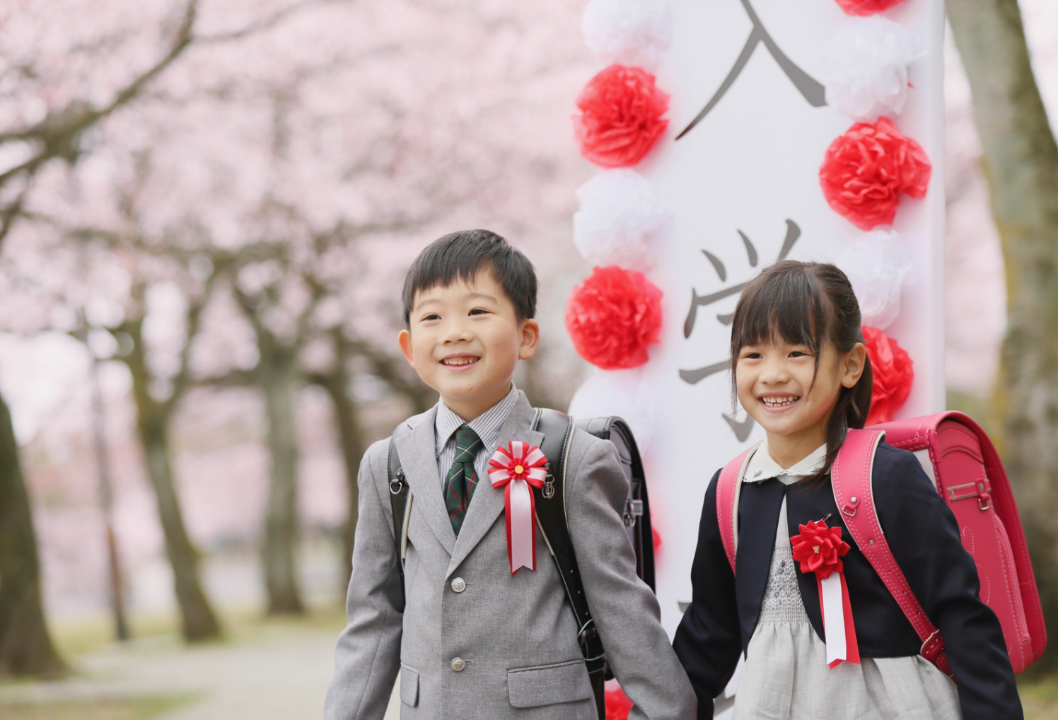
© The Japan Society 2026
Notes:
Teacher’s Notes
Spring is a time for new beginnings and new life. In Japan, the new school year starts in April, during spring. This picture is of two young elementary school children at their school’s entrance ceremony; the first day of school in April!
This is in contrast to many countries in the world where the new school year commences at the end of summer/beginning of autumn, usually around August/September.
For many people in Japan, seeing cherry blossoms can remind them of the start of the new school year and the school entrance ceremonies which usually take place in April.

Slide 17
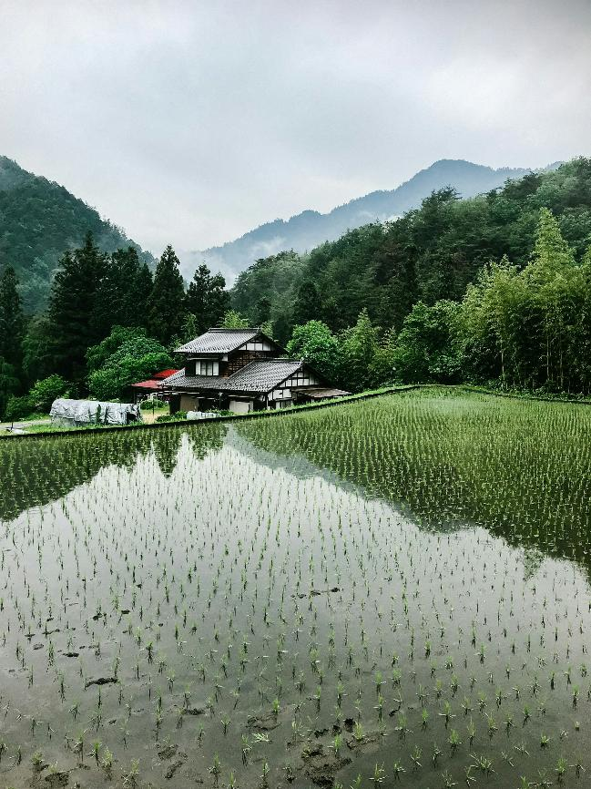
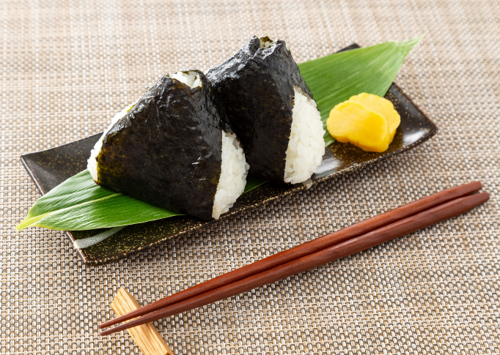
What is growing in the field?
It’s rice!
And these are rice balls.
Image credits: Robson Hatsukami Morgan via Unsplash (Left)
Notes:
Teacher’s Notes
During spring, farmers will also start to plant rice. Rice is a key ingredient in many Japanese meals!
Before revealing the answer, ask pupils if they can guess what is growing in the field on the left. Then reveal the image on the right; these are rice balls (onigiri in Japanese).
Image: https://images.unsplash.com/photo-1560931607-18ef1c47f765?q=80&w=1935&auto=format&fit=crop&ixlib=rb-4.1.0&ixid=M3wxMjA3fDB8MHxwaG90by1wYWdlfHx8fGVufDB8fHx8fA%3D%3D

Slide 18
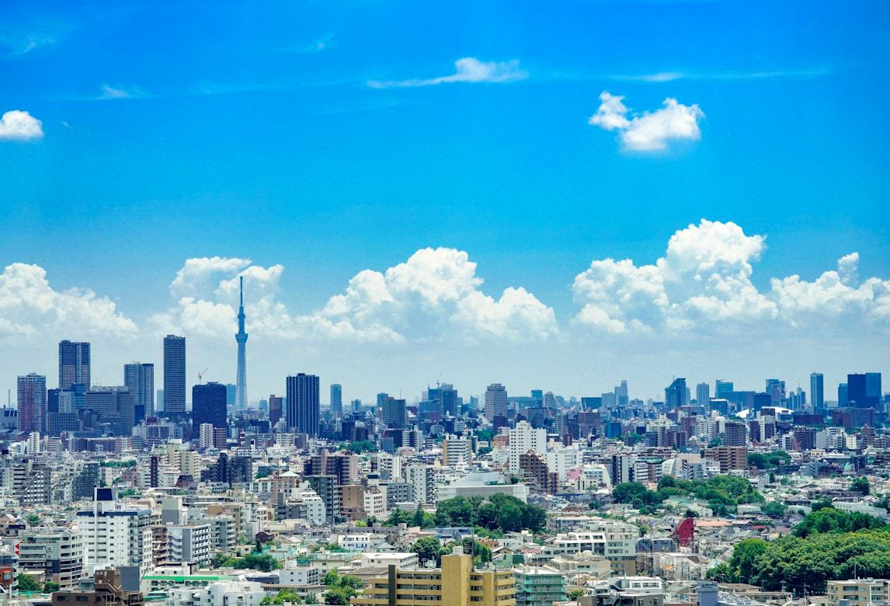
Summer
Natsu 夏
Image credit: Ryo Yoshitake via Unsplash
Notes:
Teacher’s Notes
Moving on from spring, now let’s look at summer – natsu (nat-soo) in Japanese.
Image: https://images.unsplash.com/photo-1531219435494-8e90d22adc1e?q=80&w=1170&auto=format&fit=crop&ixlib=rb-4.1.0&ixid=M3wxMjA3fDB8MHxwaG90by1wYWdlfHx8fGVufDB8fHx8fA%3D%3D

Slide 19

© The Japan Society 2026
Notes:
Teacher’s Notes
Summer in Japan can be very hot, humid, and sunny. Many people like to visit the beach to go swimming!
As Japan is an island nation, there are many beaches across the country that people can easily travel to.
Image from Canva.

Slide 20
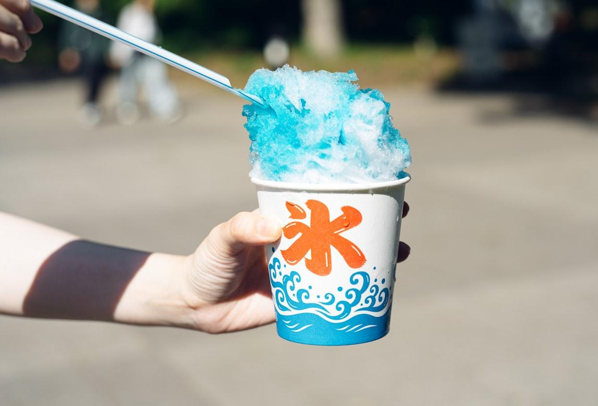
shaved ice
Image credit: Yuika Takamura via Unsplash
Notes:
Teacher’s Notes
Shaved ice is a popular treat people most commonly eat in summer time. The dessert consists of layers of finely shaved blocks of ice, usually sweetened with different syrups (strawberry, mango, melon, etc) and condensed milk. You can often buy shaved ice at summer festivals, too.
Ask your pupils if they would like to try shaved ice. Have they ever had something similar to this before (i.e., slushies)?
Image: https://images.unsplash.com/photo-1716626669148-1731504429dd?q=80&w=1171&auto=format&fit=crop&ixlib=rb-4.1.0&ixid=M3wxMjA3fDB8MHxwaG90by1wYWdlfHx8fGVufDB8fHx8fA%3D%3D

Slide 21
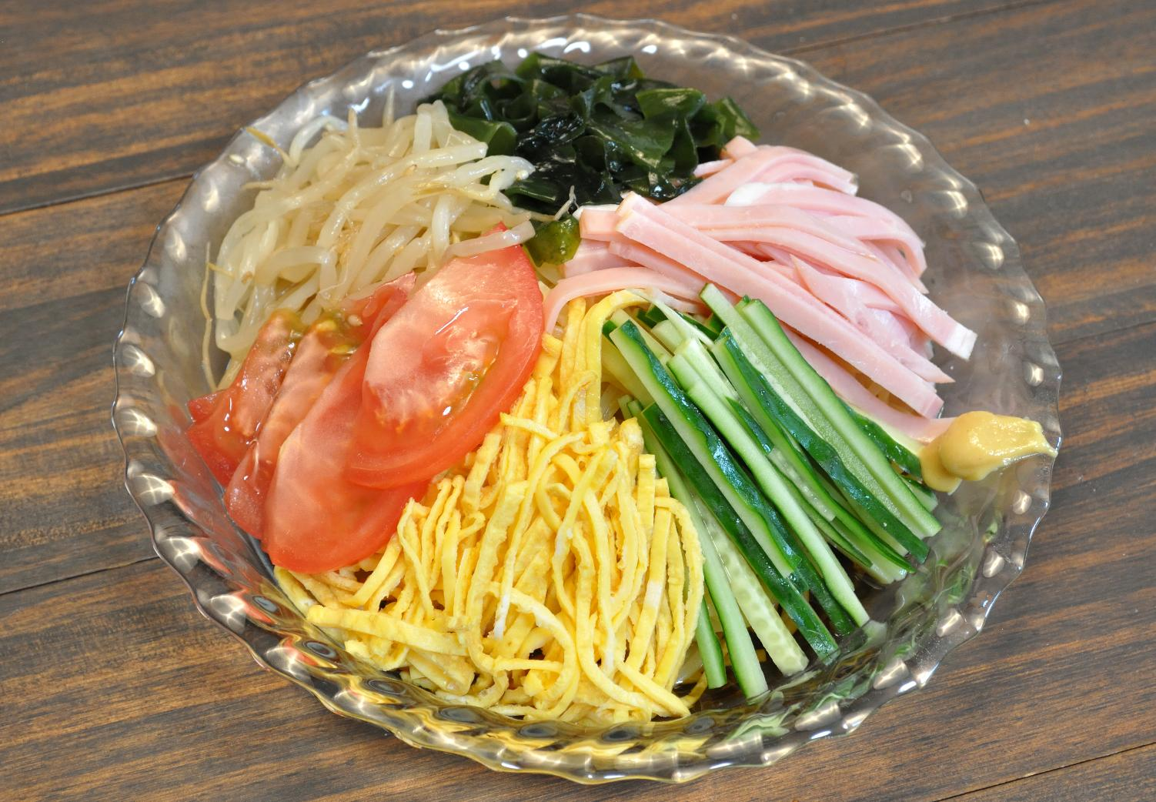
Chilled noodles
© The Japan Society 2026
Notes:
Teacher’s Notes
Chilled noodles are also popular in Japan in the summer. There are different kinds, but this one is cold ramen noodles with toppings (called hiyashi chuuka.) The toppings in thi8s picture are typical for this dish – thin strips of omelette, cucumber and ham with seaweed, tomato and bean sprouts are placed on top of the noodles. Everything is mixed up with a dressing to eat it.
Image: public domain, https://commons.wikimedia.org/wiki/File:Hiyashi_chuka_002.jpg

Slide 22
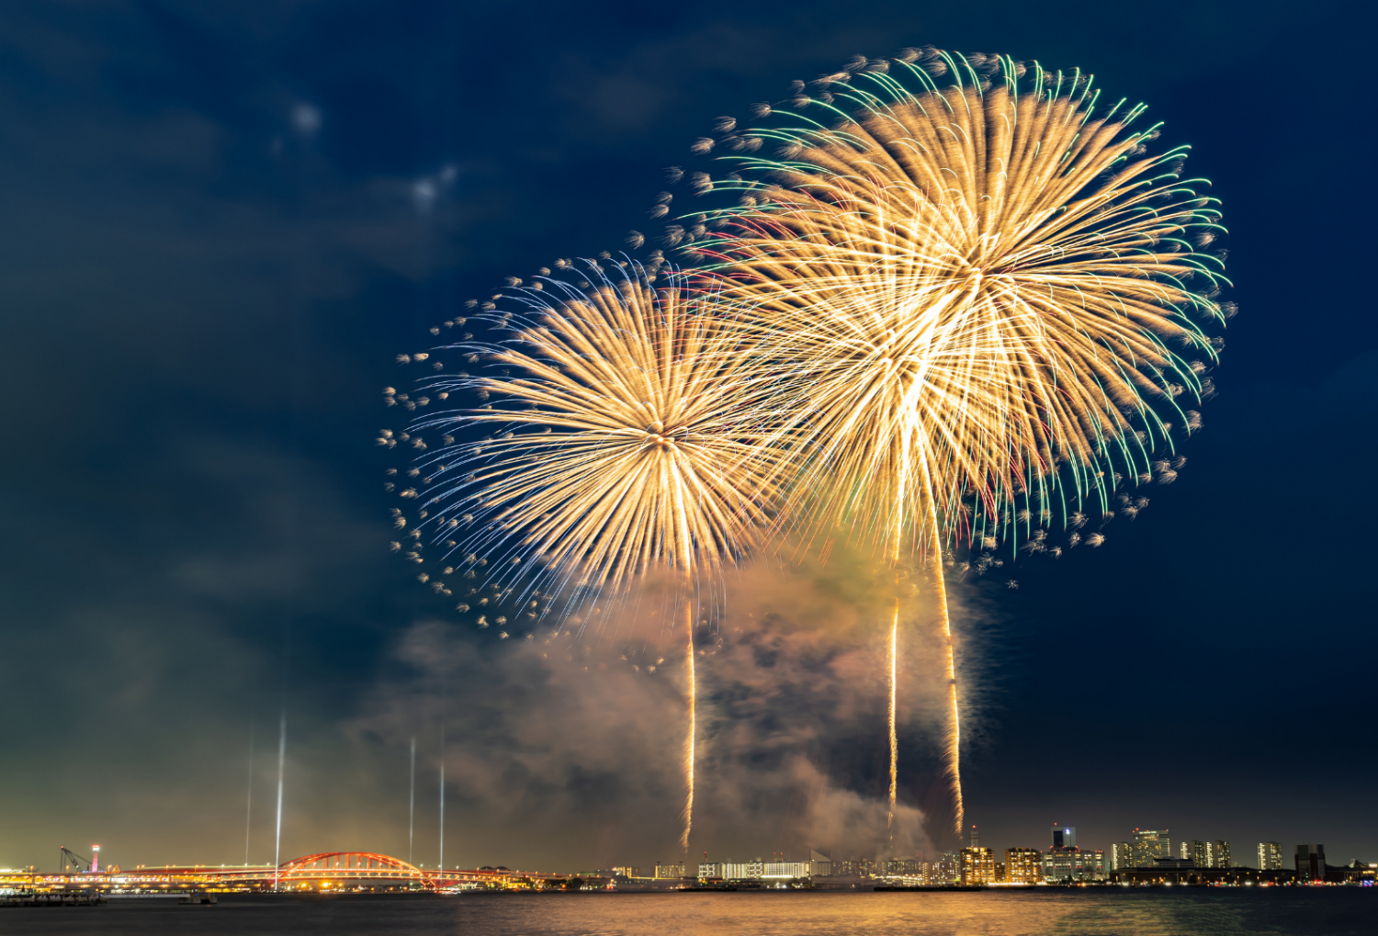
© The Japan Society 2026
Notes:
Teacher’s Notes
There are lots of festivals during summer, including firework festivals!
Ask pupils if they know when we are most likely to see fireworks in the UK, and if they know why that is.
Image from Canva.

Slide 23
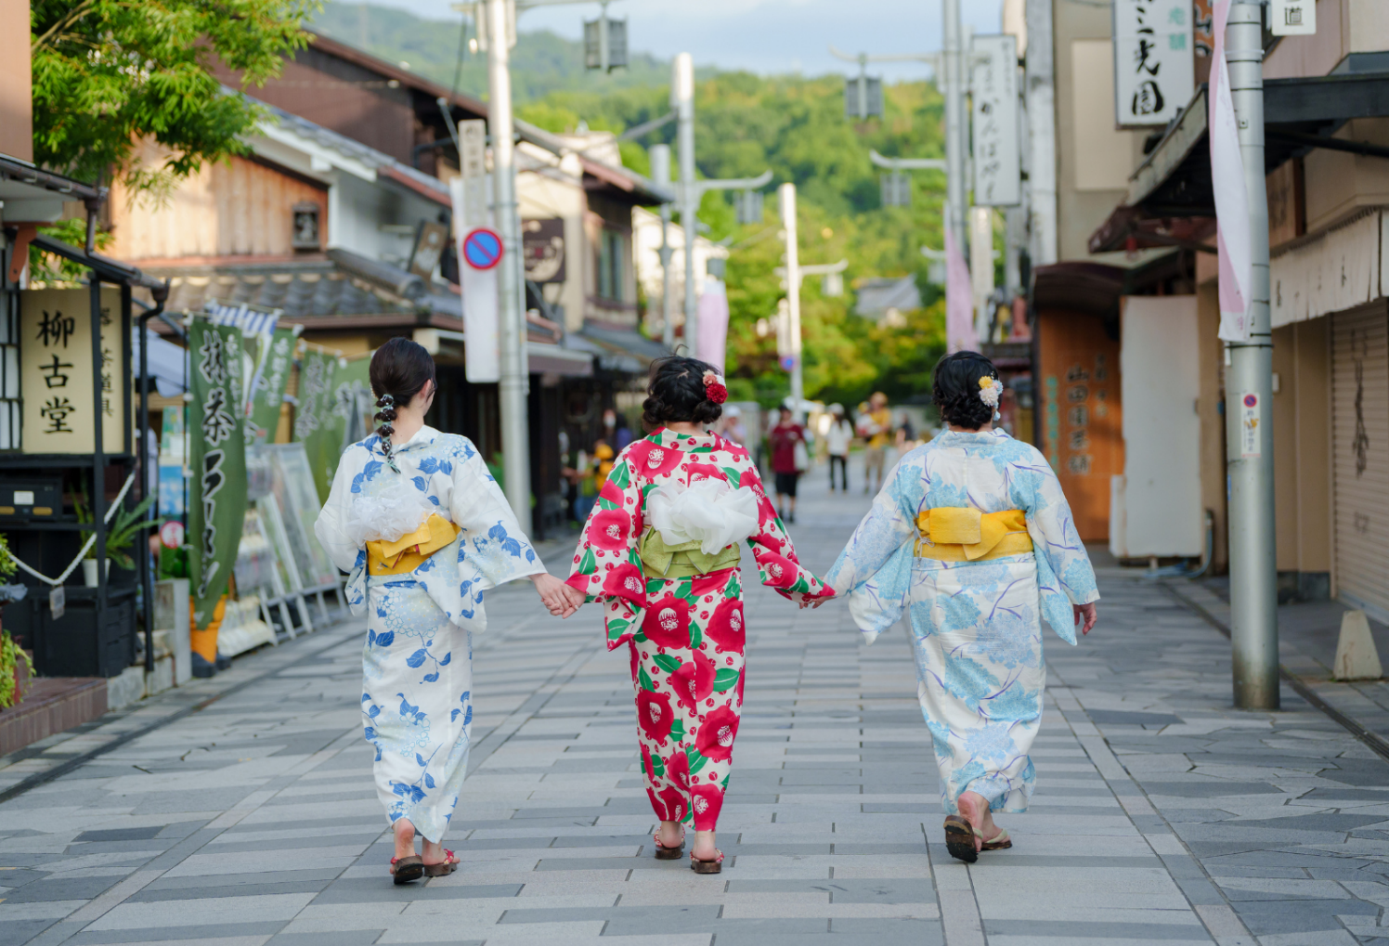
yukata 浴衣
© The Japan Society 2026
Notes:
Teacher’s Notes
At festivals, people often wear yukata – traditional Japanese summer kimono.
The yukata is like a summer version of the kimono (traditional Japanese dress). It is made with thinner and lighter materials to keep the wearer cool. Both men and women can wear yukata, and there are lots of different designs you can find. The patterns on male yukata are a bit different to what you see in this image (They tend to be darker colours).
Image from Canva.

Slide 24


Summer
Listen to this... What do you think it is?
Sound clip: Copyright © 2026 BBC
Emoji designed by OpenMoji – the open-source emoji and icon project. License: CC BY-SA 4.0
Notes:
Teacher’s Notes
You will often hear the sound of cicadas during summertime in Japan, and they can be very loud and noisy!
This is why this sound is often associated with summer in Japan. When people hear cicadas, they often think of summer. Click through to the next slide to see an image of a cicada.

Slide 25
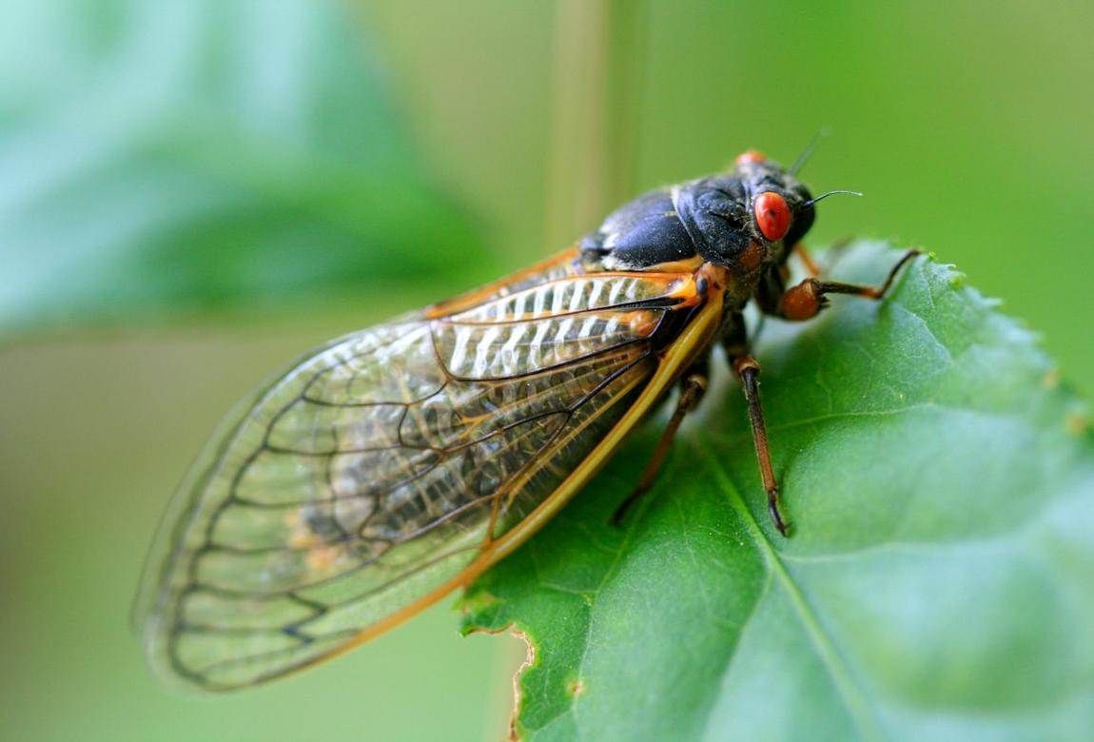
cicada
Image credit: Ashlee Marie via Unsplash
Notes:
Teacher’s Notes
Do we have cicadas in the UK?
Ask pupils are there any sounds that they commonly associate with summer time in the UK.
Image: https://images.unsplash.com/photo-1673192262158-1fe3c2fbe9f5?q=80&w=1170&auto=format&fit=crop&ixlib=rb-4.1.0&ixid=M3wxMjA3fDB8MHxwaG90by1wYWdlfHx8fGVufDB8fHx8fA%3D%3D

Slide 26
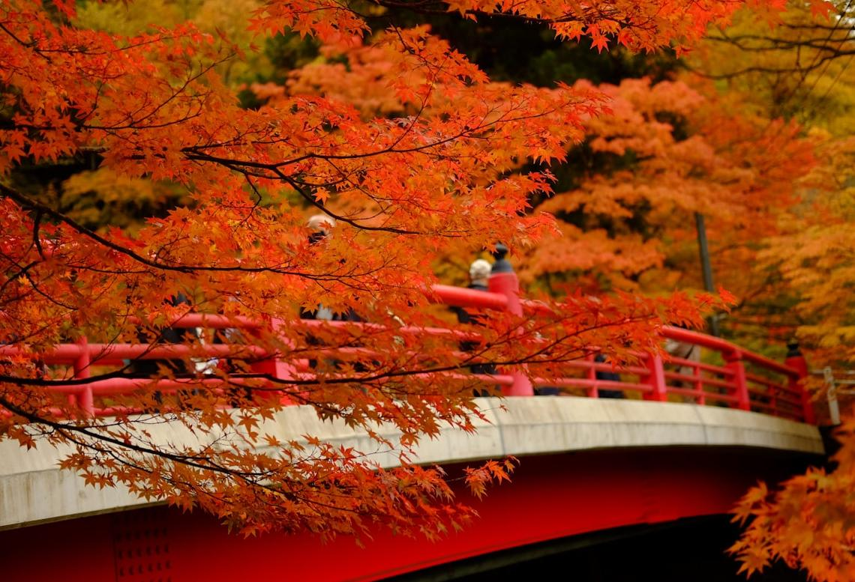
Autumn
Aki 秋
Image credit: Seiya Maeda via Unsplash
Notes:
Teacher’s Notes
Next, let’s learn more about autumn in Japan – aki (acky) in Japanese.
Image:
https://images.unsplash.com/photo-1637230922121-8eb94eff2dd6?q=80&w=1170&auto=format&fit=crop&ixlib=rb-4.1.0&ixid=M3wxMjA3fDB8MHxwaG90by1wYWdlfHx8fGVufDB8fHx8fA%3D%3D

Slide 27
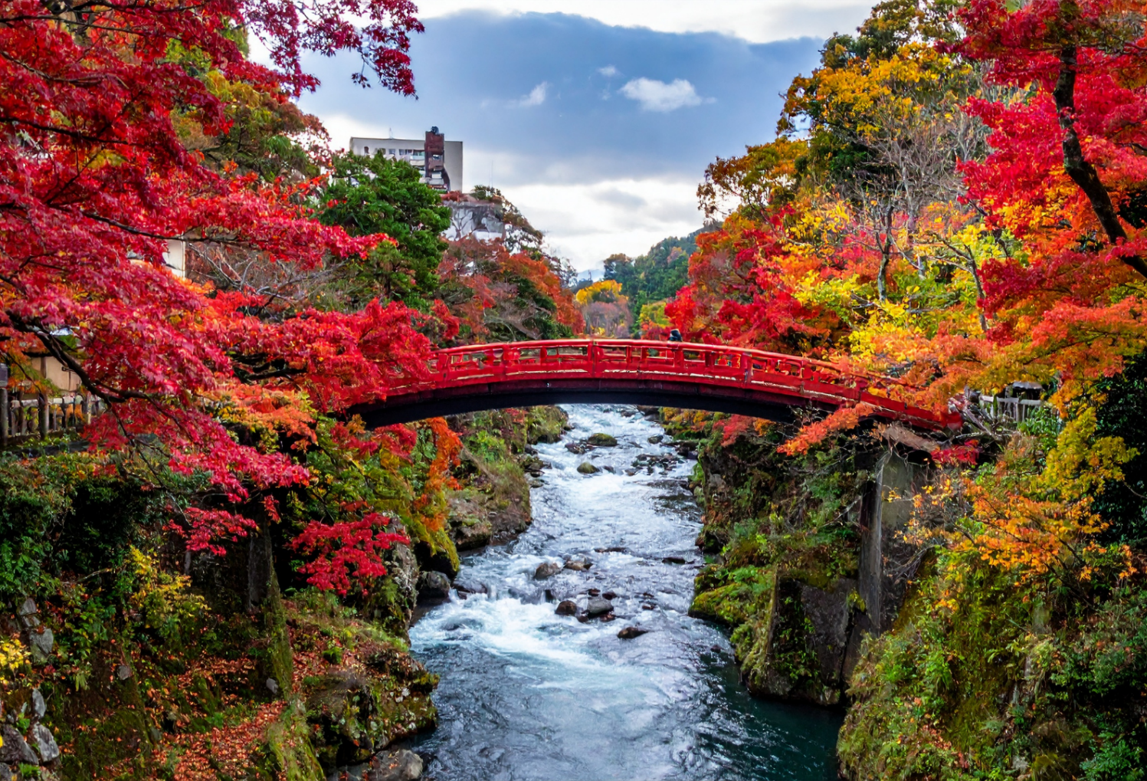
What colours can you see?
© The Japan Society 2026
Notes:
Teacher’s Notes
After a long hot summer, the weather starts to cool down, and the leaves start to change colours.
Look at the image on the slide and ask pupils what colours they can see. Autumn is a very colourful season, and you can still see lots of beautiful natural scenery all over the country.

Slide 28
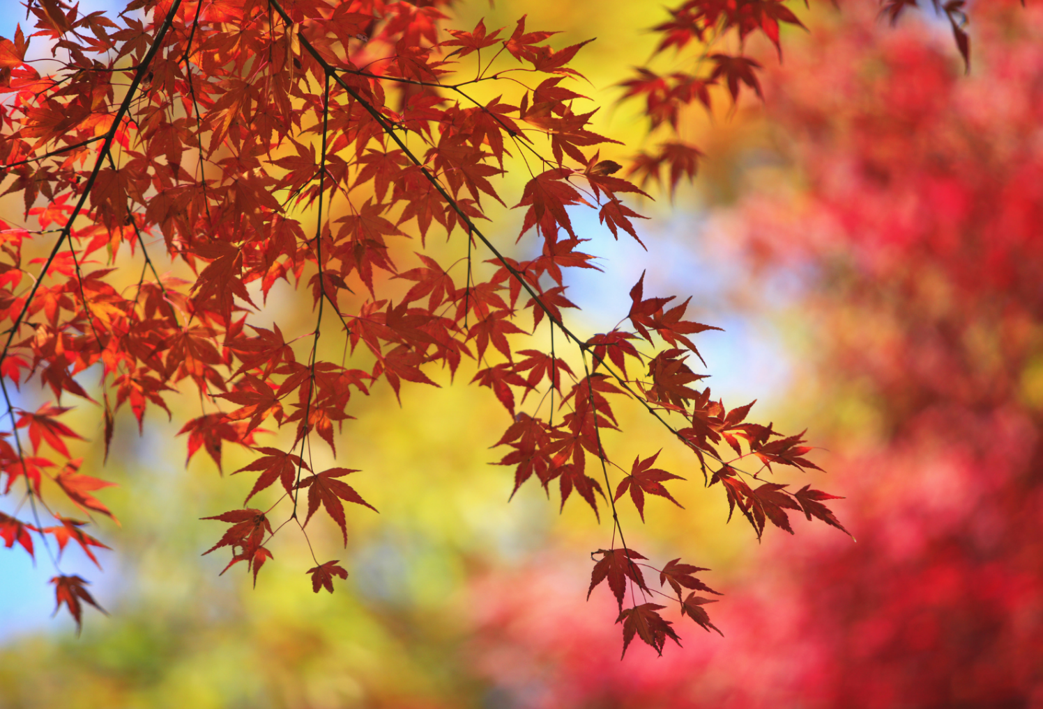
momiji 紅葉
© The Japan Society 2026
Notes:
Teacher’s Notes
These leaves are maple leaves, called momiji in Japanese.
People like to go on walks to see the beautiful autumn leaves. In Japanese, this is called momiji-gari (紅葉狩り) – autumn leaf viewing.
This is somewhat similar to hanami in spring. Many people like to go on walks and hikes to be able to see the autumn leaves.

Slide 29
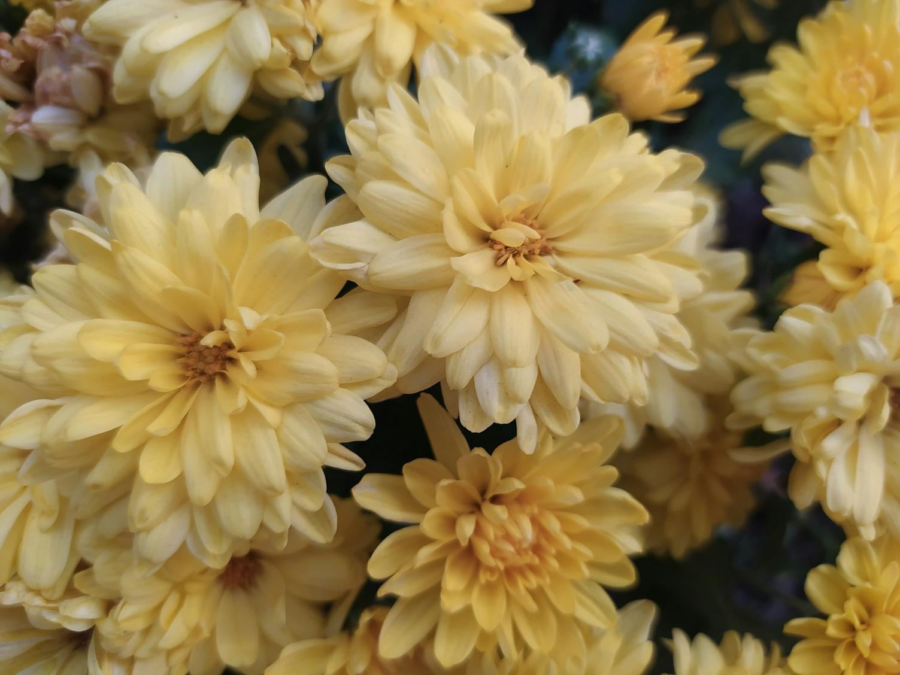
chrysanthemums
Image credit: Julia Ly via Unsplash
Notes:
Teacher’s Notes
You can still see beautiful flowers even during autumn. These are chrysanthemums.
Chrysanthemums are commonly associated with autumn in Japan.
Image: https://images.unsplash.com/photo-1695218258563-39afd70cb91b?q=80&w=1974&auto=format&fit=crop&ixlib=rb-4.1.0&ixid=M3wxMjA3fDB8MHxwaG90by1wYWdlfHx8fGVufDB8fHx8fA%3D%3D

Slide 30
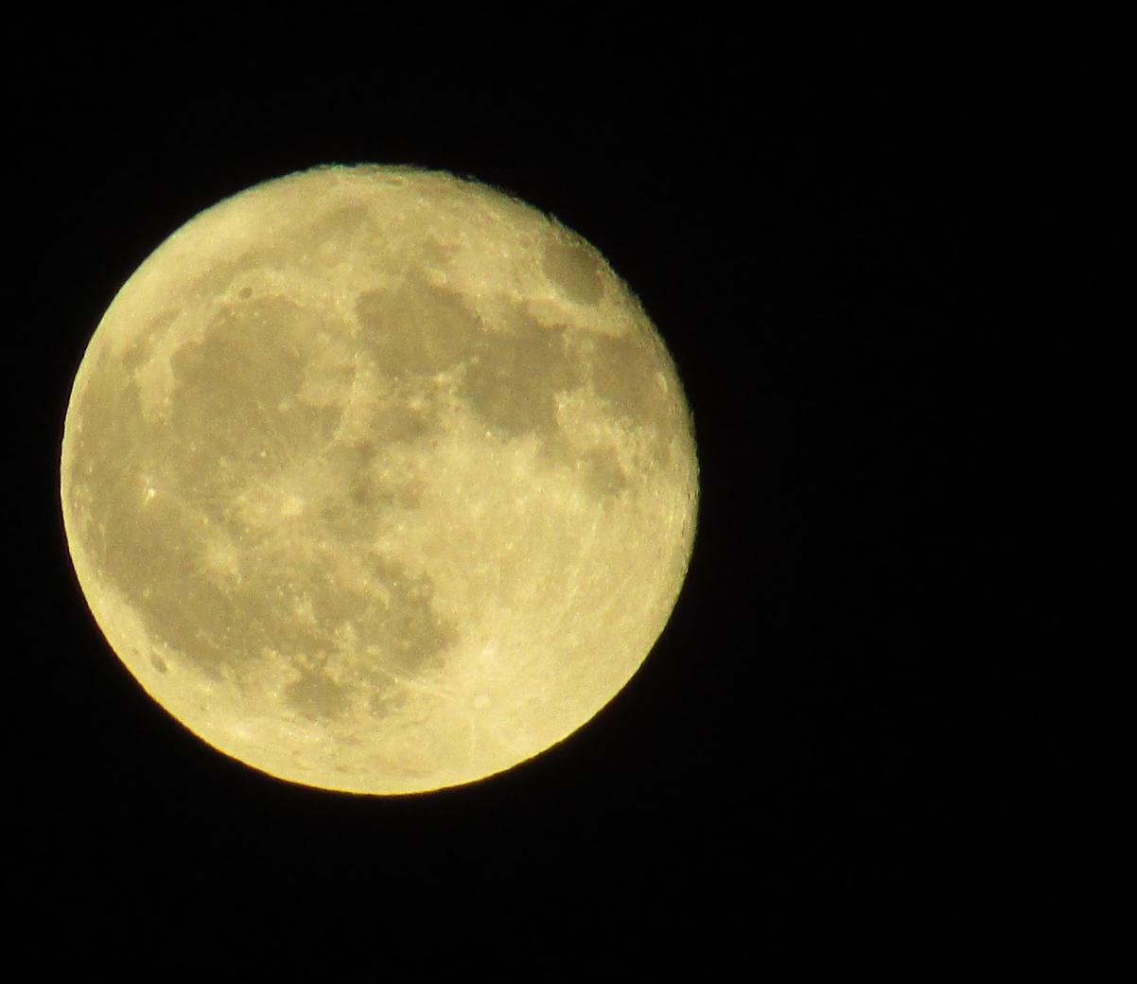
Autumn is also harvest time.
Otsukimi is a special festival to celebrate the harvest moon.
© The Japan Society 2026
Notes:
Teacher’s Notes
Traditionally, people made offerings to the moon in order to pray for a bountiful harvest. It’s less common to celebrate this festival in modern times.
When do we celebrate harvest in the UK?
The Japan Society website has a resource where you can learn more about Otsukimi in Japan. Visit the resource page to find out more: https://www.japansociety.org.uk/resource?resource=72

Slide 31
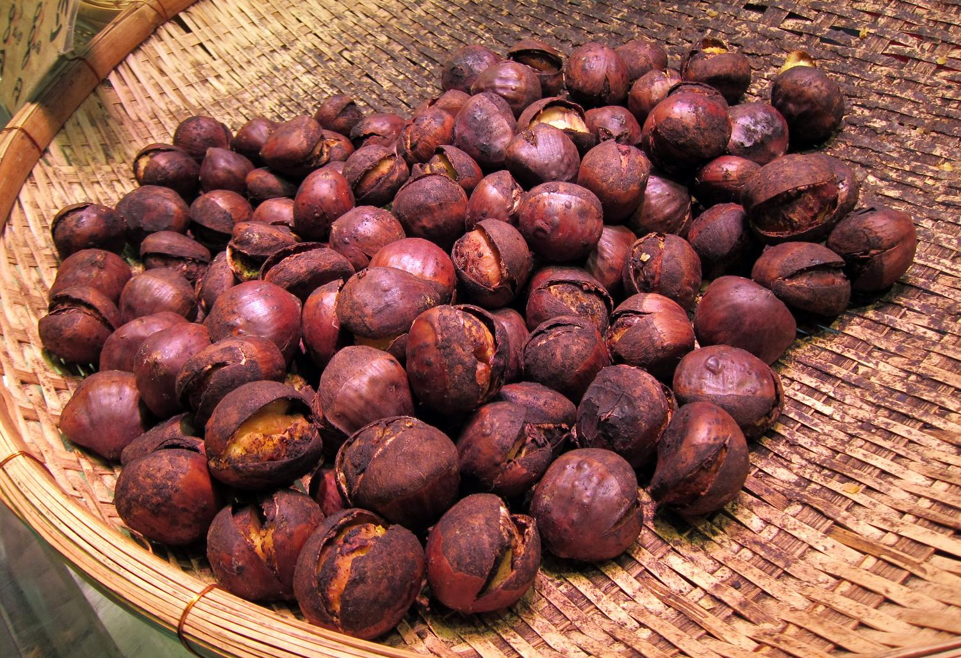
Chestnuts 栗
Image credit: Wally Gobetz, CC-BY-NC-ND 2.0
Notes:
Teacher’s Notes
Chestnuts (kuri in Japanese) are a symbol of autumn in Japan. They can be roasted and eaten like in the picture, but they are also used in sweets dishes and deserts. KitKat often make seasonal flavours in Japan, so in autumn you might see chestnut flavour KitKats!
Do pupils associate chestnuts with the same season?
Image credit: Wally Gobetz, https://www.flickr.com/photos/wallyg/5844211350, CC BY-NC-ND 2.0: https://creativecommons.org/licenses/by-nc-nd/2.0/deed.en

Slide 32
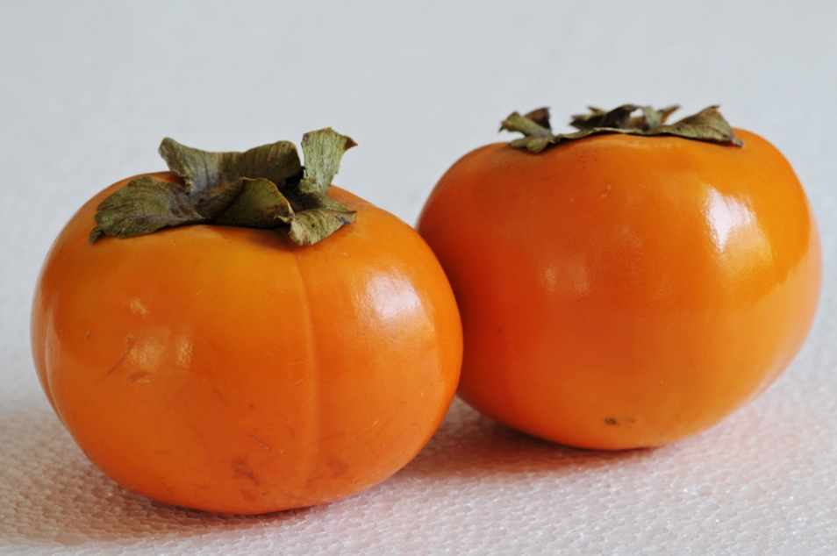
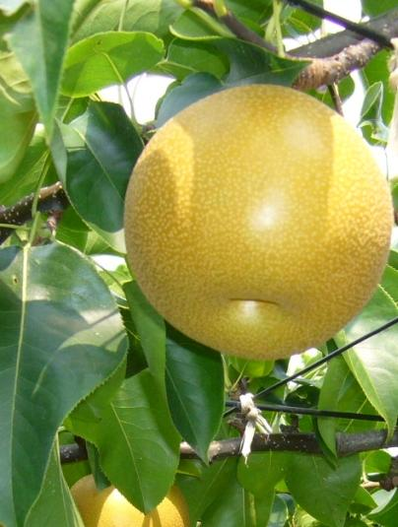
persimmons 柿
pears 梨
© The Japan Society 2026
Notes:
Teacher’s Notes
Persimmons (kaki in Japanese) are sweet fruits. They can be eaten fresh or dried and are in season from October. Japanese Pears (nashi) become available at the end of summer. The shape is different to pears in the UK – they are rounder and could be mistaken for an apple at first glance. These are usually peeled and cut into slices before eaten.
Image credits: Koshy Koshy, https://www.flickr.com/photos/kkoshy/5092619745/in/photostream/, CC BY 2.0: https://creativecommons.org/licenses/by/2.0/
Agnieszka Kwiecień, Nova, https://commons.wikimedia.org/wiki/File:Owoce_Nashi.jpg, CC BY-SA 3.0: https://creativecommons.org/licenses/by-sa/3.0> (cropped)

Slide 33
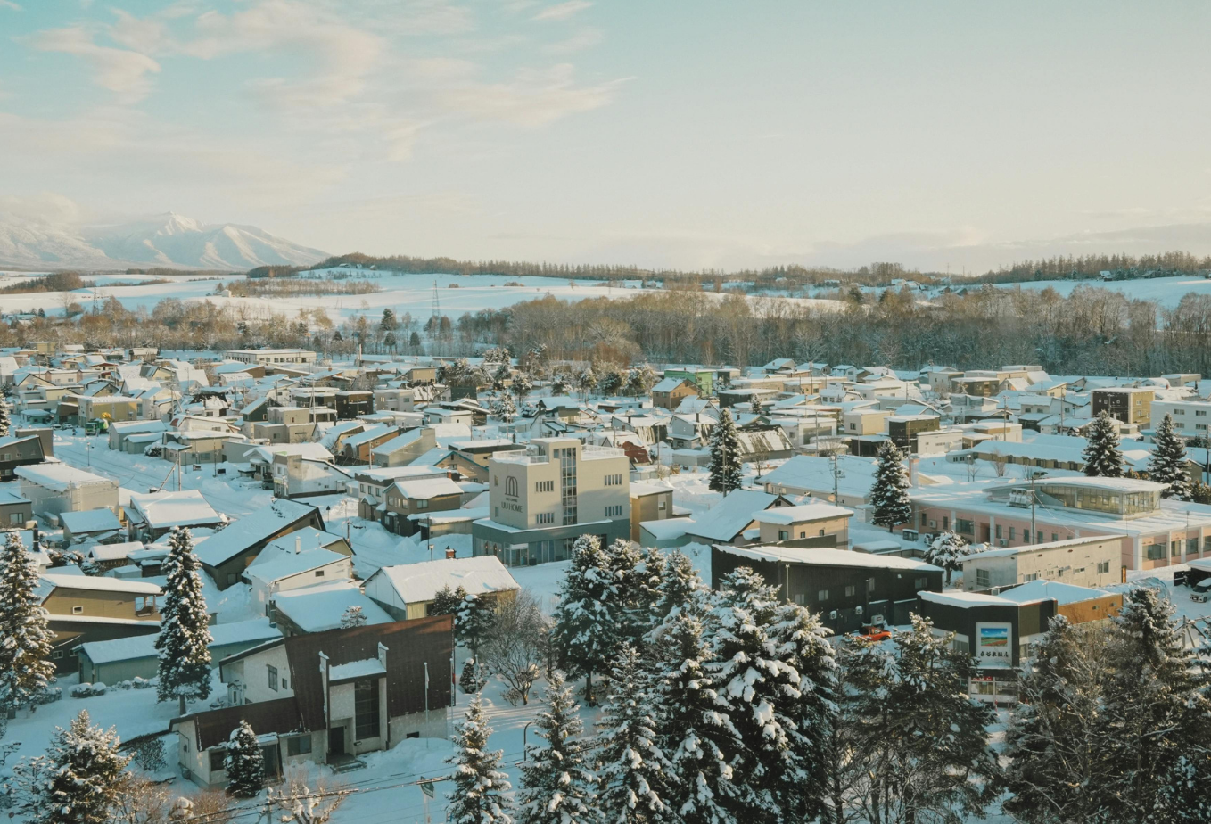
Winter
Fuyu 冬
© The Japan Society 2026
Notes:
Teacher’s Notes
Finally, let’s look at winter in Japan – fuyu (foo-you) in Japanese.

Slide 34
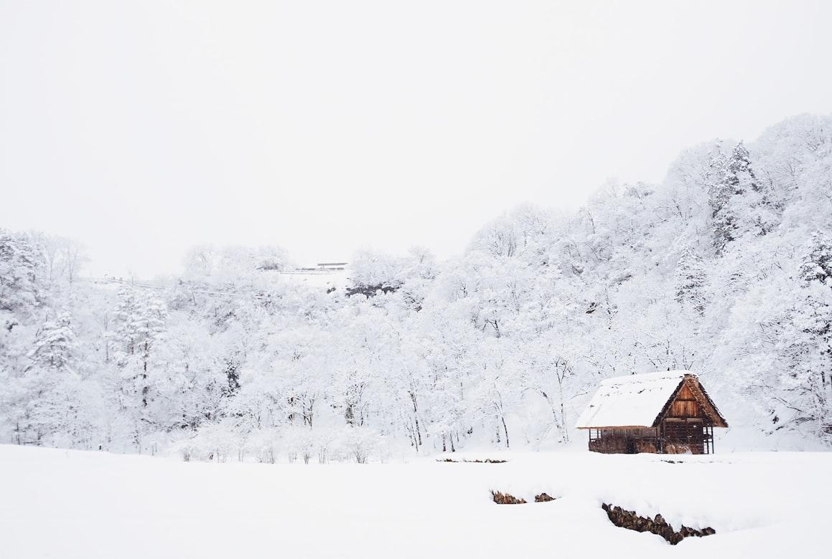
Image credit: Fabian Mardi via Unsplash
Notes:
Teacher’s Notes
Winter can be very cold in Japan. Some parts of northern Japan get lots of snow during winter!
However, this is not true for all regions of Japan; further south in Japan, winters can be quite mild.
Image: https://images.unsplash.com/photo-1517299321609-52687d1bc55a?q=80&w=1170&auto=format&fit=crop&ixlib=rb-4.1.0&ixid=M3wxMjA3fDB8MHxwaG90by1wYWdlfHx8fGVufDB8fHx8fA%3D%3D

Slide 35
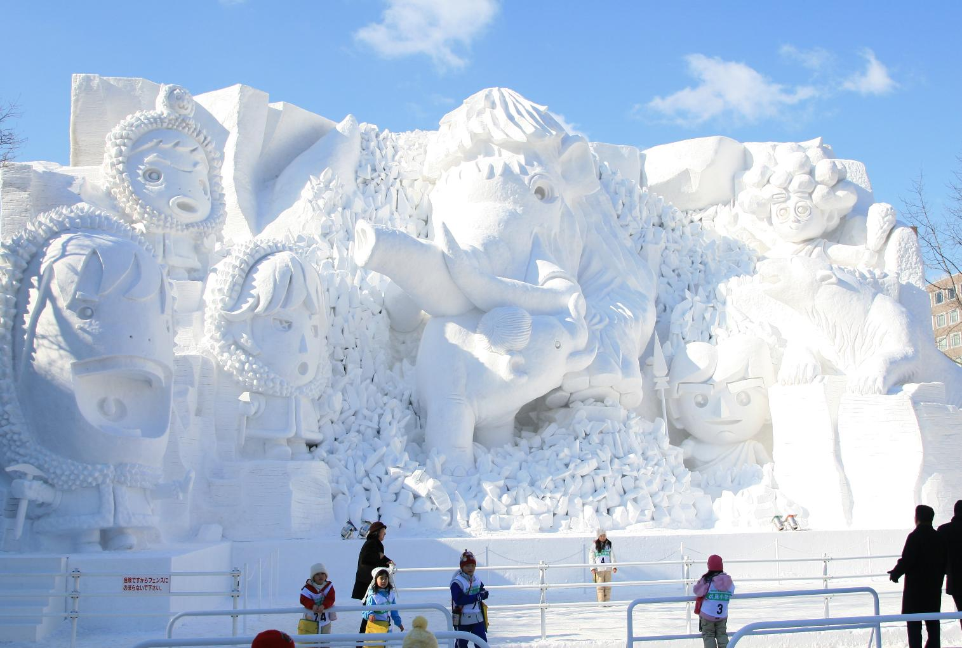
Image credit: Tony Lin via Flickr, CC BY-NC-ND 2.0
Notes:
Teacher’s Notes
In Hokkaido, there is a snow festival every year, where you can see incredible sculptures made from snow and ice!
Hokkaido is the most northern island in Japan. The Sapporo Snow Festival takes place every year, usually in February, and visitors can expect to see a stunning array of detailed snow and ice sculptures.
Image: https://www.flickr.com/photos/tony926/2283131671, License: https://creativecommons.org/licenses/by-nc-nd/2.0/deed.en

Slide 36
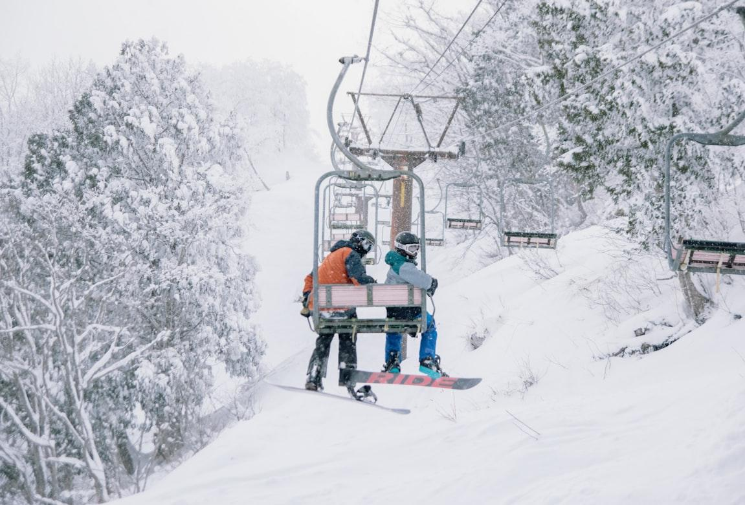
© The Japan Society 2026
Notes:
Teacher’s Notes
As Japan is a mountainous country, skiing and snowboarding are popular sports for people to enjoy during the winter!
Image credits: https://images.unsplash.com/photo-1558172474-c86baed4e874?q=80&w=1171&auto=format&fit=crop&ixlib=rb-4.1.0&ixid=M3wxMjA3fDB8MHxwaG90by1wYWdlfHx8fGVufDB8fHx8fA%3D%3D

Slide 37
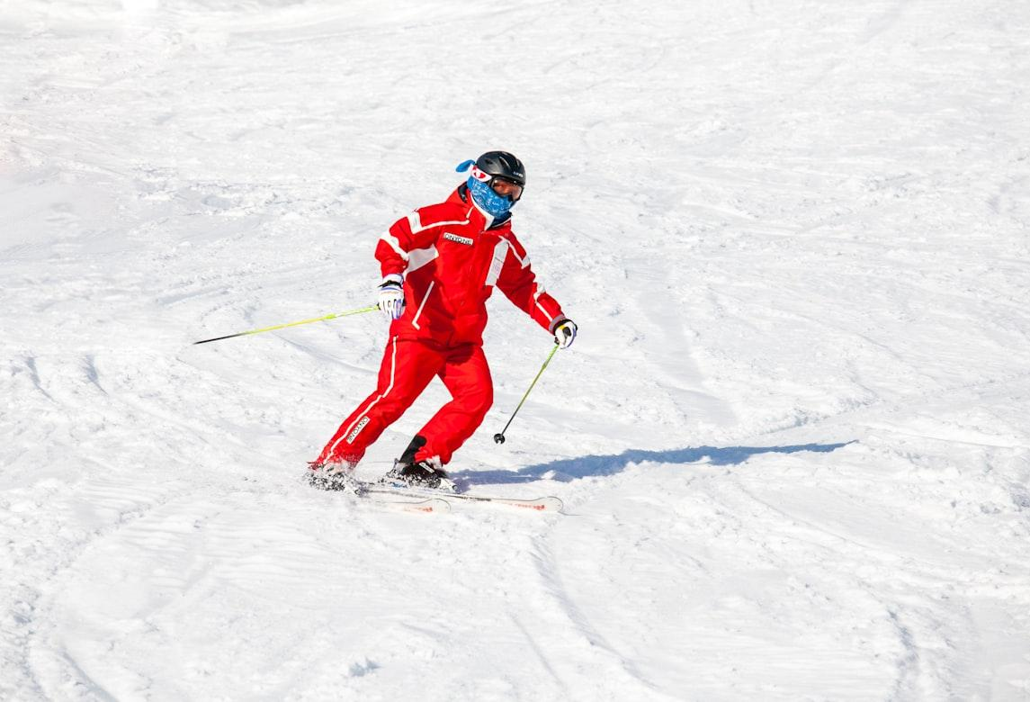
© The Japan Society 2026
Notes:
Teacher’s Notes
As Japan is a mountainous country, skiing and snowboarding are popular sports for people to enjoy during the winter!
Image credits: https://images.unsplash.com/photo-1612921771983-af515e53403e?q=80&w=1170&auto=format&fit=crop&ixlib=rb-4.1.0&ixid=M3wxMjA3fDB8MHxwaG90by1wYWdlfHx8fGVufDB8fHx8fA%3D%3D

Slide 38
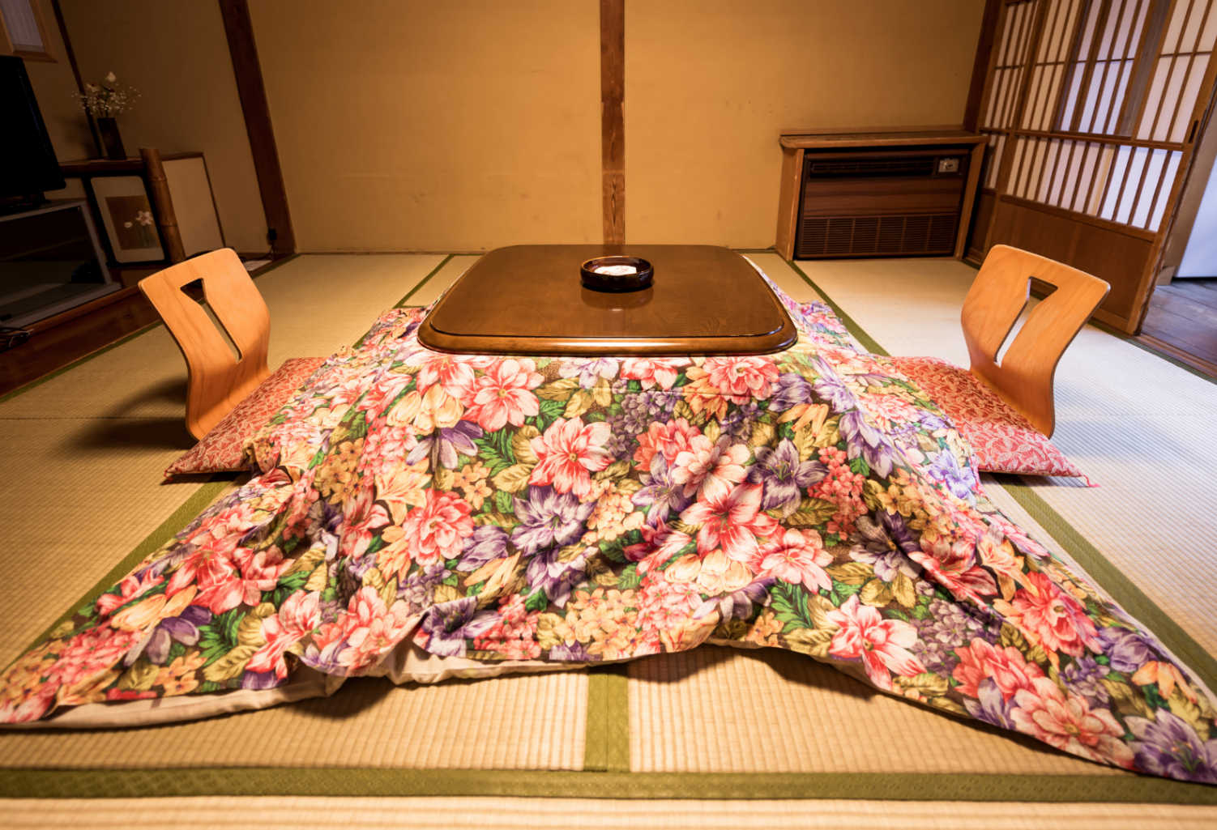
kotatsu こたつ
© The Japan Society 2026
Notes:
Teacher’s Notes
Before explaining, ask pupils to guess what the object on the screen is!
Many people use kotatsu during winter in order to keep warm. They are tables with heaters underneath them. The blanket helps to keep the heat trapped underneath the table. People can sit at the table with their feet and legs underneath which can warm up their body very quickly.
Image from Canva.

Slide 39
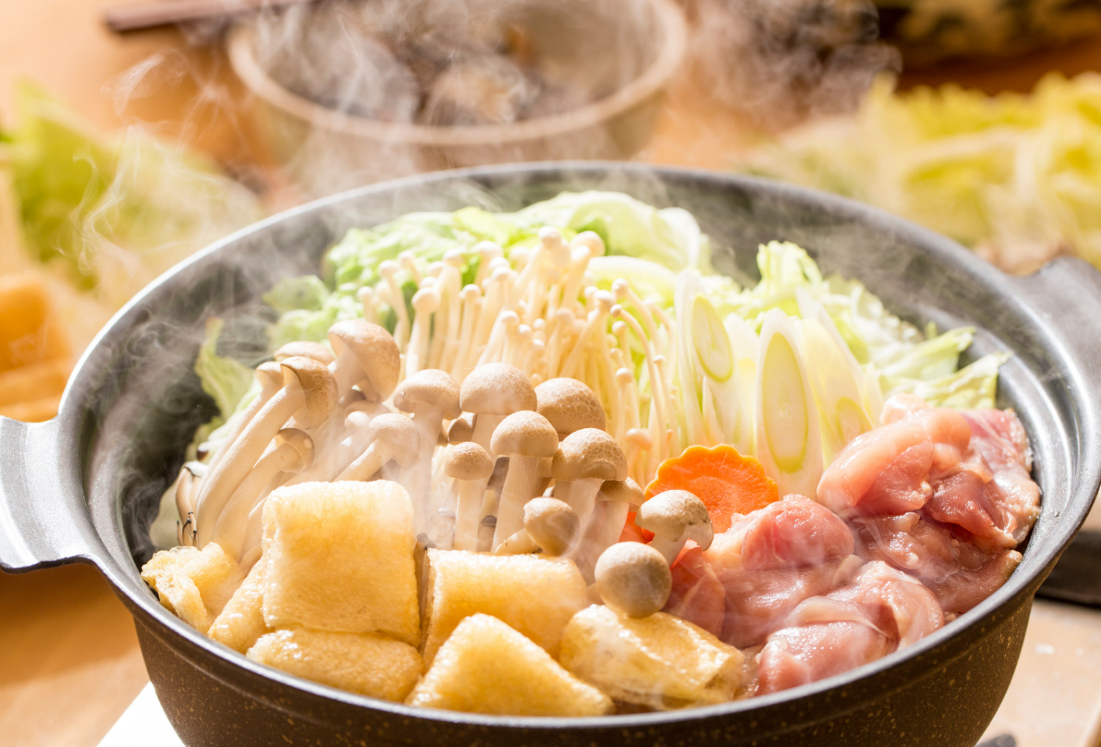
hot pot
© The Japan Society 2026
Notes:
Teacher’s Notes
People also like to eat hot pot during the wintertime to stay warm! Families and friends gather together to cook and eat a range of ingredients in the hot pot together, including vegetables, meat, and seafood.
Our Winter Food resource covers in further detail the different types of delicious dishes people in Japan like to enjoy during the colder months of the year. Visit the resource page to find out more: https://www.japansociety.org.uk/resource?resource=121
Image from Canva.

Slide 40
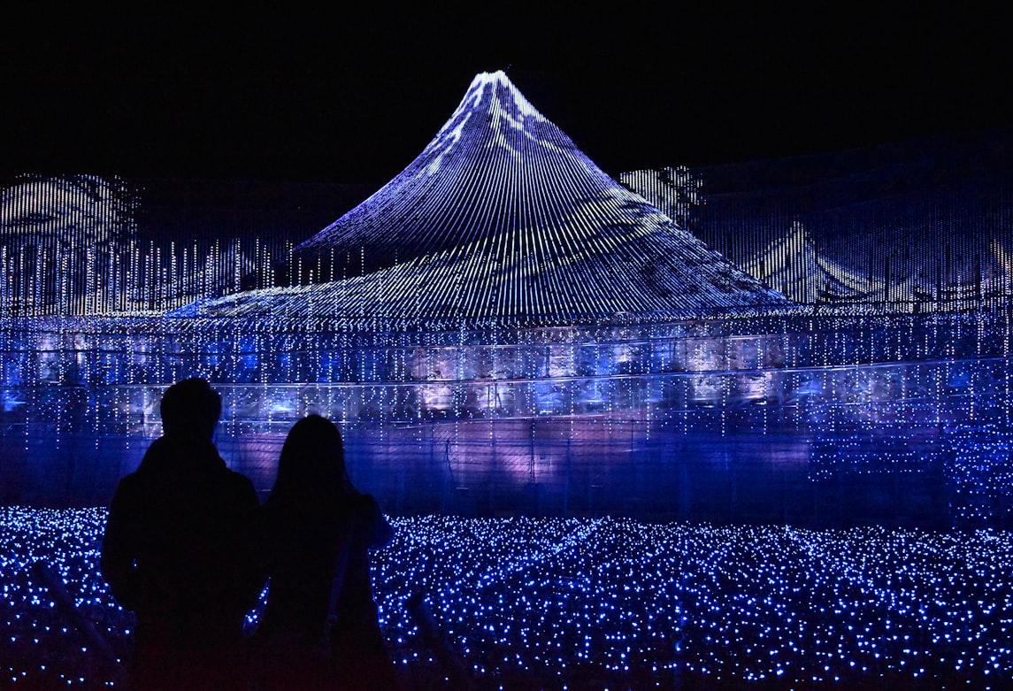
© The Japan Society 2026
Notes:
Teacher’s Notes
In Japan, it gets dark earlier in winter. This makes it a good time of year for beautiful winter lights and illuminations.
Image credits: https://images.unsplash.com/photo-1775591793676-81f243bdc16a?q=80&w=1168&auto=format&fit=crop&ixlib=rb-4.1.0&ixid=M3wxMjA3fDB8MHxwaG90by1wYWdlfHx8fGVufDB8fHx8fA%3D%3D

Slide 41
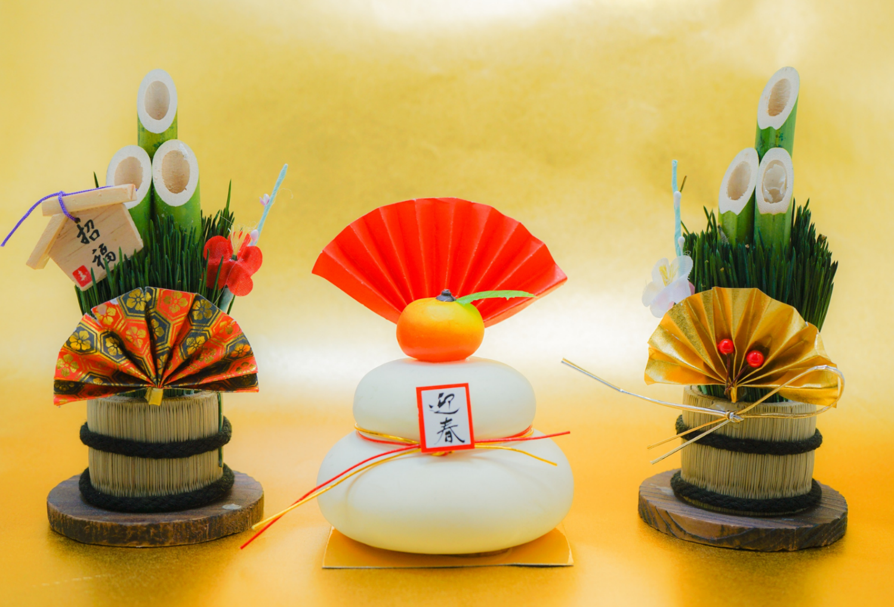
© The Japan Society 2026
Notes:
Teacher’s Notes
New Year is the most important celebration of the year in Japan. People spend time together with family, eating traditional food, and visiting shrines and temples.
Mention to pupils that Christmas is not as widely celebrated nor as significant in Japan as it is in the UK.
This slide shows some typical New Year decorations people might display in their homes.
Learn more about New Year in Japan with our Oshogatsu resource. Visit the resource page to find out more: https://www.japansociety.org.uk/resource?resource=11

Slide 42
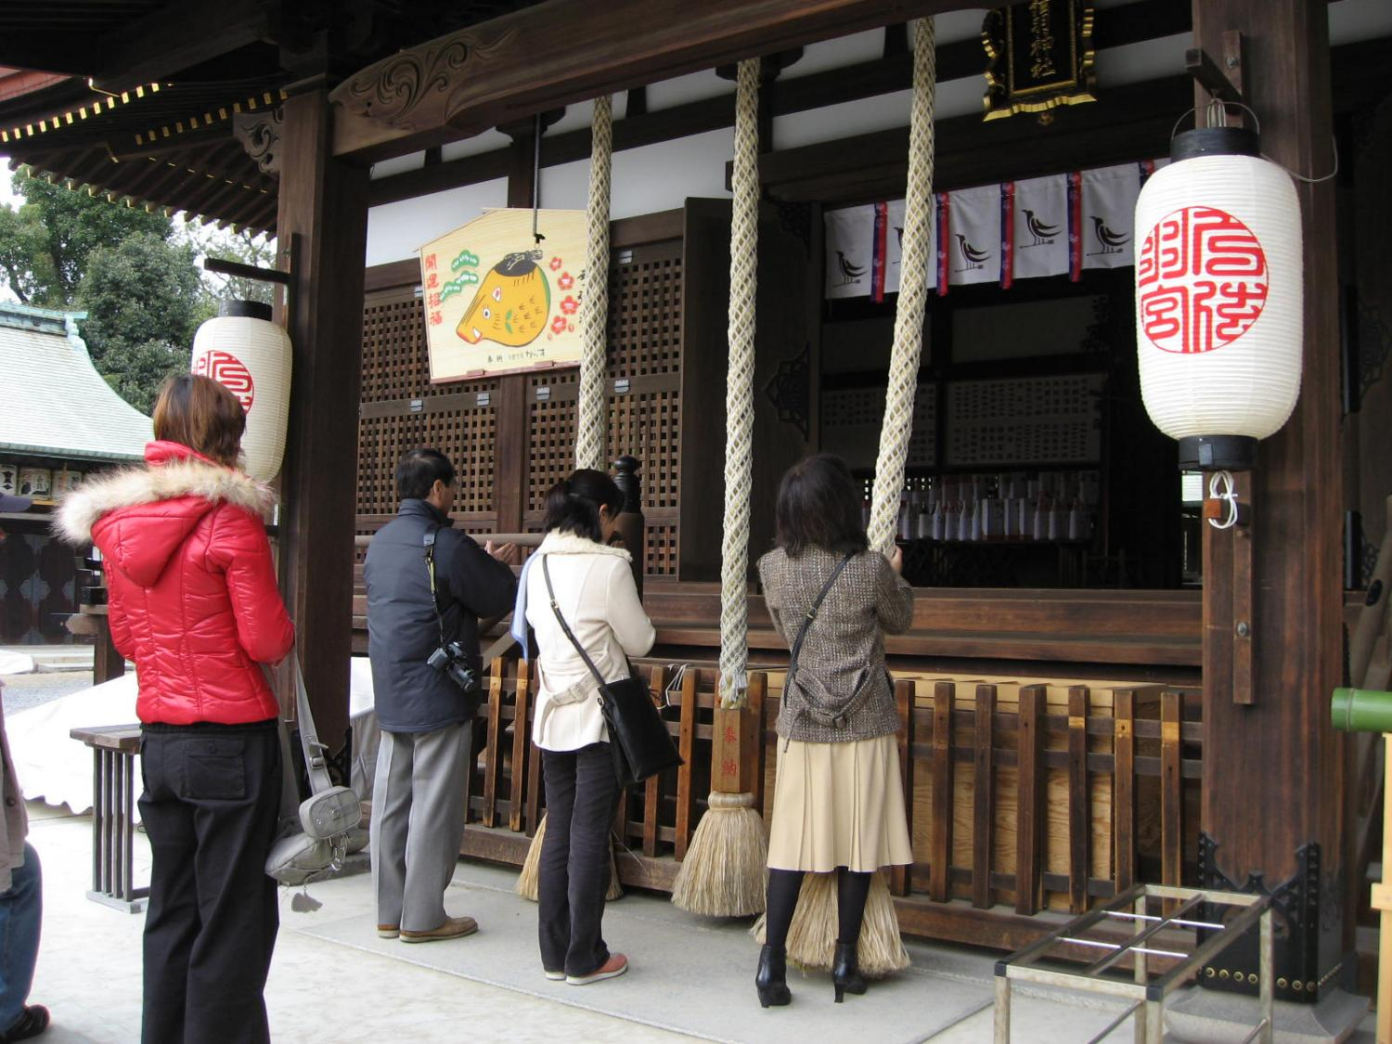
© The Japan Society 2026
Notes:
Teacher’s Notes
During the New Year, people will visit shrines to pray for good fortune in the coming year ahead.
As well as visiting shrines, people often spend time together with their family, eating delicious traditional meals, and enjoying the holiday together.
Image credits: https://commons.wikimedia.org/wiki/File:Yudzuruha_shrine_hatsumode_by_spinachdip.jpg

Slide 43

Reflection
If you could go to Japan, when would you like to go? Why?
What would you like to be able to see and do during that time?
Emoji designed by OpenMoji – the open-source emoji and icon project. License: CC BY-SA 4.0
Notes:
Teacher’s Notes
Before moving onto the main activity of today’s lesson, this is a good point to pause and re-cap with pupils what the have learned today. Thinking back on what they have seen, ask pupils which season would they like to experience if they went to Japan, and why? What would they like to be able to see or do during that season? Discuss with a partner or in groups before feeding back ideas as a class.

Slide 44
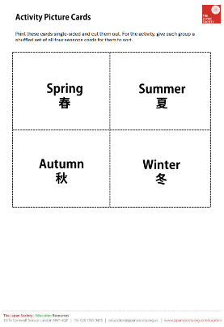
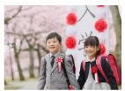
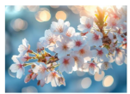
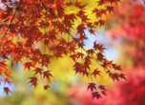

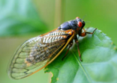
Task 1
How much can you remember from your trip to Japan?
In pairs or groups, sort the picture cards into four different groups: spring, summer, autumn, and winter.
© The Japan Society 2026
Notes:
Teacher’s Notes
Download the picture cards from the resource page, and cut out ahead of the lesson. Distribute the packs of cards to pupils. Pupils should work in a group or in pairs to organise the cards into groups of seasons. Check answers as a class at the end of the task.
You can also turn this activity into a game – see the lesson plan for instructions.

Slide 45
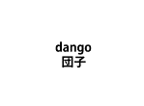




Task 1 - challenge
Now, match the key word cards to the correct groups: spring, summer, autumn, and winter.
© The Japan Society 2026
Notes:
Teacher’s Notes
To challenge pupils, ask pupils to now organise the key word cards by the groups of seasons. You can download the key word cards also from the resource page.

Slide 46




Task 2
Pick your favourite Japanese season and design a seasonal postcard to give to someone!
Use the picture cards and photos on the slides to help you with your design.
© The Japan Society 2026
Notes:
Teacher’s Notes
Pupils should design and make a postcard that represents a particular season in Japan. Their postcard design should include some of the key features explored in today’s lesson. Use the postcards on the PowerPoint slide for inspiration.

Slide 47







This resource was developed and created by
The Japan Society.
The Japan Society
13/14 Cornwall Terrace, London NW1 4QP
Tel: 020 7935 0475
Email: education@japansociety.org.uk
www.japansociety.org.uk
Follow us on social media:
@TheJapanSociety

