Slide 1
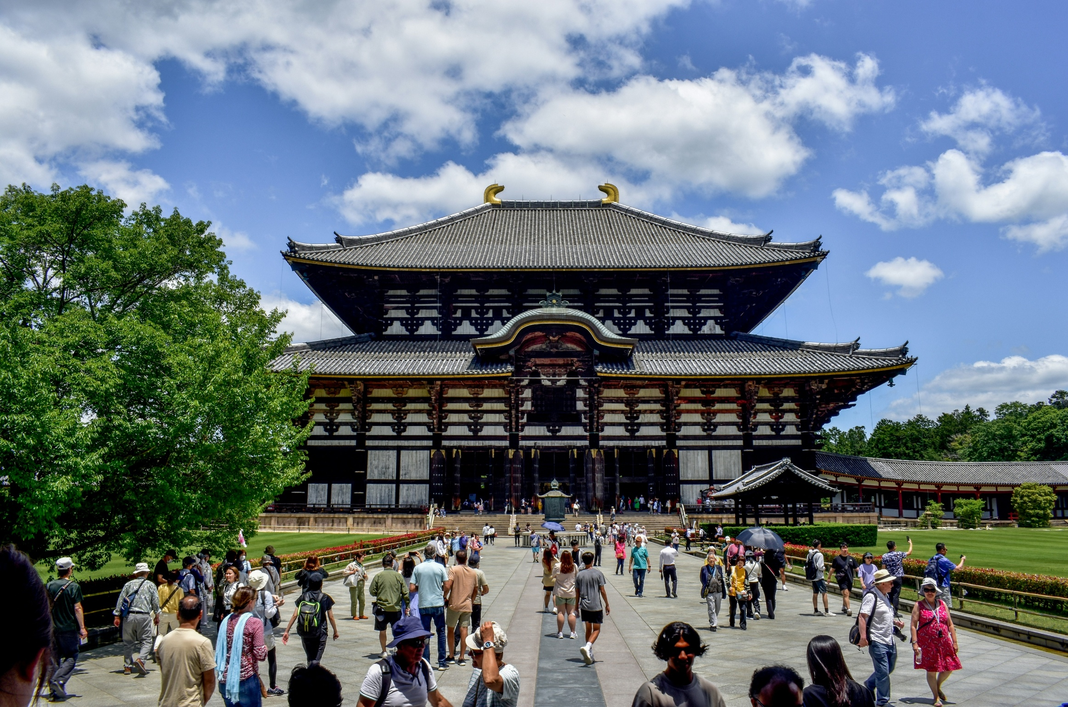

Tourism in Japan
Photo by Alex on Unsplash
Notes:
Teacher’s Notes
This photo is of Todai-ji, a Buddhist temple in Nara. It houses a giant Buddha statue which is approx. 15m tall and is a popular sightseeing spot.
Image: https://unsplash.com/photos/a-large-group-of-people-standing-in-front-of-a-building-XS83BJ5Faok

Slide 2


Starter
Discuss with your partner:
How would you define “tourism”?
What types of tourism are there?
Emojis designed by OpenMoji, license: CC BY-SA 4.0
Notes:
Teacher’s Notes
Ask pupils to discuss the questions on the slide with their partner or in a group. The types of tourism question will also be covered later in this PowerPoint, when discussing the different types of tourism people can enjoy in Japan.
Tell or remind pupils that tourism refers to when people travel to and stay in places different to their usual environment, usually for purposes such as leisure or business. There are many different types of tourism, for example: adventure/extreme sports tourism, food tourism, religious tourism, etc.
If you have learned about tourism previously, you can refer back to your own examples/previous learning.

Slide 3

Learning Objectives
To understand why Japan attracts tourists.
To understand some of the positive and negative impacts tourism is having on Japan.
Emoji designed by OpenMoji, license: CC BY-SA 4.0
Notes:
Teacher’s Notes
Introduce the Learning Objectives.

Slide 4
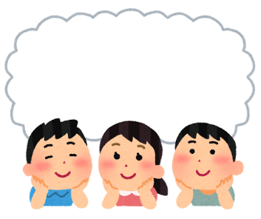
Key Words
Tourism
Tourists
Economy
Society
Environment
Impact
Overtourism
Sustainable tourism
© The Japan Society 2026
Notes:
Teacher’s Notes
Introduce the Key Words of the lesson. Do pupils know what these words mean? You can refer back to this slide at the end of the lesson to check pupil understanding.

Slide 5
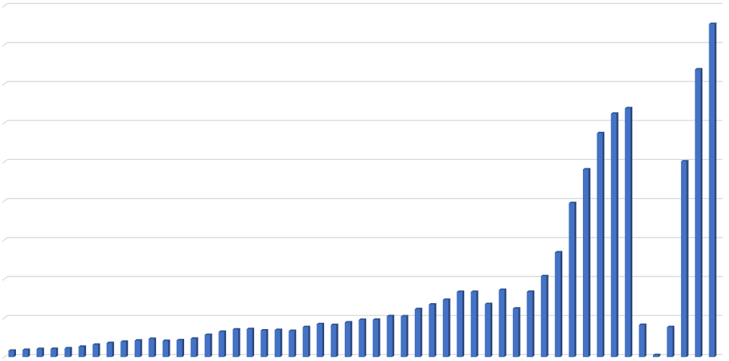
Remember TEA: Trend, Evidence, Anomaly!
Tourist Arrivals
Look at the graph and discuss what you notice with your partner.
Number of Visitor Arrivals to Japan by Year
45M
40M
35M
30M
25M
20M
15M
10M
5M
1975
1980
1985
1990
1995
2000
2005
2010
2015
2020
2025
Graph data ©Japan National Tourism Organization
based on Trends in Visitor Arrivals to Japan by Year
Notes:
Teacher’s Notes
You can visit the JNTO website to find out more information about visitor arrivals and tourism-related statistics:
https://statistics.jnto.go.jp/en/
Ask pupils to discuss what they notice about the graph with their partner/in their group, keeping TEA (trend, evidence, and anomaly) in mind. The following slide will explore some of the key points that pupils may have noticed.
Trend: the number of tourists arriving in Japan has increased over the past 50 years.
The number of tourist arrivals started to increase more significantly from around 2012 onwards.
Tourist arrivals significantly dropped in 2009, 2011 and 2020-2022. In 2009, the number of tourist arrivals dropped most likely due to the global financial crisis in 2008/2009, which made it harder for people to be able to afford to travel. In 2011, the 9.1 magnitude Tohoku earthquake, tsunami and nuclear accident deterred many tourists from visiting Japan (natural disasters as an impact of tourism will be explored later in this presentation). In 2020-2022, the COVID-19 pandemic and its aftermath led to a significant decrease in tourist arrivals in Japan. Japan’s borders remained closed to tourists until 2022, which explains the sudden increase in tourist numbers from 2023 onwards.

Slide 6
Tourist Arrivals
Trend: The number of tourists arriving in Japan has increased over the past 50 years.
Evidence: The number of tourist arrivals started to increase more significantly from around 2012 onwards.
Anomaly: Tourist arrivals dropped in 2009, 2011 and 2020-2022. Why do you think that is?
Why do you think tourism in Japan has increased significantly in recent years?
© The Japan Society 2026
Notes:
Teacher’s Notes
Refer back to the graph on the previous slide to illustrate these points where necessary.
In 2009, the number of tourist arrivals dropped most likely due to the global financial crisis in 2008/2009, which made it harder for people to be able to afford to travel.
In 2011, the 9.1 magnitude Tohoku earthquake, tsunami and nuclear accident deterred many tourists from visiting Japan (natural disasters as an impact of tourism will be explored later in this presentation).
In 2020-2022, the COVID-19 pandemic and its aftermath led to a significant decrease in tourist arrivals in Japan. Japan’s borders remained closed to tourists until 2022, which explains the sudden increase in tourist numbers from 2023 onwards.
Ask pupils to consider the challenge question on the slide. Some possible answers to this could include successful promotional campaigns that have encouraged tourists to visit Japan following the opening of its borders after the COVID-19 pandemic, as well as travel to Japan becoming relatively affordable (perhaps only for tourists from wealthier countries) to be able to travel to Japan. Pupils might also mention that the popularity of Japanese pop culture (such as anime and manga) has encouraged many tourists to visit the country.

Slide 7
Where do tourists travel from?
Look at the table and discuss what you notice with your partner.
Visitor Arrivals to Japan by Country (2025)
Country | Region | Number of visitors
South Korea | East Asia | 9,459,711
China | East Asia | 9,095,931
Taiwan | East Asia | 6,763,424
United States | North America | 3,306,820
Hong Kong | East Asia | 2,517,399
Thailand | Southeast Asia | 1,233,103
Australia | Australia/Oceania | 1,058,396
Philippines | Southeast Asia | 885,023
Singapore | Southeast Asia | 726,251
Canada | North America | 688,019
Vietnam | Southeast Asia | 678,594
Indonesia | Southeast Asia | 640,577
Malaysia | Southeast Asia | 636,575
United Kingdom | Europe | 535,004
Graph data ©Japan National Tourism Organization
based on Visitor Arrivals to Japan – Breakdown by Country/Area
Notes:
Teacher’s Notes
Ask pupils to look at the data in the table which illustrates which countries tourists in Japan have travelled from. As you will see from the table, a large number of tourists in Japan have travelled from countries in East Asia. The following slide will break down the data further.
This data can also be viewed as a pie chart on the JNTO website:
https://statistics.jnto.go.jp/en/graph/#graph--breakdown--by--country
You can visit the JNTO website to find out more information about visitor arrivals and tourism-related statistics:
https://statistics.jnto.go.jp/en/

Slide 8

Where do tourists travel from?
You may have noticed that a large proportion of the visitor were from East and Southeast Asian countries.
65% of visitors to Japan in 2025 were from East Asia.
Visitors from South Korea made up 22% of the total arrivals.
Why do you think that is?
© The Japan Society 2026
Notes:
Teacher’s Notes
Some possible answers for this question could be: easy to travel to Japan due to short flights (there are also ferries to Japan from China and Korea), cheaper to travel from neighbouring countries, perhaps better knowledge/familiarity with language or culture, the exchange rate makes shopping and accommodation more affordable, etc.
Pupils should also consider the fact the graphs count the total number of visitor arrivals. This could also include people travelling for business/work, visiting family and friends, or going to study in Japan.
Does the data surprise pupils? Why or why not?

Slide 9
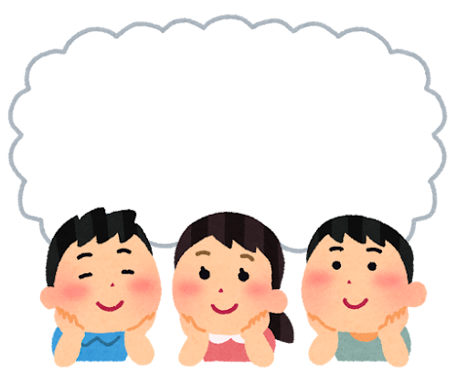
Tourism in Japan
Thinking back on what we have learned about Japan so far, discuss with your partner:
Why do you think a
tourist might want to
visit Japan?
© The Japan Society 2026
Notes:
Teacher’s Notes
Pupils can draw on their own personal experiences and ideas here, too, if they have experience of travelling to Japan or would like to visit Japan in the future.
Some of the reasons pupils might suggest could include: interest in popular culture (anime, manga, gaming, etc), food, desire to visit specific cities, see specific landmarks, natural scenery, tourist attractions, visiting family/friends, etc.

Slide 10

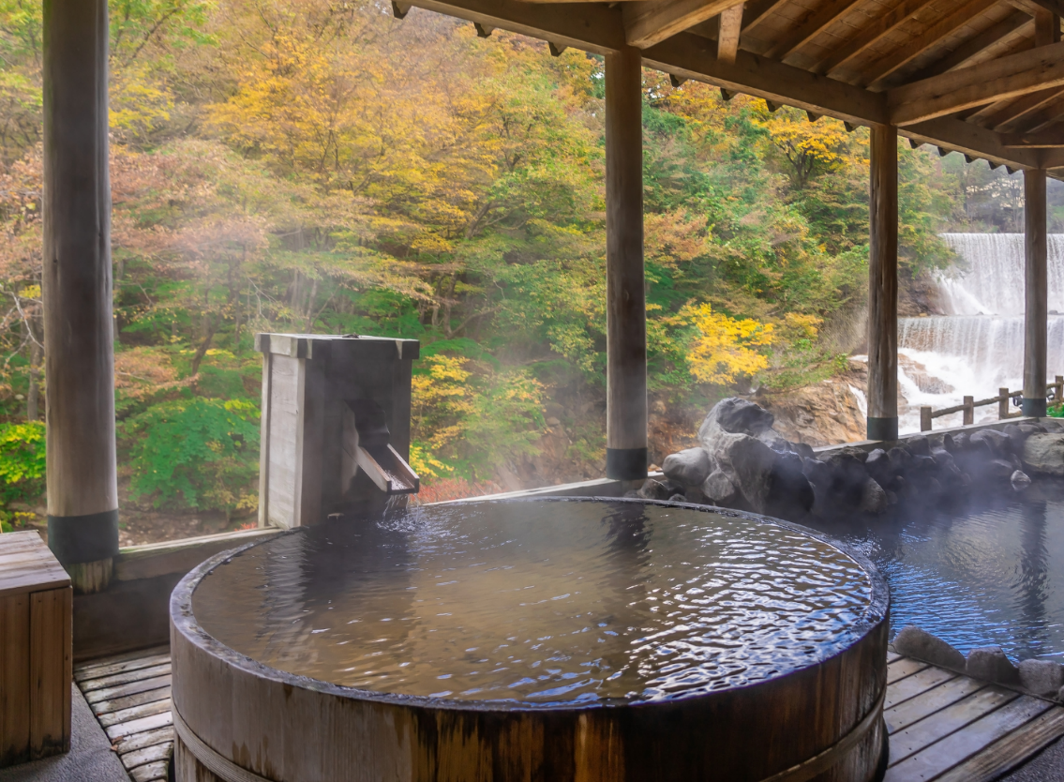
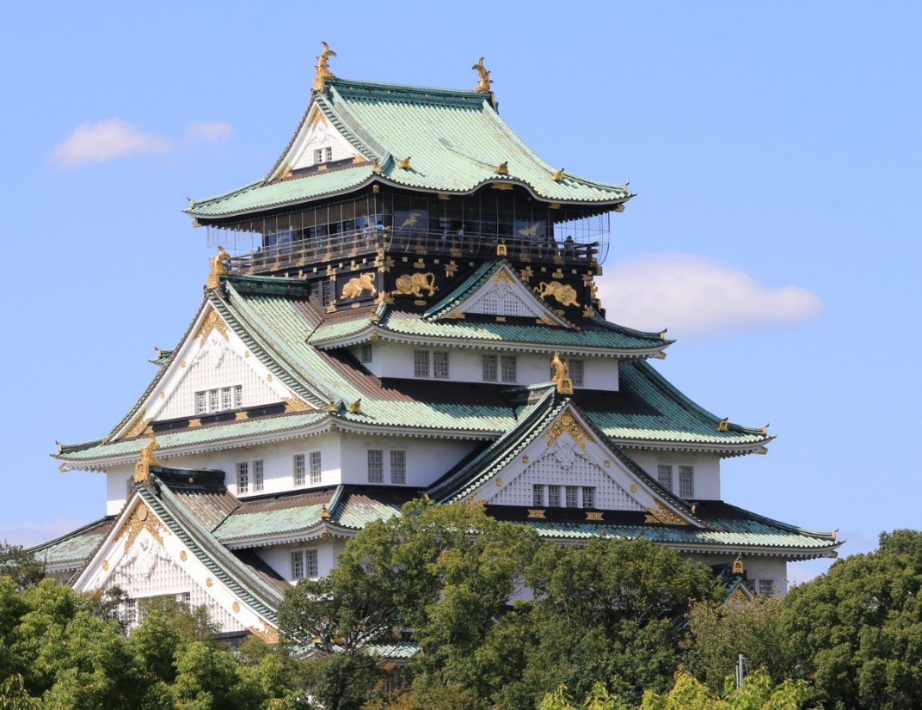
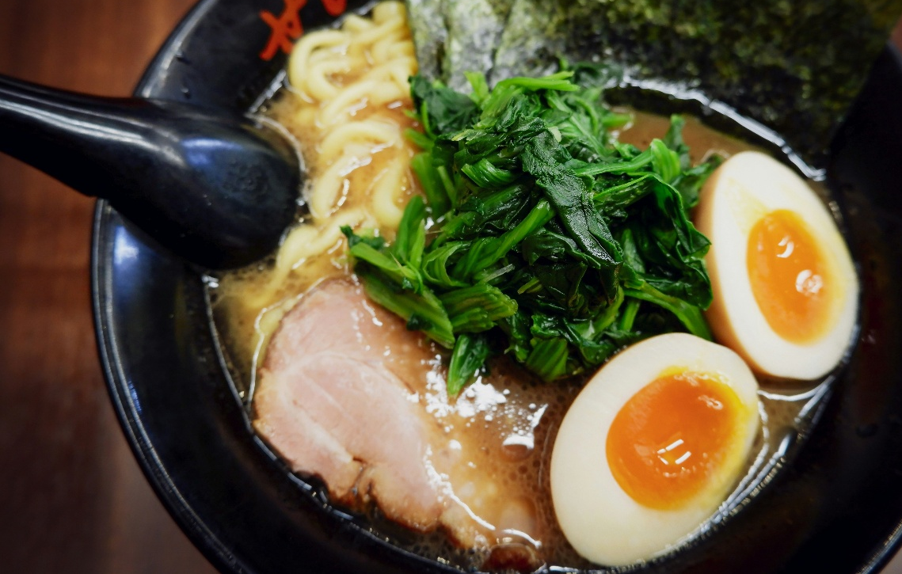
Why do people visit Japan?
© The Japan Society 2026
Notes:
Teacher’s Notes
Click through the slide to reveal different types of tourism that are popular in Japan. Did any of these surprise pupils?
L-R Clockwise: Interest in popular culture (this is manga), nature/hot springs/relaxation, culinary/food (this is ramen) history/sightseeing (this is a castle)…

Slide 11
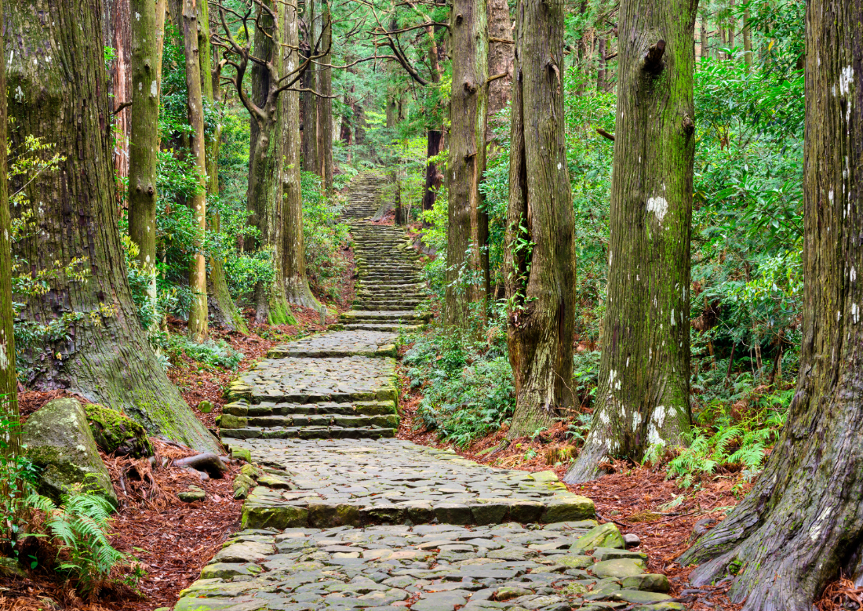
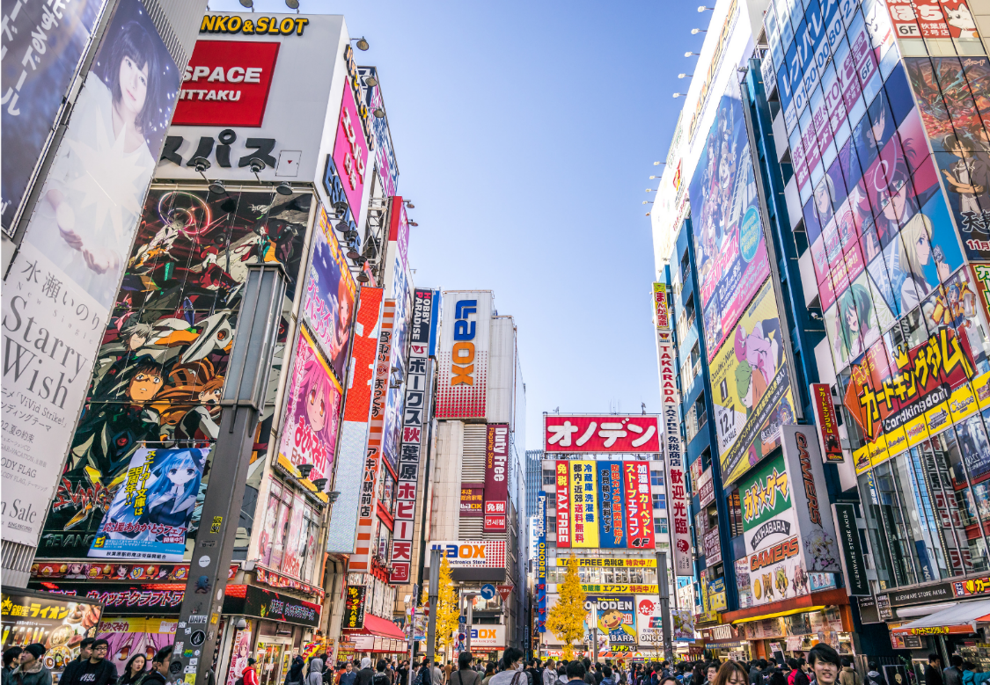
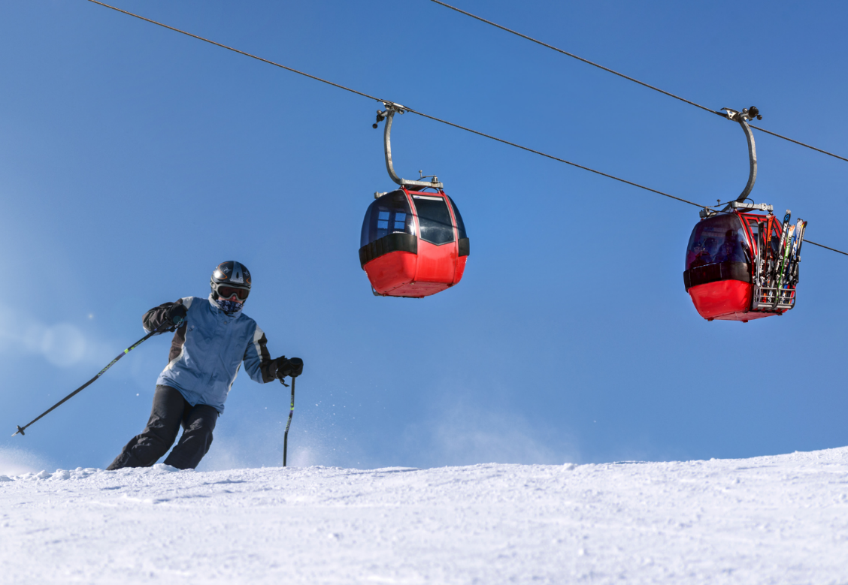
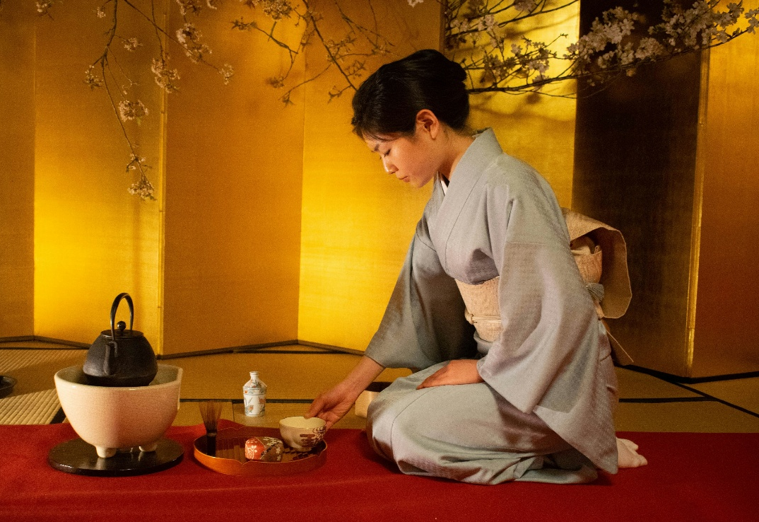
Why do people visit Japan?
© The Japan Society 2026
Notes:
Teacher’s Notes
Click through the slide to
reveal the different types of tourism that are popular in Japan. Did any of these surprise pupils?
L-R Clockwise: Spiritual or religious (this image shows part of a pilgrimage route), big cities and shopping, sports/adventure, cultural classes/workshops/experiences (e.g. tea ceremony)…

Slide 12
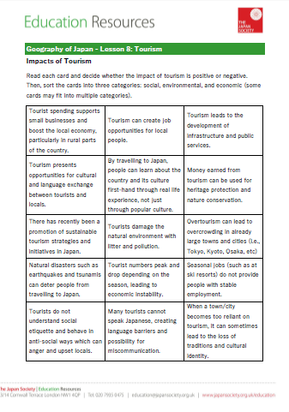
Impacts of Tourism
Let’s think about how Japan may be impacted by this significant increase in tourism.
Read each of the cards and decide whether it is a positive or negative impact.
Sort the cards into three different categories:
  social
  environmental
  economic
© The Japan Society 2026
Notes:
Teacher’s Notes
Hand pupils the impact cards (available to download from the resource page) and ask them to sort the cards into positive and negative impacts, before sorting them by category (does this impact society, the economy, or the environment?) – some cards may fit into multiple categories. This could be done in many different ways, so instruct pupils in whatever way will be easiest. For example, pupils could highlight the cards using different colours to indicate whether they are positive and negative, and then write the categories they fit into on the card, or by sorting them into different groups.
Once pupils have completed the activity, feedback ideas as a class.

Slide 13

Reflection
Tourist arrivals in Japan have been______________ .
The majority of tourists in Japan travel from _________ .
Tourists spending money in local shops is an example of an ___________ impact of tourism.
Asia
increasing
negative
Europe
economic
decreasing
© The Japan Society 2026
Notes:
Teacher’s Notes
Ask pupils to discuss with a partner or as a class the answers to these fill-in-the-blank sentences.
Click on the slid
e to reveal the answers in order.
Illustration from Irasutoya.

Slide 14
Tourism in Japan
Continued…
Photo by Alex on Unsplash
Notes:
Teacher’s Notes
The second part of this lesson continues from the previous content. In this part students will consider sustainable tourism and overtourism.
Image: https://unsplash.com/photos/a-large-group-of-people-standing-in-front-of-a-building-XS83BJ5Faok

Slide 15
Learning Objectives
To understand why Japan attracts tourists.
To understand some of the positive and negative impacts tourism is having on Japan.
To recognise how sustainable tourism can be a solution to the problem of overtourism in Japan.
© The Japan Society 2026
Notes:
Teacher’s Notes
Introduce the new LO for part 2 of this lesson.

Slide 16
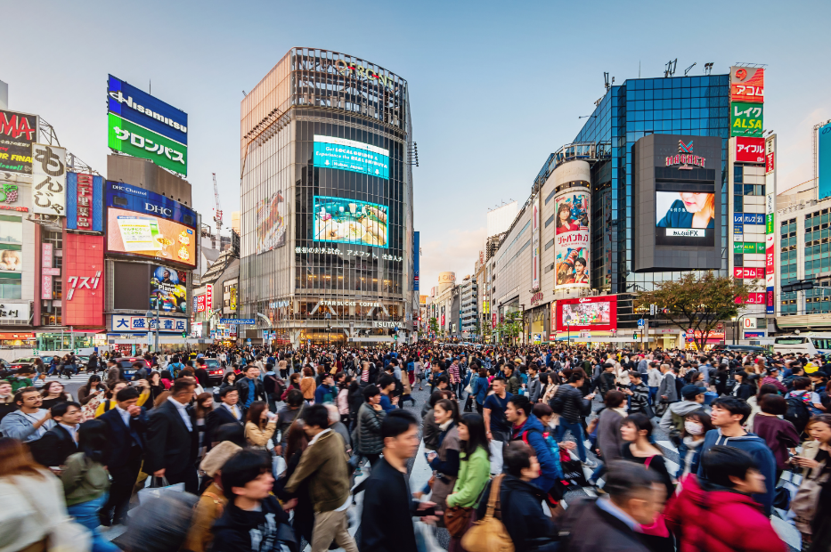
Overtourism
Discuss with your partner or write down:
What do you think the term ‘overtourism’ means?
Key Term:
Overtourism is when too many people visit a particular destination, harming the nature, economy, and quality of life for local people.
© The Japan Society 2026
Notes:
Teacher’s Notes
Ask pupils to discuss (either as a class or in pairs/groups) what they think the term “overtourism” means. If pupils need a prompt, you can remind them that one of the impact cards from the last lesson said “Tourism can lead to overcrowding in towns and cities that cannot handle large numbers of people”.

Slide 17
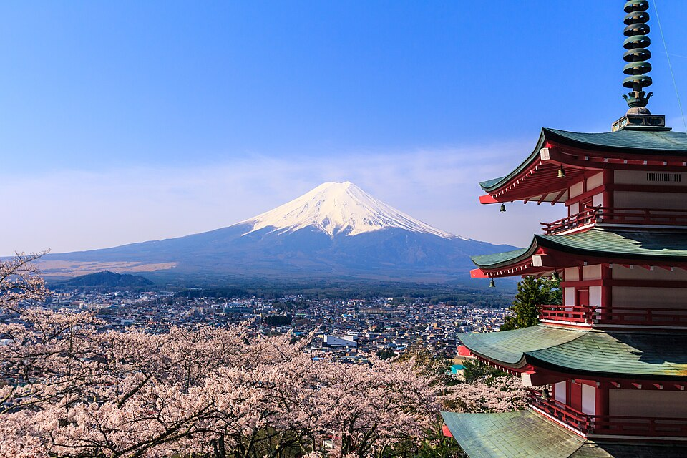
Overtourism in Japan
In 2026, Fujiyoshida, a town near Mount Fuji, cancelled its annual cherry blossom festival due to overtourism.
Authorities stated that the increase of tourists has exceeded the city’s capacity and resulted in negative impacts.
© The Japan Society 2026
Notes:
Teacher’s Notes
This slide explores a specific example of overtourism in Japan, which was reported on in February 2026.
Fujiyoshida attracts visitors during cherry blossom season (March - April) due to its picturesque scenery.
There were multiple reports, the link to the BBC article is below for more information:
Japanese city cancels cherry blossom festival over badly behaved tourists: https://www.bbc.co.uk/news/articles/c1wzrlndzjro
Image from Wikimedia Commons: https://commons.wikimedia.org/wiki/File:Chuurei-tou_Fujiyoshida_17025277650_c59733d6ba_o.jpg

Slide 18
Overtourism in Japan
Discuss with your partner:
How do you think Fujiyoshida was impacted by overtourism? (economy, society, environment...)
Why do you think organisers decided to cancel the event?
Challenge Task: Can you think of specific examples for social, environmental and economic impacts?
© The Japan Society 2026
Notes:
Teacher’s Notes
Thinking about the example of the Fujiyoshida cherry blossom festival, ask pupils to consider how the city was negatively impacted by overtourism. Possible answers could include damage to natural environment (littering), anti-social behaviour from tourists, overcrowding (traffic and congestion), cancelling the festival negatively impacting the economy (loss of jobs, loss of tourist spending, etc).
Possible answers to question 2 could be to prevent extreme overcrowding and keep people safe, to prevent damage to natural environment, to discourage people from visiting and reduce tourist numbers, to protect local people and improve the quality of life, etc.

Slide 19

Sustainable Tourism
Sustainable tourism can help to combat the problem of overtourism.
This means thinking about how people can travel to places responsibly and have a positive impact. Such as:
Travelling by public transport.
Supporting and spending money at
local businesses.
Respecting the natural environment.
What other ideas can you think of?
© The Japan Society 2026
Notes:
Teacher’s Notes
The UN defines sustainable tourism as “tourism that takes full account of its current and future economic, social and environmental impacts, addressing the needs of visitors, the industry, the environment and host communities”.
Click on the slide to reveal some examples of ways in which tourists can ensure they are being a sustainable tourist. Can pupils think of any other ideas or ways in which tourists can travel sustainably?

Slide 20

Sustainable Tourism
For example, tour operators are actively promoting alternative travel destinations within Japan to tourists.
This can help to reduce the strain in overcrowded areas, whilst boosting the economy of under-visited towns and cities which are keen to encourage more tourists.
© The Japan Society 2026
Notes:
Teacher’s Notes
The promotion of alternative travel destinations, or travelling “off the beaten path” is also an excellent way to encourage sustainable tourism. It can reduce the strain of overtourism in overcrowded areas, by creating a spread of tourists across the country, and visiting towns and cities that want to actively encourage tourism for a number of reasons.
https://www.japan.travel/en/sustainable/

Slide 21
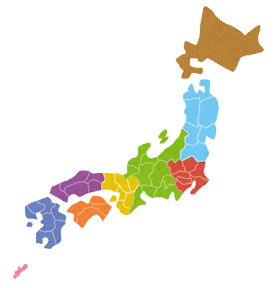
Activity
Your Task: You are going to research an alternative travel destination in Japan, and consider why it is a great place for tourists to visit!
Akita
Tokyo
Kagoshima
Wakayama
© The Japan Society 2026
Notes:
Teacher’s Notes
Hand out the fact file worksheet to pupils and explain the task. They should select one of the prefectures listed, and research why it is a great place for tourists to visit. Alternatively, they could select their own prefecture/town/city if they wish to do so; however, it must be somewhere that is not dealing with the issue of overtourism.
The JNTO website has excellent information about the above prefectures which pupils can use to fill in their worksheet. They might also like to use Google Maps to familiarise themselves with the prefecture. You can suggest other useful websites or resources that pupils can use as part of their research, too.
https://www.japan.travel/en/destinations/tohoku/akita/
https://www.japan.travel/en/destinations/kansai/wakayama/
https://www.japan.travel/en/destinations/kyushu/kagoshima/

Slide 22

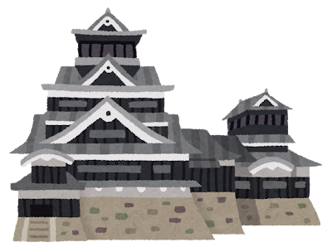

Activity
Akita
Wakayama
Kagoshima
Select one of the prefectures and fill in your fact file sheet. You can use the JNTO website, Google Maps, and other resources to help you with your research.
© The Japan Society 2026
Notes:
Teacher’s Notes
You could give students a bit more information about each destination as below, randomly assign, or print out the JNTO pages (see slides on previous page) to help pupils decide.
Akita is known for: snow and mountains, hot springs, Akita dog breed, and castle town with preserved samurai residences. It also has a manga museum.
Wakayama is known for: it’s castle, pilgrimage routes and temples, scenic nature, hot springs. It also has a theme park.
Kagoshima is known for: Sakurajima volcano, beautiful beaches (such as Amami islands) ancient forests (in Yakushima which inspired the Studio Ghibli film Princess Mononoke).

Slide 23
Reflection
Find a partner and imagine...
Partner A plans to visit Japan soon but only plans to go to areas which suffer from overtourism.
Partner B has 30 seconds to tell them about the benefits of visiting their alternative travel destination.
Was Partner A convinced? Why or why not?
© The Japan Society 2026
Notes:
Teacher’s Notes
If students have time they can swap roles and complete the activity again.

Slide 24


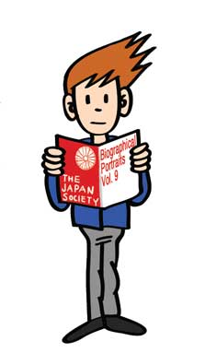




This resource was developed and created by
The Japan Society.
The Japan Society
13/14 Cornwall Terrace, London NW1 4QP
Tel: 020 7935 0475
Email: education@japansociety.org.uk
www.japansociety.org.uk
Follow us on social media:
@TheJapanSociety

