Slide 1
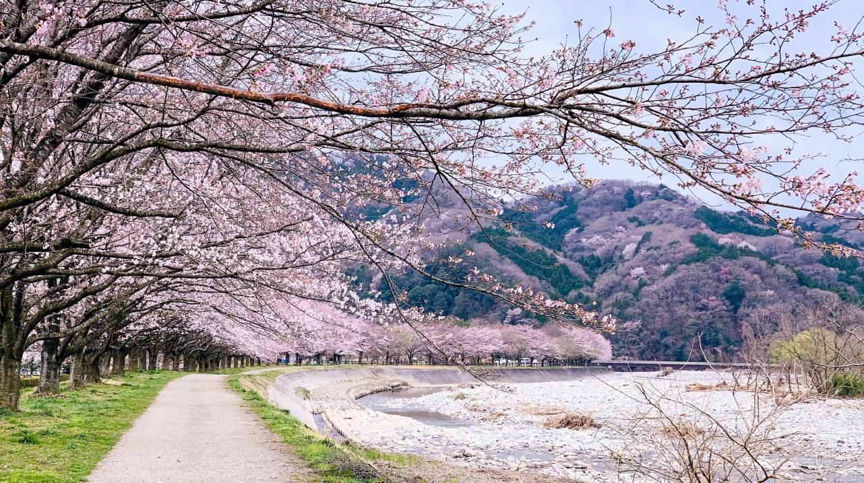
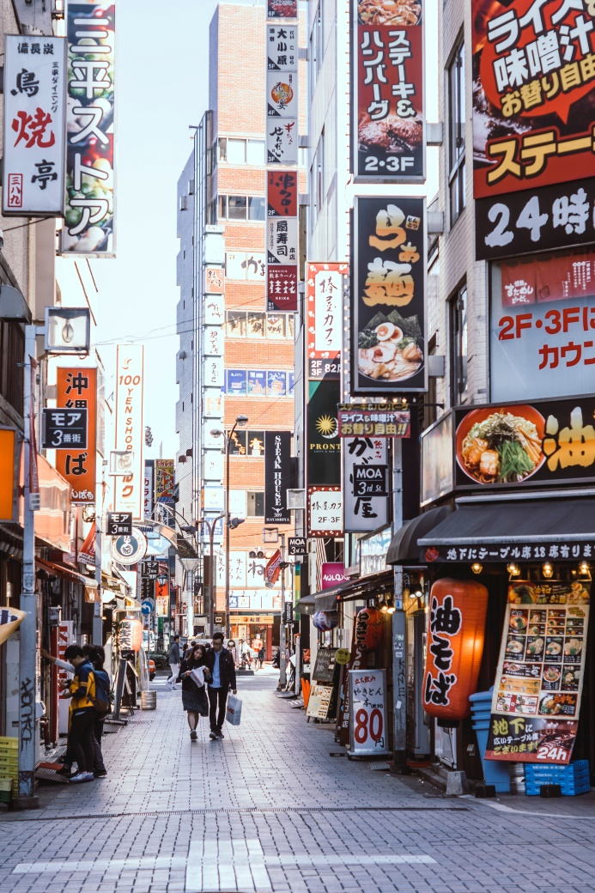
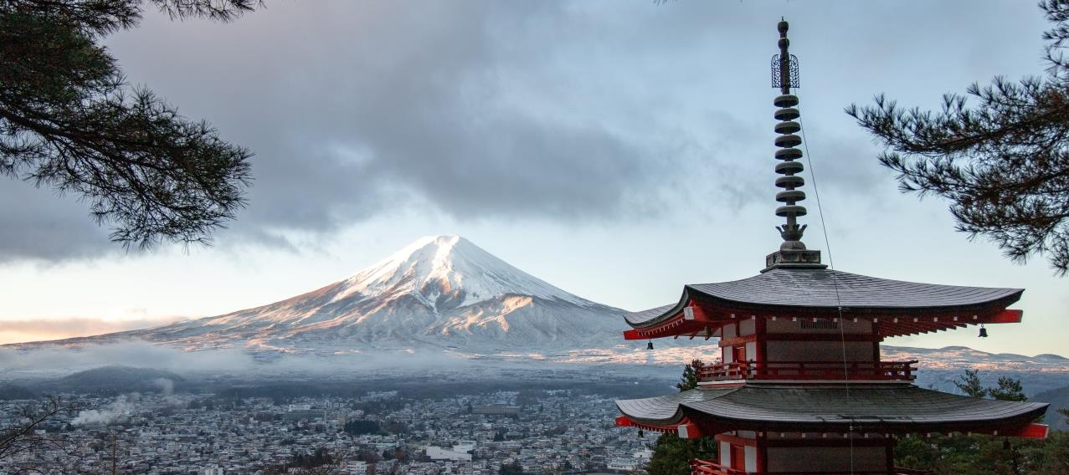
Japan!
What country are we going to be learning about?
Tomáš Malík
bantersnaps
Akira Deng
photos by bantersnaps, Akira Deng, and Tomáš Malík on Unsplash
Notes:
Teacher’s Notes
From the images, ask students to guess what country you will be learning about.

Slide 2
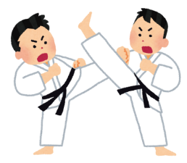
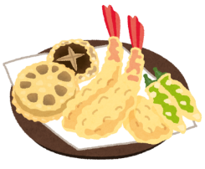
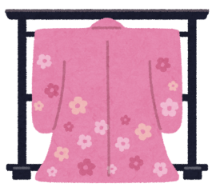
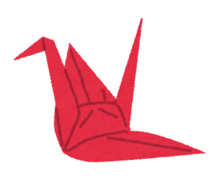
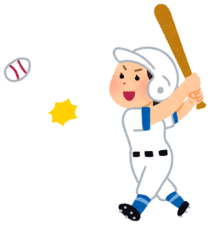
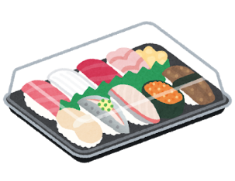
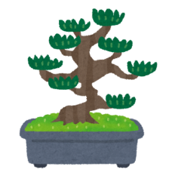
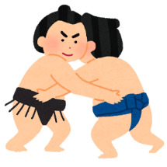
What do you know
about Japan?
What do you want to learn
about Japan?
Traditions?
Sports?
Foods?
Notes:
Ask students
Talk to your partner (TTYP): What do you already know about Japan? Take responses from pupils. Point to the images and prompt students: ‘What do you think this is?’.
TTYP: What do you want to find out about Japan? Take responses.
All images from Irasutoya: www.irasutoya.com

Slide 3
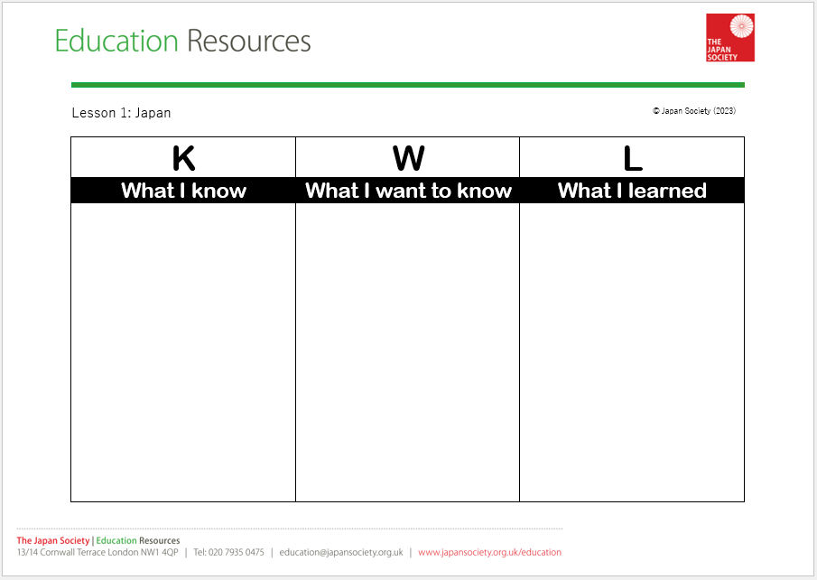
Task 1
Sushi is from Japan.
What sports are popular in Japan?
Notes:
Instructions for Task 1
Show the KWL sheet. Indicate that the first column is to record things we already know about Japan and the second column is where we can write down the things we want to find out about Japan. Explain that we will return to the sheet at the end of our topic to write down what we actually learned about Japan.
Give pupils 5 minutes at their desk to add two or three items to the first and second columns. Remind pupils how to correctly punctuate statements (what I know) and questions (what I want to know). Once complete, bring pupils back to the carpet.

Slide 4
Learning Objectives
Locate Japan on a world map
Locate and name Japan’s capital city and four main islands
Notes:
Task 1
Introduce the LOs for the lesson.

Slide 5
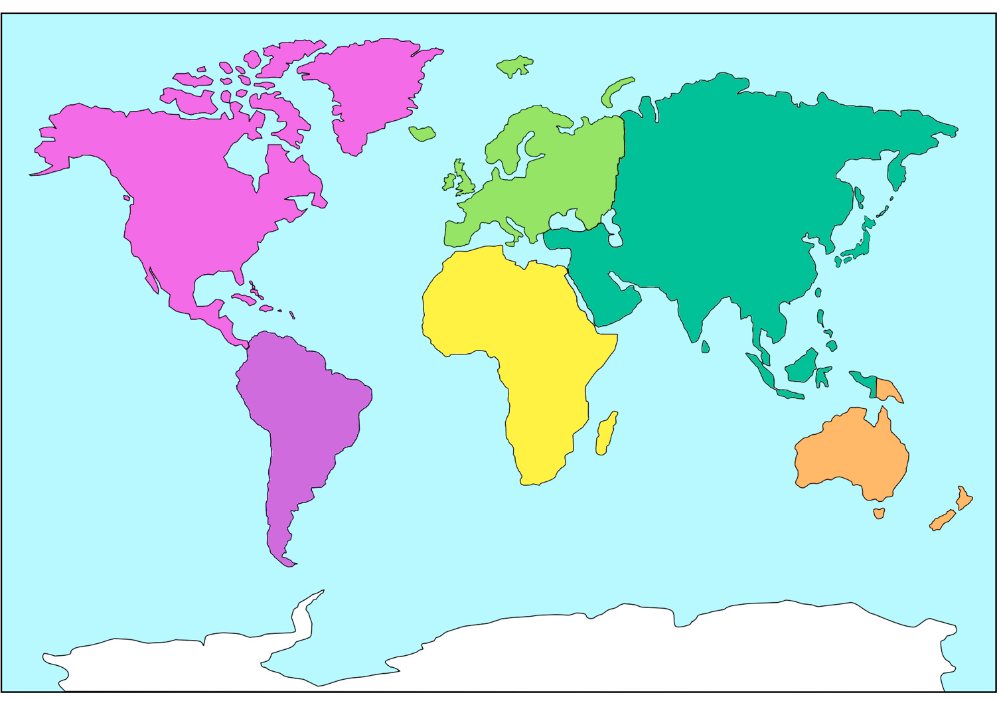
North America
Europe
Asia
Africa
Equator
South America
Australia
Antarctica
Notes:
Ask pupils to locate the UK on the above world map. KQ: In which continent is the UK?
Identify Europe on the map and explain that a continent is a large area of land, often containing several different countries, separated from other continents by water or another geographical feature (e.g. mountains). Explain that there are seven continents. TTYP: Name the 6 remaining continents and try to locate them on the map. (Note: Australia is the name of the continent, as this is the large landmass. However, the wider region, including New Zealand, New Guinea and some Pacific islands, is known as Oceania. For this reason, some people use these terms interchangeably).
Ask pupils to locate Japan on the map. KQ: In which continent is Japan? Indicate the Equator and explain that this is an imaginary line the runs around the middle of Earth. The half of the Earth north of the Equator is called the Northern Hemisphere and the half below is called the Southern Hemisphere. Use a globe to model this if available. KQ: Is Japan in the Northern or Southern Hemisphere? What about the UK? Can you name any countries in the Southern Hemisphere?

Slide 6
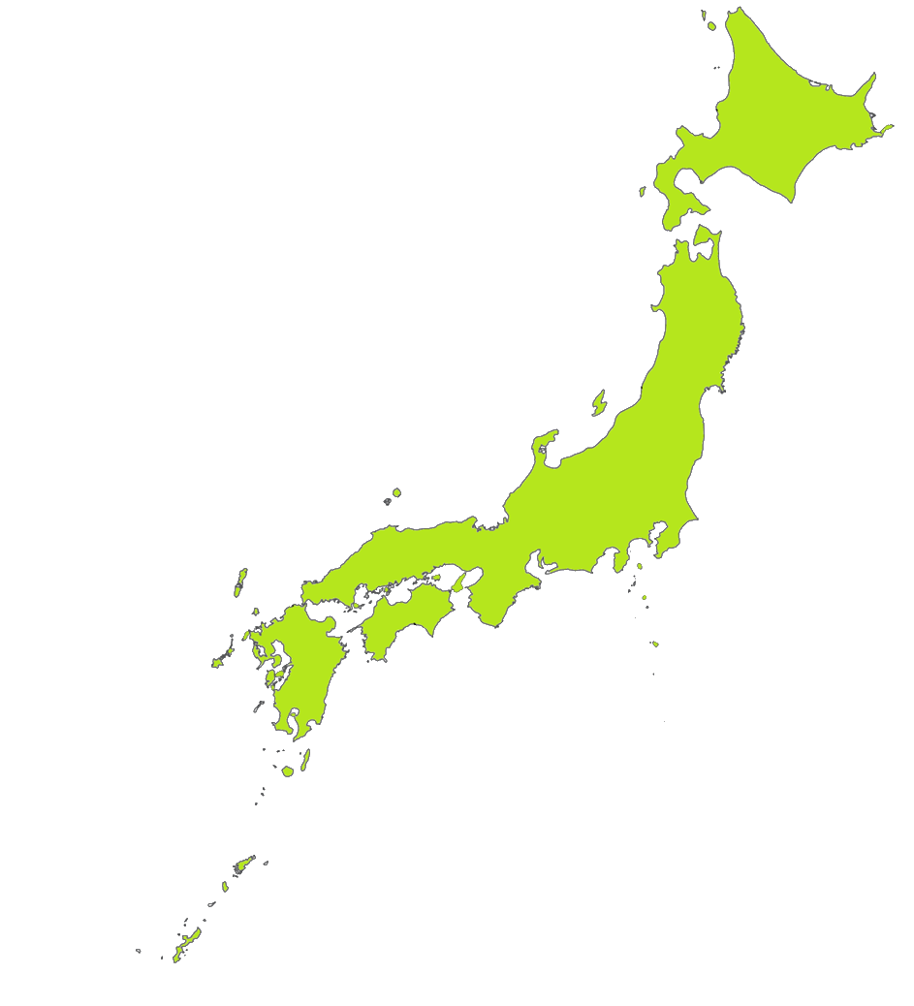
Geography
of Japan
What can you say about Japan just by looking at its map?
Notes:
Teacher’s Notes
Look at the map of Japan. KQ: What can you tell me about Japan just by looking at this map? Prompt students to notice that Japan is a chain of islands and introduce the term ‘archipelago’. Point out the four main islands and explain that there are thousands of smaller islands that altogether make up Japan.
Additional Information: Explain that until very recently it was thought that Japan was made up of 6,852 islands. This figure came from a survey, released in 1987 by the Japanese coast guard, which used paper maps to tally the islands.
However, a new survey announced in 2023 that the number of islands that make up Japan is in fact 14,125 - 7,273 more than previously thought! This new survey was performed by the Geospatial Information Authority of Japan using digital mapping technology.

Slide 7
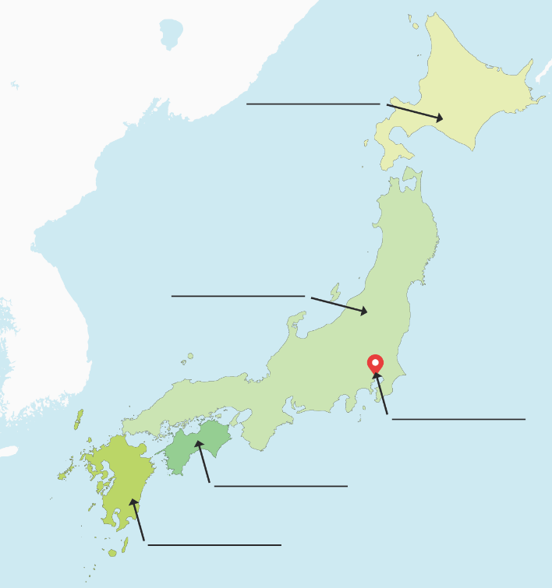
Task 2
Look at the maps and atlases on your table to find Japan. Look for the capital city and names of the main four islands and label them on your worksheet.
Extra challenge
Also find and label the sea and ocean around Japan and any other main cities.
Notes:
Instructions for Task 2
Provide pupils with a range of world maps, atlases and globes. Explain that they must work in pairs to find Japan and identify the names of its four main islands and capital city. As an additional challenge, ask children to label the sea and ocean that surround Japan, as well as any other main cities.

Slide 8
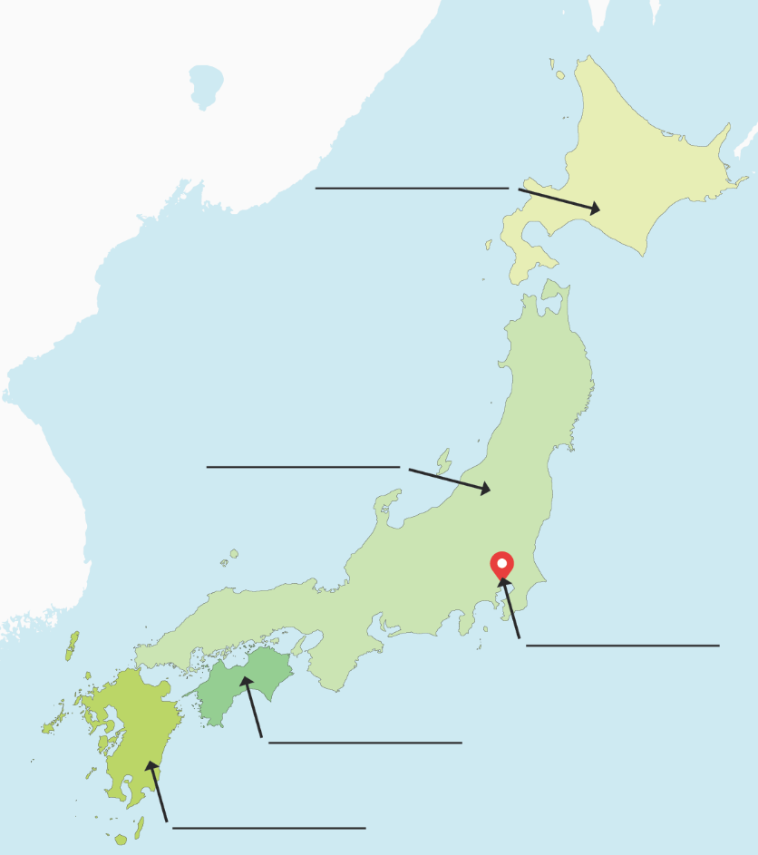
Task 2
Look at the maps and atlases on your table to find Japan. Look for the capital city and names of the main four islands and label them on your worksheet.
Extra challenge
Also find and label the sea and ocean around Japan and any other main cities.
Hokkaido
Honshu
Tokyo
Shikoku
Kyushu
Notes:
Instructions for Task 2
Once children have had sufficient time to complete the task, reveal the answers on the board. Ask pupils who completed the additional challenge to share what they discovered.

Slide 9
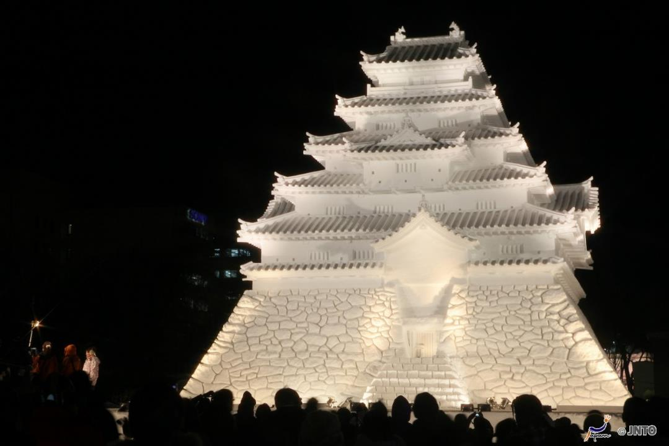
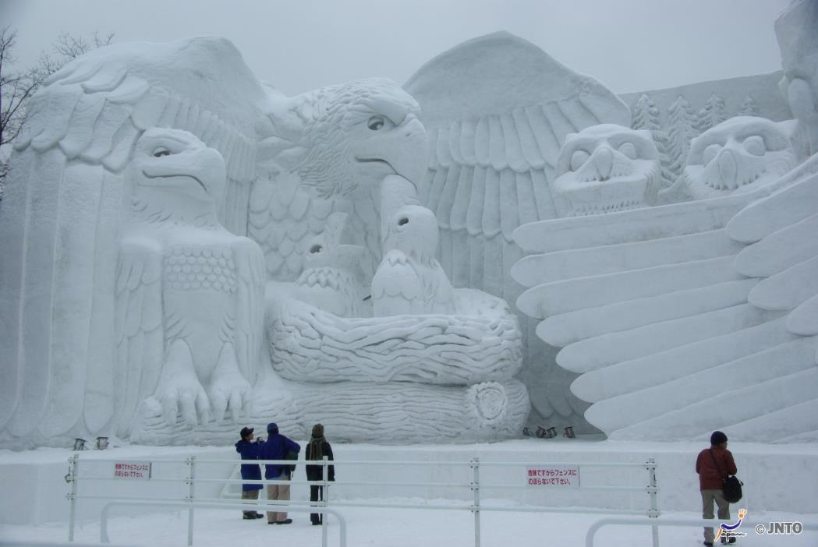
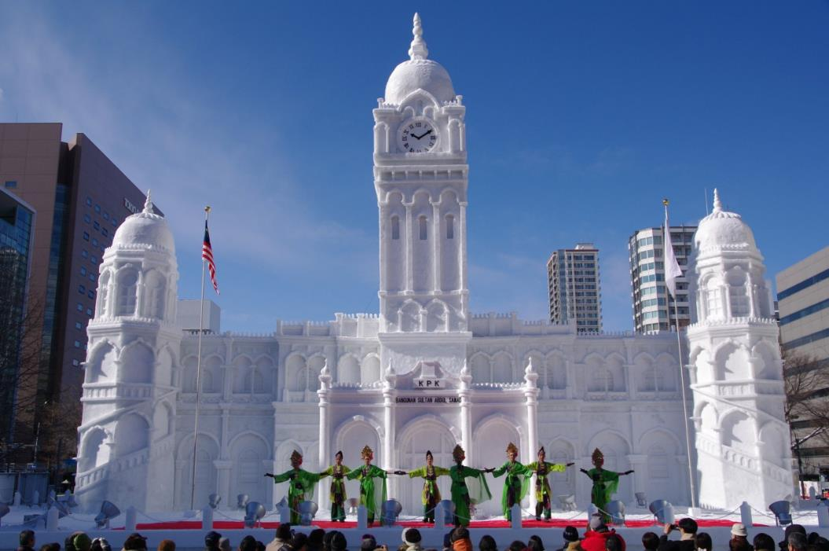
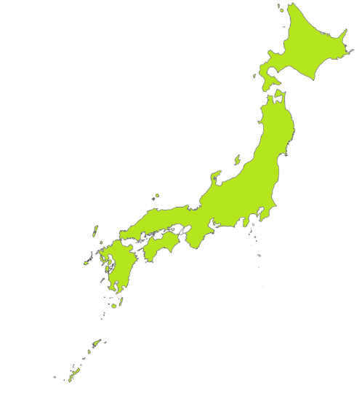
Hokkaido
© Yasufumi Nishi/ JNTO
Notes:
Teacher’s Notes
Explain that as Japan’s most northern main island, it has very cold winters. The main city of Sapporo hosts and annual snow festival (yuki matsuri), when people make enormous snow and ice sculptures.
People from all over Japan and many foreign visitors attend the festival every year.

Slide 10
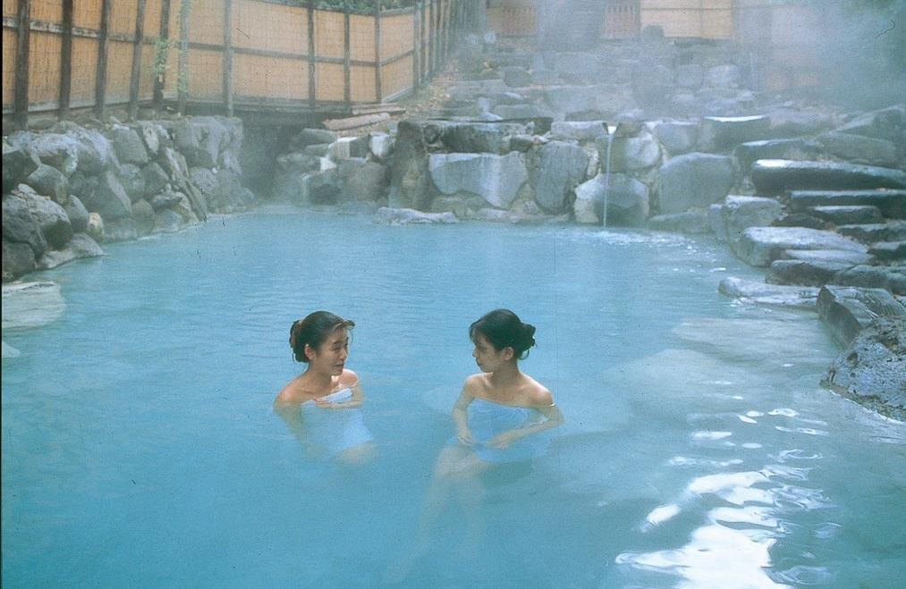
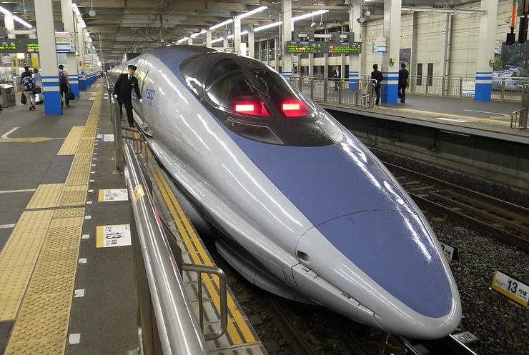
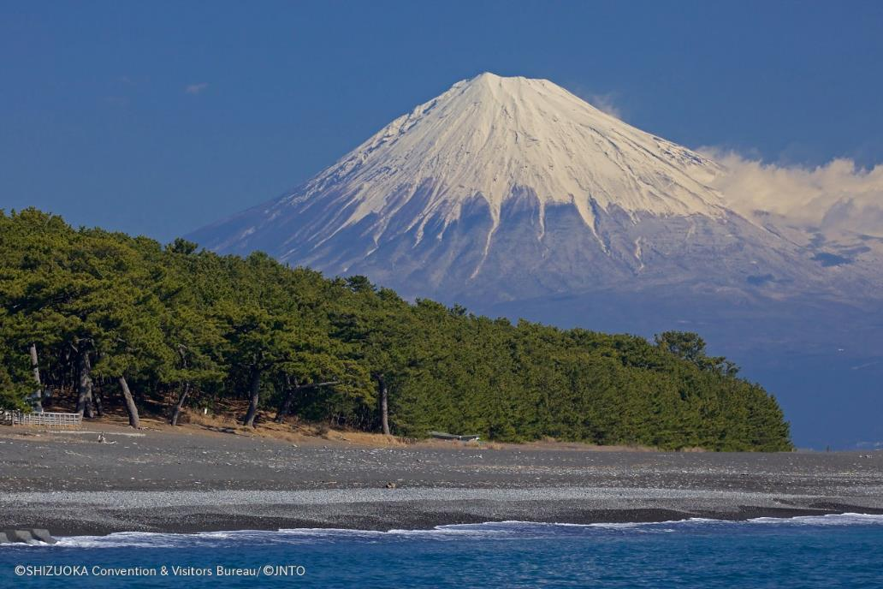
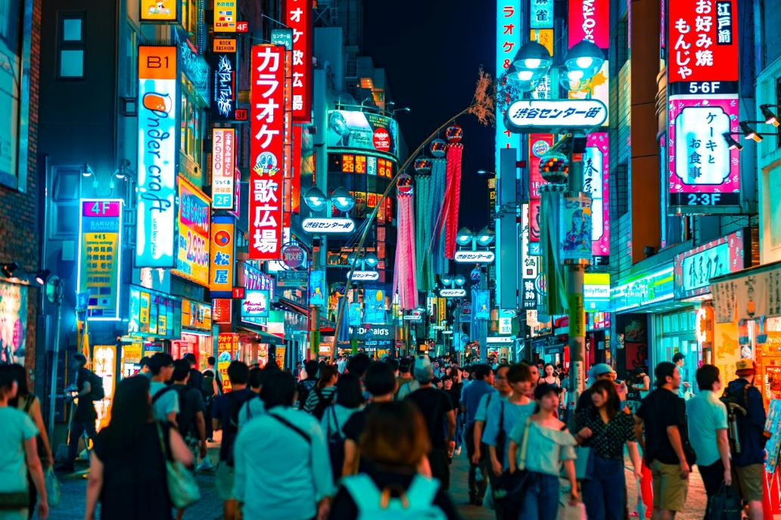
Honshu
© JNTO
Pelican CC BY SA 2.0
Notes:
Teacher’s Notes
Japan’s largest island is Honshu – in fact it is the seventh largest island in the world! It is home to Japan’s capital city, Tokyo, as well as its most famous landmark, and tallest mountain, Mount Fuji. Fuji-san is actually an active volcano. Because there are a lot of volcanoes in Japan, there are also lots of hot springs. A hot spring is a pool of naturally hot water from the ground. People can relax in them, like in the picture.
As the central island, Honshu is connected to the rest of Japan by bridges, undersea tunnels and the shinkansen high-speed rail network.
Image: Shinkansen 500 series by Pelican, Attribution-ShareAlike (CC BY-SA 2.0) via Flickr

Slide 11
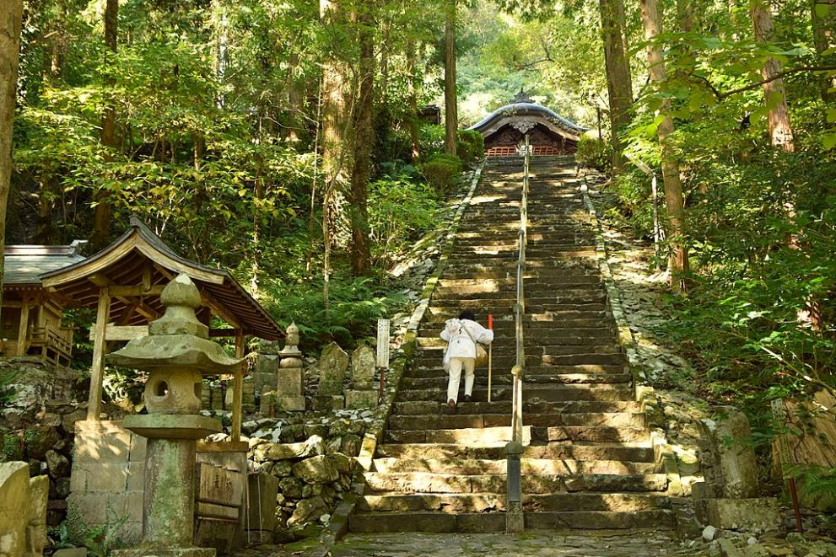
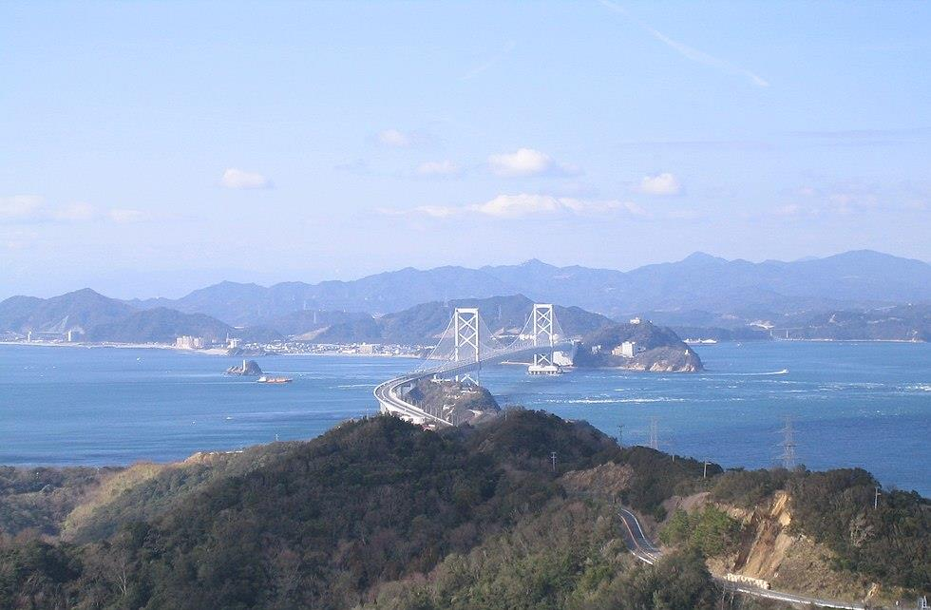
Shikoku
Nagono, CC BY SA 3.0
Raita Futo, CC BY 2.0
Notes:
Teacher’s Notes
Shikoku is the smallest of Japan’s main islands and is famous for its many Buddhist temples. Many people visit Shikoku to do the Shikoku Henro, a famous pilgrimage around 88 temples and many other sacred Buddhist sites on the island.
Images:
Raita Futo from Tokyo, Japan, CC BY 2.0, via Wikimedia Commons
Nagono, CC BY-SA 3.0, via Wikimedia Commons

Slide 12
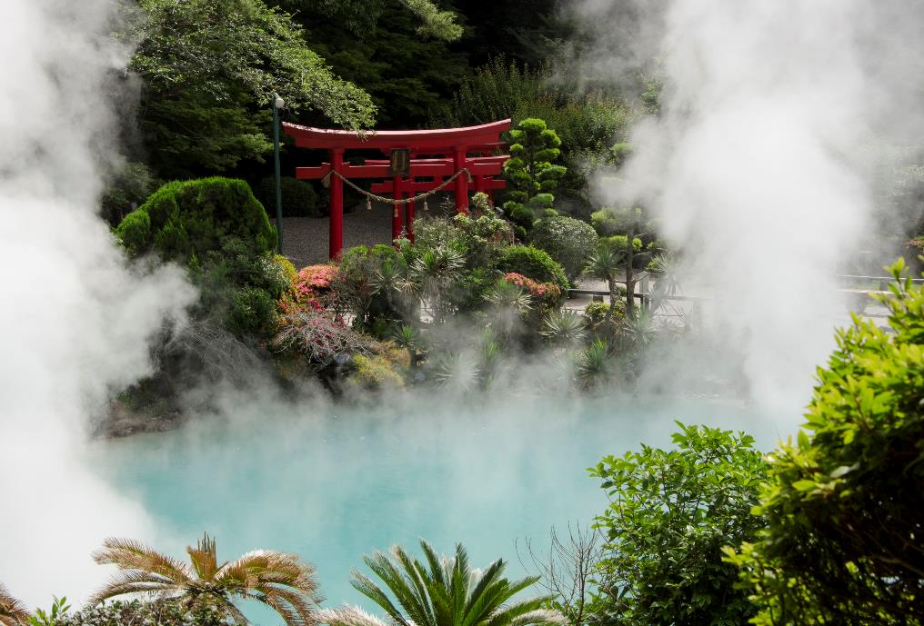
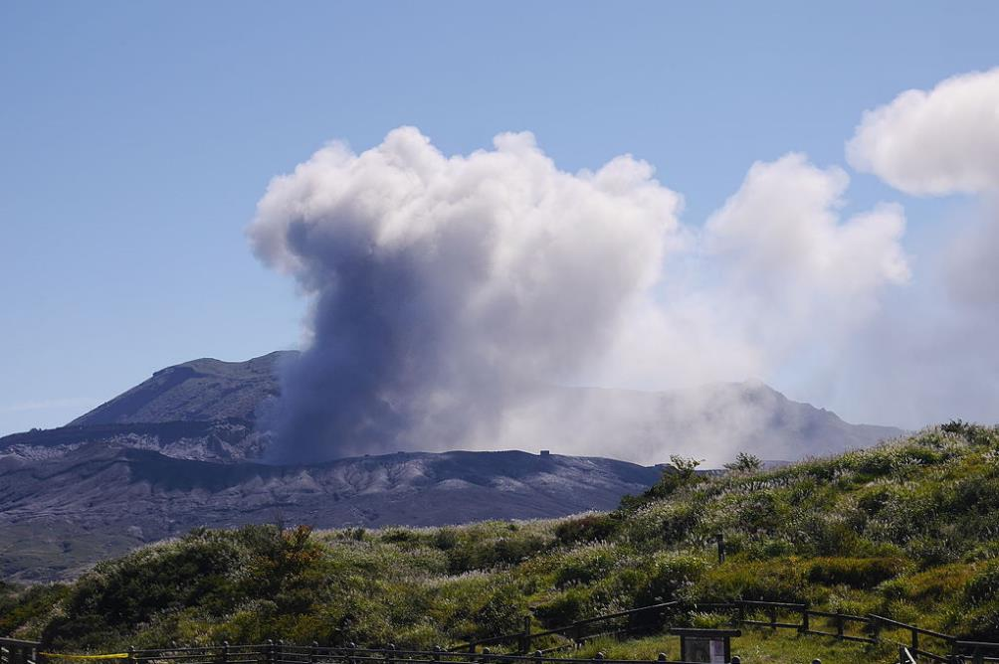
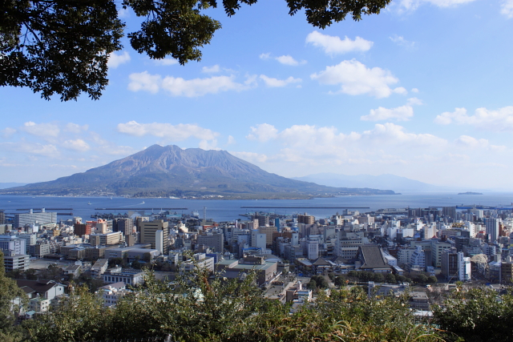
Kyushu
I, Sailko, CC BY-SA 3.0
こたつむり, CC BY-SA 2.1 JP
Notes:
Teacher’s Notes
Kyushu, in southern Japan, is home to Mount Aso and Sakura-jima, two of Japan’s most active volcanoes. Due to so much volcanic activity in Kyushu there are many hot spring resorts, such as in the town of Beppu, famous for its ‘Hells of Beppu’ springs. Some parts of Kyushu have a subtropical climate. This means it has hot summers and mild winters.
Images:
こたつむり from Hokkaidō, Japan., CC BY-SA 2.1 JP, via Wikimedia Commons
I, Sailko, CC BY-SA 3.0, via Wikimedia Commons

Slide 13
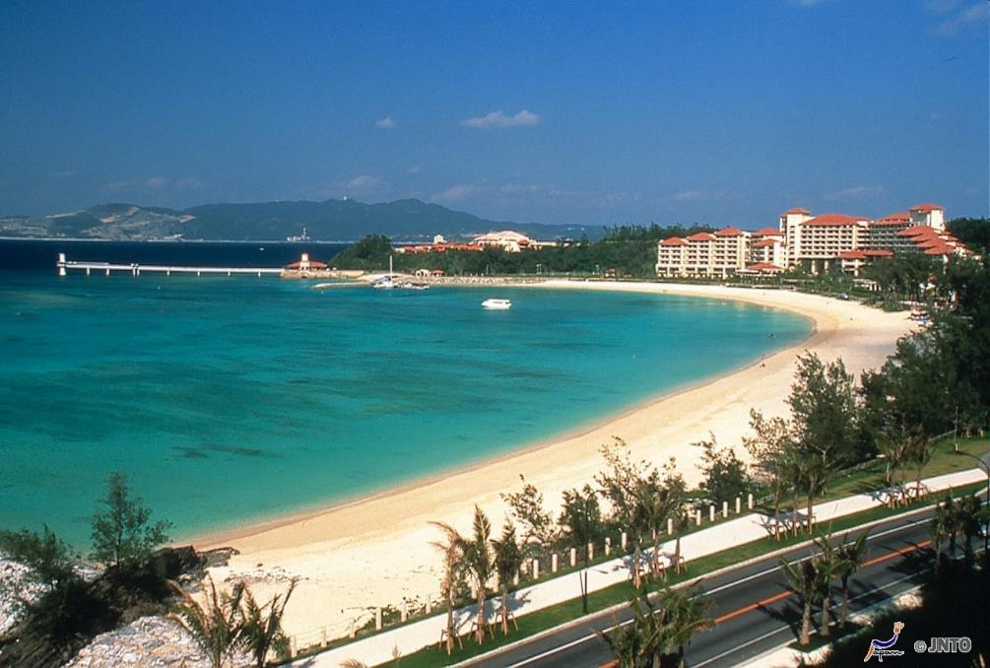
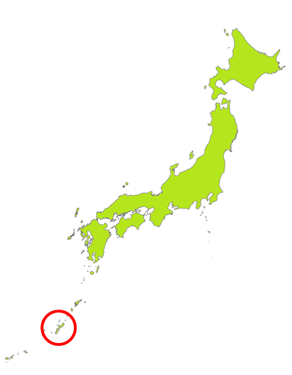
Okinawa
Notes:
Teacher’s Notes
Japan has hot places like Okinawa, where it is never cold – not even in the winter.
Winter in Okinawa is usually between 15 – 20 degrees, similar to May or June in the UK.
There are lots of beaches and many people visit to go diving.

Slide 14
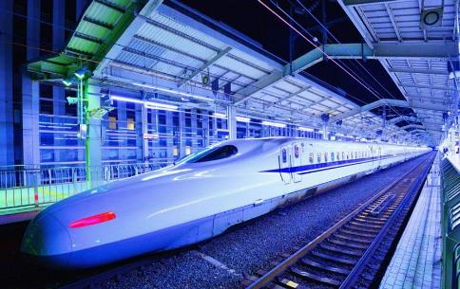


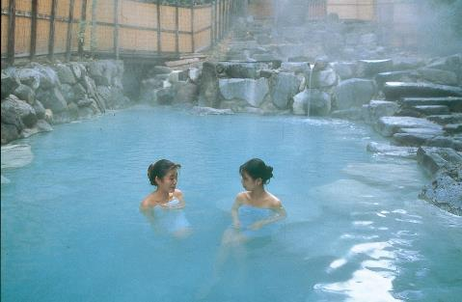
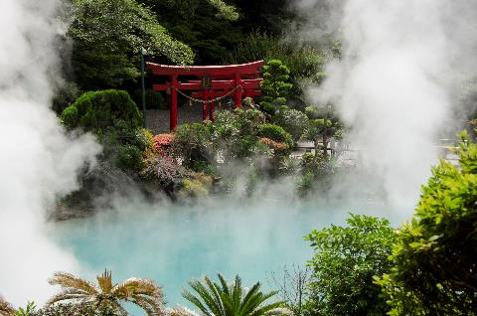

Where do you want to visit?
Notes:
Plenary
TTYP: Where would you like to visit in Japan and why? Do you think Japan is similar to the UK different? Explain your answer.
By the end of the lesson, children will probably have some additional questions to add to the W column on their KWL sheet. Give them a few moments to do this now.

Slide 15


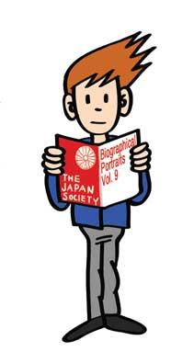


These resources were developed by Oliver Reed in collaboration with the Japan Society.
The Japan Society
13/14 Cornwall Terrace, London NW1 4QP
Tel: 020 7935 0475
Email: education@japansociety.org.uk
www.japansociety.org.uk
Follow us on:
@japansocietylon
@JapanSocietyLondon
© The Japan Society

