Slide 1
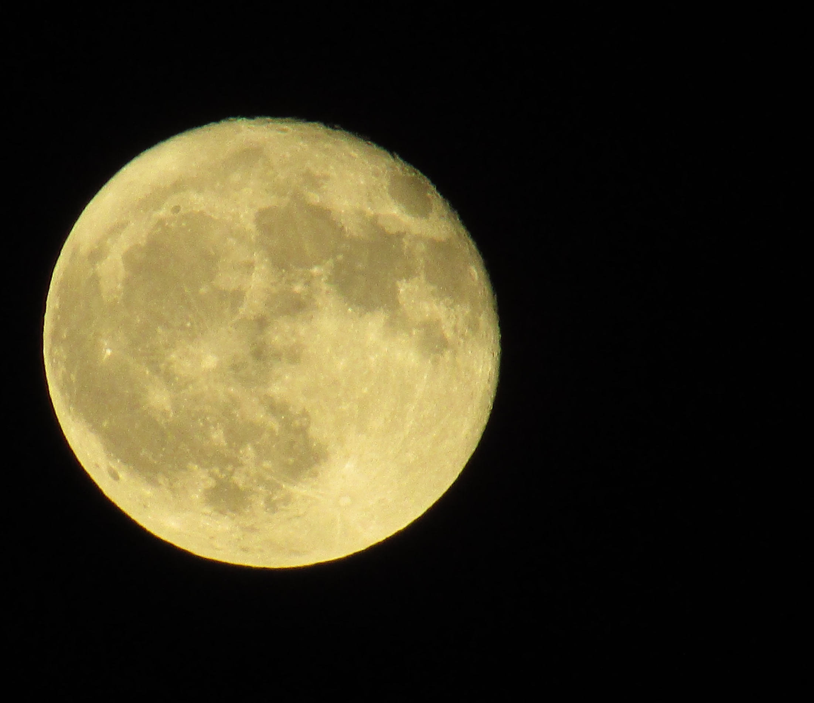
Otsukimi
Moon Festival
Notes:
Teacher’s Note
Otsukimi is pronounced oh-tsue-key-me
Discuss beliefs relating to the moon in the culture/country of the children.
What image do people think they see when they look at the moon?

Slide 2
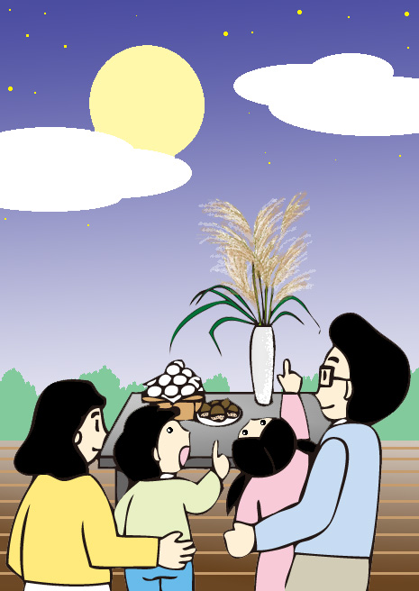
They are celebrating
Otsukimi, an autumn festival in Japan
Notes:
Ask students
What can you see in this picture?
What do you think they are doing?
*This slide contains content from the from the “Minna no Kyozai” website (https://minnanokyozai.jp)” by the Japan Foundation Japanese-Language Institute, Urawa.

Slide 3
What is ‘Otsukimi?’
Otsukimi means
“moon viewing”
People gather together to watch the full moon
They hope there will be a good harvest
月
見
Moon
Watch/view
Tsuki
Mi
Notes:
Tell students
These characters have meanings in Japanese. “Tsuki” means moon, “Mi” means “Watch” or “View.”
So Tsukimi means ‘Moon Viewing’.
Explain that for important words in Japan to show respect, they place an ‘O’ in front. So “O Tsukimi” and “Tsukimi” have the same meaning, but using ‘O’ is more polite language.

Slide 4
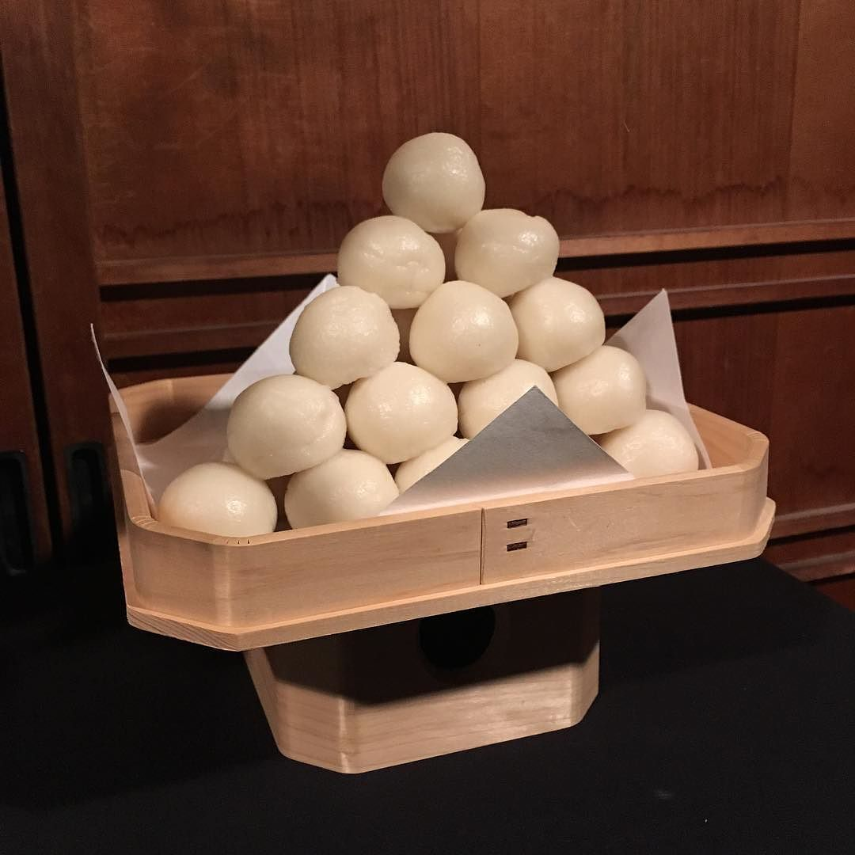
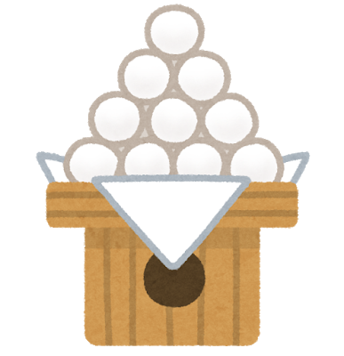
Food and decorations
People make rice dumplings called Tsukimi Dango
They are round and white
They are put out for display and can be eaten too
What do they look like to you?
©Evan p cordes
Notes:
Teacher’s Notes
Please see Japan Foundation for Japanese explanation of Otsukimi and a video of Tsukimi Dango being made: https://hirogaru-nihongo.jp/hoshi/article/tsukimi/
This slide contains content from the “Minna no Kyozai” website (https://minnanokyozai.jp)” by the Japan Foundation Japanese-Language Institute, Urawa.
Tsukimi dango photograph: https://www.flickr.com/photos/51035644690@N01/37477488676

Slide 5
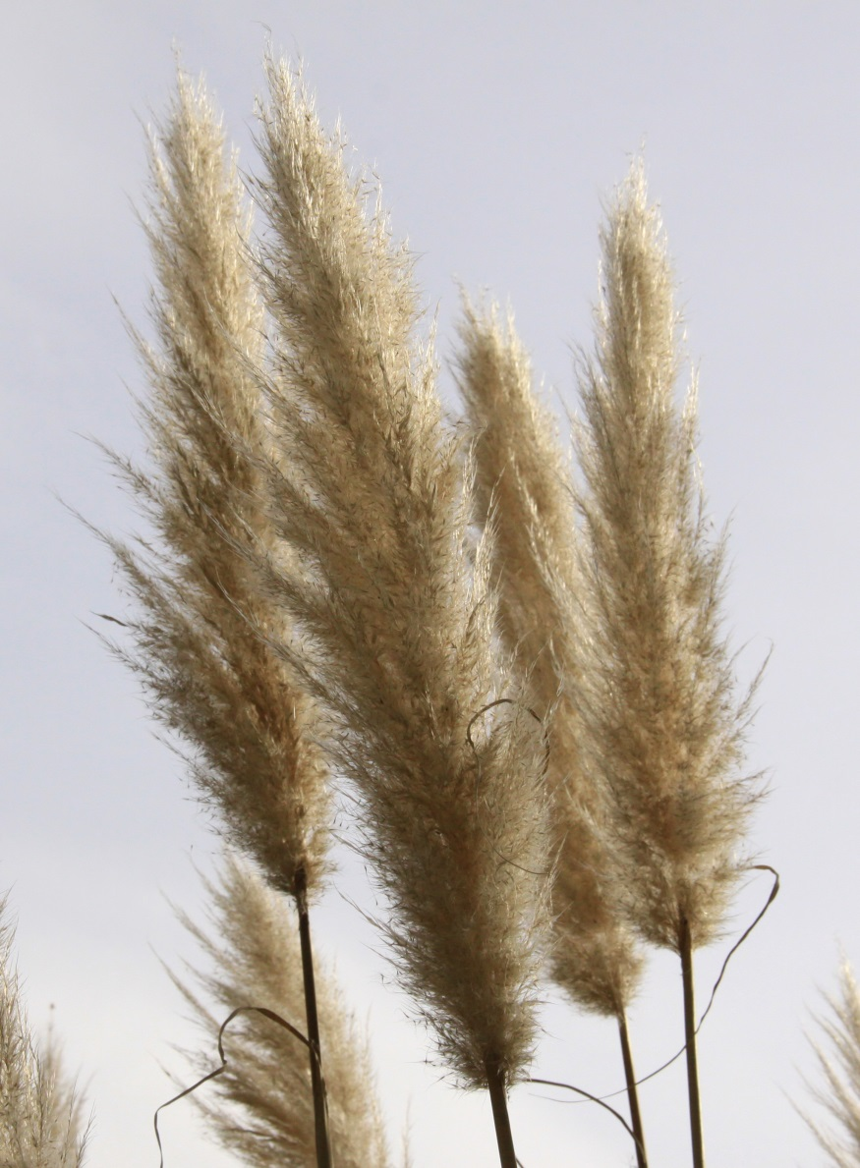
Food and decorations
People also display a plant called susuki or pampas grass
It looks like a rice plant
So it symbolises a bountiful harvest
Notes:
Teacher’s Note
This slide contains content from the “Minna no Kyozai” website (https://minnanokyozai.jp)” by the Japan Foundation Japanese-Language Institute, Urawa.

Slide 6
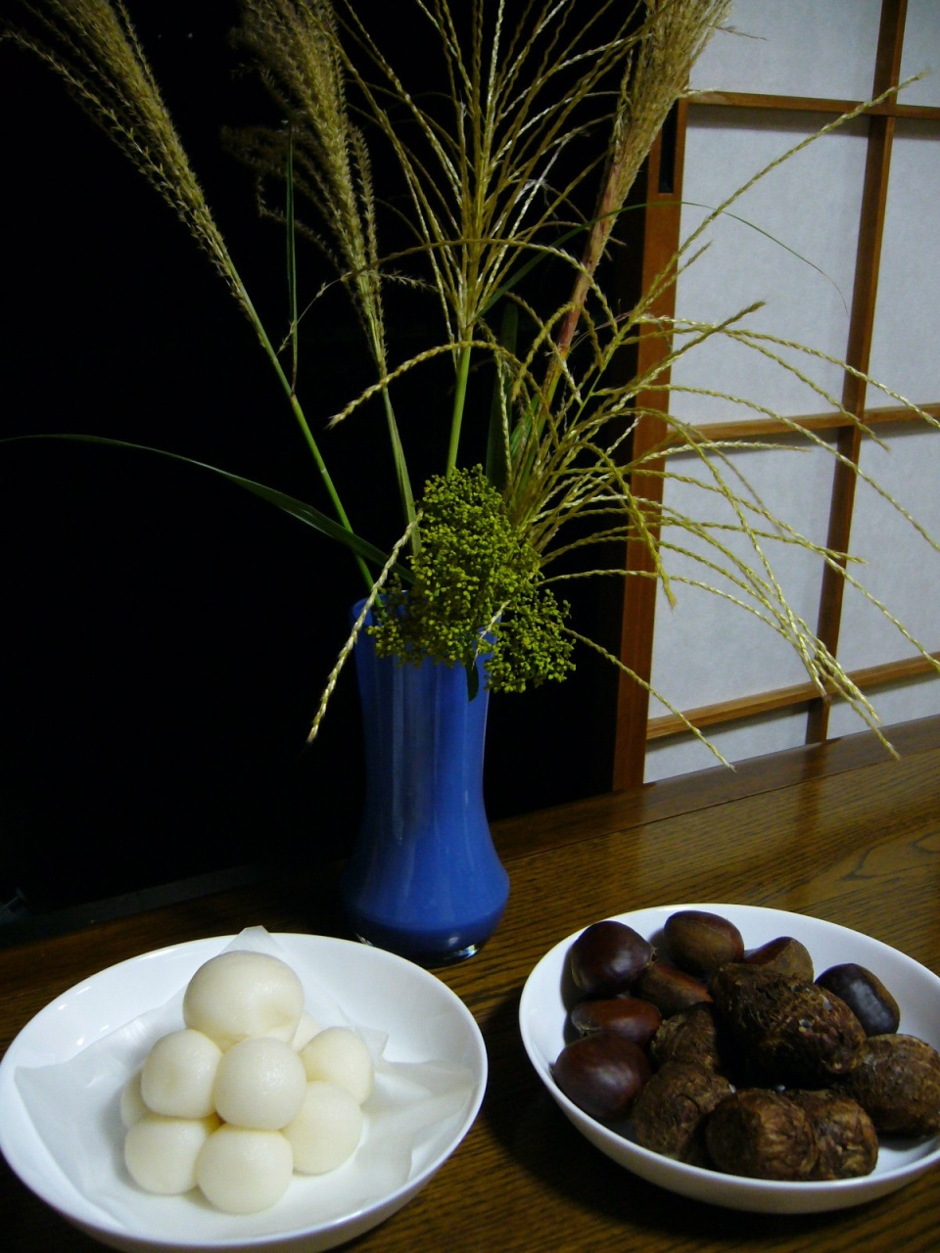
This is a traditional
Otsukimi display
What can you see?
Notes:
Tell Students
This is a traditional Otsukimi display.
These things will normally be placed by a window or somewhere the full moon is visible.
This display has other seasonal produce, chestnuts and taro.

Slide 7
Mini Task
Soon you are going to see another picture.
Can you see anything new?

Slide 8
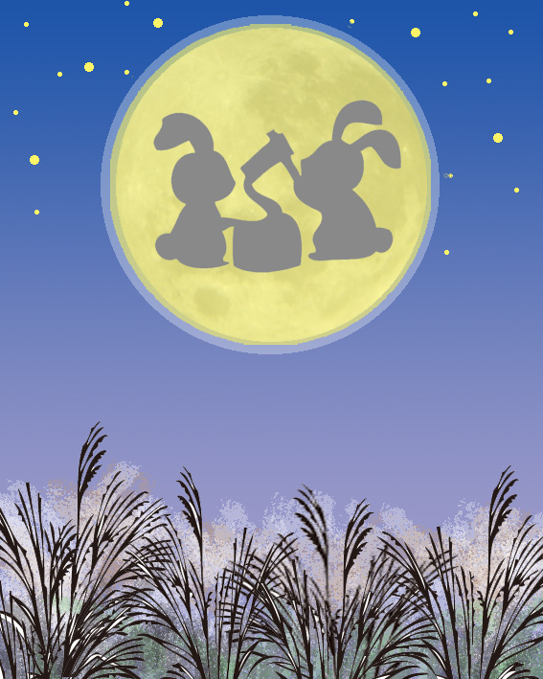
Rabbits on the Moon
Usagi means rabbit in Japanese
Notes:
Teacher’s Note
Ask students what they can see before revealing the answer.
Explain that in different cultures there are different beliefs about what you can see in the moon.
Rabbit is usagi (oo-sah-ghee) in Japanese
Tell students the rabbits are making mochi (a food similar to Tsukimi Dango). You can see a video of it being made here: https://www.youtube.com/watch?v=T44R78e2Dms
*This slide contains content from the from the “Minna no Kyozai” website (https://minnanokyozai.jp)” by the Japan Foundation Japanese-Language Institute, Urawa.
This slide contains content from the “Minna no Kyozai” website (https://minnanokyozai.jp)” by the Japan Foundation Japanese-Language Institute, Urawa.

Slide 9
Europe:
a face

Slide 10
New Zealand:
a woman

Slide 11
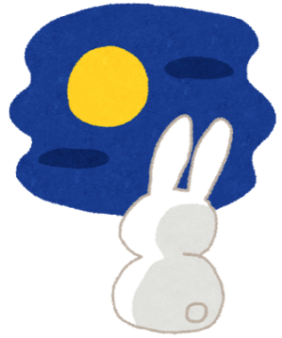
Why are there rabbits
on the moon?
Notes:
Teacher’s Note
The following slides explain the myth in English.
A version with some vocabulary in Japanese follows (slide 23 onwards).
For a version with animated and sound effects please see the digital kamishibai resources on the Japan Society website
See this link for a full Japanese version of the story: https://www.youtube.com/watch?v=TS3TmNortf4

Slide 12
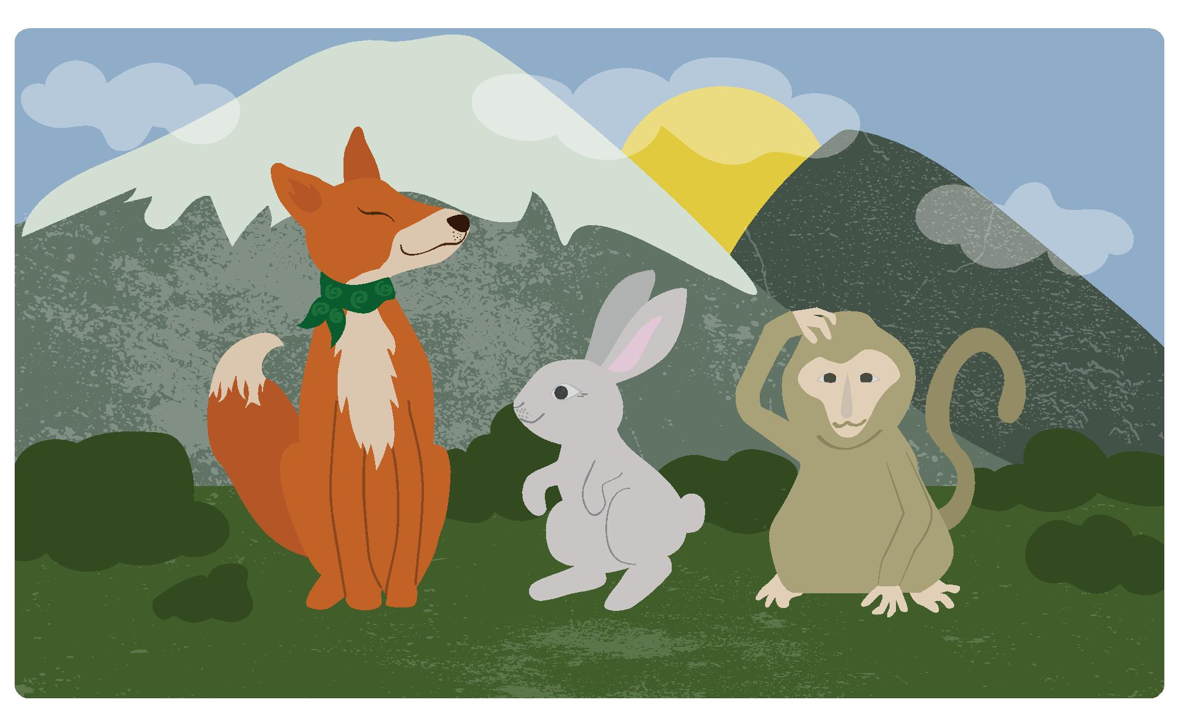
A long long time ago, there were three friends - a monkey, a fox, and a rabbit.
They would often spend time playing together on the side of a mountain.

Slide 13
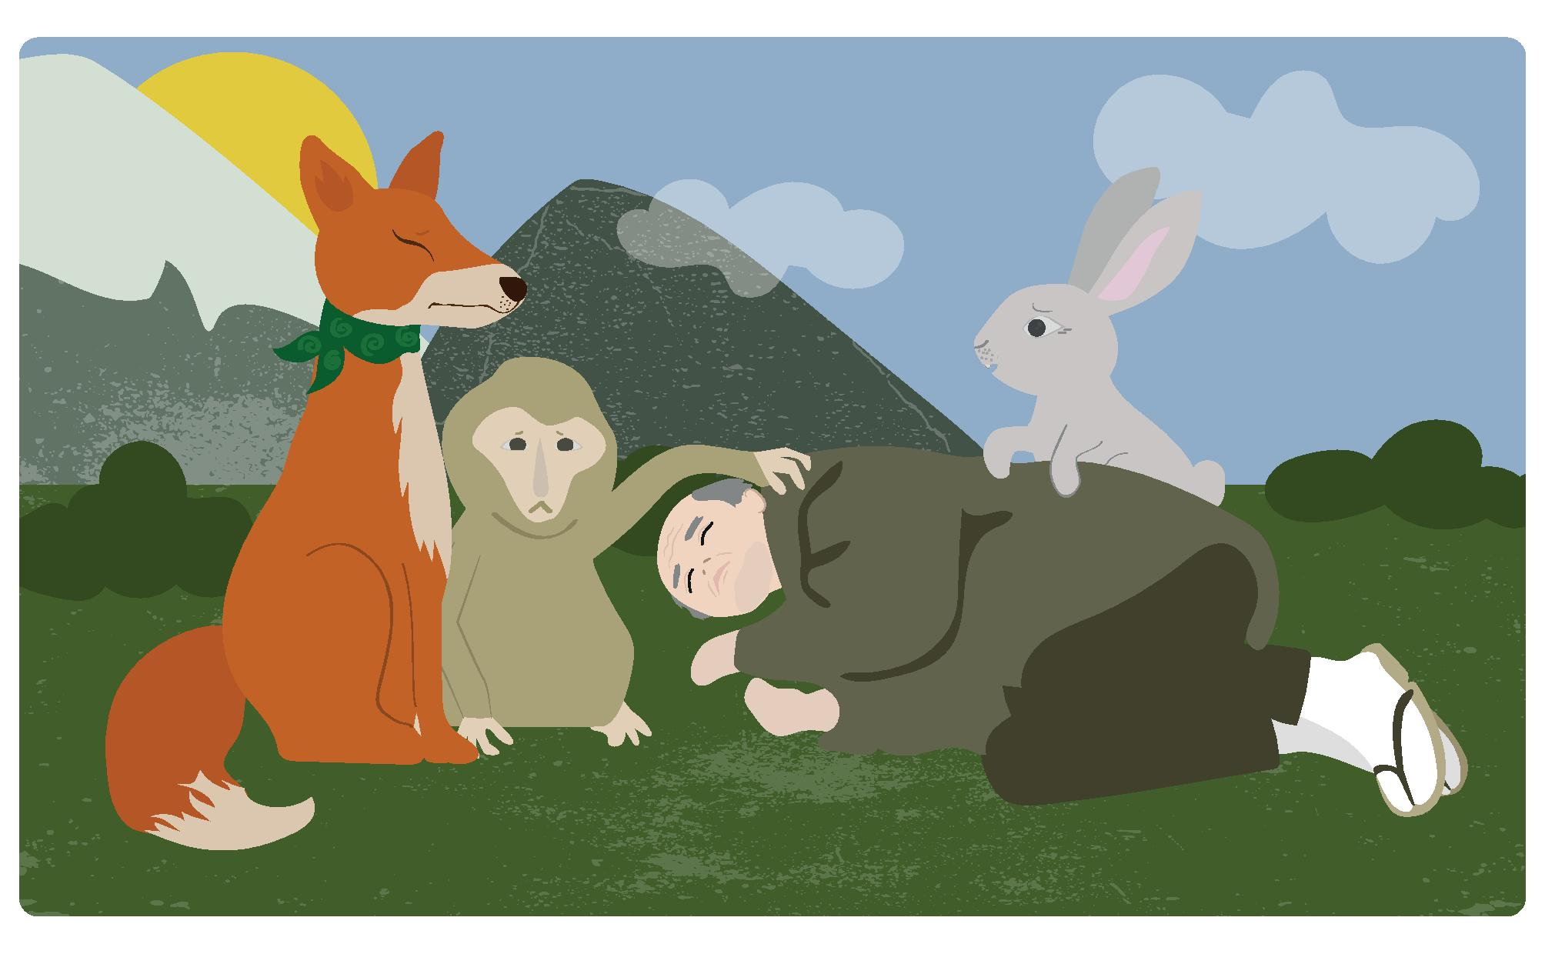
One day, they came across an old man who had fallen down, and was lying on the grass.
“Oh no, old man, are you ok?” said the fox.
“I’m so hungry and tired that I can’t move” replied the old man in a whisper.

Slide 14
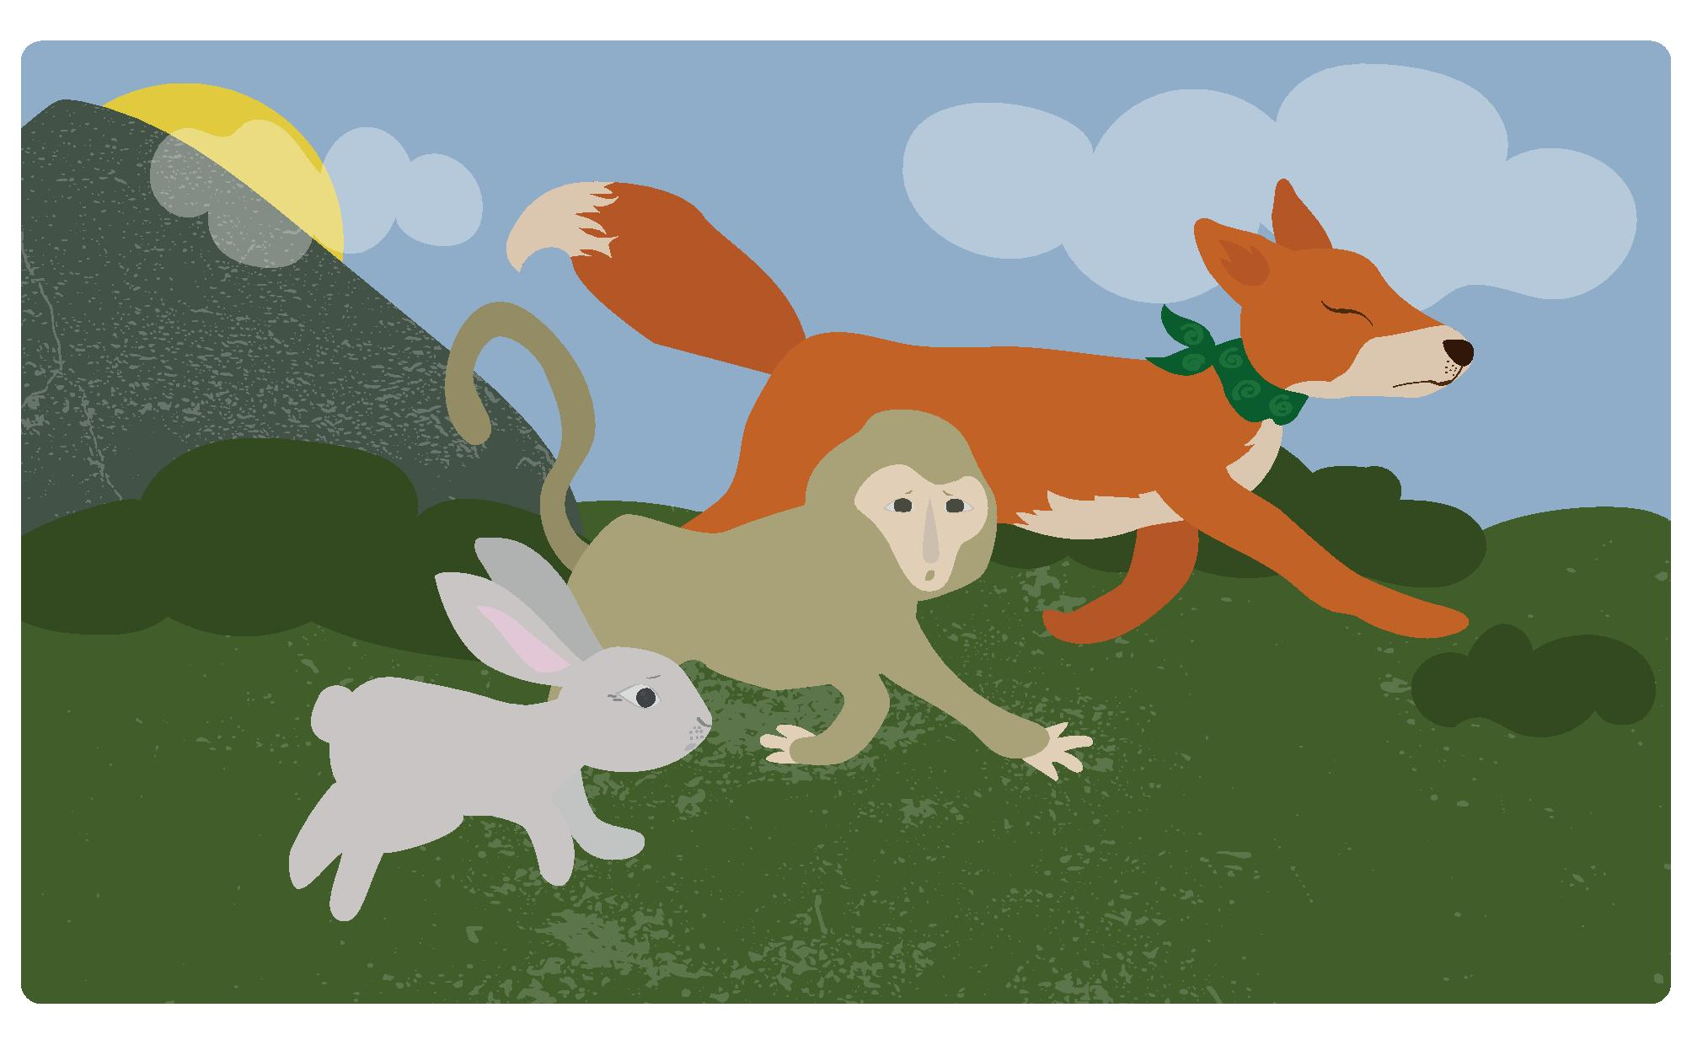
“Don’t worry, we will go and find you some food so you can be strong and healthy again” said the three friends.
So, the fox, monkey and rabbit ran off to find food for the
old man.

Slide 15
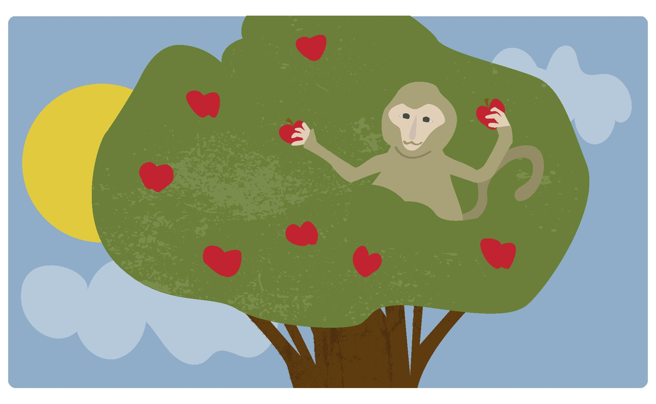
The monkey, who was good at climbing trees, easily swung up a tree and he picked lots of fruit.

Slide 16
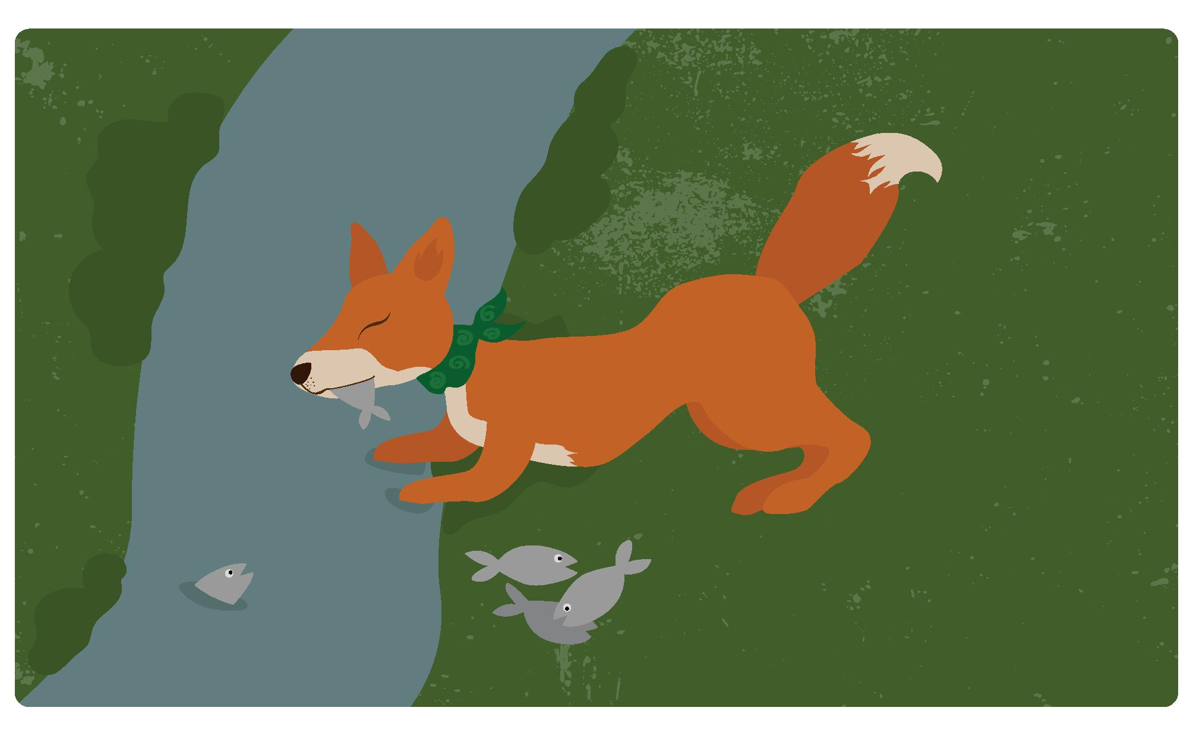
The fox was good at hunting and ran off to the river where he caught lots of fish.

Slide 17
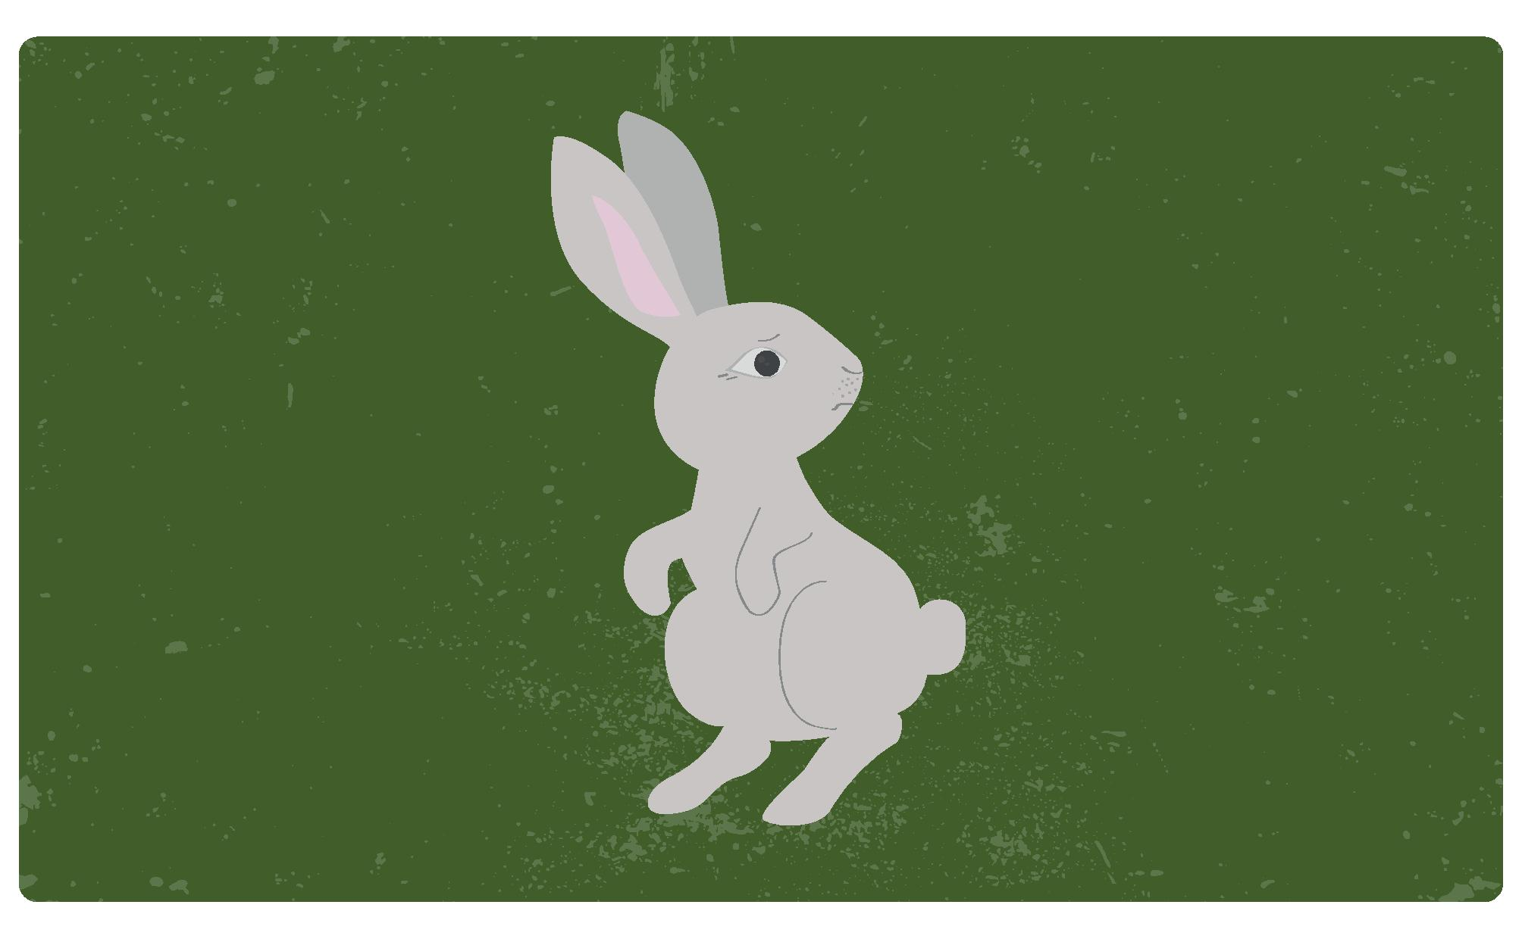
But, the rabbit could neither climb nor hunt.
He didn’t know what to do so he ran here and there around the woods.

Slide 18
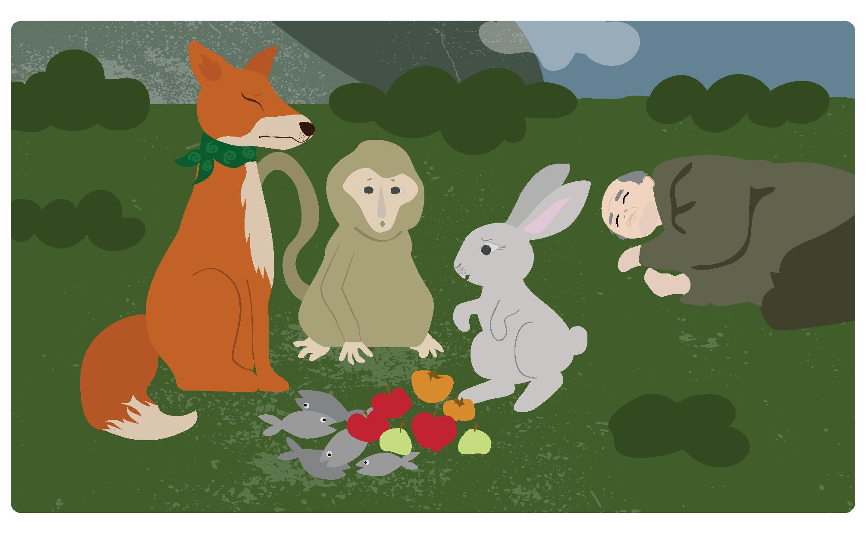
They all returned to see the old man.
The monkey had collected lots of fruit and the fox had collected lots of fish, but the rabbit had not been able to find anything!

Slide 19
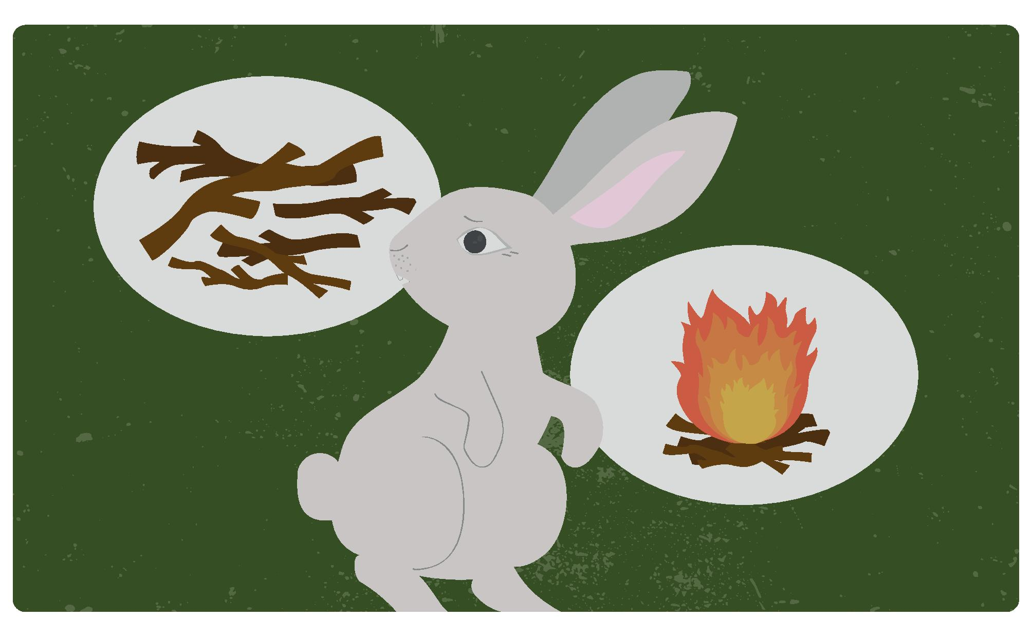
So the rabbit asked the monkey to collect lots of firewood.
And he asked the fox to build a big fire.

Slide 20
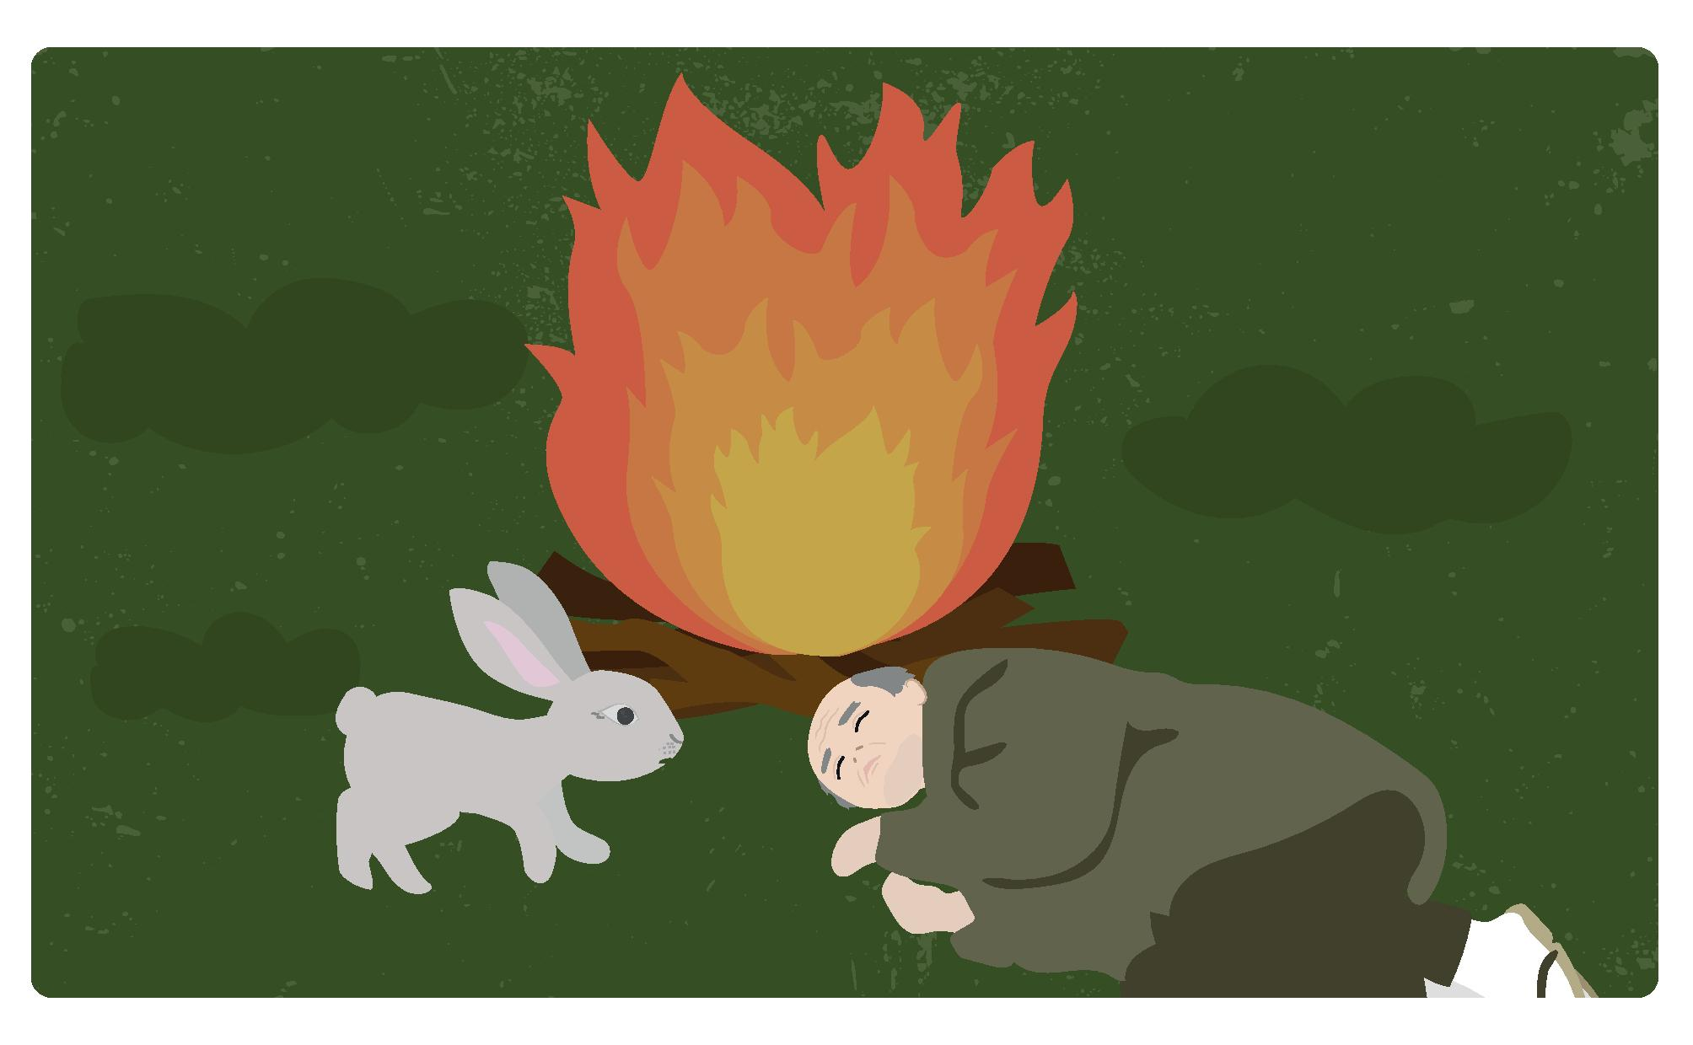
When the fire was burning brightly, the rabbit said to the old man:
‘I’m sorry, I could not find anything for you. So, instead, you can put me on the fire, cook, and eat me.”

Slide 21
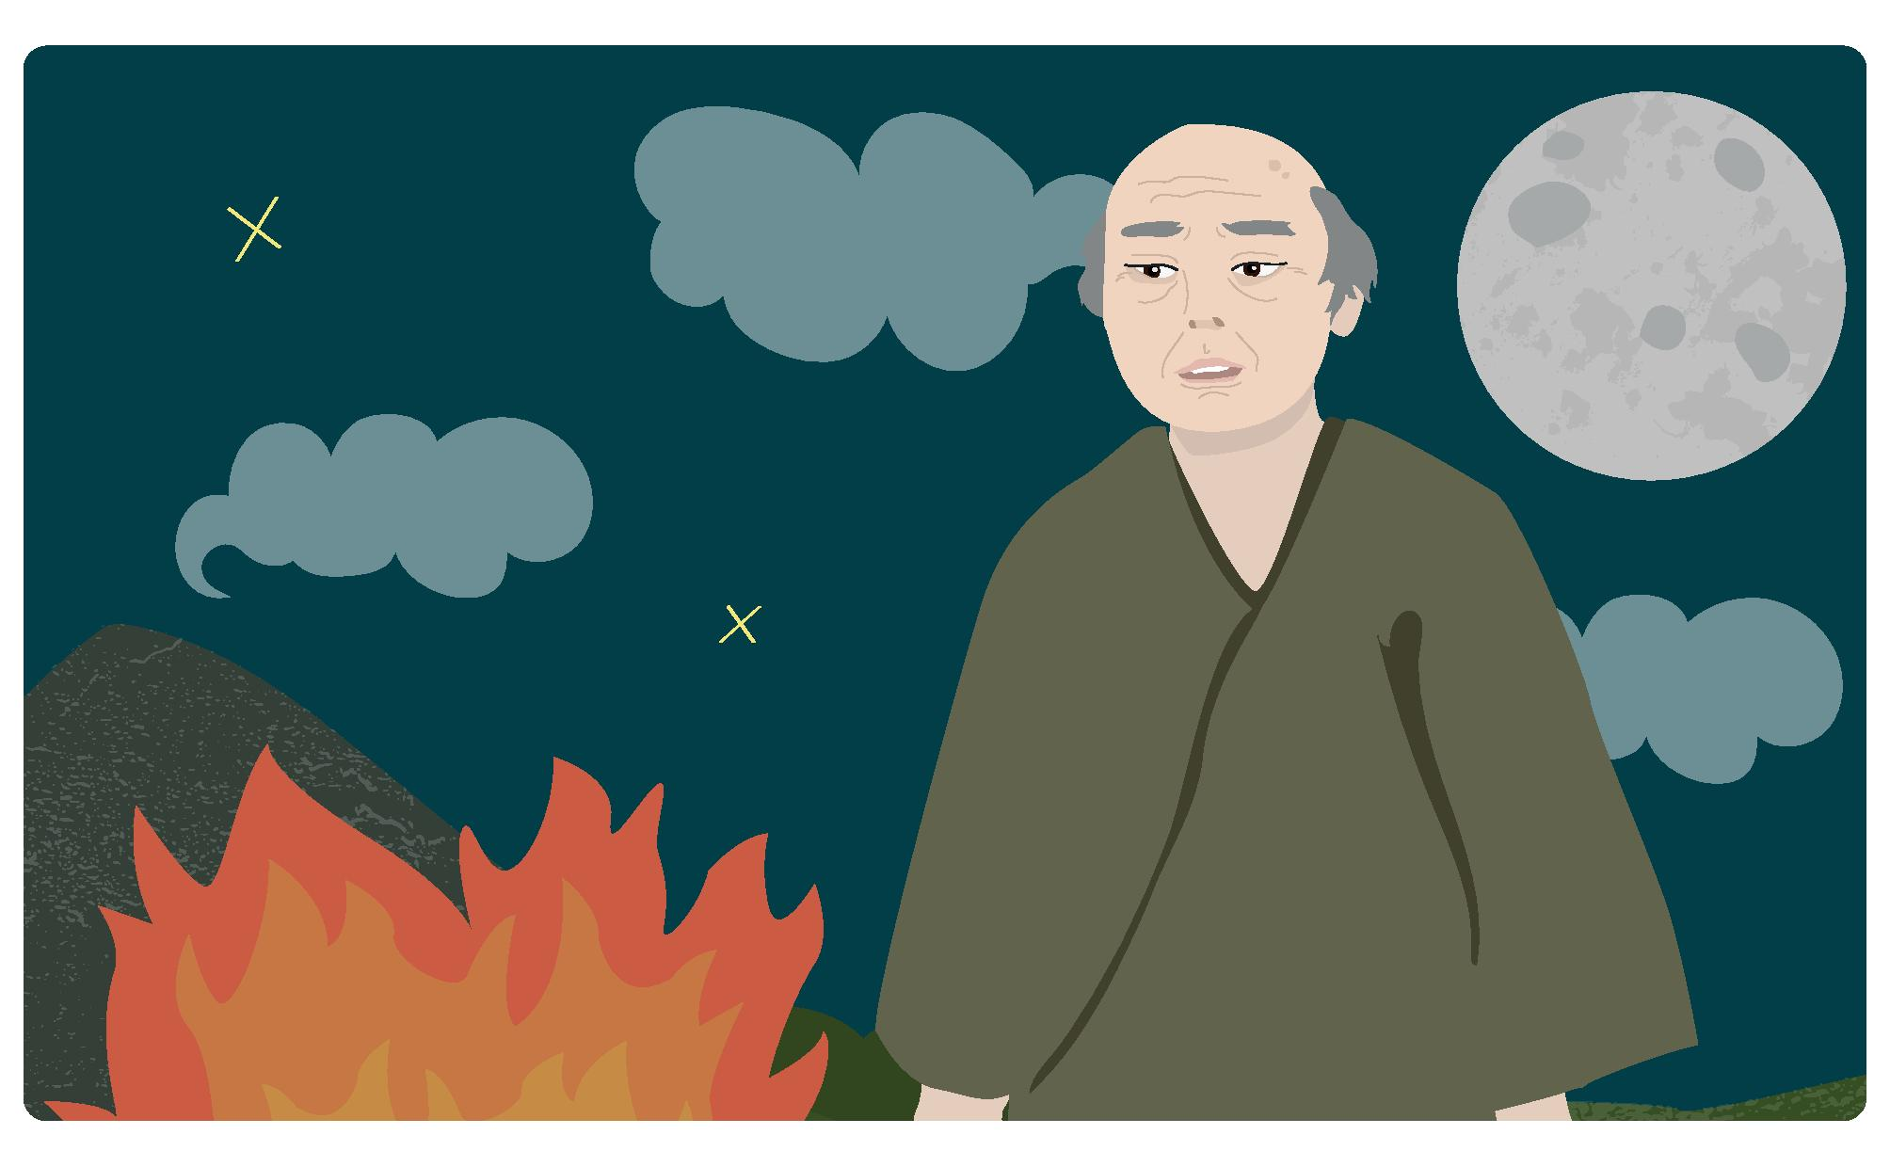
At that moment, the old man suddenly got up and said, “No, no rabbit, you must not do that! But, you are so kind that I wish to give you a reward.”

Slide 22
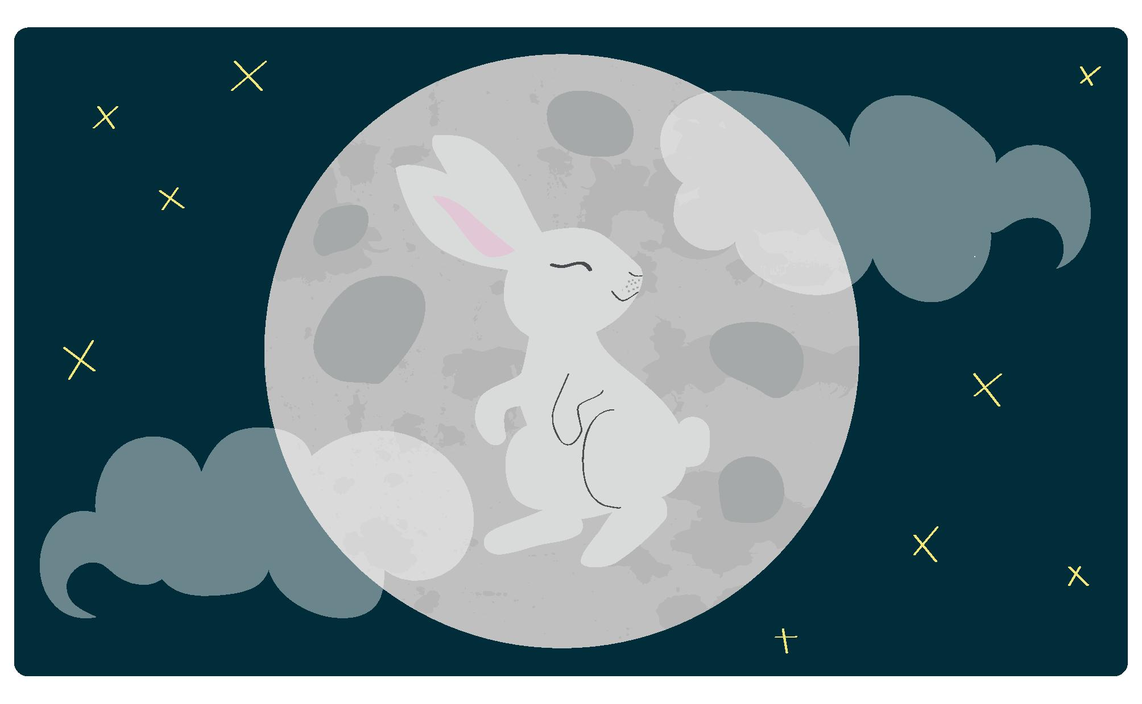
And with that, the old man magically transformed.
In fact, he was the Old Man of the Moon, and he took the rabbit to live with him there.
And to this day you can still see the rabbit on the moon.

Slide 23
A long long time ago, there were three friends - a monkey, a fox, and usagi.
They would often spend time playing together on the side of a mountain.
Notes:
Teacher’s notes
The following slides introduce the Japanese vocabulary for: rabbit, monkey, fox, old man, moon, fish and fruit.
Even students with no prior knowledge of Japanese can guess the meaning from the illustrations.

Slide 24
One day, they came across an ojiisan who had fallen down, and was lying on the grass.
“Oh no, ojiisan, are you ok?” said the fox.
“I’m so hungry and tired that I can’t move” replied the old man in a whisper.

Slide 25
“Don’t worry, we will go and find you some food so you can be strong and healthy again” said the three friends.
So, the fox, monkey and usagi ran off to find food for the
ojiisan.

Slide 26
The saru, who was good at climbing trees, easily swung up a tree and he picked lots of fruit.

Slide 27
The kitsune was good at hunting
and ran off to the river where he caught lots of fish.

Slide 28
But, the usagi could neither climb nor hunt.
He didn’t know what to do so he ran here and there around the woods.

Slide 29
They all returned to see the old man.
The saru had collected lots of kudamono and the kitsune had collected lots of sakana, but the rabbit had not been able to find anything!

Slide 30
So the usagi asked the monkey to collect lots of firewood.
And he asked the kistune to build a big fire.

Slide 31
When the fire was burning brightly, the usagi said to the ojiisan:
‘I’m sorry, I could not find anything for you. So, instead, you can put me on the fire, cook, and eat me.”

Slide 32
At that moment, the ojiisan suddenly got up and said, “No, no usagi, you must not do that! But, you are so kind that I wish to give you a reward.”

Slide 33
And with that, the ojiisan magically transformed.
In fact, he was the Old Man of the Moon, and he took the rabbit to live with him there.
And to this day you can still see the usagi on the tsuki.

Slide 34
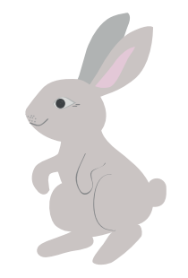
The Rabbit Song
うさぎ うさぎ
usagi usagi
なに みて はねる
nani mite haneru
じゅうごや おつきさま
jūgoya otsuki-sama
みて はねる
mite haneru
Rabbit Rabbit
What does it see when it jumps?
It sees the full moon when it jumps.
Notes:
Teacher’s Note
See the links below for the music:
https://www.youtube.com/watch?v=5vWDSmXV994 (Japanese only)
https://www.youtube.com/watch?v=NYQ9Tue02f4 (with English subtitles)

Slide 35
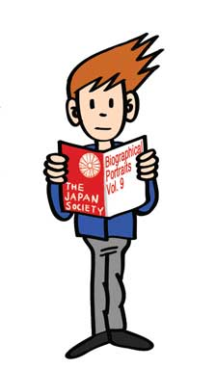
This resource was developed by the Japan Society in collaboration with Katy Simpson.
The Japan Society 13/14 Cornwall Terrace, London NW1 4QP
Tel: 020 7935 0475
Email: education@japansociety.org.uk
www.japansociety.org.uk
Follow us on:
@japansocietylon
@JapanSocietyLondon

