Slide 1


Starter
What do you remember about haiku from last lesson? Discuss the following questions with your partner.
How many lines do they have?
Do haiku rhyme?
What are haiku usually about?
What are the five senses?
Notes:
Teacher’s Notes
Ask pupils to discuss the questions on the slide with a partner/in a group.
Challenge: Do pupils remember what the traditional syllable structure is for a Japanese haiku?
Illustration from Irasutoya.

Slide 2
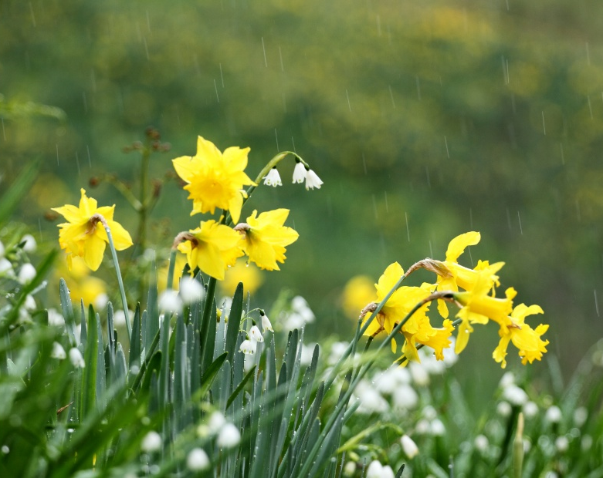
Starter
Read the haiku and discuss the questions with a partner:
nearly Mother’s Day
my best daffodils bent low
in the constant rain
What season do you think the haiku is set in?
What is the kigo (seasonal word)?
Notes:
Teacher’s Notes
Read the haiku on the slide. Ask pupils to discuss with a partner/in a group - think about what season they think the haiku is set in; what is the Kigo, what senses are being described?

Slide 3


Haiku
Poems
Notes:
Teacher’s Notes
If you like, you could introduce another short guided visualization here. Click once for the title and logo to disappear. An example script is below:
Look at the picture. Now close your eyes.
You are outside and it’s cold. You are walking home with a friend. Both of you are wearing big coats and boots. As you pick up your feet, you can hear the sound of the snow crunching and the sound of your own breath. You stick your tongue out and wait for a snowflake to land on it. You hear a laugh and turn around – your friend is about to throw a snowball. Thump! It hits the arm of your coat. You bend down to make your own snowball, scooping some snow up with your hands.
Open your eyes. How did you feel?

Slide 4
Learning Objectives
To understand what fragments and phrases are and to be able to identify them in a haiku.
To write my own haiku inspired by my surroundings, using fragments and phrases.
Notes:
Teacher’s Notes
Introduce today’s Learning Objectives.

Slide 5
Key Words
Haiku
Nature
Kigo
Fragments
Phrases
Seasons
Senses
Notes:
Teacher’s Notes
Introduce the key words for today’s lesson.
Illustration from Irasutoya.

Slide 6
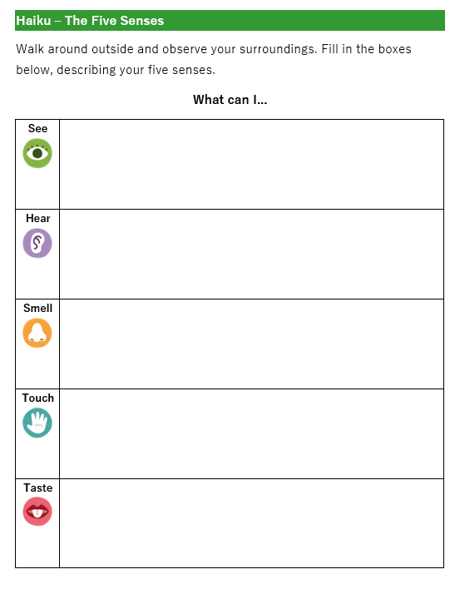
Let’s write a haiku!
Last time, we filled in our five senses worksheet.
Today we will use the ideas to write our own haiku!
Before we start, we need to think about the fragments and phrases we will use.
Notes:
Teacher’s Notes
Fragments and phrases are introduced in the next slides.

Slide 7
Fragments
Fragments are short lines, usually no more than 4 words long. They can even be a single word.
Church bells
A piercing wind
Sand in my slippers
Evening shadows
Thunder rumbles
In pairs, think of some fragments you could use in your haiku.
Notes:
Teacher’s Notes
Ask pupils to share some ideas of fragments they could use in a haiku. They may already have some written down on their worksheet from the previous lesson. They can circle these if they like. The Haiku Seasons Worksheet (see Beyond 5-7-5 booklet, page 4 in additional resources) could also be used for this activity.
Illustration from Irasutoya.

Slide 8
Phrases
Phrases are like “almost sentences”, that describe what you can see, hear, feel, smell, and touch.
The chestnut seller’s fingerless gloves
One hundred and one striped caterpillars
Sweat dripping down my forehead
The grass tickling my ankles
Birds soaring up above me
In pairs, think of some phrases you could use in your haiku.
Notes:
Teacher’s Notes
Phrases are “almost sentences”; they don’t necessarily make sense on their own, but they do provide more detail than a fragment would.
Ask pupils to share some ideas of phrases they could use in a haiku. They may already have some written down on their worksheet from the previous lesson.
Illustration from Irasutoya.

Slide 9
Fragments and Phrases
Let’s see if we can identify the phrase and the fragment
nearly Mother’s Day
my best daffodils bent low
in the constant rain
Notes:
Teacher’s Notes
Mention to pupils that haiku are normally 1 fragment and 1 phrase (split over 2 lines)
Reading haiku out loud can help to hear the fragments and phrases more clearly. Click on the next slide to reveal the answers.

Slide 10
Fragments and Phrases
Let’s see if we can identify the phrase and the fragment
fragment
nearly Mother’s Day
my best daffodils bent low
in the constant rain
phrase
Notes:
Teacher’s Notes
Notice how the phrase is split across two lines. This is very common. The phrase could be first followed by the fragment.
Haiku may sometimes have more than one fragment. (The next slide shows The Old Pond as an example of this – you can skip it if you like).

Slide 11
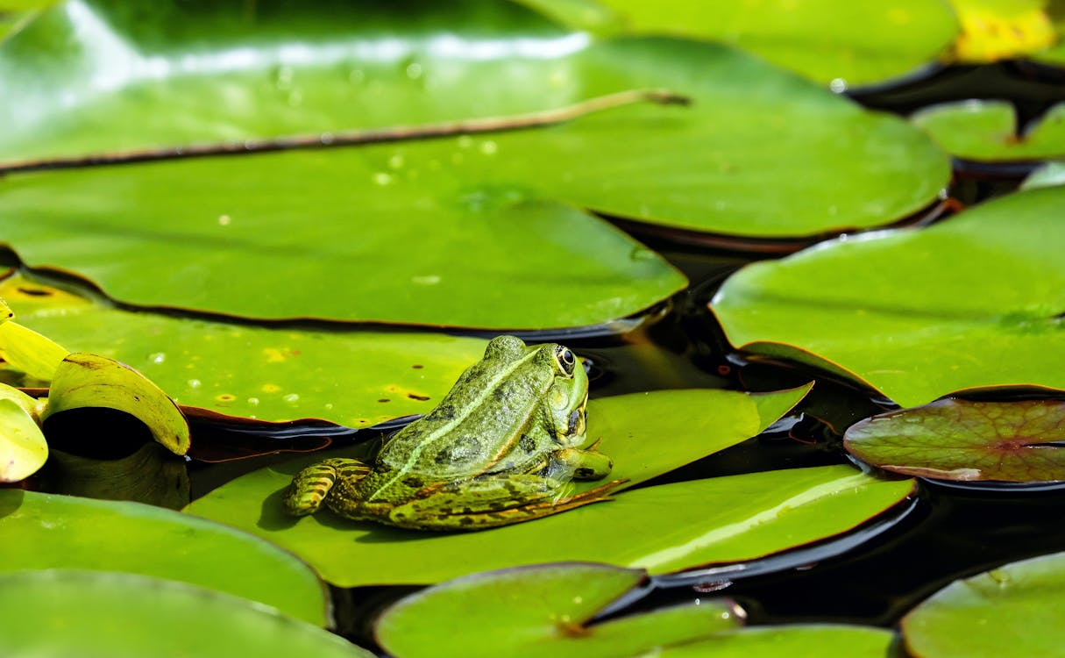
Fragments and Phrases
Let’s see if we can identify the fragment and phrases.
old pond...
a frog leaps in
water’s sound
Notes:
Teacher’s Notes
It’s more common to have just 1 fragment and 1 phrase (split across 2 lines) but it’s not always the case. Click on the next slide to reveal the answers.

Slide 12

Fragments and Phrases
Let’s see if we can identify the fragments and phrases.
old pond...
a frog leaps in
water’s sound
fragment
phrase
fragment
Notes:
Teacher’s Notes
Illustration from Irasutoya.

Slide 13
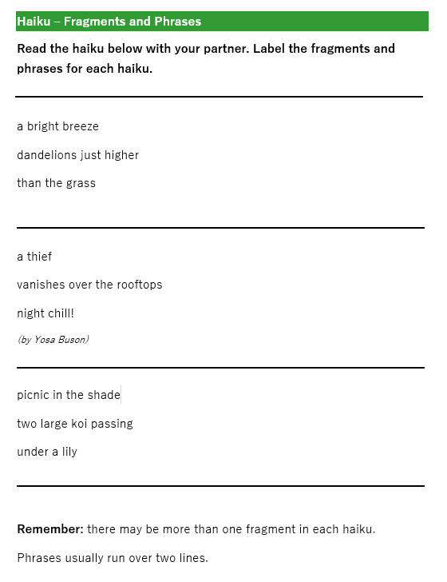

Task 1
Read the haiku on your worksheet.
Identify the fragments and phrases for each of the haiku.
Notes:
Teacher’s Notes
Hand out the worksheet. Pupils must identify the fragments and phrases of each of the haiku. (They could circle, use 2 colours to highlight, or label F + P)
You could also choose not to use the worksheet for the activity and instead ask pupils to read the haiku on the following slides and identify the fragments and phrases through discussion.
For a more challenging version of this activity, use The Haiku Seasons Worksheet (see Beyond 5-7-5 booklet, page 4 in additional resources) instead.

Slide 14

Fragments and Phrases
a bright breeze
dandelions just higher
than the grass
Notes:
Teacher’s Notes
Skip if using worksheet. Click through to reveal the answers.
Illustration from Irasutoya.

Slide 15
Fragments and Phrases
a bright breeze
dandelions just higher
than the grass
fragment
phrase
Notes:
Teacher’s Notes
Illustration from Irasutoya.

Slide 16


Fragments and Phrases
a thief
vanishes over the rooftops
night chill!
by Yosa Buson
Notes:
Teacher’s Notes
Skip if using worksheet. Click through to reveal the answers.
Illustration from Irasutoya.

Slide 17
Fragments and Phrases
a thief
vanishes over the rooftops
night chill!
by Yosa Buson
phrase
fragment
Notes:
Teacher’s Notes
Illustration from Irasutoya.

Slide 18

Fragments and Phrases
picnic in the shade
two large koi passing
under a lily
Notes:
Teacher’s Notes
Skip if using worksheet. Click through to reveal the answers.
Illustration from Irasutoya.

Slide 19
Fragments and Phrases
picnic in the shade
two large koi passing
under a lily
fragment
phrase
Notes:
Teacher’s Notes
Illustration from Irasutoya.

Slide 20
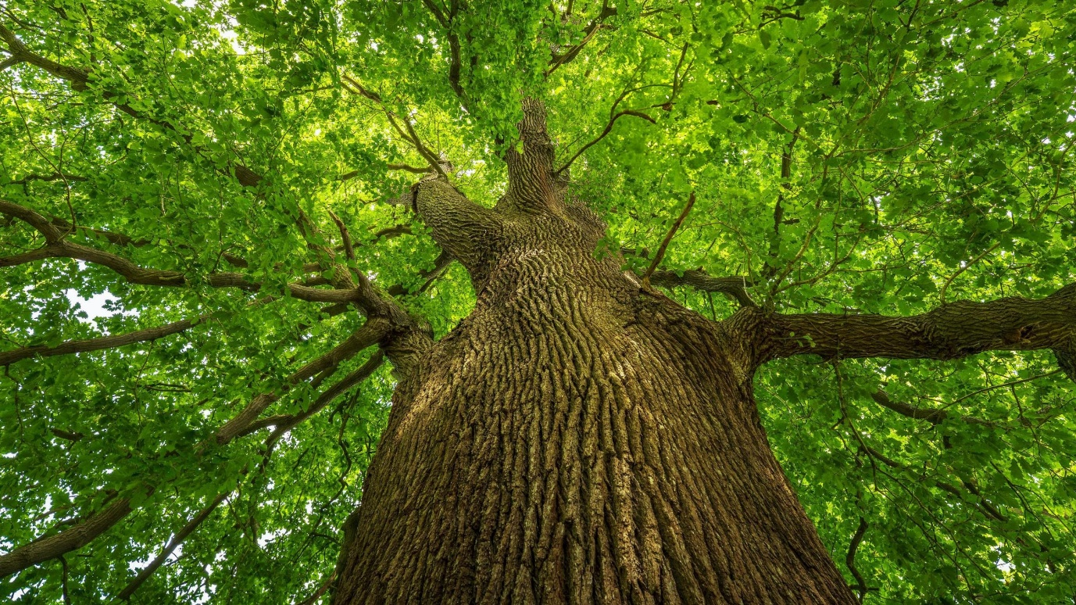
Let’s write a haiku!
Now, together as a class, we are going to try writing a haiku about a tree.
Notes:
Teacher’s Notes
Model how to write a haiku on a flipchart or interactive whiteboard by combining fragments and phrases.
Pupils will do this independently in tasks 2 and 3, so you may find it beneficial to write a haiku together as a class first, to help them better understand what they must do. This slide suggests writing a haiku about a tree, but you could write it about anything interesting you noticed whilst outside last time.
You could pre-select and write a number of fragments and phrases on the board or ask pupils to contribute fragments first, then phrases which you then combine to create a haiku.
You can choose to structure the haiku how you like. Writing a haiku with a fragment for the first line, followed by a phrase that extends over lines 2 and 3 may be the most straight-forward approach.

Slide 21
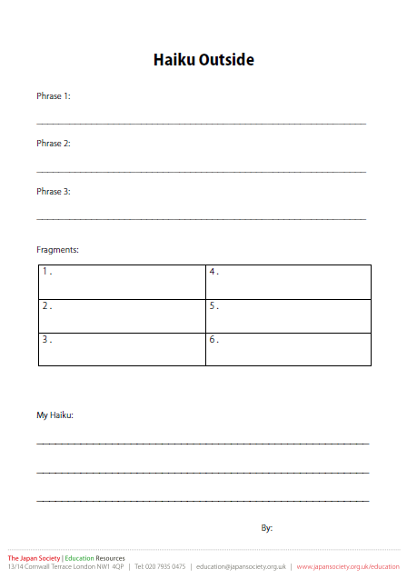
Task 2
Using your worksheet from last time, write out some fragments and phrases that you could use for your haiku.
You can write new ideas too if you like.
Notes:
Teacher’s Notes
Now, pupils will write down their own fragments and phrases. They can take directly from their Five Senses worksheet from last lesson or use it to guide/inspire them.
You can complete Tasks 2 and 3 outside in the same location you did last lesson’s activity, however this is not strictly necessary.

Slide 22
Task 3
Then combine your fragments and phrases together to create your own haiku!
Once you’re done, try reading your haiku out loud with your partner.
Notes:
Teacher’s Notes
At the bottom of the worksheet, pupils will now combine their fragments and phrases together to create a haiku.
Encourage pupils to get creative and to try combining different fragments and phrases in different structures. They can use the back too to create as many haikus as they like.
Once complete, pupils can share their haiku with their partner.

Slide 23


Reflection
How did you find writing your haiku?
Let’s share our haiku together as a class.
Notes:
Teacher’s Notes
Reflect on your haiku learning as a class. Did pupils enjoy learning about haiku? Did they enjoy writing their haiku? Was it easier or more difficult than expected? Why?
You could compare haiku to previous poems you may have studied as a class; which did pupils like more, and why?
Traditionally, haiku are read aloud twice. At the end of the lesson, ask for volunteers to read their haiku out loud in front of the class (reading their haiku twice through)! You can ask pupils to share feedback and what they liked about their classmates’ haiku. Alternatively, you could ask pupils to walk around the classroom and exchange haiku with their classmates.
Illustrations from Irasutoya.

Slide 24






This resource was developed and created by
The Japan Society, using poems by Paul Conneally.
The Japan Society
13/14 Cornwall Terrace, London NW1 4QP
Tel: 020 7935 0475
Email: education@japansociety.org.uk
www.japansociety.org.uk
Follow us on social media:
@TheJapanSociety

