Slide 1
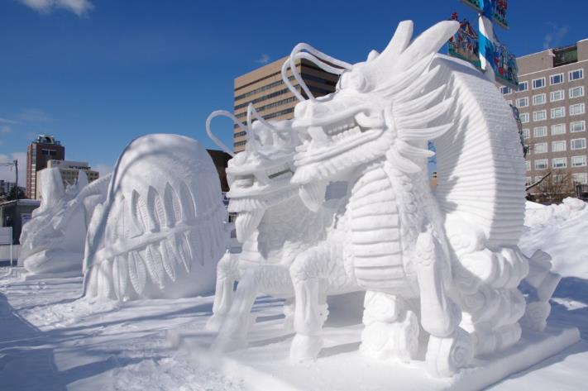
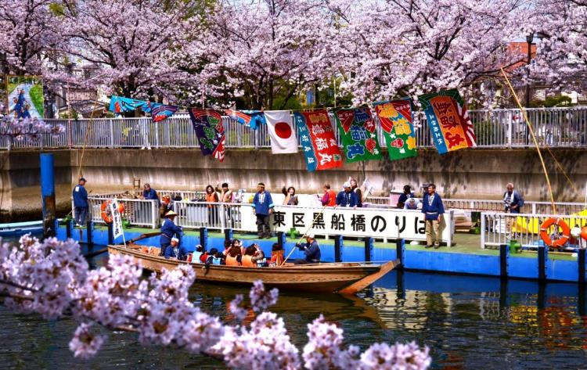
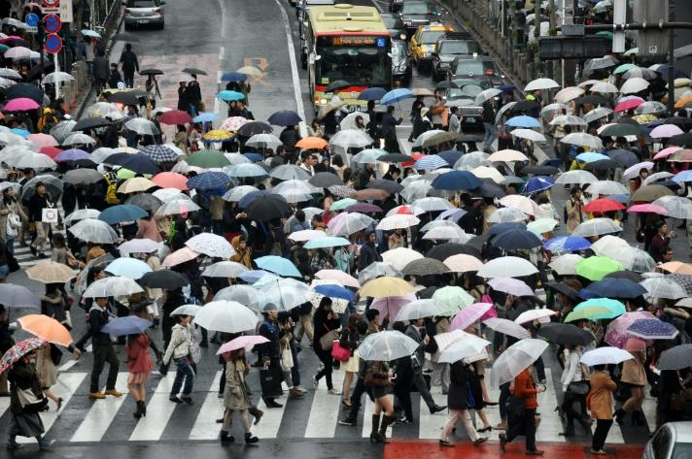
Warm Up
Look at the pictures.
What is the weather
like in Japan?
©Yasufumi Nishi/©JNTO
©Koto City Tourism Association/©JNTO
Photo by Alex Block
Notes:
Teacher’s Notes
Use the images above and the knowledge gained about Japan during this topic, ask the pupils what they think the weather is like in Japan. TTYP: What does ‘weather’ mean? Make a list of language we might use to describe weather.
Images:
Rain photo by Alex Block on Unsplash
Sapporo Snow Festival © Yasufumi Nishi/JNTO;
Oedo Fukagawa Sakura (Cherry Blossoms) Festival ©Koto City Tourism Association/JNTO

Slide 2
Describe the climate of Japan
Analyse, evaluate and present weather data from Japan using Excel
Learning Objective
Notes:
Teacher’s Notes
Introduce the Learning Objectives, explaining any key words as necessary. Ask pupils why they think it is important to collect and analyse weather data.

Slide 3
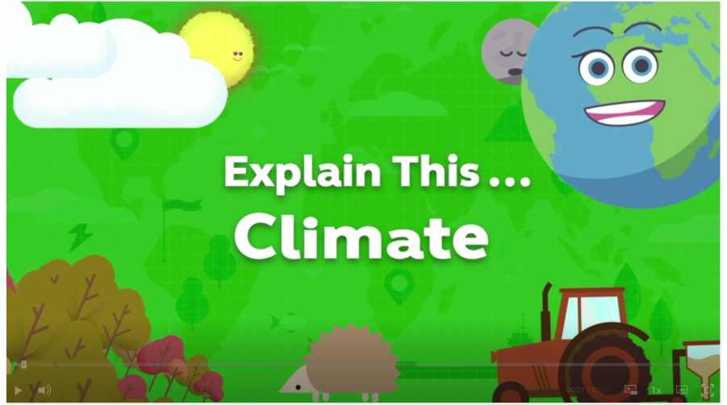
What is the difference between climate and weather?
Notes:
Teacher’s Notes
In the first slide, students were asked about the weather in Japan. But how are the terms ‘weather’ and ‘climate’ different? Watch this BBC video to understand:
https://www.bbc.co.uk/teach/class-clips-video/geography-ks1--ks2-climate/zjdthbk
Check understanding by asking pupils to TTYP to explain the difference between weather and climate.
Weather describes atmospheric conditions at any time or short period of time. These conditions can change suddenly. Today may be cold and windy and tomorrow may be hot and sunny. Weather conditions include sunshine, rain, snow, fog, sleet, hail, mist, sunshine, wind, temperature and thunderstorms.
Climate describes conditions over a longer time period or large geographical area. The climate of an area depends on the average weather conditions which are collected over a year or more. Climate changes slowly, usually over decades or centuries. Different parts of the world have different climate regions.
Explain that in today’s lesson we will start by looking at what today’s weather is in Japan. Then we will explore the climate in Japan and look at the weather over the course of 12 months.

Slide 4
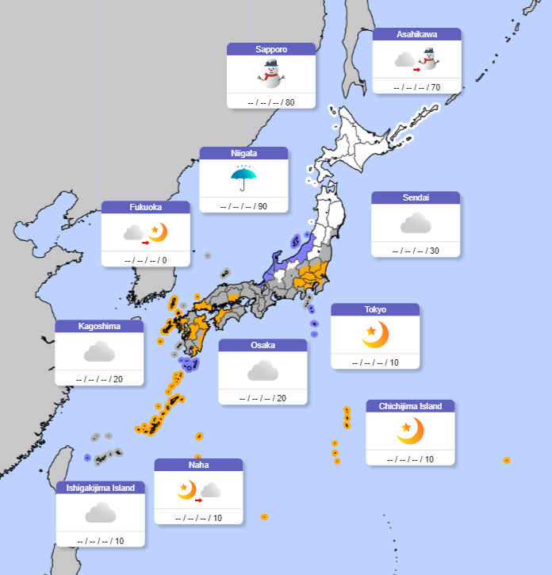
What’s the weather like today?
Map image © Japan Meteorological Agency
Notes:
Teacher’s Notes
Click on the map to visit the daily forecasts page on the Japan Meteorological Agency website (https://www.jma.go.jp/bosai/map.html#5/34.5/135/&contents=forecast&lang=en).
Ask the pupils what they notice. How does the weather forecast in Japan compare with the weather today where we live? Is the temperature in Hokkaido (very north of Japan) the same or different to that in Okinawa (the very south)? Why is that?
Click on the weather forecast for Tokyo to look at the detailed forecast. Highlight the different information presented and discuss what it means. For example, explain that ‘probability of precipitation (%)’ means how likely it is that rain (or other precipitation: sleet, snow, hail, drizzle etc.) will fall from the sky at the time shown.
Ask questions to check understanding.

Slide 5
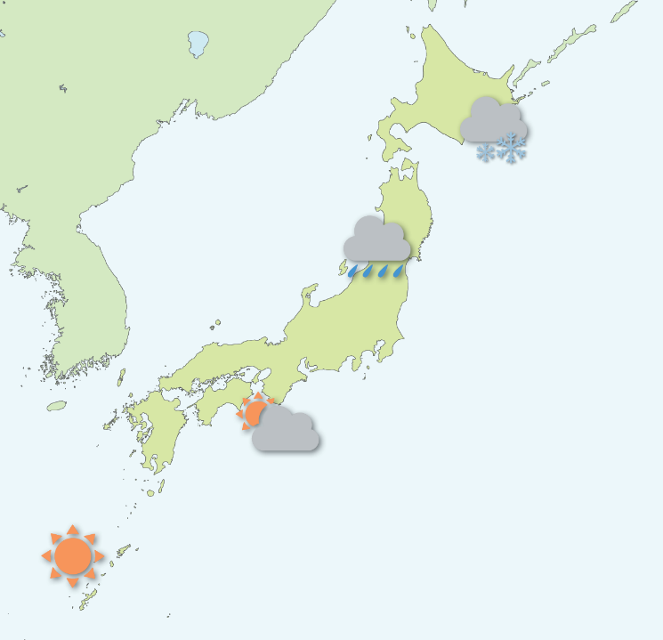
Task 1
Research the weather forecast for your assigned Japanese city on the JMA website.
Practise giving a weather report for your city to your friends!
Notes:
Teacher’s Notes
Divide pupils into five groups and assign each group a different Japanese city shown on the JMA weather forecast map. Each groups researches their city’s weather forecast on the JMA website using an iPad and uses the information to write a weather report. This can be done independently or pupils may use the writing frame.
Put the pupils in new groups and get them to share their weather forecasts with each other, in the style of a TV weather reporter.

Slide 6
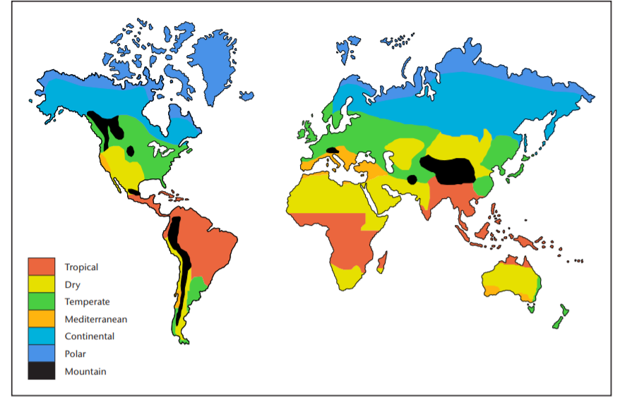
Climate zones
UK
Japan
© Met Office
Notes:
Teacher’s Notes
As we learned from the video, climate is different to weather. TTYP: Can you remember how they are different?
Can pupils see the UK on the map? Which climate zone is it in?
Remind pupils that the UK has a temperate climate which means we have four distinct seasons with cool winters and warm summers.
Can pupils identify Japan on the map? Which climate zone is it in? It is also in the temperate zone, meaning it has 4 seasons too.
Map courtesy of the Met Office - public sector information licensed under the Open Government Licence v3.0

Slide 7
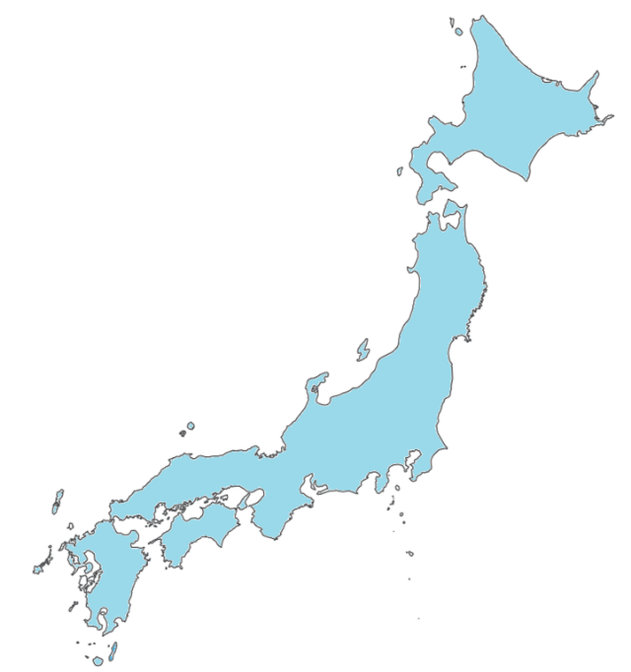
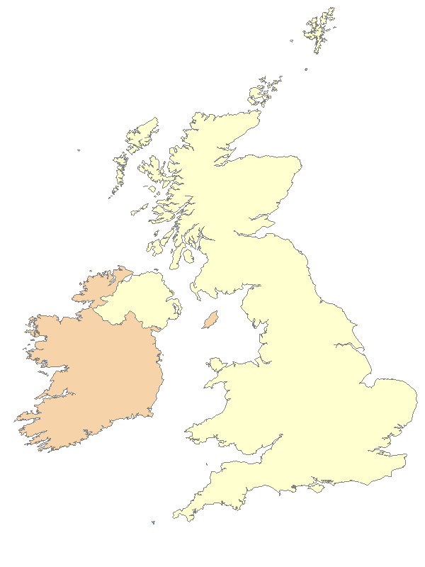
Climatic Variations
The UK and Japan are long countries and stretch from north to south.
The climate in the north is different to the south.
Notes:
Teacher’s Notes
Explain that in both the UK and Japan the north is usually cooler than the south. In the UK the south of the country, e.g., Cornwall and Kent, tend to be warmer than it is at the other end, e.g., the north of Scotland.
KQ: Why is this? How is this different for countries in the southern hemisphere?

Slide 8
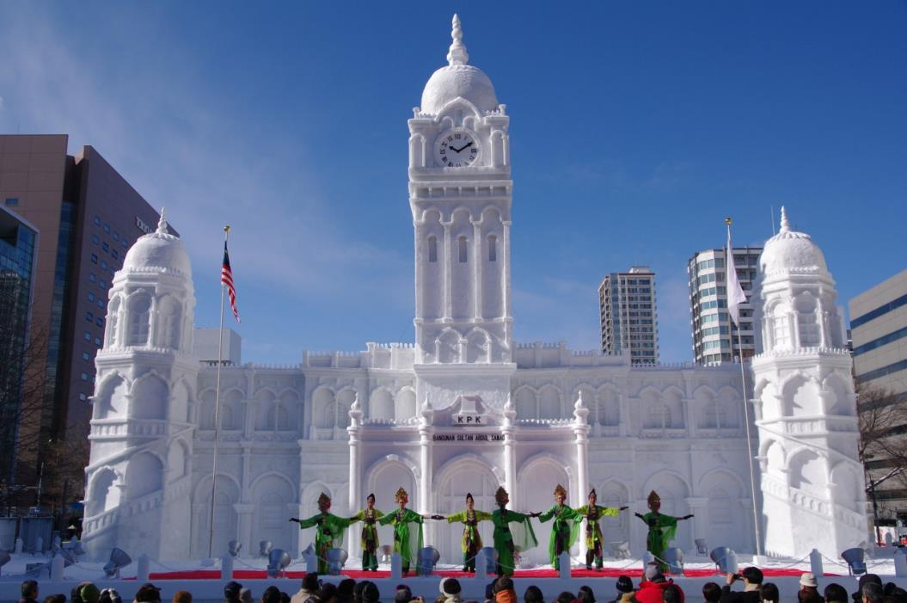
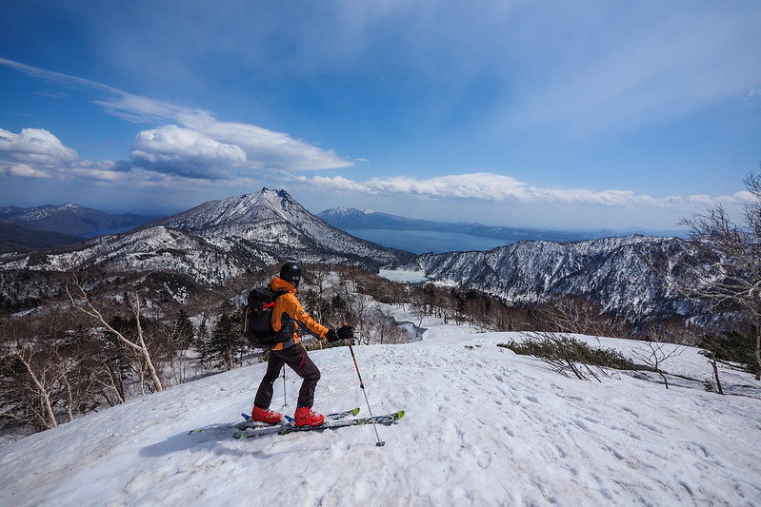
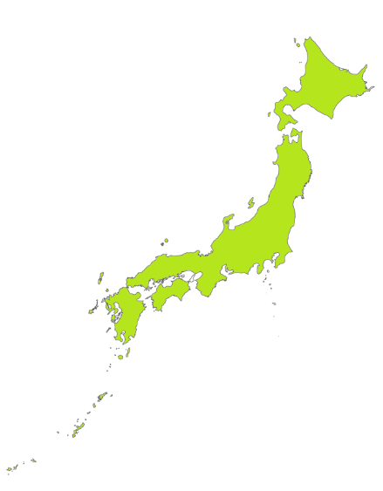
Robert Thomson, CC BY-NC 2.0
© Yasufumi Nishi/ JNTO
Hokkaido is very cold in winter.
People visit to ski and snowboard.
Notes:
Teacher’s Notes
Winter temperatures in Hokkaido, which is Japan’s northern island, can go below freezing. People might visit for winter sports. Do students remember learning about the snow festival (yuki matsuri) in Lesson 1? Many people from across Japan and foreign visitors attend it every year. At the festival you can see huge snow and ice sculptures.
Image: Spring backcountry skiing on Mt. Izari-dake (Hokkaido, Japan) by Robert Thomson, CC BY-NC 2.0, via Flickr

Slide 9
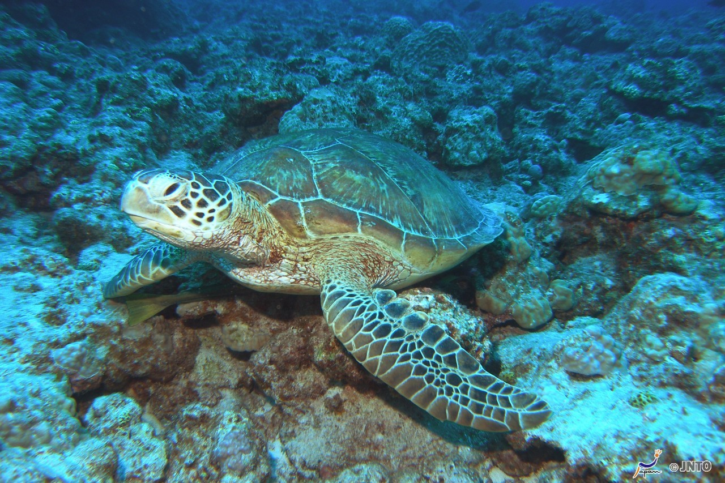
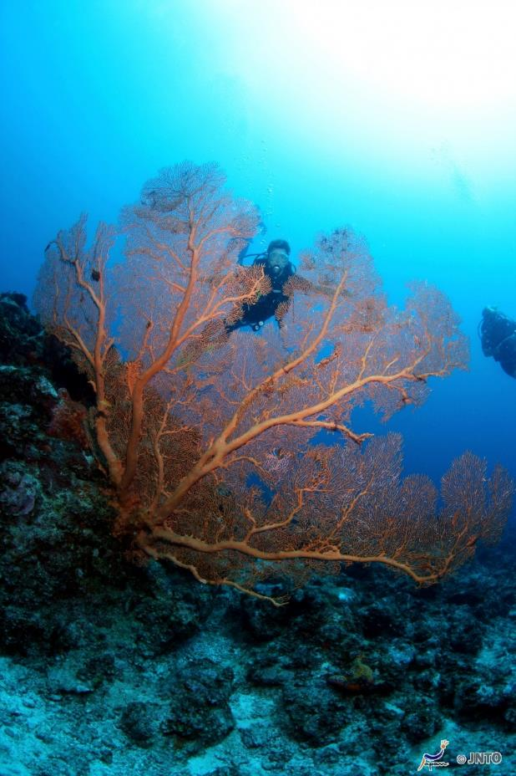
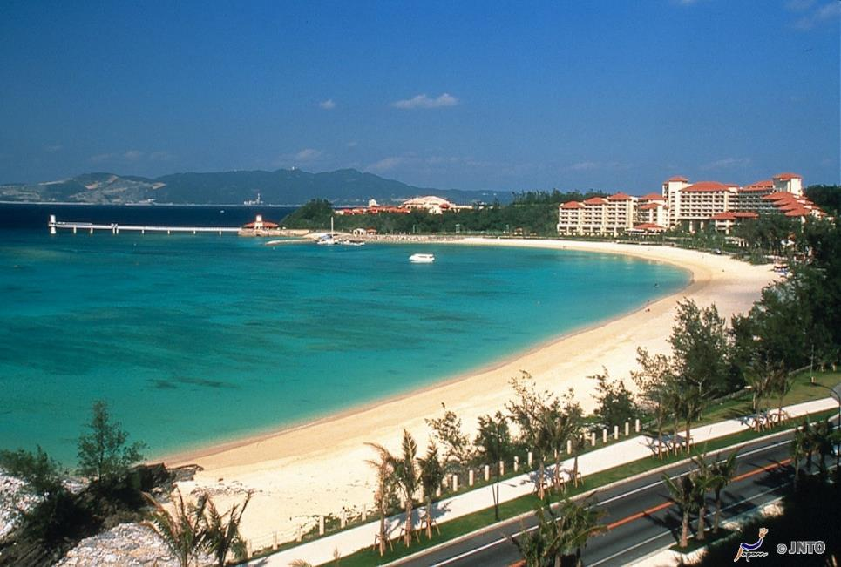
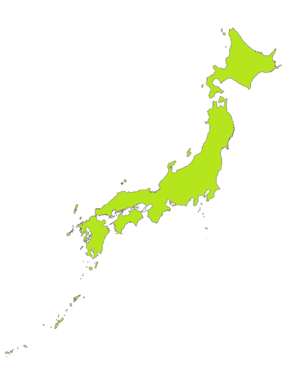
Okinawa is not cold, even in winter!
People visit to enjoy the beaches
and go diving.
Notes:
Teacher’s Notes
Winter in Okinawa, an island towards the very south of Japan, is usually between 15 – 20 degrees Celsius, similar to May or June in the UK.
There are lots of beaches and many people visit to go diving. (Click through to see picture of diver and coral and a sea turtle)

Slide 10
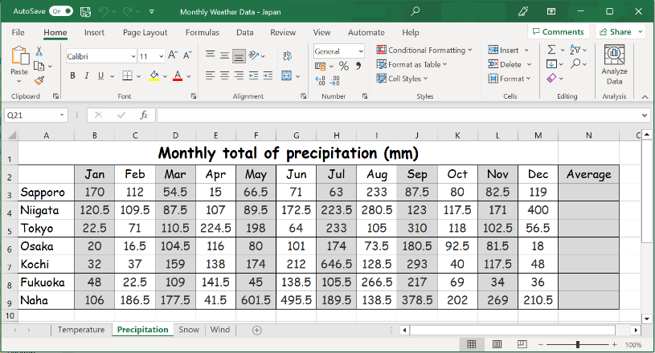
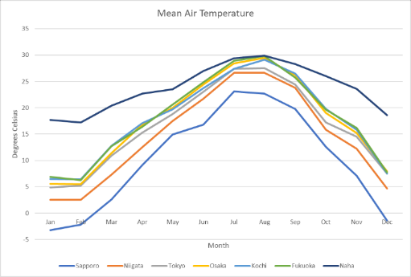
Task 2
You have an excel file showing weather data for seven Japanese cities.
Create a table, complete with a title and axis labels, for each set of data. Then calculate the annual average temperature and precipitation for each city.
Notes:
Teacher’s Notes
Introduce the task to pupils. Model how to highlight the relevant columns of data then create a table by navigating to the INSERT tab and going to Recommended Charts. Show how pupils can scroll through the list of charts that Excel recommends for the data, and click any chart to see how your data will look. Once the correct chart type has been selected, model how to create a title and label the axis.
Once you have shown how to complete the task on one of the data tabs, send pupils to the tables to complete the other tabs independently. Remind them to save their work with a new file name.

Slide 11
Which city has the best weather for a visitor to Japan?
Emojis by OpenMoji, CC BY-SA 4.0
Notes:
Teacher’s Notes
Once pupils have created their various charts, encourage them to interpret the information by asking which of the cities has the best weather for a tourist visiting Japan. Ask pupils to explain their answers with reference to the data. How would their answer change for a visitor who wanted to have a beach holiday compared to a snowboarder?
Images:
All emojis designed by OpenMoji – the open-source emoji and icon project. License: CC BY-SA 4.0

Slide 12
These resources were developed by Oliver Reed in collaboration with the Japan Society.
The Japan Society 13/14 Cornwall Terrace, London NW1 4QP
Tel: 020 7935 0475
Email: education@japansociety.org.uk
www.japansociety.org.uk
Follow us on:
@japansocietylon
@JapanSocietyLondon
© The Japan Society

