Slide 1
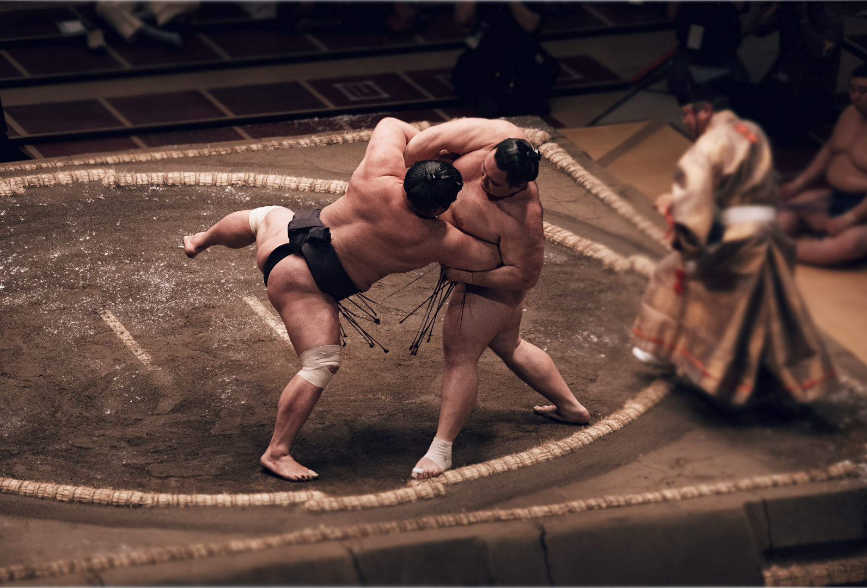
Sumo 相撲
KS2
©The Japan Society (2025)
Notes:
Teacher’s Notes
Title slide
Image from Canva.

Slide 2
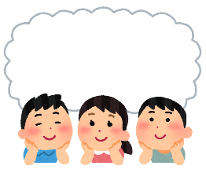
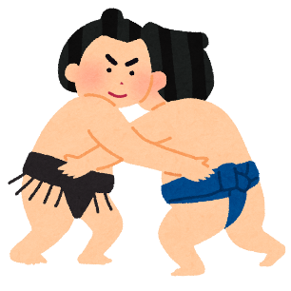
Starter
What do you already know about sumo?
What is sumo?
Where is it from?
Is it an individual sport or a team sport?
Anything else you can think of!
©The Japan Society (2025)
Notes:
Teacher’s Notes
Ask pupils to think about the questions on the slide. You could show them some images or a video to help prompt discussion if they are struggling to think of answers to the questions.
Images from Irasutoya.

Slide 3
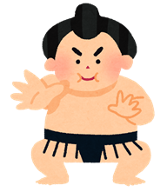
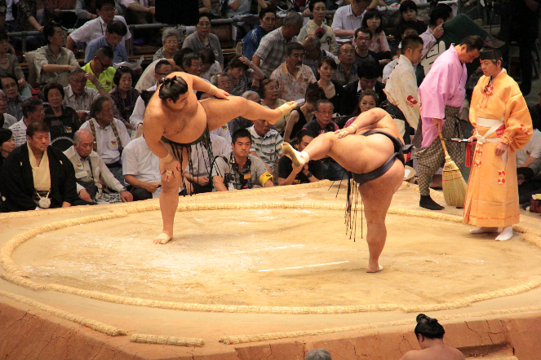
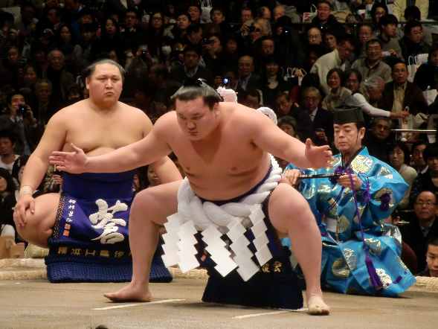
Learning Objectives
To learn and understand what sumo is.
To recognise the significance of sumo as a sport.
©The Japan Society (2025)
Notes:
Teacher’s Notes
Introduce the Learning Objective’s for today’s lesson.
Images from Irasutoya and Wikimedia Commons:
https://commons.wikimedia.org/wiki/File:Sumo_tournament_(15715079492).jpg
https://commons.wikimedia.org/wiki/File:Hakuho_Shiranui_dohyo-iri_2012_Jan.JPG

Slide 4
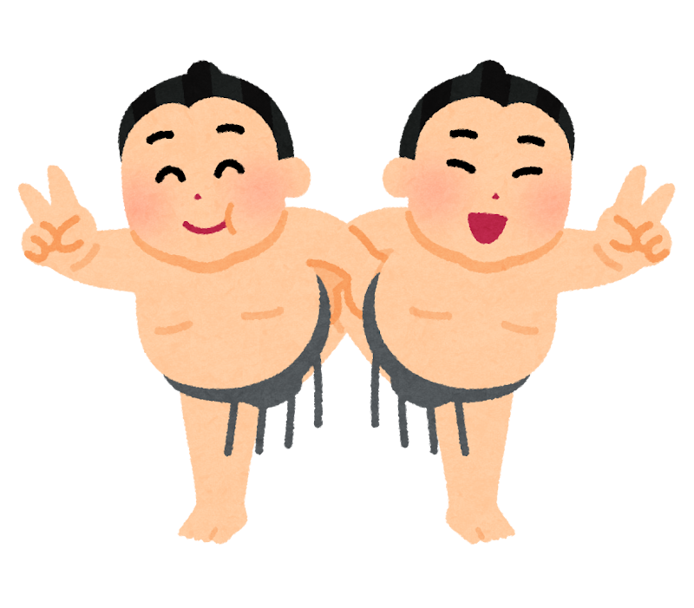
Key Vocabulary
Sumo
Dohyo (ring)
Rikishi (wrestler)
Mawashi (loincloth)
Mage (topknot)
Shinto
©The Japan Society (2025)
Notes:
Teacher’s Notes
Introduce the key vocabulary. Do pupils recognise any of the key words that they see on this slide?
You could come back to this slide at the end of the lesson to see if pupils remember the meanings of each of the words.

Slide 5
What is Sumo?
©The Japan Society (2025)
Notes:
Teacher’s Notes
The following section will provide pupils with a general overview of what sumo is, its rules, and why it is so significant.
Image from Canva.

Slide 6
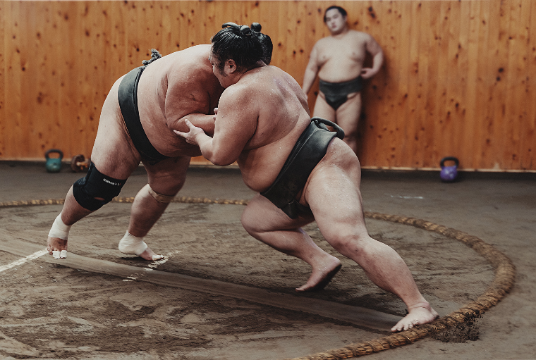
Sumo 相撲
Sumo is a traditional form of wrestling from Japan.
In order to win, two wrestlers must try to push or throw one another outside of the ring.
Or, they can try to force one another to the ground.
Sumo matches usually only last for a few seconds!
©The Japan Society (2025)
Notes:
Teacher’s Notes
Read out the sumo definition and explanation. Did these match the ideas that pupils suggested during the starter activity?
Image from Canva.

Slide 7
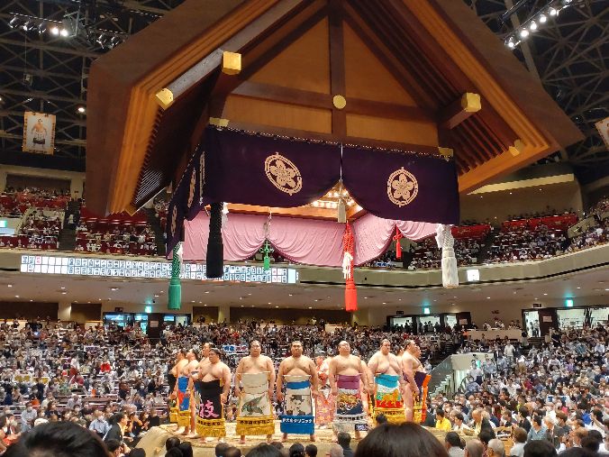
Sumo 相撲
Even though sports such as baseball and football are also popular in Japan, sumo is considered to be the country’s national sport.
What does national sport mean?
Do you know what the national sports are for other countries around the world?
©The Japan Society (2025)
Notes:
Teacher’s Notes
Ask pupils what they think “national sport” means.
You could link this question to any other learning you may have down about other countries around the world – what is the national sport of that country? What is the national sport of England/Scotland/Wales/Northern Ireland?
Image from Wikimedia Commons: https://commons.wikimedia.org/wiki/File:Sumo_wrestlers.jpg

Slide 8
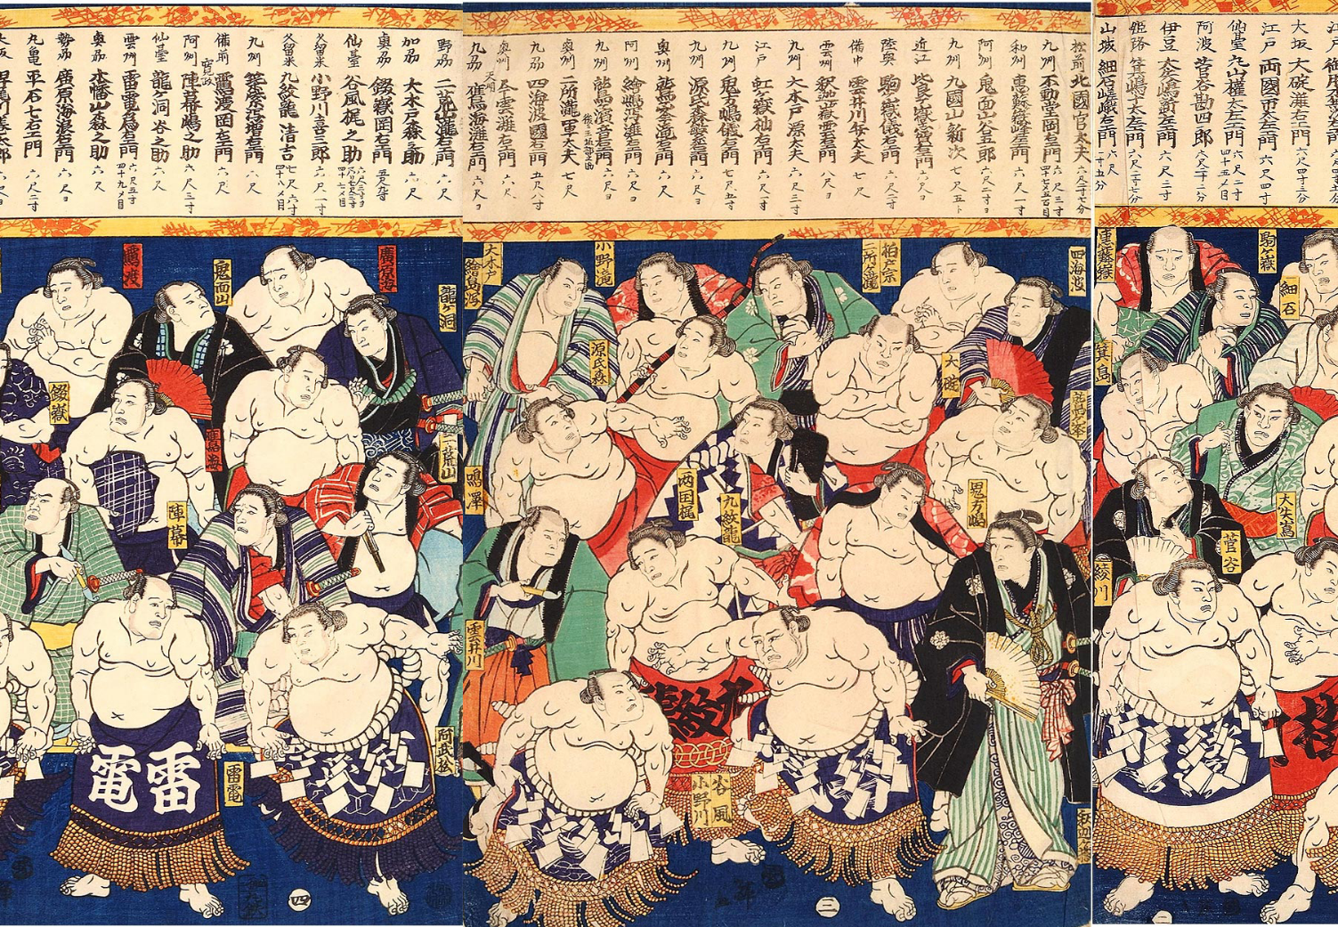
History and Traditions
©The Japan Society (2025)
Notes:
Teacher’s Notes
This section will provide pupils with a brief overview of the origins of sumo. It will also cover some of the traditions and rituals that are important in professional sumo.
Image from Wikimedia Commons: https://commons.wikimedia.org/wiki/File:97-Sumo-Wrestlers-Edo-period-Utagawa-Kuniteru-1867.png

Slide 9
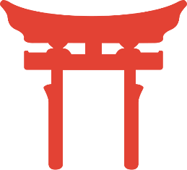
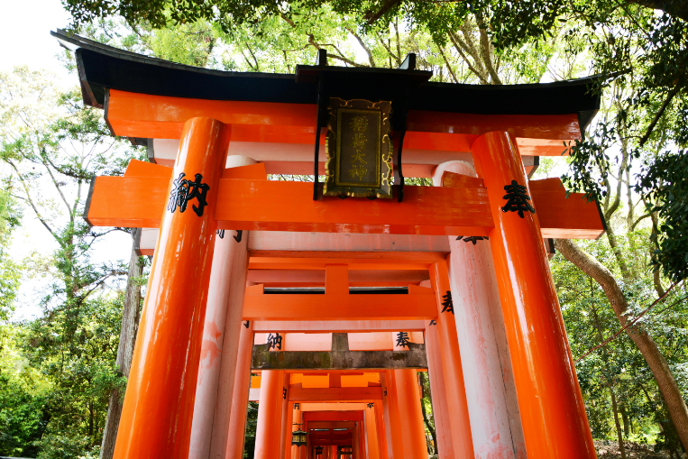
History
Sumo has existed for over 1,500 years!
Many aspects of sumo today can be linked to Shinto – one of Japan’s main religions.
©The Japan Society (2025)
Notes:
Teacher’s Notes
Define what Shinto is if necessary, as pupils may not have studied about it before.
Shinto is an indigenous religion to Japan and it is one of the country’s main religions, alongside Buddhism.
Shinto as a religion centres around the belief and worship of kami – sacred spirits that take many different shapes and forms. For example, kami can take the form of elements or the natural landscape, like wind, rain, waterfalls, or mountains.
Image from Wikimedia Commons: https://commons.wikimedia.org/wiki/File:Shinto_torii_vermillion.svg
Image from Canva

Slide 10
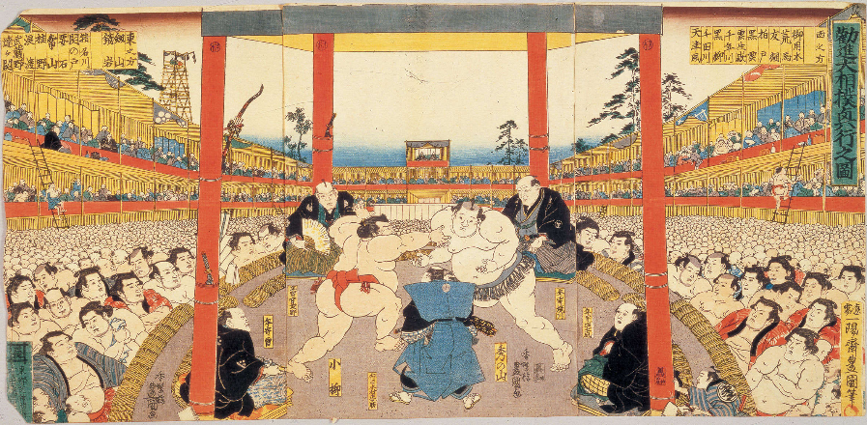
History
Originally, sumo matches took place as a sport for Shinto gods to watch.
But eventually, it became a sport for anyone to watch and enjoy.
©The Japan Society (2025)
Notes:
Teacher’s Notes
Originally, sumo was a sport for only the gods to watch. Sumo bouts would be performed for gods to ask for a bountiful and successful harvest. However, overtime, it has become a sport that anyone can watch and enjoy.
Image from Wikimedia Commons: https://commons.wikimedia.org/wiki/File:Grand-Kanjin-Sumo-Tournament-by-Utagawa-Kunisada-1846.png

Slide 11
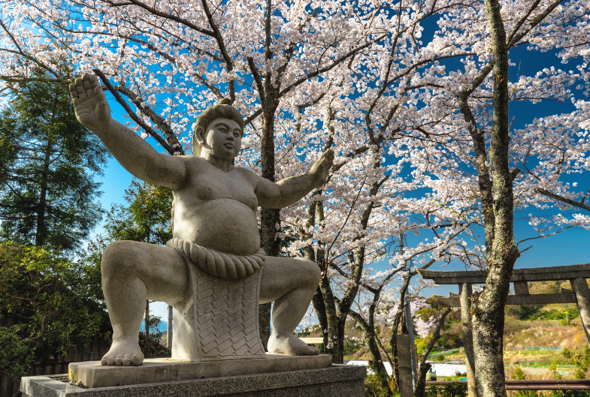
Traditions
Because of sumo’s deep-rooted connection to religion, many of the traditions and rituals that take place in the sport have been influenced by Shinto beliefs.
What is a tradition or a ritual?
Can you think of any examples?
©The Japan Society (2025)
Notes:
Teacher’s Notes
Explain to pupils that, due to sumo’s past and links to Shinto, many of the traditions and rituals we see take place at sumo matches nowadays, are directly connected to the history and religious associations with the sport!
Define tradition and ritual. Ask pupils to think of examples of a religious tradition or ritual – you could link this to previous learning you may have done about a religion.
Image from Canva.

Slide 12
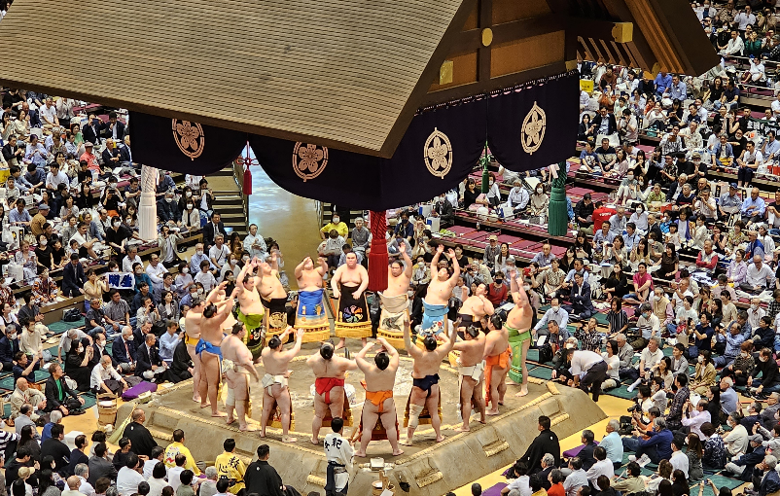
Traditions
The dohyo is considered to be a sacred place.
Above the ring, there is a roof that looks similar to the roof of a Shinto shrine.
©The Japan Society (2025)
Notes:
Teacher’s Notes
Show pupils the images and see if they can notice the similarities between the two. Image from Wikimedia Commons: https://commons.wikimedia.org/wiki/File:Dohyo-iri_Mai_2023.jpg

Slide 13
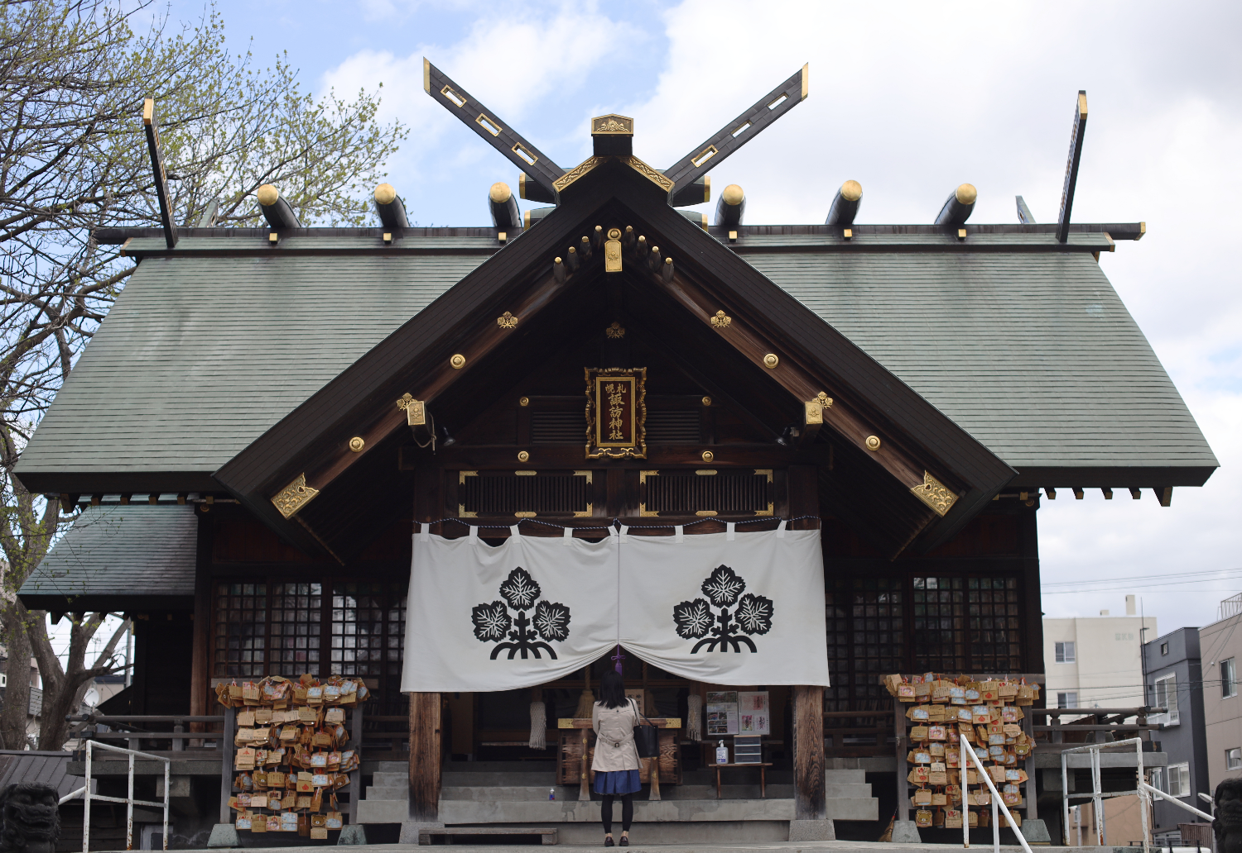
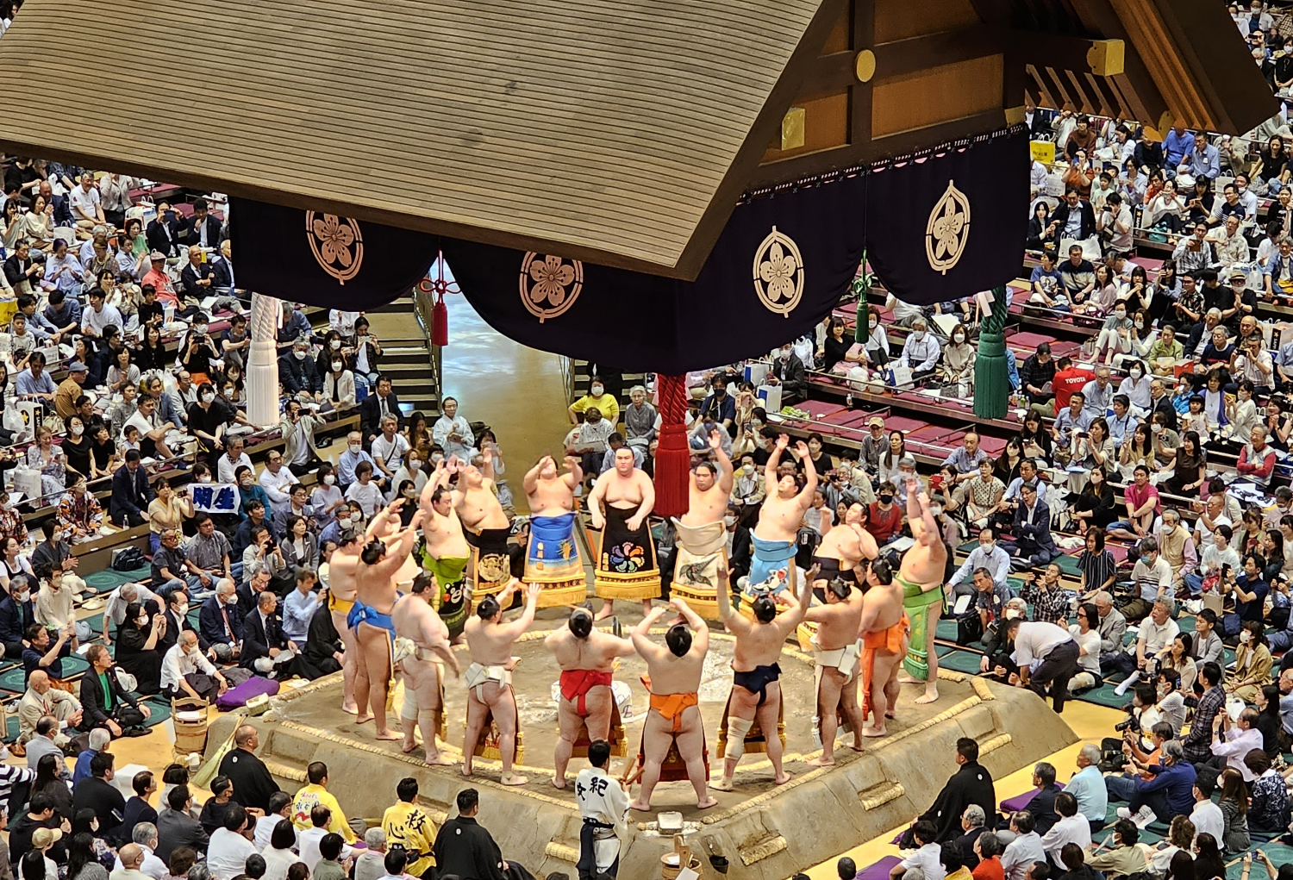
©The Japan Society (2025)
Notes:
Teacher’s Notes
Click on the slide again to reveal the image of the Shinto shrine underneath. Can pupils notice the similarities between the dohyo roof and the shrine roof?

Slide 14
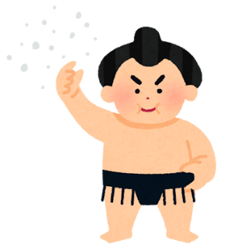
Ring Entering Ceremony
Before matches, there is a ring entering ceremony, where the wrestlers will perform a series of moves...
Clapping their hands to attract the attention of the gods
Stomping their feet to help drive away evil spirits
Throwing salt in the ring to purify it
Can you think of any other sports that might have special traditions or rituals?
©The Japan Society (2025)
Notes:
Teacher’s Notes
You could show pupils a video of a ring-entering ceremony at a professional sumo match, to help them better understand what they are like.
Ask pupils to think of any other sports that have special traditions – they do not have to be religious!
Image from Irasutoya.

Slide 15
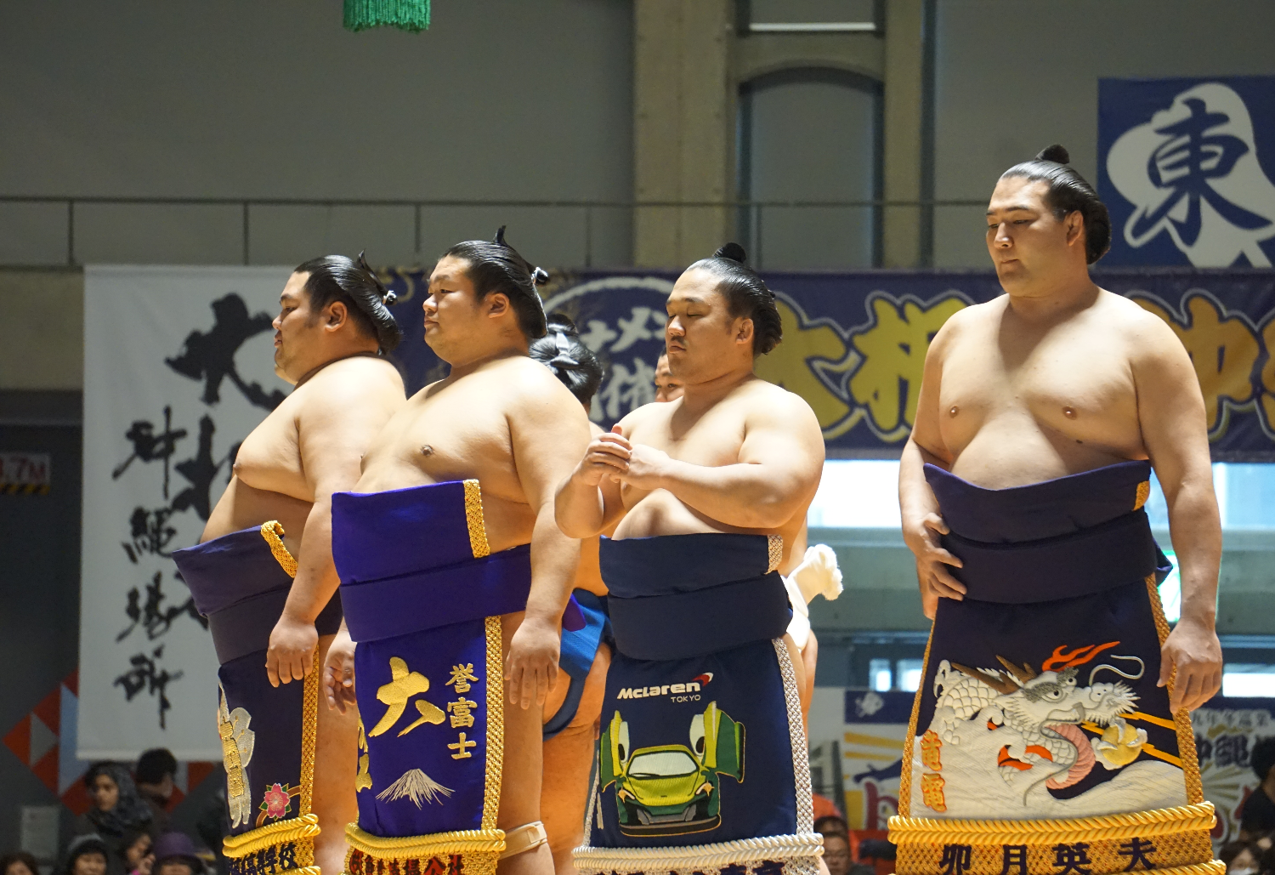
Wrestlers
©The Japan Society (2025)
Notes:
Teacher’s Notes
This section will provide pupils with more information about the sumo wrestlers (rikishi) themselves.
Image from Wikimedia Commons: https://commons.wikimedia.org/wiki/File:Sumo_in_Okinawa_-_2017_-_43033101885.jpg

Slide 16
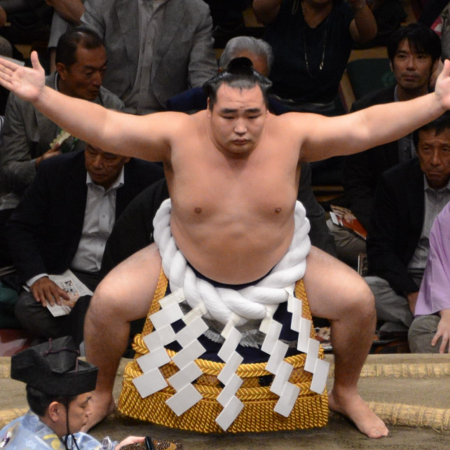
Rikishi 力士
The word for sumo wrestler in Japanese is rikishi 力士. Sumo wrestlers have an iconic and unique appearance.
What do you notice about this
sumo wrestler’s appearance?
©The Japan Society (2025)
Notes:
Teacher’s Notes
Ask pupils to look at the image of the sumo wrestler on the slide. What features do they notice about him? What is so special or unique about his appearance?
Images from Irasutoya and Wikimedia Commons: https://commons.wikimedia.org/wiki/File:Yokozuna-close_up.jpg

Slide 17
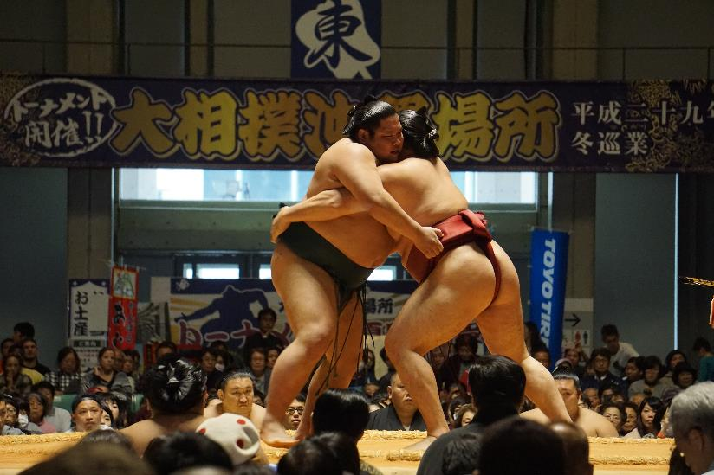
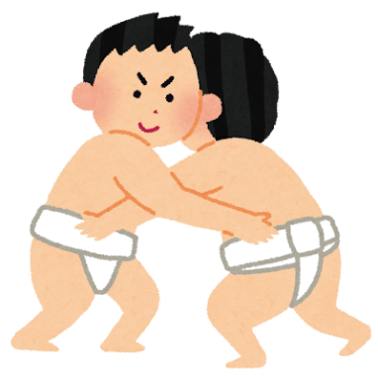
Mawashi 廻し
When competing, all wrestlers wear a loincloth known as mawashi 廻し in Japanese.
By wearing as little clothing as possible, wrestlers can show they are not cheating, and display their true strength.
©The Japan Society (2025)
Notes:
Teacher’s Notes
Historically, it’s believed that, if a sumo wrestler were to wear clothing whilst in a match, they could potentially conceal a weapon and thus fight unfairly.
Images from Irasutoya and Wikimedia Commons: https://commons.wikimedia.org/wiki/File:Sumo_in_Okinawa_-_2017_-_29000541487.jpg

Slide 18
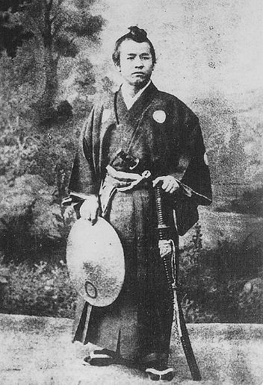
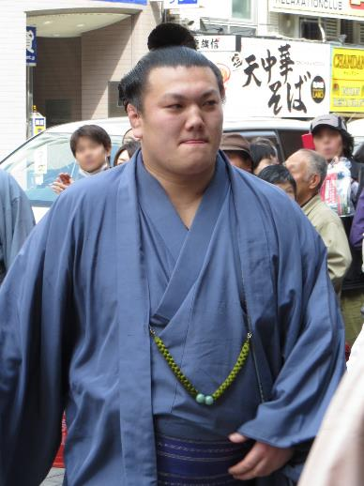
Mage 髷
Mage is the name for the topknot hairstyle that sumo wrestlers wear. This hairstyle was actually popular for men and samurai during the Edo period (1603-1868).
©The Japan Society (2025)
Notes:
Teacher’s Notes
When mentioning the Edo Period, you could ask pupils if they know what was happening in the UK/elsewhere in the world during this time – linking back to previous learning you may have done in History.
The image on the left is of a samurai warrior named Eiichi Shibusawa (1840-1931) with the mage hairstyle. On the right is an image of sumo wrestler Ikioi Shota in 2013, also wearing the mage hairstyle.
Images from Wikimedia Commons:
https://commons.wikimedia.org/wiki/File:Eiichi_Shibusawa_samurai.jpg
https://commons.wikimedia.org/wiki/File:Ikioi_in_Harubasho_2013_IMG_1879-2_20130324.JPG

Slide 19
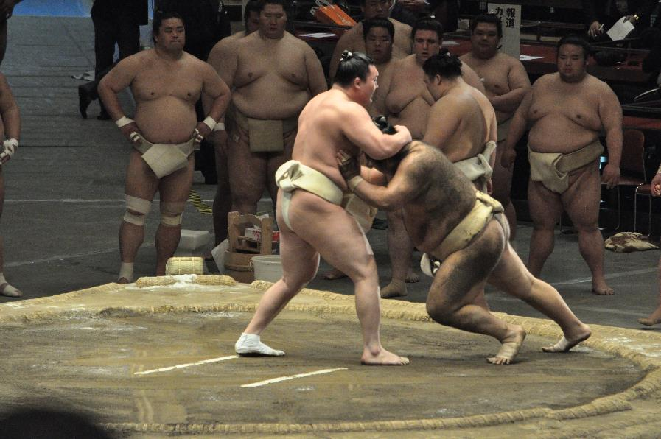
Weight
Gaining weight is important for a wrestler, to help them build strength and muscle.
In professional sumo, there are no weight classes, meaning that wrestlers could be matched against someone who is double or triple their size!
©The Japan Society (2025)
Notes:
Teacher’s Notes
If necessary, explain what weight classes mean.
Emphasise that there are no weight classes in professional sumo – there are weight classes in amateur sumo, and this will be explored further on slide 23.
Image from Wikimedia Commons: https://commons.wikimedia.org/wiki/File:Yokoduna_Keiko_Soken-62.jpg

Slide 20
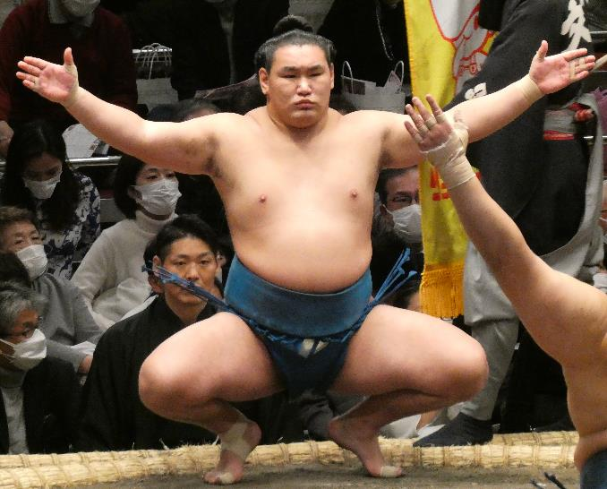
Shikona 四股名
Did you know that wrestlers also have wrestler names (shikona in Japanese) that they are referred to when competing. These are different to their real names!
This is Sugarragchaagiin Byambasüren, a sumo wrestler from Mongolia.
His shikona (wrestler name) is Hoshoryu Tomokatsu.
©The Japan Society (2025)
Notes:
Teacher’s Notes
Historically, wrestlers were given shikona as a way to hide their identities.
Challenge question: Can pupils think of examples of other types of people who might use “stage names”?
Image from Wikimedia Commons: https://commons.wikimedia.org/wiki/File:Hoshoryu_Tomokatsu20220115.jpg

Slide 21
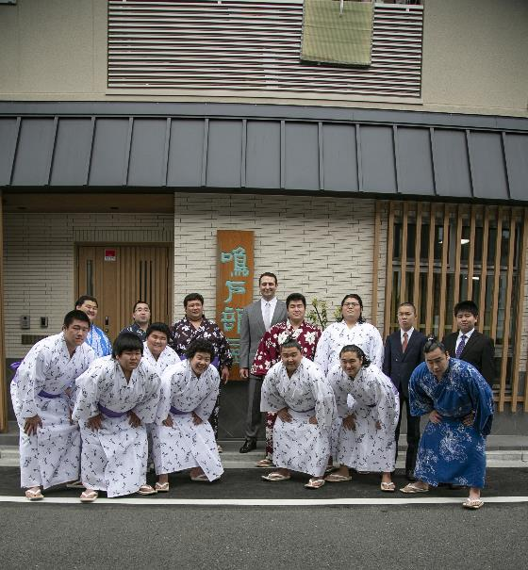
Heya 部屋
Professional sumo wrestlers live and train in special accommodations, called stables (heya in Japanese).
The stables are managed by a
stablemaster.
The stablemaster is usually a
retired sumo wrestler who has
had a successful professional
career.
©The Japan Society (2025)
Notes:
Teacher’s Notes
The special accommodation that sumo wrestlers live and train in are called stables (heya in Japanese). Their whole lives revolve around sumo.
Image is of Takasago sumo stable, from Wikimedia Commons: https://commons.wikimedia.org/wiki/File:Takasago_sumo_stable_building.jpg

Slide 22
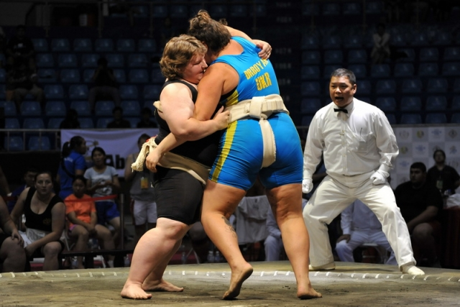
Women in Sumo
There are many women wrestlers that compete in sumo tournaments all around the world!
However, currently, women are only able to compete in amateur sumo tournaments, not professional ones.
©The Japan Society (2025)
Notes:
Teacher’s Notes
Pupils may ask why women are not able to participate in professional sumo – this is because of a traditional Shinto belief that prohibits them from entering the ring. However, there are many passionate women wrestlers out there who are fighting to be recognised as professionals and want to see a change to the rules of sumo, that will allow them to be able to compete.
There are many women sumo wrestlers that do have successful amateur careers and compete in tournaments all around the world!
Image from Wikimedia Commons: https://commons.wikimedia.org/wiki/File:%D0%94%D1%80%D0%B1%D0%BE%D1%8F%D0%BD_%D0%9C%D0%B0%D1%80%D0%B8%D1%8F_%D0%A7%D0%B5%D0%BC%D0%BF%D0%B8%D0%BE%D0%BD%D0%B0%D1%82_%D0%9C%D0%B8%D1%80%D0%B0.jpg

Slide 23
Amateur vs Professional
What’s the difference between amateur and professional sumo tournaments?
Amateur:
Divided by weight classes
Men and women can compete
Less focus on traditions and rituals
Tournaments happen across the world
Professional:
No weight classes
Only men can compete professionally
Following traditions and rituals is important
Tournaments are almost always in Japan
©The Japan Society (2025)
Notes:
Teacher’s Notes
Click on the slide to reveal the points in order.
Professional sumo wrestlers train every single day, live in stables, and get paid – it is a career for them. There is a bigger emphasis on following the Shinto traditions and rituals.
In contrast, amateur sumo focuses more on the competition and is more accessible to people across the world. Amateur sumo tournaments happen across the world, and both men and women are able to participate.

Slide 24
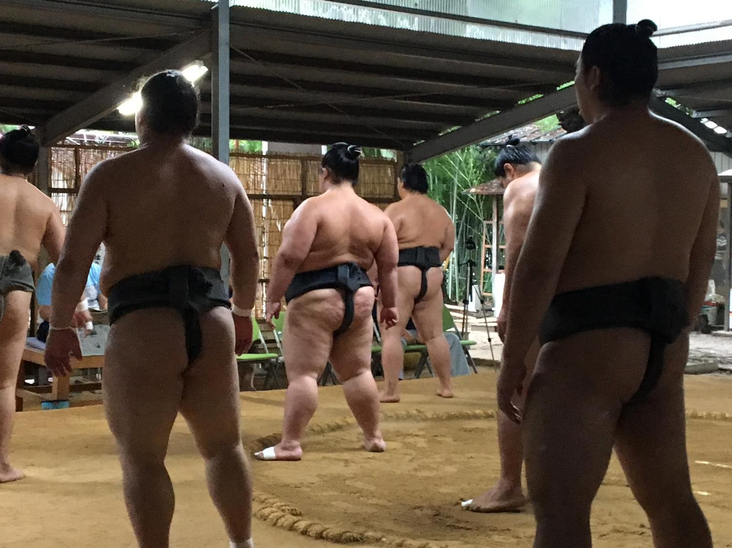
Day in the Life of a
Sumo Wrestler
©The Japan Society (2025)
Notes:
Teacher’s Notes
This section will cover what a typical day might be like for a professional sumo wrestler living in a stable.
Image from Wikimedia Commons: https://commons.wikimedia.org/wiki/File:Kashiwai%EF%BC%BFHachiman-sha_Shrine_Sumo_training.jpg

Slide 25
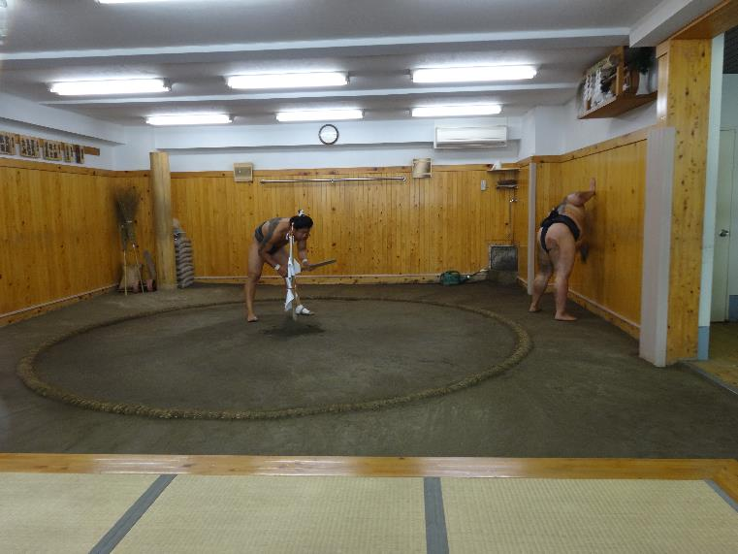
Morning:
A typical day for a sumo wrestler starts early, around 5am or 6am.
Skipping breakfast, they head straight to the dohyo, where they start sweeping and preparing the area for a busy morning of training.
©The Japan Society (2025)
Notes:
Teacher’s Notes
The above image is an example of what a dohyo would look like in a stable.
Image from Wikimedia Commons: https://commons.wikimedia.org/wiki/File:Neatly_arranging_the_ring_soil_after_Sumo_training_Arashio_Stable_Tokyo_Japan_(14841100431).jpg

Slide 26
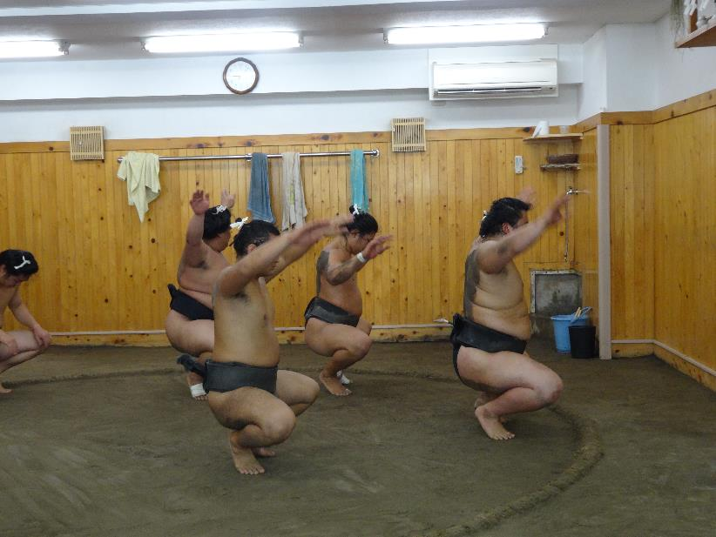
Morning:
First, it’s time to warm-up and stretch – being flexible is important for a sumo wrestler!
Why do you think it’s important for a wrestler to be flexible?
©The Japan Society (2025)
Notes:
Teacher’s Notes
Being flexible is important for a sumo wrestler because it can help them adapt to their opponents’ moves when in the ring; improve their balance; and prevent injuries.
Image from Wikimedia Commons: https://commons.wikimedia.org/wiki/File:Sumo_squats_training_at_Arashio_Stable_Tokyo_Japan_(14657643137).jpg

Slide 27
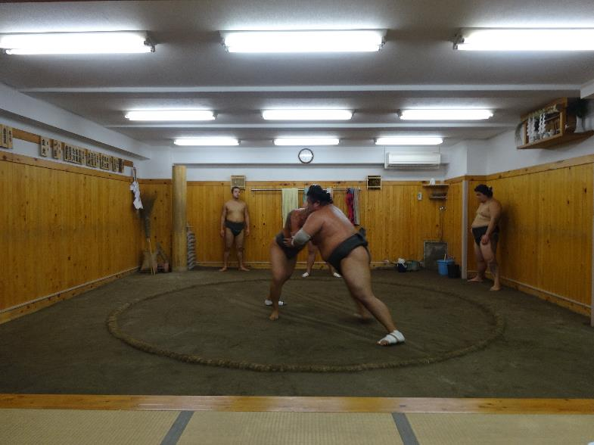
Morning:
After some warming up, it’s time to move straight onto some practice matches. The stablemaster watches the sumo wrestlers training, and offers his advice and guidance.
©The Japan Society (2025)
Notes:
Teacher’s Notes
You could show pupils here a video of what a typical training routine looks like for a sumo wrestler, so they can see what some of the moves look like in actions. This is good if you are planning on doing the Sumo Wrestler Training activity as a part of this lesson.
Image from Wikimedia Commons: https://upload.wikimedia.org/wikipedia/commons/8/80/Practice_at_Arashio_Stable_2014-08-05.jpg

Slide 28
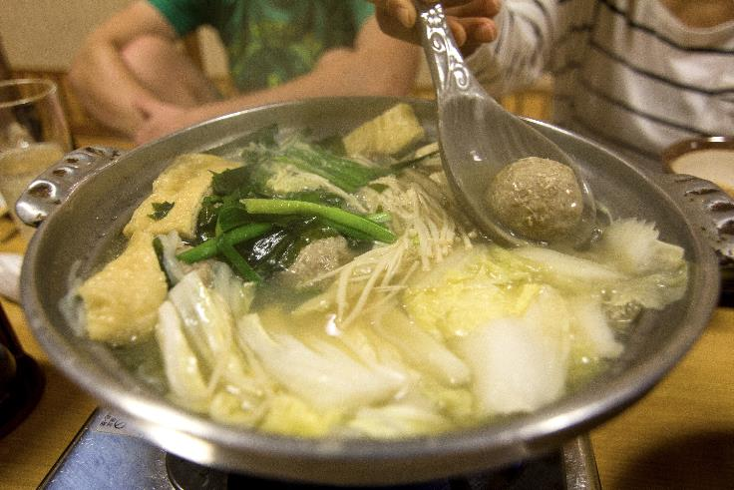
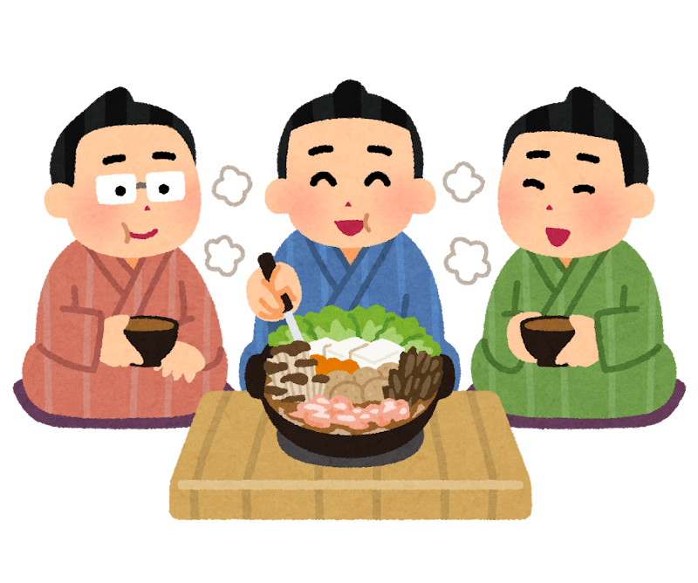
Lunch:
After a long morning of training, it’s finally lunch time. One meal that is particularly popular is chankonabe.
Chankonabe contains meat and vegetables such as chicken, seafood, tofu, bok choy, and mushrooms, that help wrestlers to gain weight and grow strong.
Would you like to try chankonabe?
©The Japan Society (2025)
Notes:
Teacher’s Notes
Chankonabe is an excellent meal for sumo wrestlers to eat, as they can eat it in vast quantities and helps them to gain weight and grow strong.
Images from Irasutoya and Wikimedia Commons: https://commons.wikimedia.org/wiki/File:Chankonabe.jpg

Slide 29
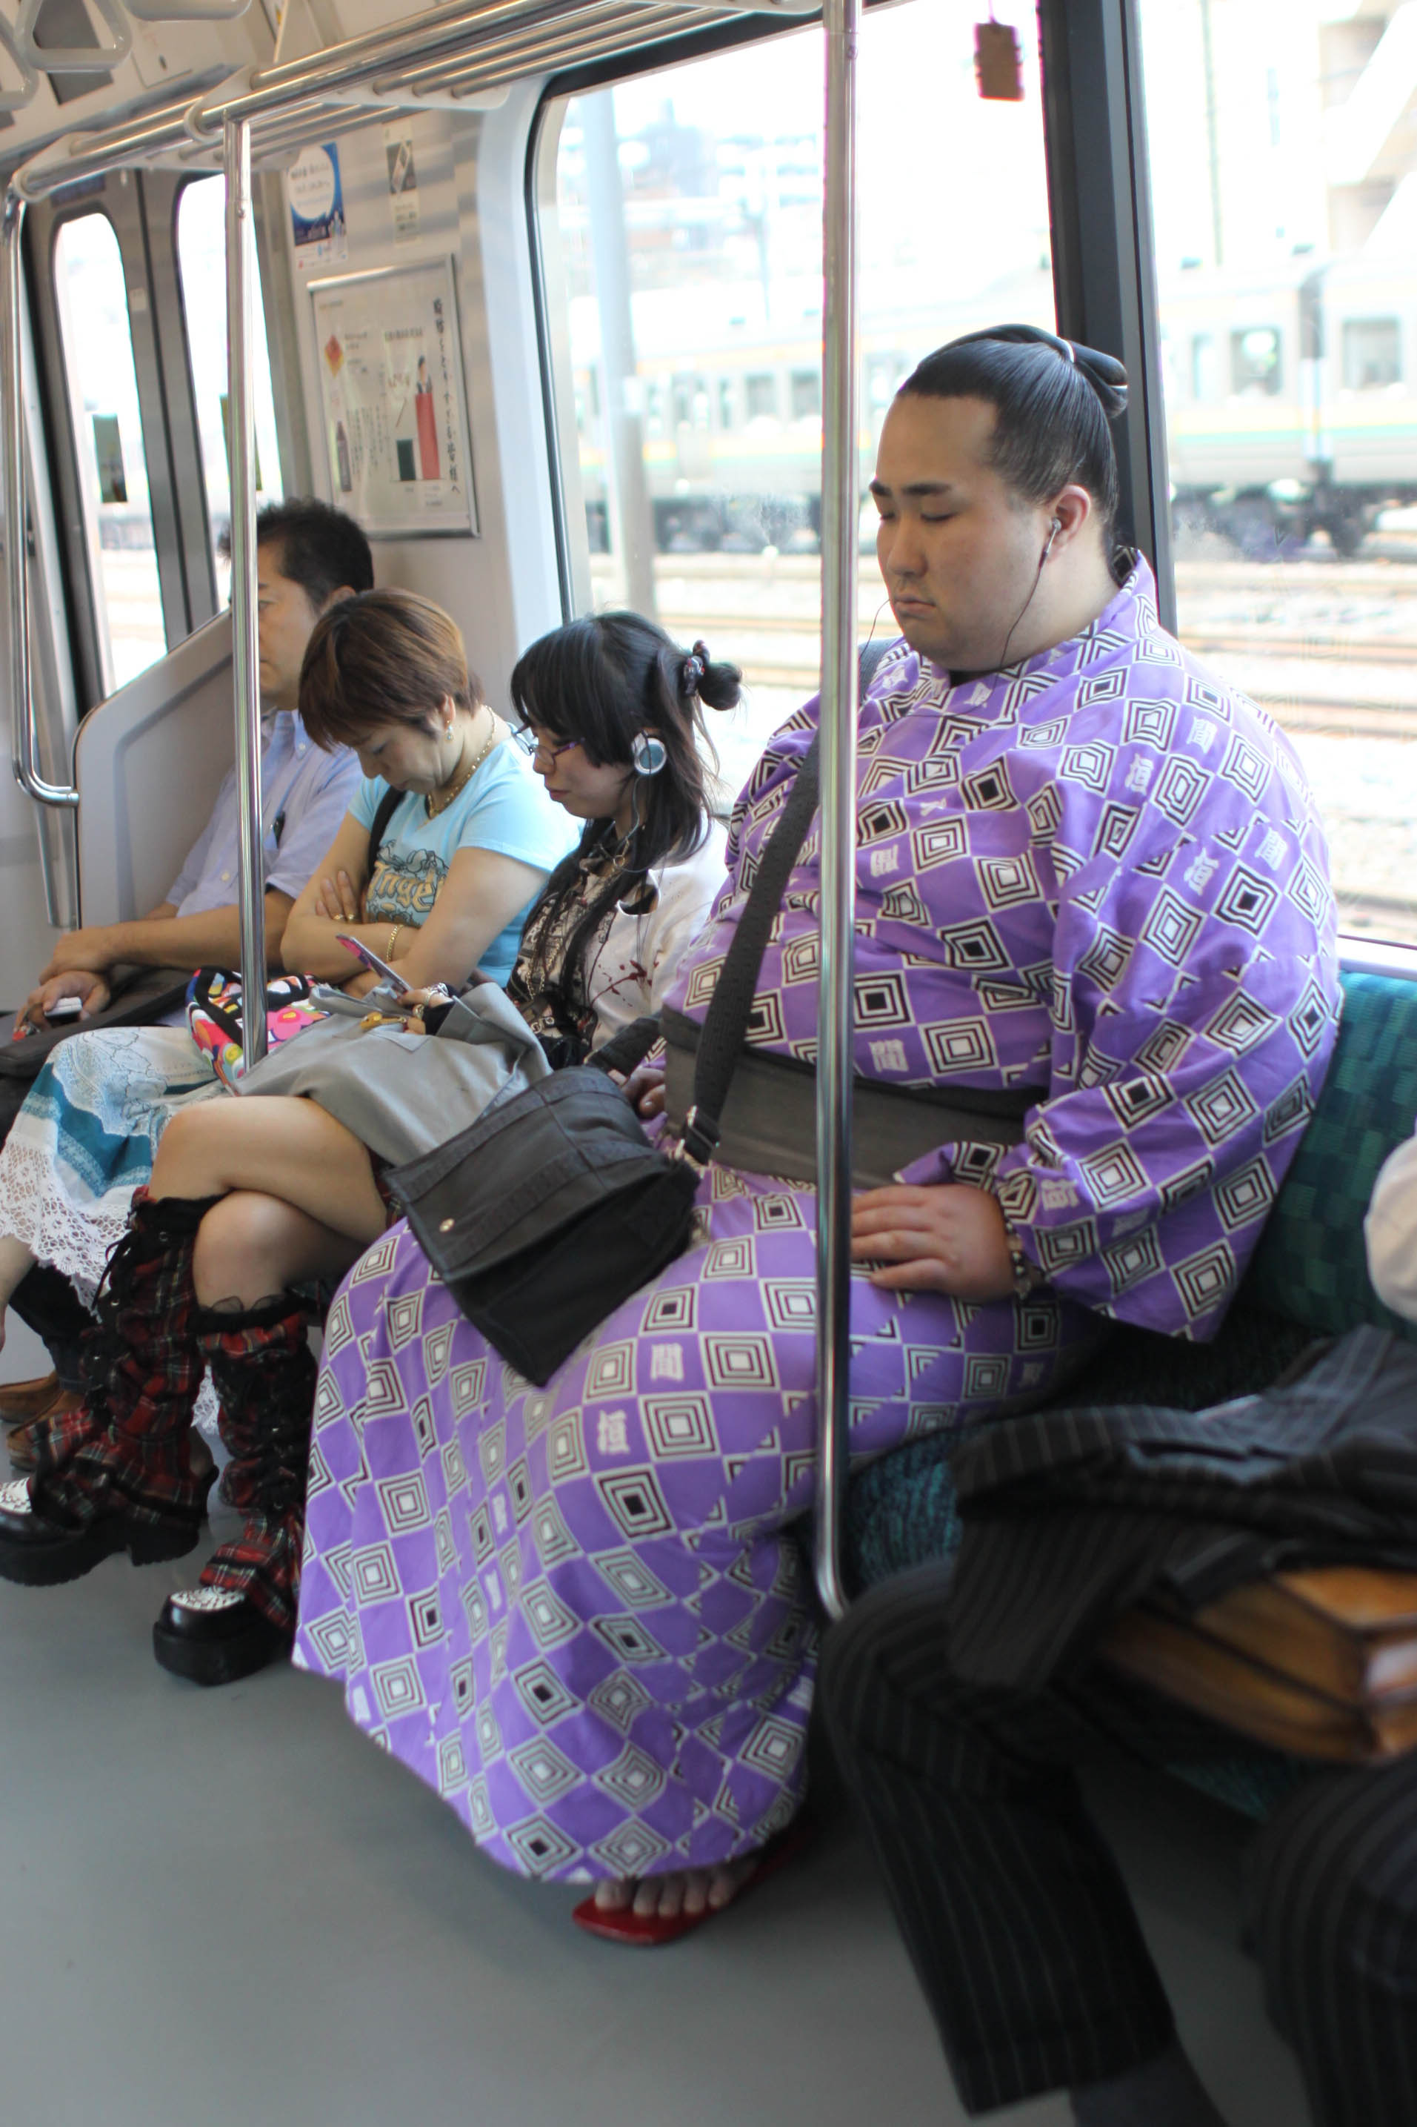
Afternoon:
After lunch, the wrestlers have free time.
Some may have extra duties and chores to help out around the stables.
However, many wrestlers like to take naps after eating, as this also helps them to gain weight.
©The Japan Society (2025)
Notes:
Teacher’s Notes
The image on this slide is of a sumo wrestler sleeping whilst travelling on a train in Japan. Point out the kind of clothing he is wearing and his hairstyle – they stand out from other people travelling on public transport!
Image from Wikimedia Commons: https://commons.wikimedia.org/wiki/File:Sleeping_Sumo_(4860096411).jpg

Slide 30
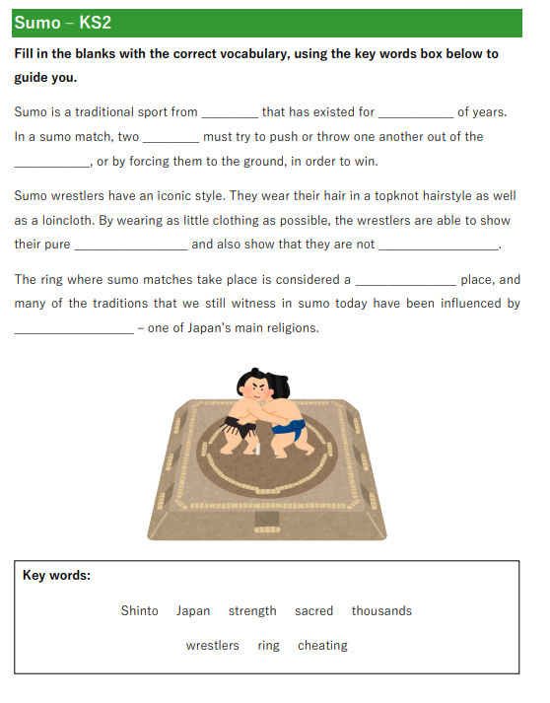
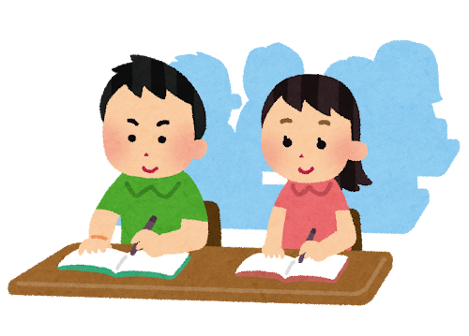
Activity 1:
How much do you remember about sumo?
Fill in the blanks on the activity sheet and test your knowledge!
©The Japan Society (2025)
Notes:
Teacher’s Notes
Worksheet available to download and print from the sumo resource page on The Japan Society webiste.
Illustration from Irasutoya.

Slide 31
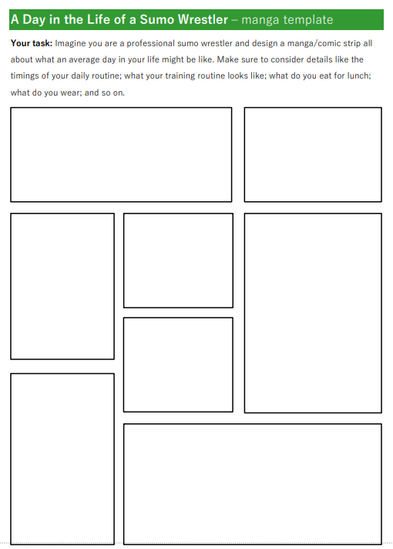
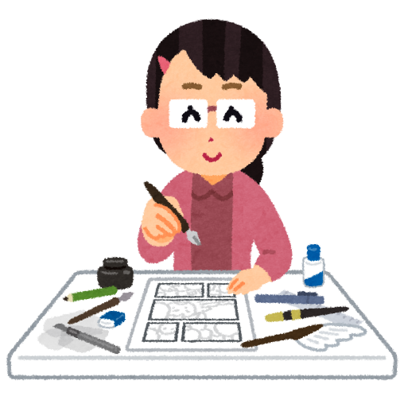
Activity 2:
Imagine you are a sumo wrestler living in a stable.
Write a diary entry or design a manga/comic strip about what an average day in your life would be like!
©The Japan Society (2025)
Notes:
Teacher’s Notes
Worksheet available to download and print from the sumo resource page on The Japan Society webiste.
Illustration from Irasutoya.

Slide 32
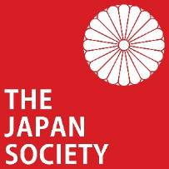
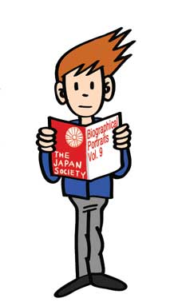
This resource was developed and created
by The Japan Society.
The Japan Society 13/14 Cornwall Terrace, London NW1 4QP
Tel: 020 7935 0475
Email: education@japansociety.org.uk
www.japansociety.org.uk
Follow us on:
@TheJapanSociety
The Japan Society
©The Japan Society (2025)

