Slide 1
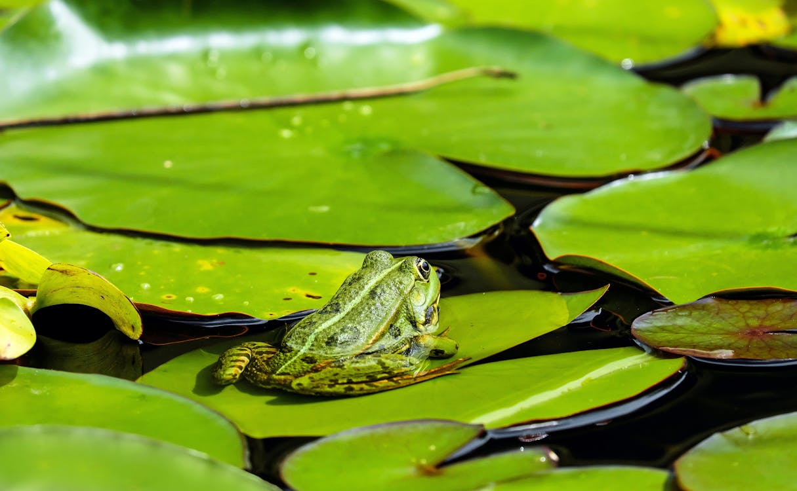

Starter
What words would you use to describe the image? Discuss and share ideas with your partner.
Notes:
Teacher’s Notes
This image will appear again later in the lesson, when pupils read The Old Pond.
Illustration from Irasutoya.

Slide 2
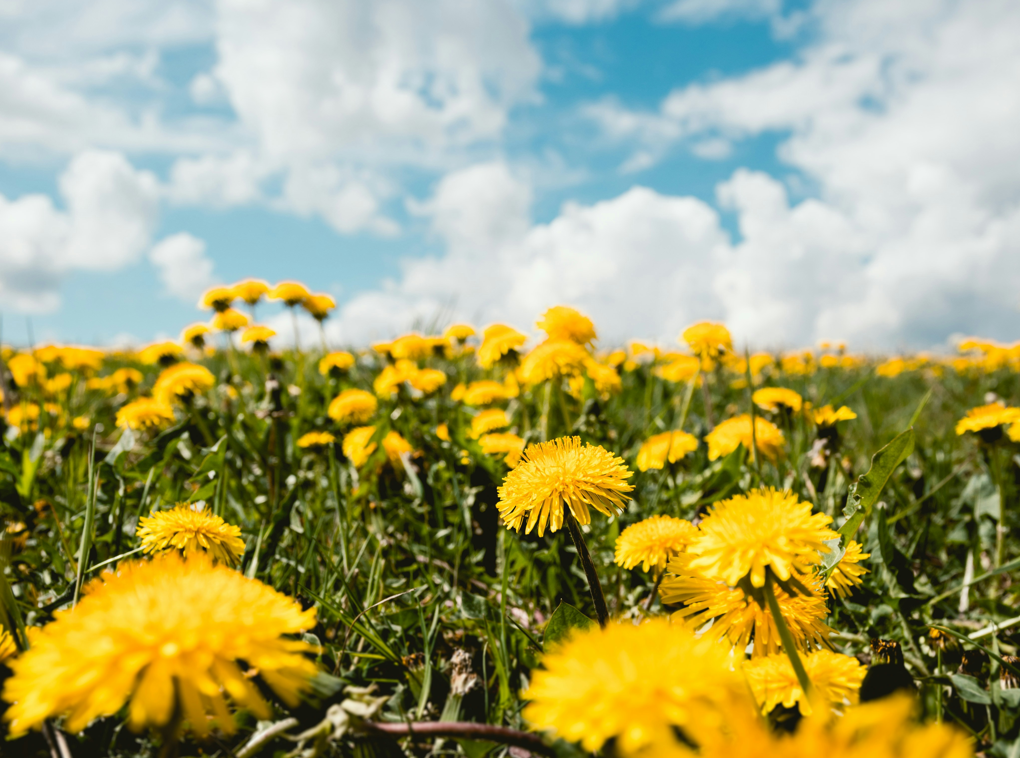

Haiku Poems
Photo by Niklas Hamann on Unsplash
Notes:
Teacher’s Notes
Introduce the topic of today’s lesson. Haiku are about capturing a moment in time, and taking in the world around us.
If you have time you can take a minute to do a guided visualization, encouraging students to think about this image and engaging their senses. (Click once for the title and logo to disappear).
Look at this image. (Give a few seconds). Now we’re all going to close our eyes.
Imagine you are sitting down in the middle of this field. There is no one else around, it’s just you, on your own.
The sun is shining and you look up towards the sky. Your face feels warm in the sun.
Your hands are resting by your sides. You reach out and run your finger tips lightly over the grass and the flowers.
In the distance, you can hear the sounds of birds. You keep listening…now you can hear an aeroplane passing by, high above you.
Open your eyes. How did you feel?

Slide 3





Learning Objectives
To understand what the key features of a haiku poem are.
To be able to describe my surroundings, using my five senses.
Notes:
Teacher’s Notes
Introduce the learning objectives. The 5 senses are recapped later in the lesson.

Slide 4
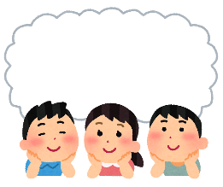
Key Words
Haiku
Nature
Syllables
Kigo
Seasons
Senses
Notes:
Teacher’s Notes
Introduce the key words for today’s lesson.
Kigo is Japanese, it means "seasonal word". Give examples if students are unsure – e.g. "snow", "pumpkin".
Illustration from Irasutoya.

Slide 5

Haiku
Have you heard of “haiku” before?
Do you know anything about them?
Notes:
Teacher’s Notes
Discuss as a class.
Have you studied haiku previously? Have pupils heard of haiku before? Have they read any before?
Does anyone know what haiku are? Are they short or long? Do they rhyme? Prompt discussion with these questions.

Slide 6
Let’s read a haiku!
The Old Pond
by Matsuo Basho
old pond...
a frog leaps in
water’s sound
What do you notice about this poem?
How does it make you feel?
Notes:
Teacher’s Notes
Before explaining what haiku are, read The Old Pond together as a class. This is perhaps one of the most famous haiku in the world, written by one of the most famous haiku poets of all time, Matsuo Basho. It has been translated from Japanese.
After reading through the haiku twice (as haiku are traditionally read aloud twice), ask pupils to discuss with a partner or in a group the following questions:
What do they notice? Is it long or short? Does it rhyme? Do you like the haiku - why or why not?
Referring back to the starter activity… Would pupils say that the haiku provides a particularly in-depth description of the pond and the frog, or does it provide a more simplified description?
Illustrations from Irasutoya.

Slide 7

Haiku
A haiku is a traditional Japanese poem.
They are short poems of only three lines.
They do not have to rhyme.
Notes:
Teacher’s Notes
Were pupils right with their initial ideas? Did they manage to work out or identify any key features?
Do pupils like that haiku are so short?

Slide 8
Syllables
In Japanese, haiku usually follow a strict 5-7-5 syllable structure.
However, in English, haiku don’t have to follow this traditional structure.
What is a syllable?
Count the number of syllables in the words below!
grape apple banana
1 syllable
2 syllables
3 syllables
Notes:
Teacher’s Notes
Traditionally, in Japanese, haiku follow a strict 5-7-5 syllable structure; the first line is 5 syllables, the second line is 7 syllables, and the third line is 5 syllables. Mention though that haiku written in English do not need to follow this strict structure.
Ask pupils if they know what a syllable is. Read the words below, and clap out the syllables in each word. Click on the slide to reveal the answers.
Illustration from Irasutoya.

Slide 9

Syllables
Let’s read The Old Pond again.
How many syllables does each line have?
old pond...
a frog leaps in
water’s sound
2 syllables
4 syllables
3 syllables
How many syllables in total?
9 syllables
Notes:
Teacher’s Notes
Read The Old Pond again together as a class. Get pupils to clap out the syllables of each line. Click on the slide to reveal the answers.
The original Japanese does follow the 7-5-7 structure.

Slide 10

Kigo
Haiku poems are often about nature.
They usually contain a word or a phrase that might make you think of a particular season or time of year.
These seasonal words are called kigo.
Notes:
Teacher’s Notes
Haiku are often seasonal poems, that contain phrases or words that make you think of a particular time of year.
Kigo (key-go) refers to the word or phrase in a haiku that makes you think of a particular season.

Slide 11
Five senses
Haiku poets like to use the five senses to help describe and set the scene of their haiku.
What are the five senses?
What can I...
See
Hear
Touch
Taste
Smell
Notes:
Teacher’s Notes
Ask pupils if the know what the five senses are. Click on the slide to reveal the answers.
Illustration from Irasutoya.

Slide 12
Task 1
Read the haiku on the following slides. Think about and discuss with your partner...
What season do you think the haiku is set in? (Think about kigo!)
Which of the five senses are described in the haiku?
Notes:
Teacher’s Notes
Pupils will now read the haiku from slides 13 – 16, and together with their partner or group, they must think about what season they think the haiku is set in, as well as which of the five senses are being described in the haiku. Ask pupils to feedback their answers, ensuring they share their reasons why (i.e., what is the Kigo of each haiku).
Note that there is not necessarily a right or wrong answer for some (e.g. dandelions on slide 13 could be spring or summer). Allow pupils to discuss and consider the word choices and nuances of each of the haiku.
Alternatively print out The Haiku Seasons, page 4 from the Beyond 5-7-5 booklet (see additional resources). This has 15 haiku for students to guess the season.
Illustration from Irasutoya.

Slide 13

The Haiku Seasons
a bright breeze
dandelions just higher
than the grass
What season do you think it is?
What senses are being described?
Notes:
Teacher’s Notes
Read the haiku twice out loud, before pupils discuss their ideas.
Illustration from Irasutoya.

Slide 14

The Haiku Seasons
church bells
the weight of fresh snow
on bare branches
What season do you think it is?
What senses are being described?
Notes:
Teacher’s Notes
Read the haiku twice out loud, before pupils discuss their ideas.
Illustration from Irasutoya.

Slide 15

The Haiku Seasons
piercing wind
the chestnut seller’s
fingerless gloves
What season do you think it is?
What senses are being described?
Notes:
Teacher’s Notes
Read the haiku twice out loud, before pupils discuss their ideas.
Illustration from Irasutoya.

Slide 16

The Haiku Seasons
longer days
large white geese
amongst the pregnant sheep
What season do you think it is?
What senses are being described?
Notes:
Teacher’s Notes
Read the haiku twice out loud, before pupils discuss their ideas.
Illustration from Irasutoya.

Slide 17
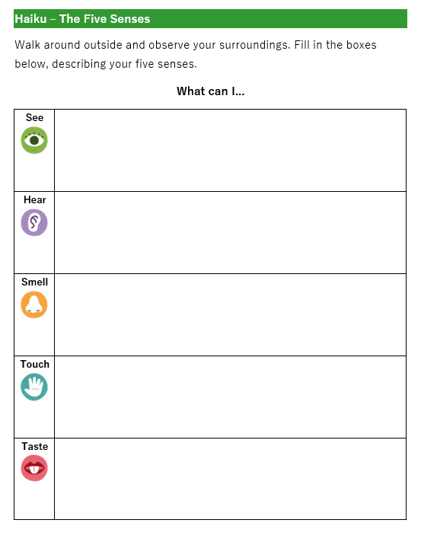
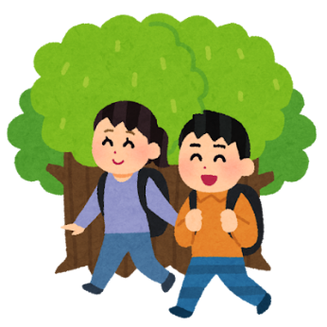
Let’s go outside!
Walk around outside.
Think about what you can see, hear, smell and write down words or phrases to describe these.
We will use these next time to write our haiku!
Notes:
Teacher’s Notes
Hand out The Five Senses worksheet to pupils and explain that you will now be going outside as a class to gain some inspiration in order to be able to write your own haiku next time. (Collect and keep them after the activity for the next lesson).
You could go outside to your playground, the field, or even take a walk to your local park – wherever you feel pupils will best be able to engage in this activity. Pupils should fill in the table with ideas. Give some examples to pupils once outside to help them understand the kinds of things they should be writing down. Taste may be difficult, but you could give an example to pupils, i.e., the cool water from the water fountain.
At the end of this task, gather together and ask pupils to share interesting words and phrases they have written.
Illustrations from Irasutoya.

Slide 18






This resource was developed and created by
The Japan Society.
The Japan Society
13/14 Cornwall Terrace, London NW1 4QP
Tel: 020 7935 0475
Email: education@japansociety.org.uk
www.japansociety.org.uk
Follow us on social media:
@TheJapanSociety

