Slide 1
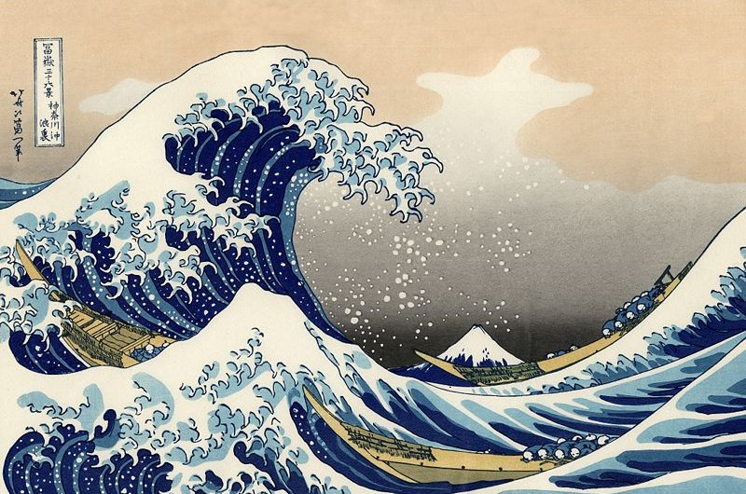
Exploring Hokusai
Notes:
Starter (click once to remove the title)
Display this image by Japanese artist Katsushika Hokusai on the screen. As a warm-up, ask pupils to look at the picture closely and tell their partner what they can see. If they recognise the picture, ask them to tell their partner where they have seen it and what do they know about it. Ask pupils to say what they think of the picture. Do they like it? Why/why not?
After a few minutes of discussion, ask pupils to share their feelings about the picture and what they noticed. Be certain to highlight Mount Fuji in the background, the three boats and the sailors. Tell the pupils that the writing in the rectangle says ‘Thirty-six views of Mount Fuji’, which is the series of pictures in which this is included, and ‘Under the Wave off Kanagawa’ a.k.a. The Great Wave, which is the title of the picture. The writing to the left of the rectangle is the artist’s name.
Additional Info
As pupils what they notice about the writing. Explain that Japanese writing can be written horizontally from left to right, like English, but also it can be written vertically from right to left.

Slide 2
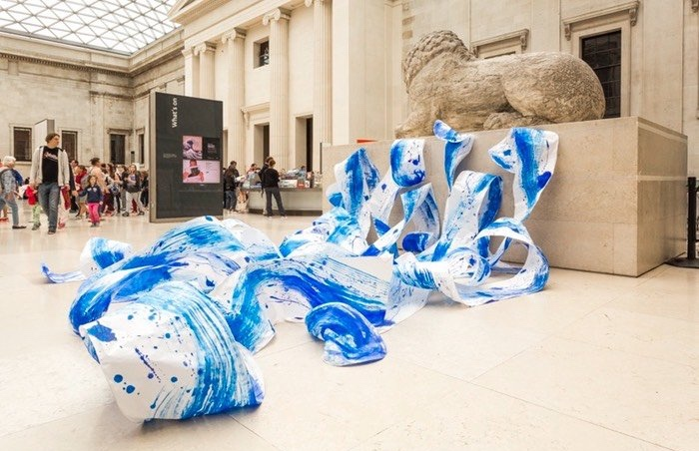
© Hiroko Imada 2017
Notes:
Now display the image of an installation by Japanese artist Hiroko Imada on the screen. Ask students if they can make any connections or see any similarities between the previous image and this one.
Confirm that this exhibition was inspired by Hokusai’s work. Hiroko Imada is a living artist who was born in Tokyo and now lives in the UK. From her early youth, Hiroko’s favoured subjects have been ‘Nature’ and ‘Dance and Movement’. Can pupils see this in the evidence?
Now tell pupils they will make their own work inspired by Hokusai in this lesson.

Slide 3
To explore the art of Katsushika Hokusai
To create an artwork inspired by Hokusai’s techniques
Learning Objective
Notes:
Introduce the LO, explaining any difficult words.

Slide 4
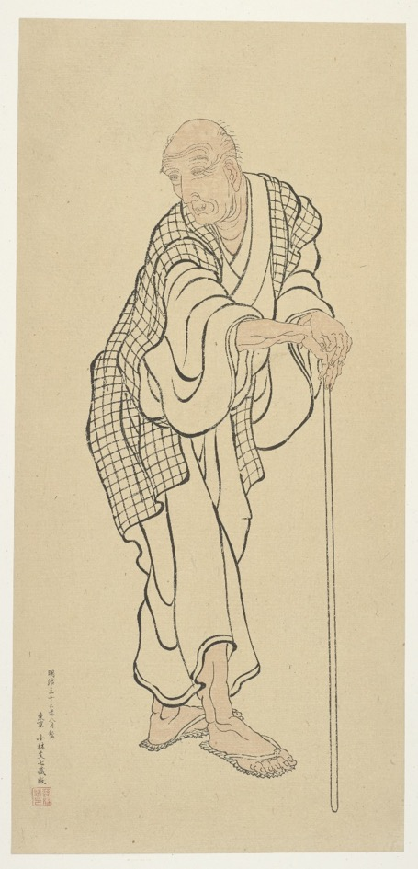
Katsushika Hokusai
(1760 – 1849)
Self-portrait at the age of 83
Notes:
Explain that today’s lesson will focus on Katsushika Hokusai, a world-famous Japanese artist. He was born in 1760 in Edo (the city known today as Tokyo). He is known as a master of Ukiyo-e, which is a style of Japanese woodblock printing produced from the 17th until the early 20th centuries. In English ‘Ukiyo-e’ means 'pictures of the floating world’. These were pictures that showed many things such as: famous people (such as kabuki actors or sumo wrestlers), scenes from history or legend, everyday life, and nature and landscapes of Japan at that time.
The most famous example of ukiyo-e/woodblock prints is Hokusai’s ‘Great Wave’, but he also made many other works.

Slide 5

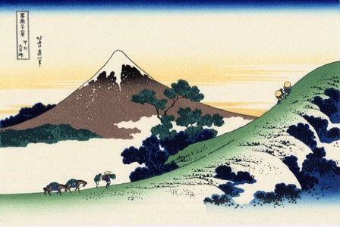
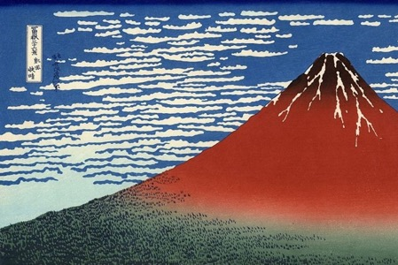
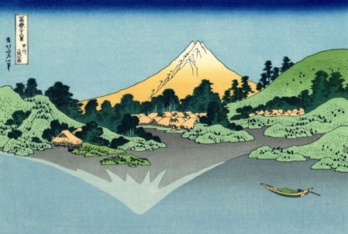
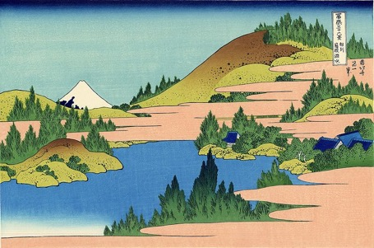
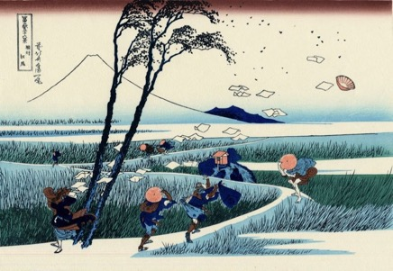
Thirty-Six Views of Mount Fuji
Notes:
The Great Wave is just one image from the series Hokusai made (Thirty Six Views of Mount Fuji) The different scenes all show Mount Fuji, but from different places and in different seasons/weather conditions.
Today we are going take a closer look at some of his work and explore how woodblock prints are made. Then we are going to produce our own print inspired by Hokusai.
Use the question prompts on the following slides to initiate discussion.

Slide 6
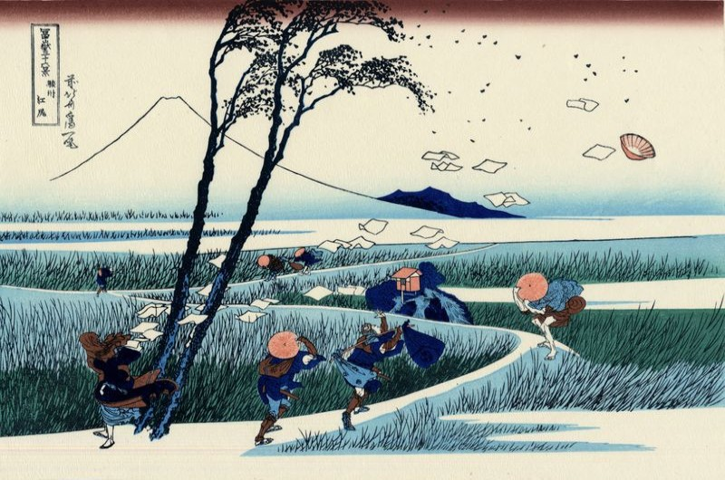
Ejiri in Sugura Province
Notes:
As we look at each picture, ask the pupils:
To say what they can see in the image.
Can they spot where Mount Fuji is?
What season do you think it is/could this be?
How does each picture make you feel?
What colours has Hokusai used? What detail has he included?
Why do you think he decided to create a print of this view?

Slide 7
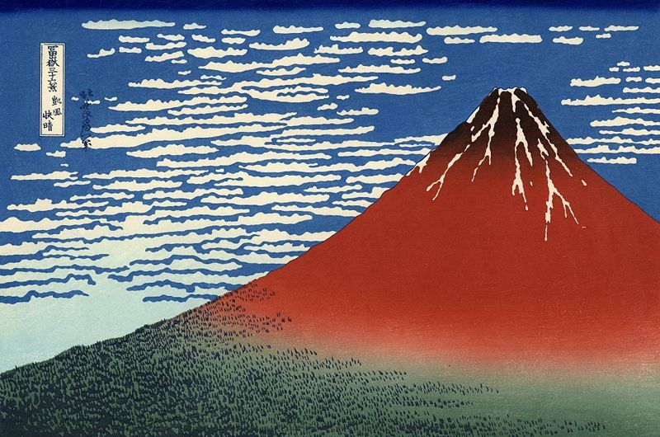
South Wind, Clear Sky (Red Fuji)
Notes:
As we look at each picture, ask the pupils:
To say what they can see in the image.
Can they spot where Mount Fuji is?
What season do you think it is/could this be?
How does each picture make you feel?
What colours has Hokusai used? What detail has he included?
Why do you think he decided to create a print of this view?

Slide 8
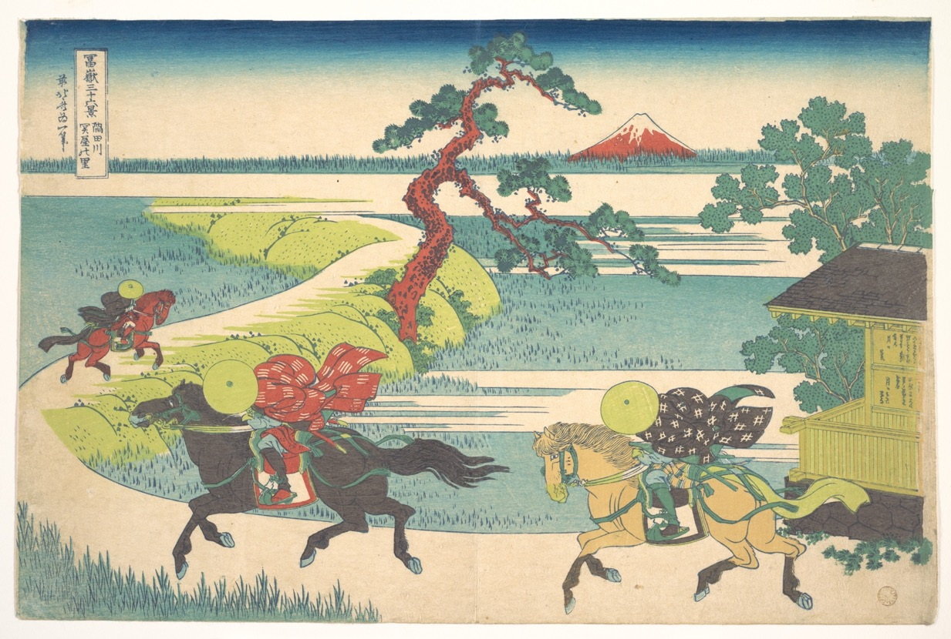
Sekiya Village on the Sumida River
Notes:
As we look at each picture, ask the pupils:
To say what they can see in the image.
Can they spot where Mount Fuji is?
What season do you think it is/could this be?
How does each picture make you feel?
What colours has Hokusai used? What detail has he included?
Why do you think he decided to create a print of this view?

Slide 9

The lake at Hakone in the Segami Province
Notes:
As we look at each picture, ask the pupils:
To say what they can see in the image.
Can they spot where Mount Fuji is?
What season do you think it is/could this be?
How does each picture make you feel?
What colours has Hokusai used? What detail has he included?
Why do you think he decided to create a print of this view?
Before we look at how wood block prints are made, we are going to move to our tables for Task 1.

Slide 10
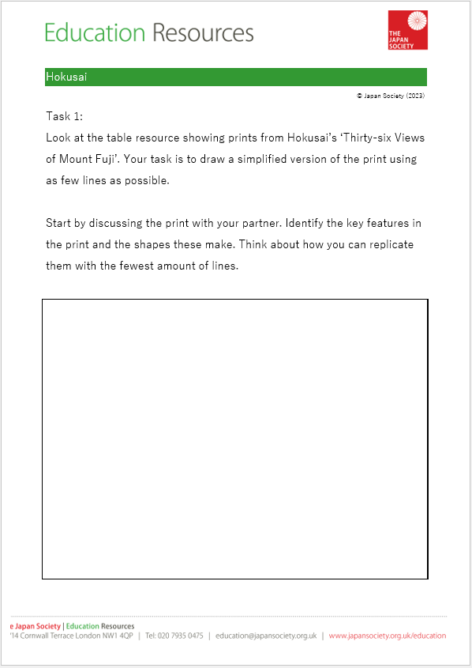
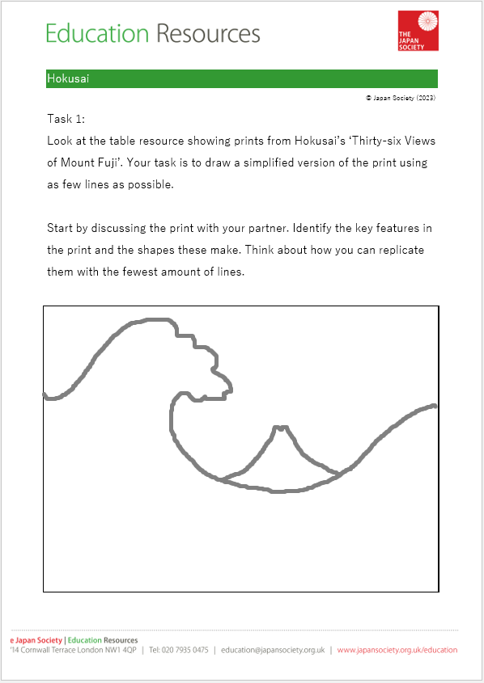
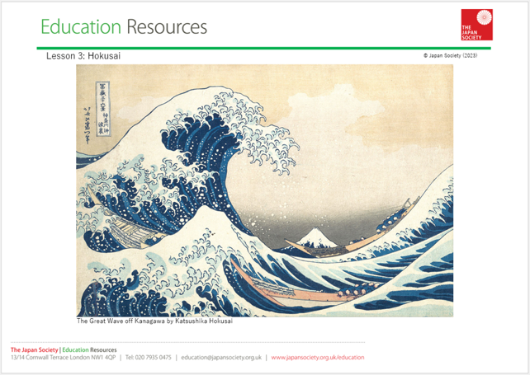
Activity 1
Notes:
Task 1
For this activity, the pupils will need a copy of the Task 1 worksheet and a Hokusai print. There are four prints to choose from on the Hokusai Prints worksheet provided by The Japan Society (also displayed on the following slide), or you could choose a single print or broader selection from the series. Make sure to pick image(s) that can be easily simplified into three or four key sections.
Explain to the pupils that their task is to look closely at the Hokusai print they have chosen/been given and discuss it with their partner. Ask pupils to identify the key features in the print and the shapes these make. Then pupils need to draw a simplified version of the print on their worksheet using as few lines as possible. Challenge them to recreate the image using as few as three or four lines – highlighting that it is vital that Mount Fuji is visible in their drawing.
Say that they will use what they create now to help them with their final activity.

Slide 11

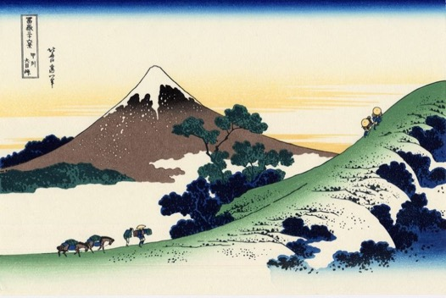
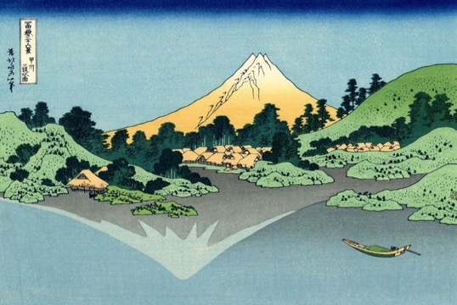

Thirty-Six Views of Mount Fuji
Notes:
These 4 images are provided for use with the Hokusai Prints worksheet. Skip this slide if using alternative prints.

Slide 12
Notes:
Explain that although ‘The Great Wave off Kanagawa’ looks like a painting, it is not. TTYP: How do you think Hokusai made this image?
Explain that it is a woodblock print. Encourage children to explain what they think that means. Build on any contributions to explain the process by which woodblock prints are made. In Edo Japan, first the artist would draw an image onto a thin piece of paper. Then a copy would be made and placed face down on top of a block of wood (usually cherry wood). Using the image as a guide, the design was carved through the paper into the wood block. A different block would need to be made for each different colour the artist wants in the final image. Once a block is carved, ink is applied to the surface and then printed onto a sheet of paper.
The technique is still used today by some artists, as well as by people who create patterns for wallpaper or fabrics. Let’s look at the process on the next slides.

Slide 13
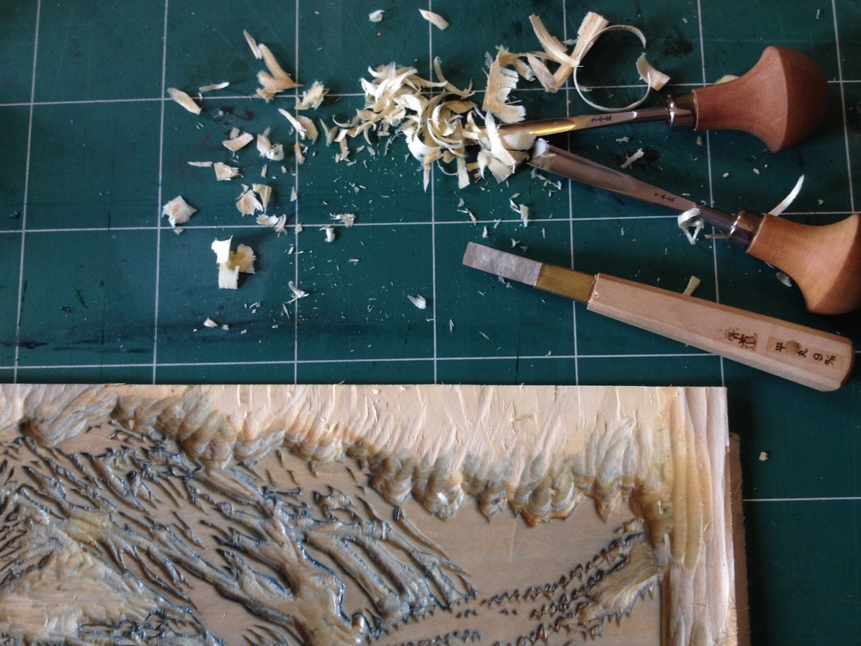
"150519 woodblock print" by Vincent Desplanche
Notes:
The image the artist carves into the block of wood will be in reverse when its printed. They will need to carve several different blocks, depending how many colours or how much detail they want to include.
"150519 woodblock print" by Vincent Desplanche is licensed under CC BY-NC-ND 2.0. (https://www.flickr.com/photos/53942696@N06/17676558268)

Slide 14
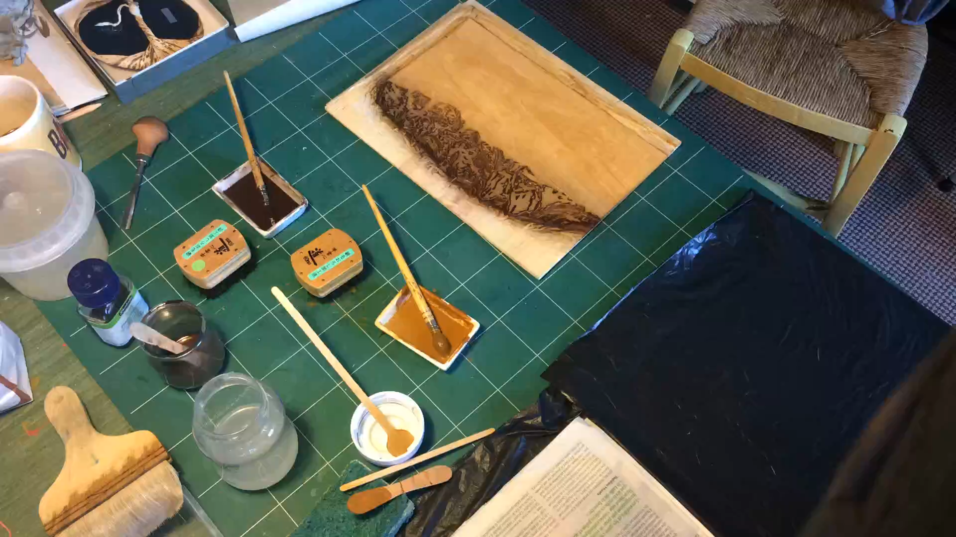
Notes:
Once the blocks are ready, they can carefully apply the coloured inks in the correct place, before placing a piece of paper on top of the block. Next, they carefully smooth the back of the paper (using a tool called a baren) to make sure the ink is properly applied.
As you watch the video on this slide and the following ones, highlight how the image, visible on the bottom right, changes each time. Also, notice the different tools that the artist is using.
"Color woodblock printing process block 1" by Vincent Desplanche is licensed under CC BY-NC-ND 2.0. (https://www.flickr.com/photos/vincentdesplanche/23380788990/in/album-72157648931859633)

Slide 15
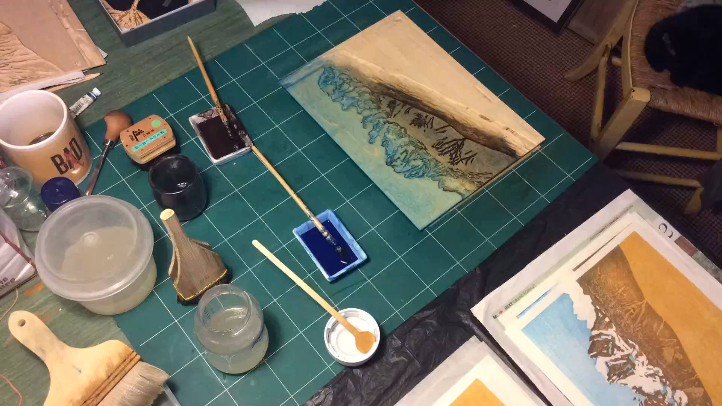
Notes:
Then the process is repeated with the additional blocks, adding a different colour, until the finished image is completed.
"Color woodblock printing process block 1" by Vincent Desplanche is licensed under CC BY-NC-ND 2.0. (https://www.flickr.com/photos/vincentdesplanche/23593996121/in/album-72157648931859633)

Slide 16
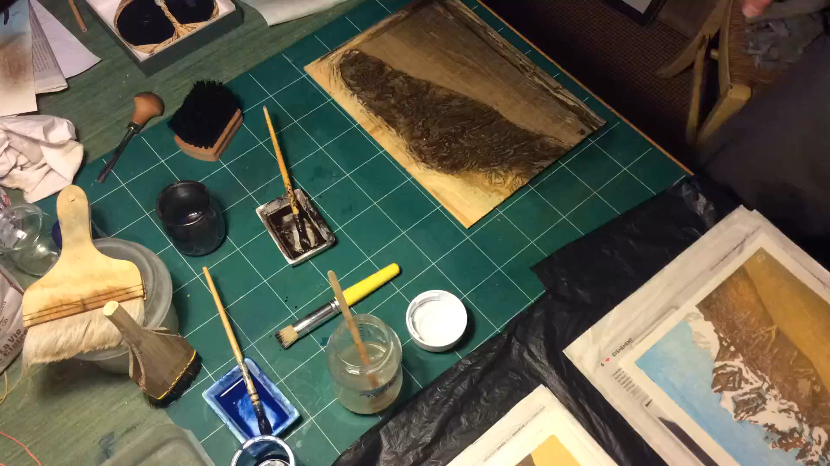
Notes:
"Color woodblock printing process block 1" by Vincent Desplanche is licensed under CC BY-NC-ND 2.0. (https://www.flickr.com/photos/vincentdesplanche/23676459685/in/album-72157648931859633)

Slide 17
Notes:
Let’s take another close look at ‘The Great Wave’. Now you know how it was made, can you work out how many blocks were necessary to create the final image?
It’s thought at least 7 woodblocks were needed* (Dark blue, light blue, medium blue, light grey, dark grey, yellow or beige, pink or beige) – but blocks were frequently carved on both sides.
*Source: See page 10 of The Making and Evolution of The Great Wave for more details (https://www.britishmuseum.org/sites/default/files/2022-03/korenberg_article-for_hokusai%20_edited_volume_final-2020_accessible.pdf)

Slide 18
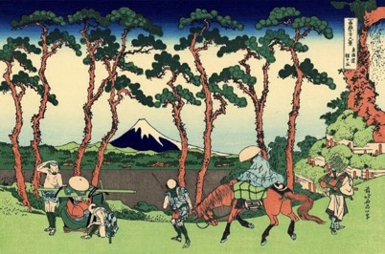
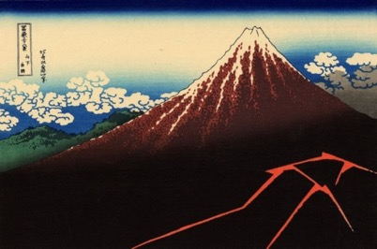
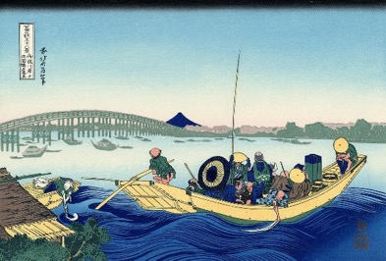
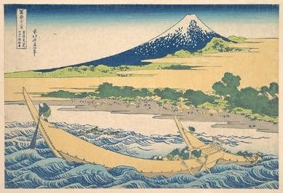
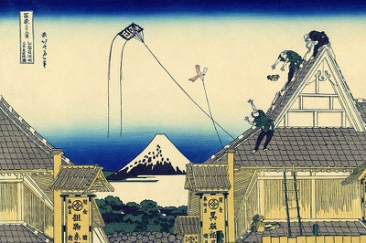
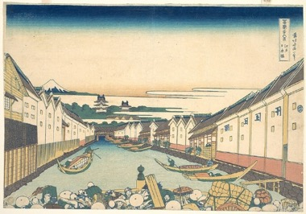
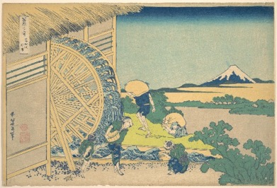
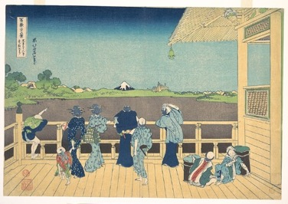
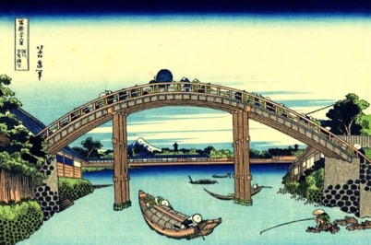
Notes:
Now we know how more about Hokusai and how hist artworks were created, we can appreciate all the details in them. He was a very prolific artist – meaning he produced a lot of art during his lifetime.
Here are more examples of his work from the Thirty-Six Views of Mount Fuji.

Slide 19
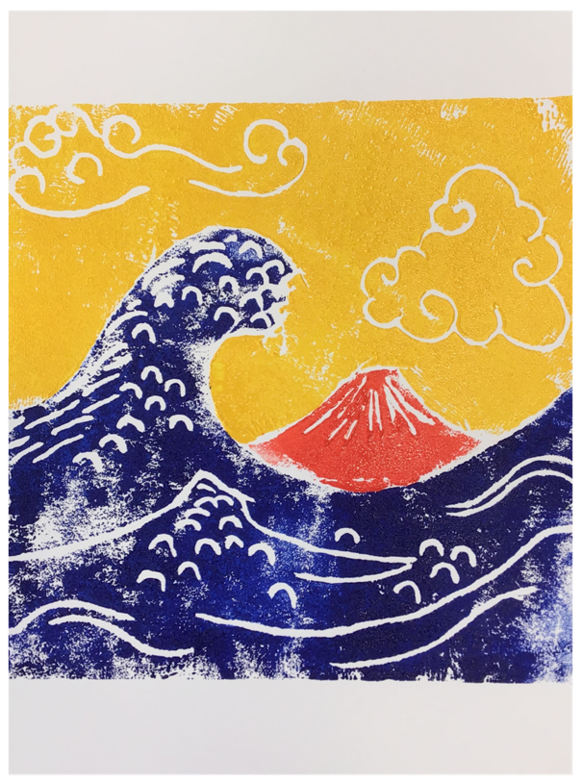
Activity 2
Make a relief print inspired by Hokusai’s Thirty-six Views of Mount Fuji
Notes:
Task 2
Introduce today’s main task, which is to make a relief print inspired by Hokusai’s ‘Thirty-six Views of Mount Fuji’. Just like Hokusai, we will be carving our design. However, unlike him we won’t be carving into wood. Instead, we will use polystyrene. TTYP: Why are we using polystyrene today instead of wood?

Slide 20
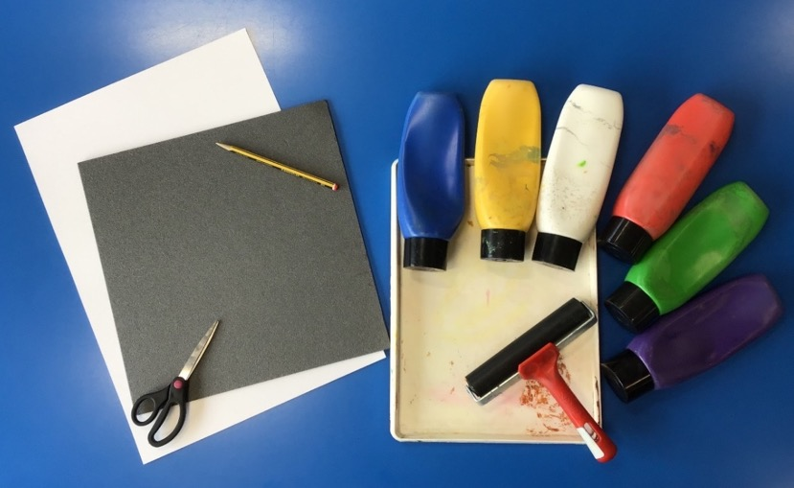
Equipment
Polystyrene sheet
White paper / Card
Pencil
Scissors
Water-based printing ink
Paint tray
Roller
Notes:
Explain the various resources needed for this task. The polystyrene sheets can be bought from an art supply shop or you can ask pupils to collect the bases of supermarket pizzas. Although the inks are water-based, it is recommended that children wear overalls and tables are covered with newspaper while printing. Children will also need to have their worksheet from Task 1 as well as a copy of the Hokusai print they are recreating.

Slide 21
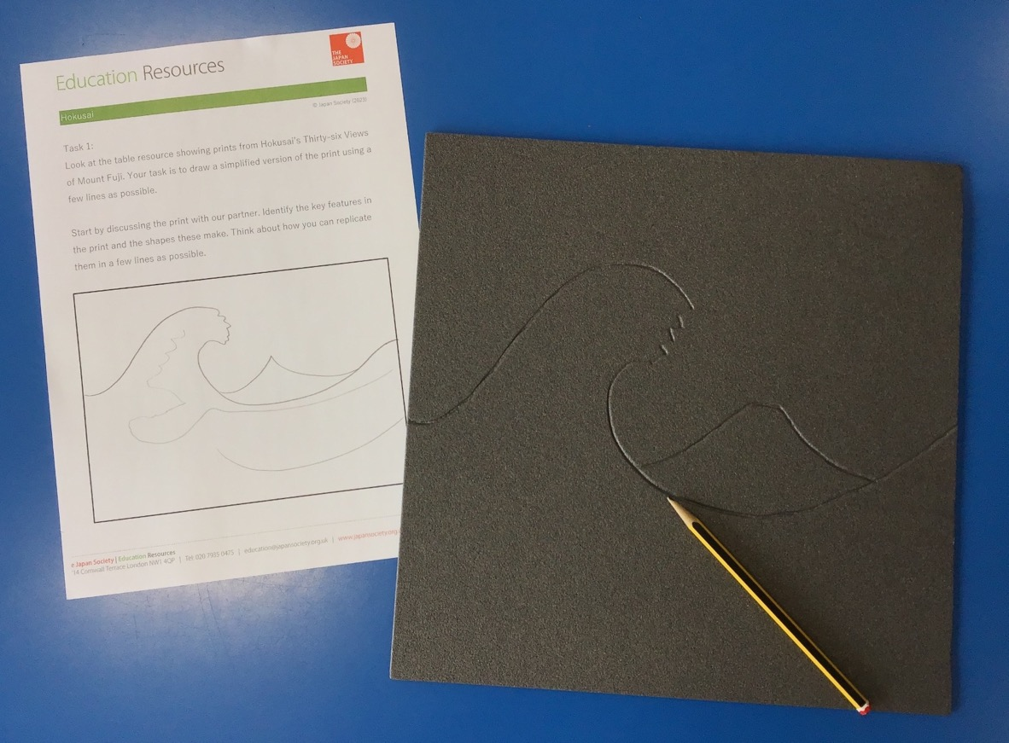
Notes:
Using a blunt pencil, copy the outline you created in Task 1 on to your polystyrene sheet. Once you are happy with the shapes you have created, and you can clearly identify Mount Fuji, carefully cut out each section using scissors. Younger children will need support from an adult to do this.

Slide 22
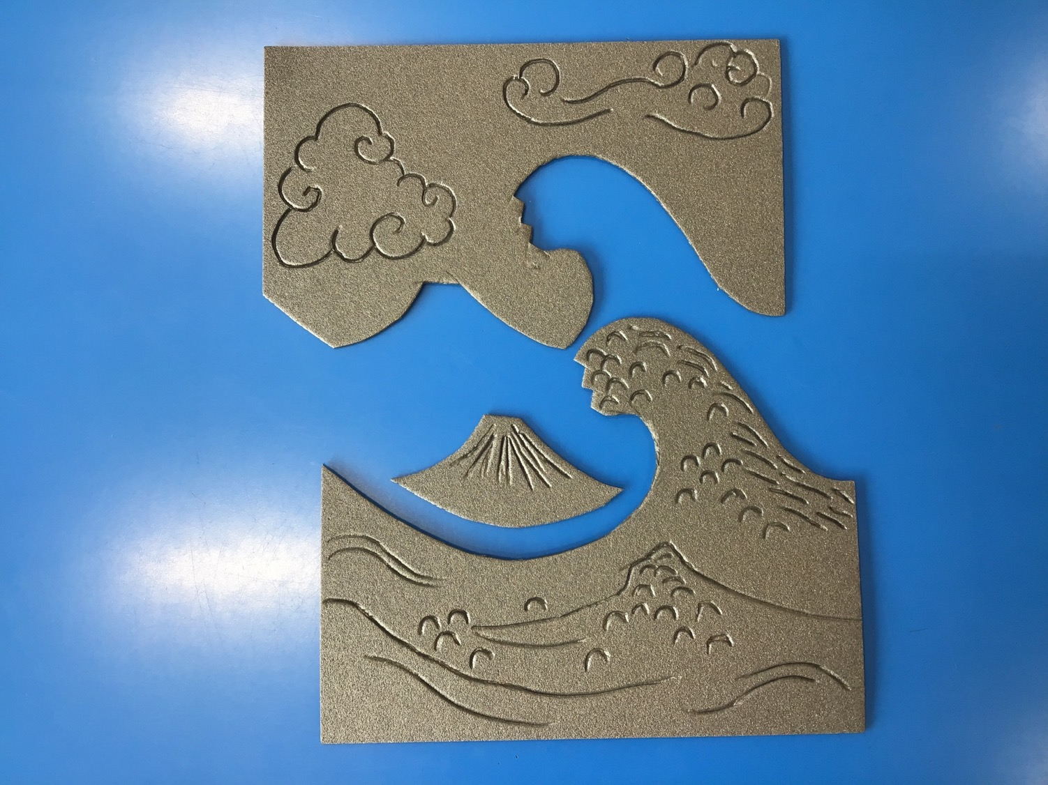
Notes:
Remind pupils that they the final image will be the reverse of the print. Therefore, at this point it is important to turn over the sections you have created. If you forget to do this, your final image will be a reverse of the original.
Next, use your blunt pencil to add detail to each section, looking carefully at the original picture to inspire you.

Slide 23
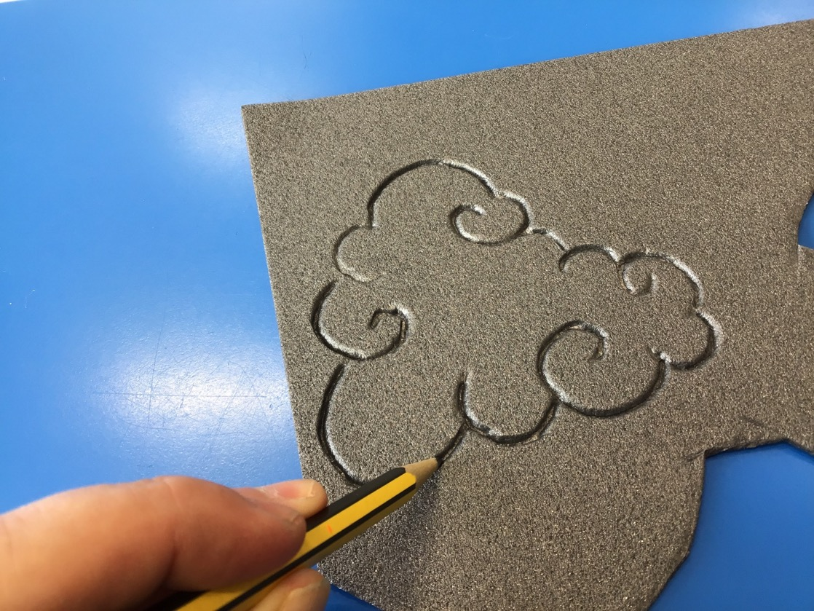
Notes:
It is important that you press hard enough into the polystyrene to create a relief, but not so hard that you go all the way through. Practise will make perfect! If you vary the depth of some lines, this will show in the final print.

Slide 24
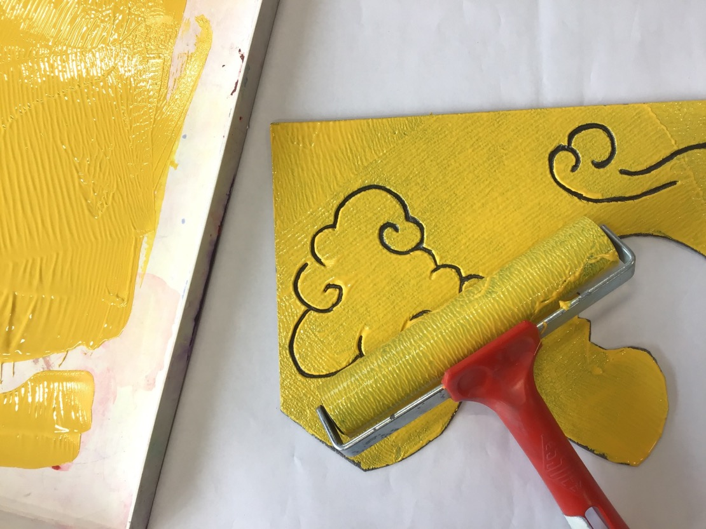
Notes:
Once you are satisfied with the design of your printing block, cover your table with newspaper and put on your apron. Choose which colour you want to use for each section of the print, squeezing the first colour into your paint tray. You do not need too much ink - just enough to cover the roller thinly and evenly. Roll the ink out using your roller, then apply to your first section of printing block. Cover the block all the way to the edges, rolling the roller back and forth gently over the block.

Slide 25
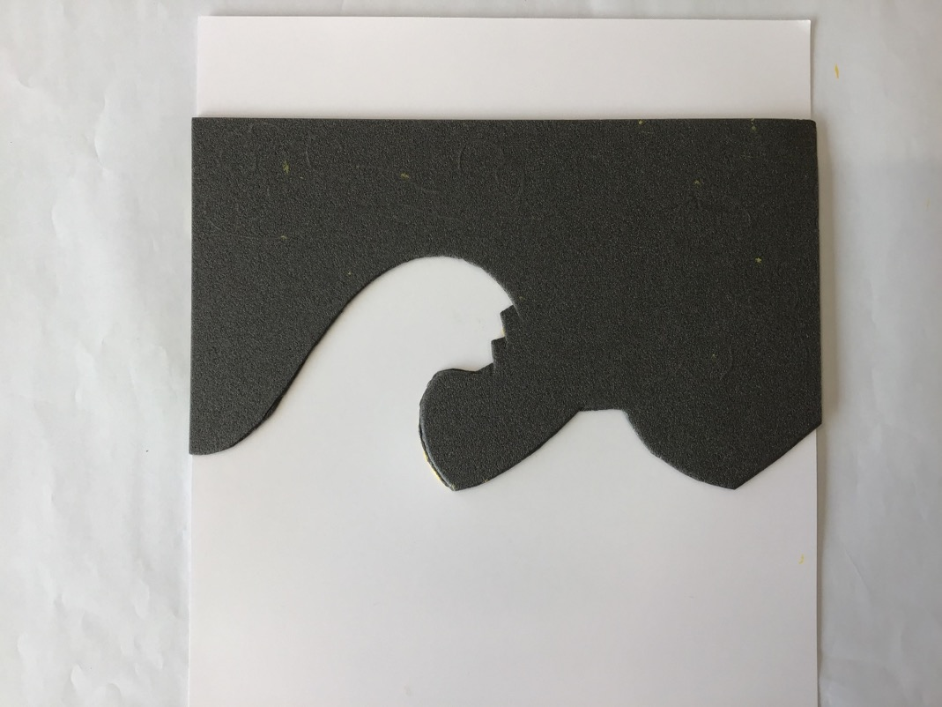
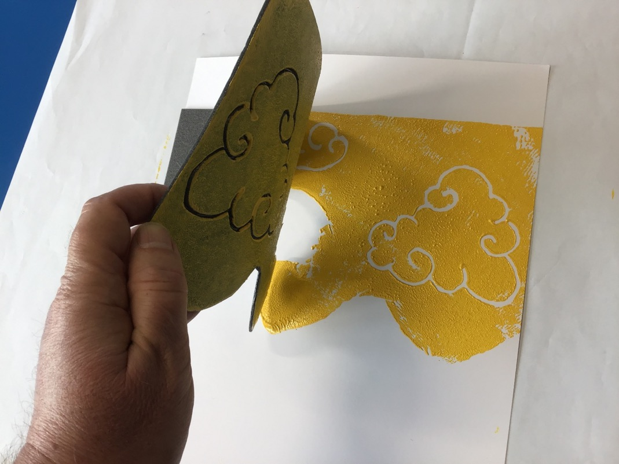
Notes:
Next, place the block carefully on to your piece of paper, being sure not to move it once you’ve pressed it down. Gently press down across the block to make sure that ink is evenly applied to the paper.
Then peel the paper off the block slowly so it won’t smudge your design.

Slide 26
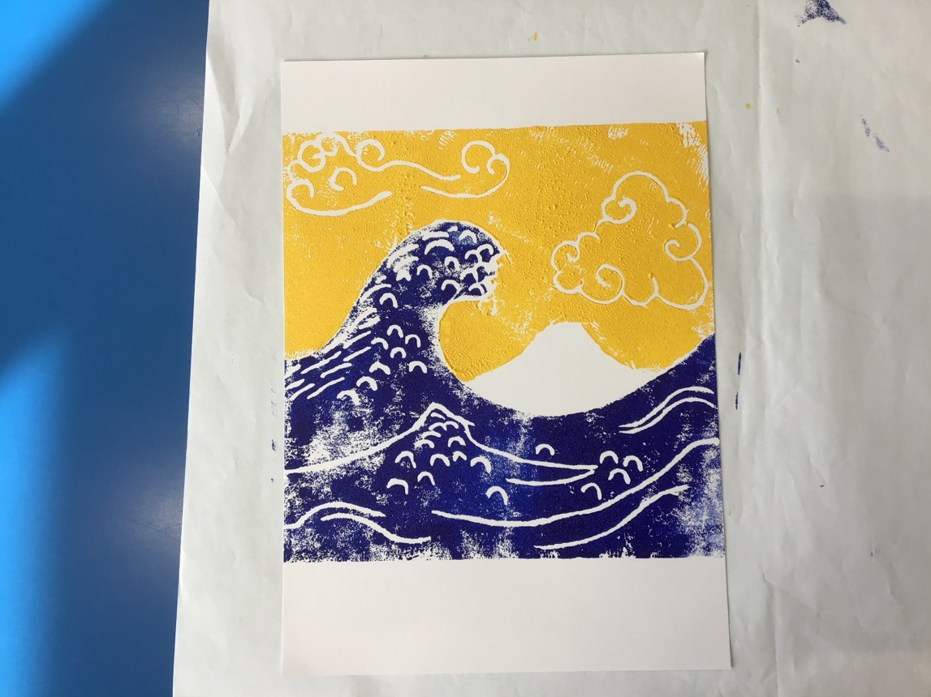
Notes:
Repeat the process with the remaining colours and blocks, paying lots of attention to where you place the blocks in order that you do not overlap the colours.

Slide 27
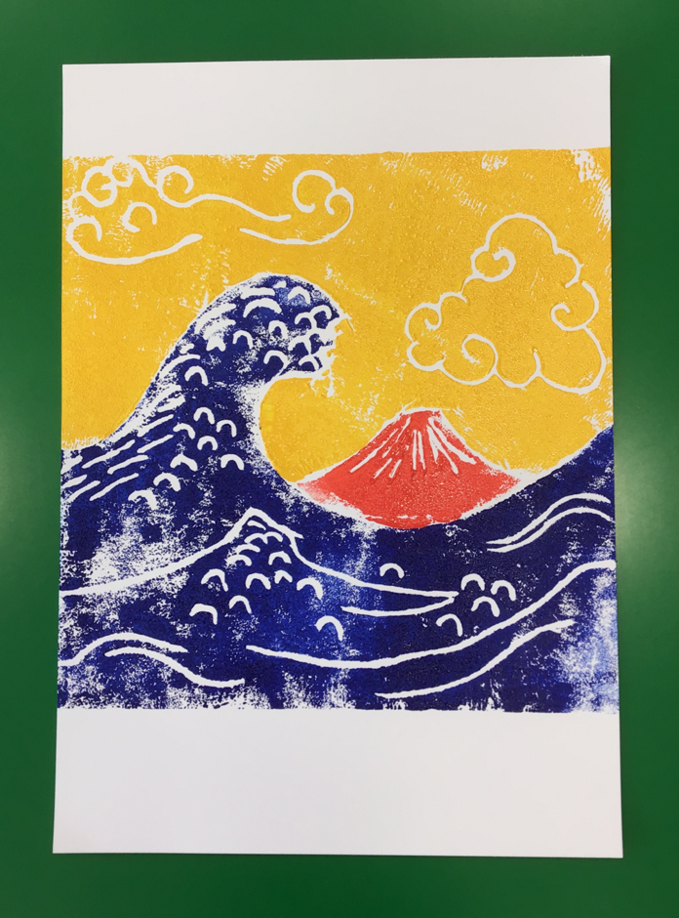
Notes:
Finally, you have your finished artwork inspired by the woodblock printing of Hokusai! Let’s create a classroom gallery so we can appreciate each other’s work.

Slide 28
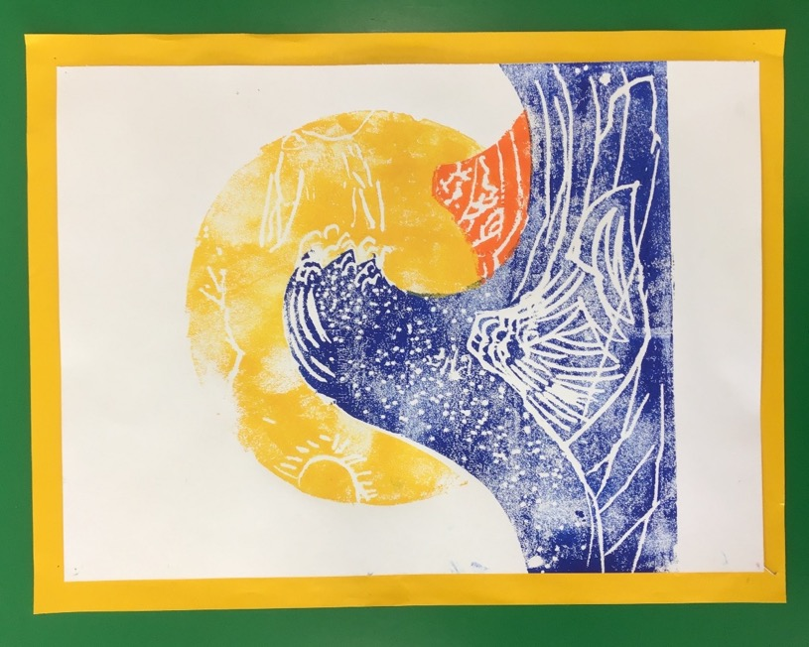
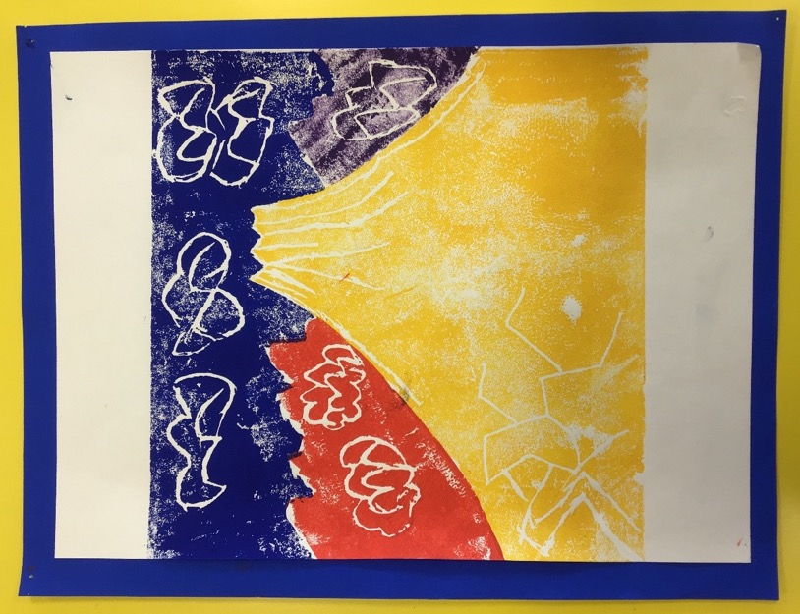
Notes:
Have a look at the prints on the following slides for inspiration. Can you tell which print by Hokusai they are based upon?

Slide 29
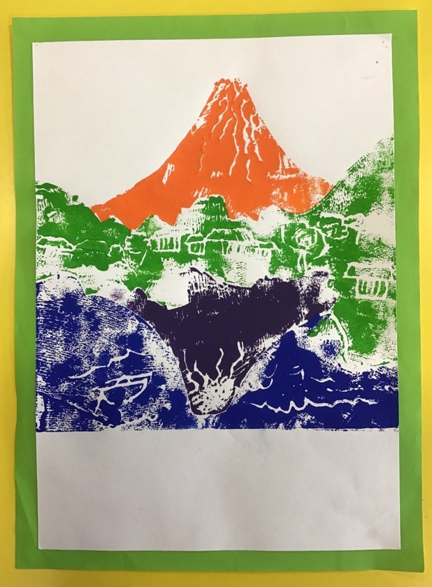
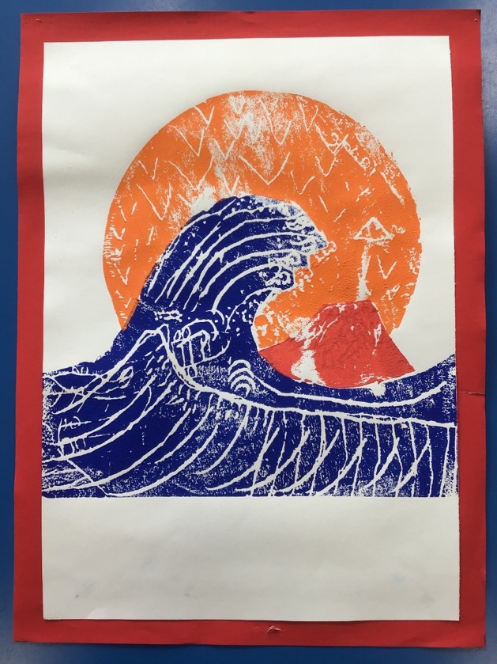

Slide 30
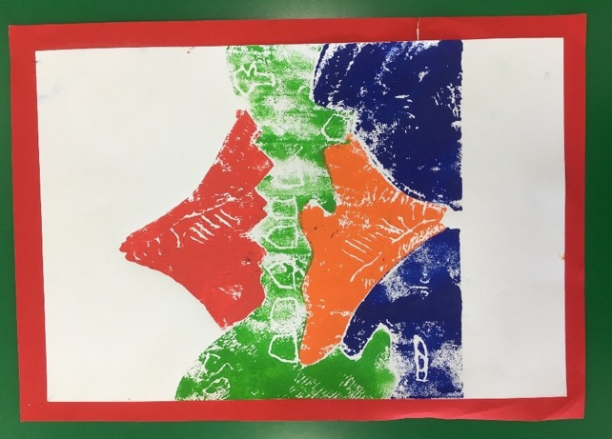
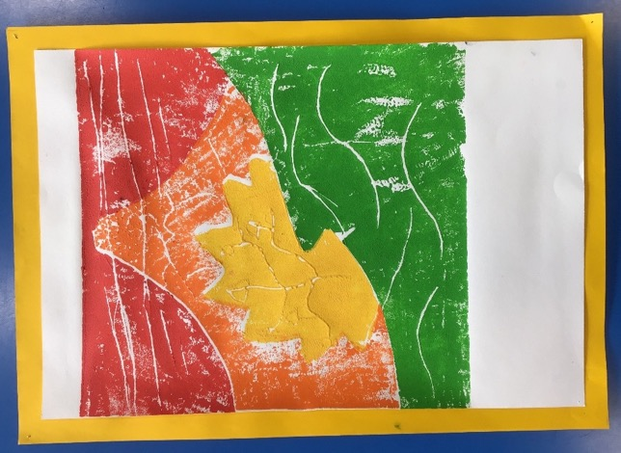
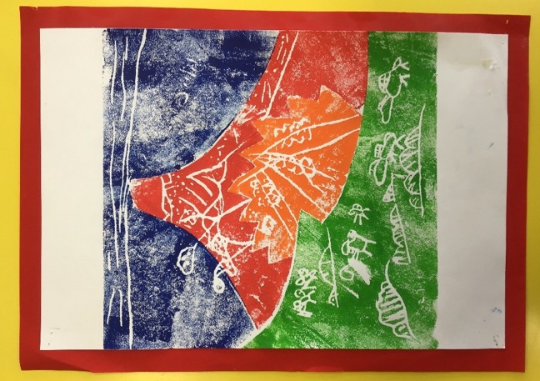

Slide 31
Notes:
Here are more examples of his work from the Thirty-Six Views of Mount Fuji.
We can see from his work that landscapes and the natural world was a big source of inspiration.

Slide 32

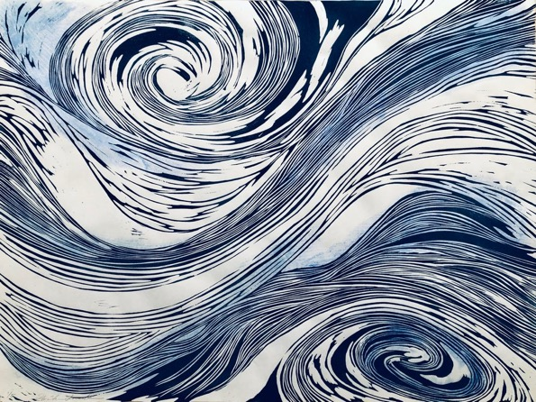
Alternative Activity
Design an print inspired by some of the natural elements featured in Hokusai’s work
© Hiroko Imada 2021
Notes:
This is a differentiated version of the main task. Students can use the whole tile of polystyrene (rather than cut it into sections) and only 1 colour.
Remind students of Hiroko Imada - whose work they also saw at the beginning of the lesson. Here, they can see her piece “Naruto Whirlpools” which was also inspired by water/nature, and there is a lot of detail, just like in Hokusai’s work*
For their own print, students will take inspiration from part of a Hokusai print and create an abstract design (like Hiroko’s).
*Additional Information: The Naruto Whirlpools are a real tourist attraction in Japan. There is a famous ukiyo-e print called “Naruto Whirlpools” by Hiroshige – an artist who was particularly influenced by Hokusai’s landscape prints.

Slide 33


Example 1
Notes:
Give students one of the worksheets which has close ups showing the details in water, clouds, and trees in his prints.
The next slide is optional and shows an example.

Slide 34
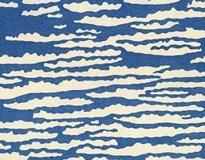
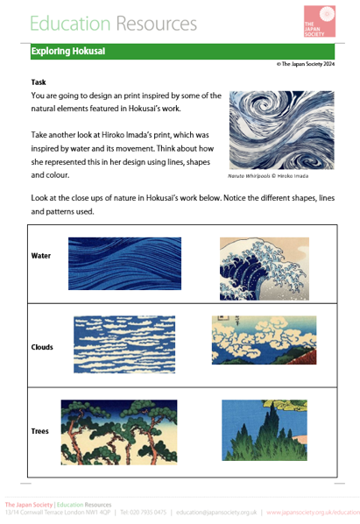
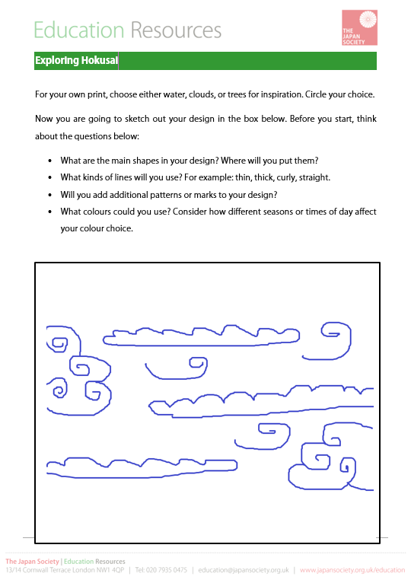

Example Design
Notes:
Show this example for clouds then ask students to use the worksheet to plan their own designs,
If time and location allows, take students outside and take inspiration from real life. If this isn’t possible you might like to prepare other images or items which students can draw on for inspiration (e.g. cotton wool, leaves, water bottles for shaking etc.)

Slide 35
Equipment
Polystyrene sheet
White paper / Card
Tracing paper
Pencil
Water-based printing ink
Paint tray
Roller
Notes:
Explain the various resources needed for this task. The polystyrene sheets can be bought from an art supply shop or you can ask pupils to collect the bases of supermarket pizzas. Although the inks are water-based, it is recommended that children wear overalls and tables are covered with newspaper while printing. Children will also need to have their worksheet with their design.
Teacher’s Note: The following images are examples from students who did the main version of the activity. You may wish to show pupils the process in the classroom instead.

Slide 36

Notes:
Tell/remind pupils that they the final image will be the reverse of the print. Therefore, at this point it is important to turn over the copy of the design they made on tracing paper. If you forget to do this, your final image will be a reverse of the original.

Slide 37

Notes:
Using a blunt pencil, now copy the outline from your tracing paper (which should be face down) on to your polystyrene sheet.
Teacher’s note: If you prefer, students can place the face down tracing paper directly on top of the polystyrene and mark through it to get an accurate copy of their design.

Slide 38




Notes:
Next, use your blunt pencil to add detailed marks, lines and patterns. Look carefully at the original prints to inspire you.
It is important that you press hard enough into the polystyrene to create a relief, but not so hard that you go all the way through. Practise will make perfect! If you vary the depth of some lines, this will show in the final print.

Slide 39

Notes:
Once you are satisfied with the design of your printing block, cover your table with newspaper and put on your apron. Choose which colour you want to use and squeeze it into your paint tray. You do not need too much ink - just enough to cover the roller thinly and evenly. Roll the ink out using your roller, then apply to your printing block. Cover the block all the way to the edges, rolling the roller back and forth gently over the block.

Slide 40

Notes:
Next, place the block carefully on to your piece of paper, being sure not to move it once you’ve pressed it down. Gently press down across the block to make sure that ink is evenly applied to the paper.
Then peel the paper off the block slowly so it won’t smudge your design.

Slide 41

Extension Activity
You are going to write a postcard from Mount Fuji.
Imagine you are visiting the place in your printed image.
Write to a friend and tell them:
Where you are
What you can see
What the weather is like
Anything else you want to tell them about Japan
Notes:
Students can write these in their workbooks, on postcard-sized printouts versions of the original Hokusai prints or, if the prints are dry, even write their final version of their postcard directly on the back of their work.

Slide 42





This resource was created by Oliver Reed in collaboration with The Japan Society
The Japan Society
13/14 Cornwall Terrace, London NW1 4QP
Tel: 020 7935 0475
Email: education@japansociety.org.uk
www.japansociety.org.uk
Follow us on:
@TheJapanSociety
@TheJapanSociety

