Slide 1
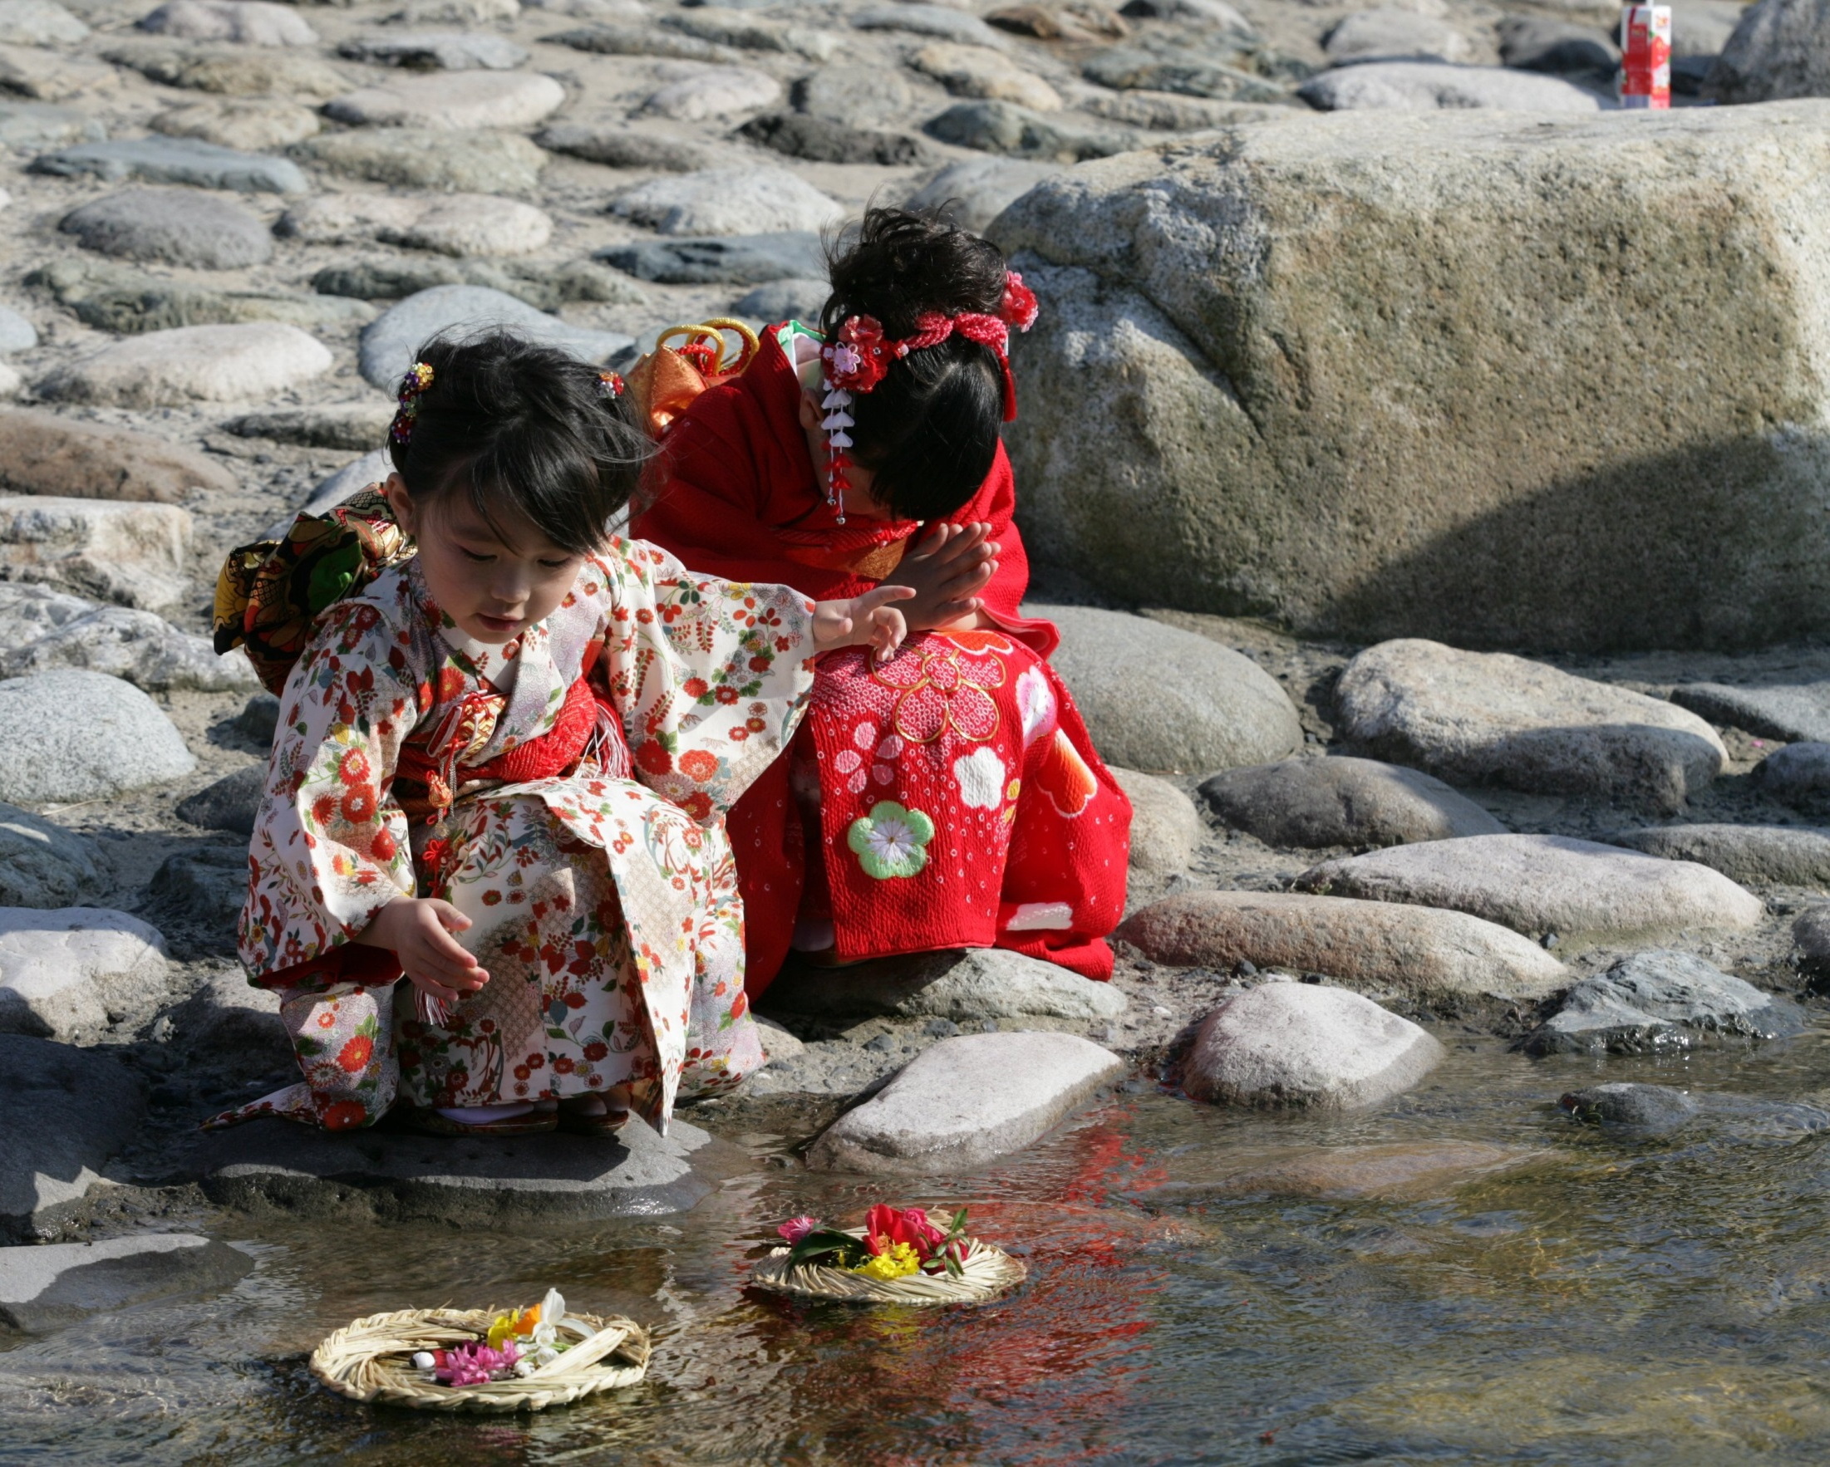
Hina-matsuri

Slide 2
Hina-matsuri
A festival which celebrates happiness, health and the growth of young girls.
It is celebrated on March 3 in Japan.
In Japanese, March 3 is :
三月三日
(third month, third day)

Slide 3
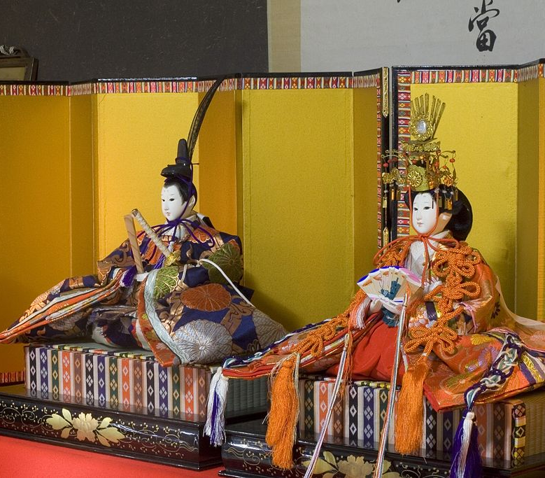
What does Hina-matsuri mean?
Hina (ひな) means doll
Matsuri (祭り) means festival
©tab2_dawa /CC BY 2.0
So Hina-Matsuri means
Doll Festival
Notes:
Tell Students
The dolls in the picture are decorations.
During the festival it is common to see large displays of these dolls in public places and some people will also display dolls in their homes.
The dolls represent important people who lived in Japan around 1000 years ago. This picture shows an emperor (left) and an empress (right).
Image is ©tab2_dawa /CC BY 2.0

Slide 4
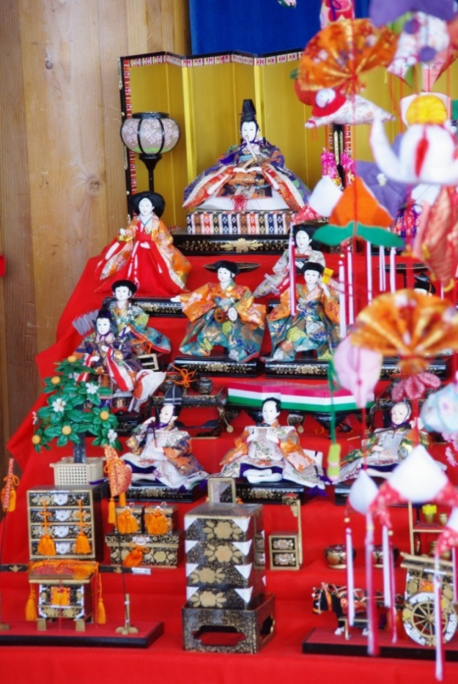
Why dolls?
400 years ago, people believed that dolls were lucky charms to ward off evil spirits.
So the tradition began to set up displays of dolls a few weeks before the festival begins.
©JNTO
Notes:
Tell Students
The dolls are dressed in ancient traditional costumes.
There are usually several shelves displaying the dolls and the most important person (the emperor and/or the empress) will always be displayed at the top.
Attendants who help the empress and musicians are underneath.

Slide 5
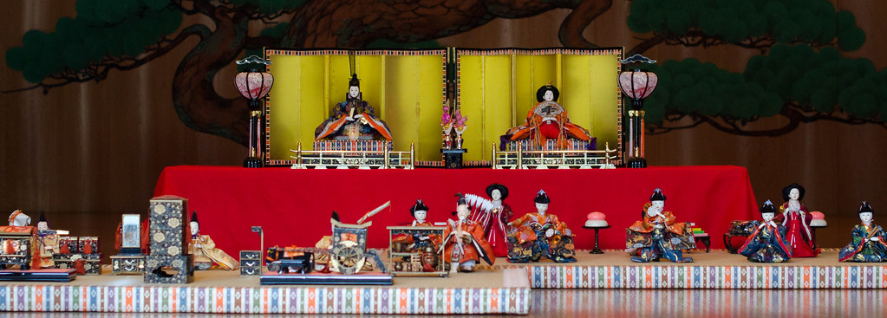
Special Customs
The dolls should be put away again as soon as the festival is over. If you leave them out, it is supposed to be bad luck.
Some people float paper dolls down the river, believing they will carry away bad luck with them.
© theKNB /CC BY-NC 2.0
Notes:
Image is ©theKNB /CC BY-NC 2.0 "2015-03-11_MitoUme-002“ (cropped)

Slide 6
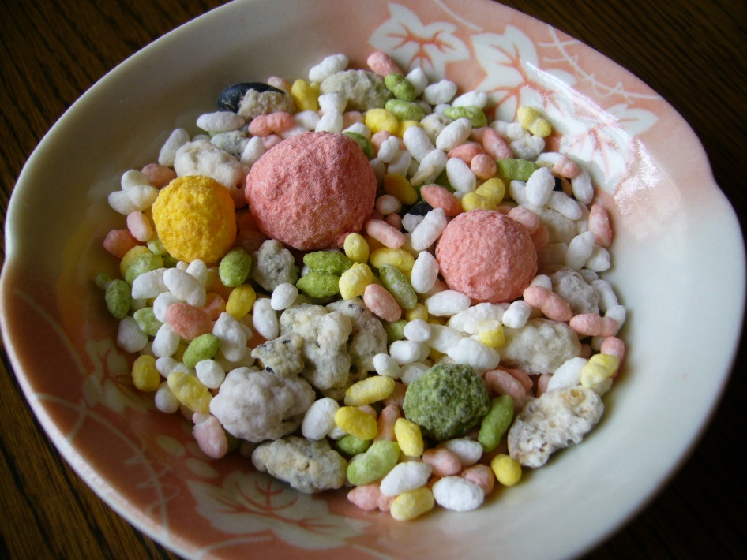
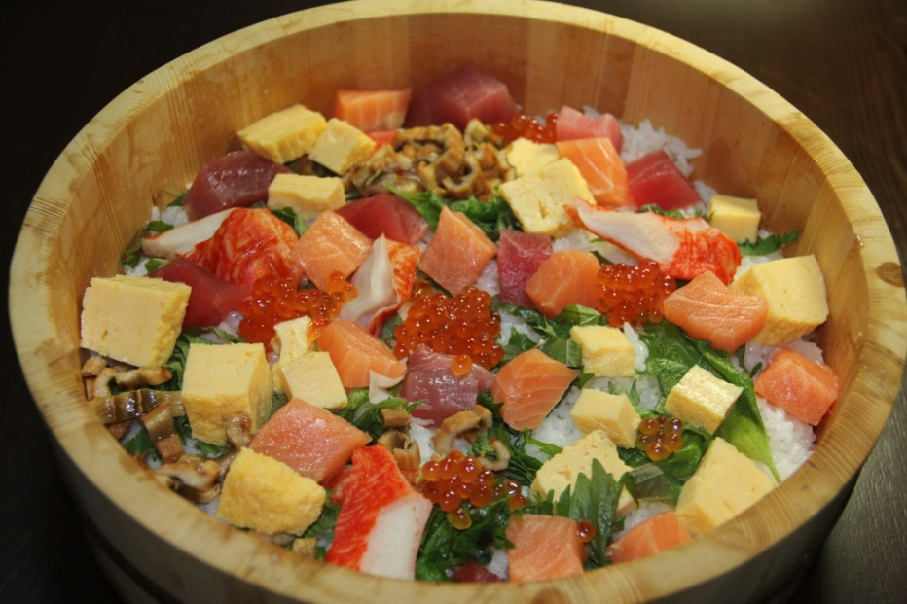
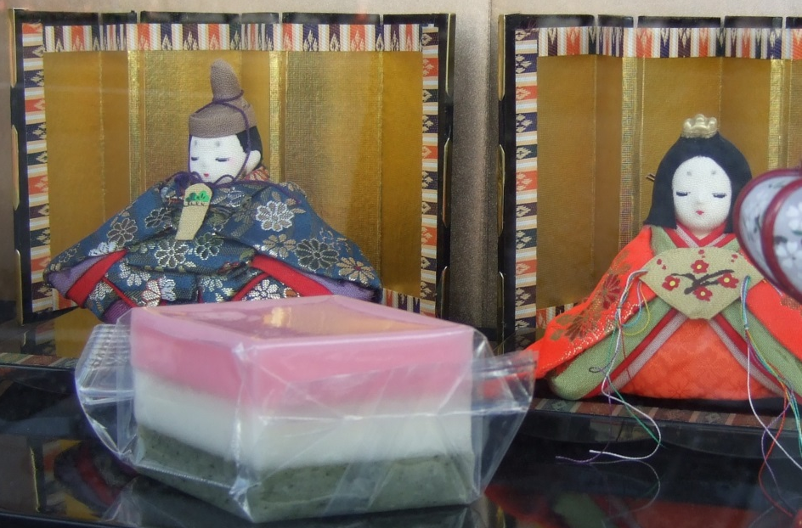
Andhong09/ CC BY-NC-ND 2.0
Special Foods
© Arashiyama/ CC BY SA 3
©Midori/ CC BY SA 3
Notes:
Traditional Hina Matsuri dishes are white, pink, green and yellow. Colours of winter (white snow) and spring (green shoots and pink cherry blossom)
Top left: Rice crackers dyed different colours – hina arare.
Top right: Sweet rice drink – amazake.
Bottom left: – ‘scattered sushi’ or fish and vegetables on rice – Chirashi zushi
Bottom right: multicoloured rice cake in a diamond shape – Hishi mochi
Images:
Amazake: © Andhong09/ CC BY-NC-ND 2.0
Chirashizushi:© Arashiyama/ CC BY SA 3
Hishi-mochi: ©Midori/ CC BY SA 3

Slide 7
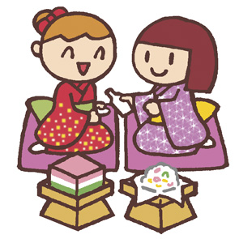
Hina-matsuri Quiz
You will be divided into teams.
How many facts can you remember about
Hina-matsuri?
©The Japan Society with Katy Simpson

Slide 8
Hina-matsuri Quiz
What does ‘hina’ mean? | 1point
When is hinamatsuri? | １point
Why do people celebrate Hinamatsuri? | 2 points
Why should dolls be put away after the festival? | 2 points
What colours are used for hinamatsuri foods? | up to 4 points
©The Japan Society with Katy Simpson

Slide 9
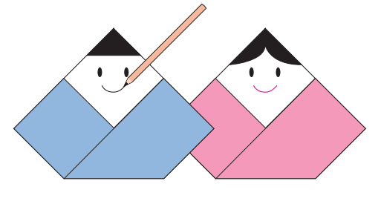
Activity
Make your own origami Japanese dolls.
©The Japan Society with Katy Simpson
Notes:
Teacher’s Notes
Use the printed instructions to make the origami dolls. There is an easy and a difficult version.
Alternatively students can use the colouring sheet, any of the other extension activity worksheets (see lesson plan), or make a doll bookmaer using the video tutorial below:
https://www.youtube.com/watch?v=fMUrr-HpbGk

Slide 10
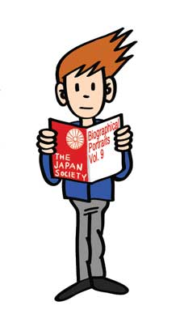
The activities included as part of this resource were designed by Katy Simpson in collaboration with the Japan Society.
The Japan Society 13/14 Cornwall Terrace, London NW1 4QP
Tel: 020 7935 0475
Email: education@japansociety.org.uk
www.japansociety.org.uk
Follow us on:
@japansocietylon
@JapanSocietyLondon

